Slide 1
Design Methodology
Lecture-3 Chapter-2 Computer Architecture and Organization- Jhon P. Hayes

Slide 2
Design Methodology
System Design:
A computer is an example of a system, which is defined informally as a collection – often a large and complex one – of objects called components, that are connected to form a consistent entity with a specific function or purpose. The function of the system is determined by the functions of its components and how the components are connected.
If mathematical function f maps element a of A (input information items) onto element b of B (output information items), we write b = f (a) or b := f (a).

Slide 3
Design Methodology
System Representation:
Figure 2 shows a block diagram representing a small gate-level logic circuit called an EXCLUIVE or modulo-2 adder. This circuit has the same general form as Figure 1 that exhibiting a graph, which is a useful way of representing a system with the help of vertices and edges.
Structure versus behaviors:
Figure 3 shows one kind of behavioral description for the logic circuit of Figure 2. This tabulation of all possible combinations of input output values is called a truth table. Another description of the same Exclusive OR behavior can be written in terms of mathematical equations as follows, noting that f (a) = f(x₁, x₂)
f(0,0) = 0
f(0,1) = 1
f(1,0) = 1
f(1,1) = 0

Slide 4
Design Methodology (Structure versus behaviors)
Figure 2.1:
1
2
7
8
3
4
5
6
Figure 1: A graph with eight nodes and nine edges

Slide 5
Design Methodology (Structure versus behaviors)
Input a Output
x₁ x₂ f(a)
0 0 0
0 1 1
1 0 1
1 1 0
Figure 2.2
AND
x₁
NOT
x₁
x₂
+
OR
NOT
x₂
AND
Figure 2: A block diagram representing an Exclusive–OR logic circuit

Slide 6
Design Methodology (Structure versus behaviors)
Input a Output
x₁ x₂ f(a)
0 0 0
0 1 1
1 0 1
1 1 0
Figure 3: Truth table for the EXCLUSIVE-OR function

Slide 7
Design Methodology
Hardware description language: We can fully describe a system’s structure and behavior by means of a block diagram. The term schematic diagram is also used, in which it identify the functions of the components. We can convey the same detailed information by means of a hardware description language (HDL), a format that resembles a high-level programming language such as Ada or C.

Slide 8
Design Methodology
Design Process: Given a system’s structure, the task of determining its function or behavior is termed analysis. The converse problem of determining a system structure that exhibits a given behavior is design or synthesis.
The complexity of computer systems is such that the design problem must be broken down into smaller, easier task involving various classes of components. Each smaller part can be solve independently by different designers and each major design step can be implemented by iterative process as shown in Figure 4

Slide 9
Design Methodology
Begin
Construct an
initial design
Evaluate its cost
and performance
Are
the design
goals met?
No
Modify the design
to meet the goals
Yes
End
Figure 4 Flowchart of an iterative design process

Slide 10
Design Methodology
Design levels:
The processor level, also called the architecture, behavior, or system level
The register level, also called the register-transfer level (RTL).
The gate level, also called the logic level

Slide 11
Design Methodology

Slide 12
The Gate Level
Gate level (logic) design is concerned with processing binary variables whose possible values are restricted to be the bits (binary digits) 0 and 1. The design components are logic gates, which are simple, memoryless processing elements and flip-flops which are bit-storage devices.
Combinational logic: A combinational function also referred to as a logic or a Boolean function, is to mapping from the set of 2^{n} input combinations of n binary variables onto the output values 0 and 1.

Slide 13
Common Logic Gates
Fig 5: Common Boolean logic gates with symbols and truth tables

Slide 14
The Gate Level
Figure 2.9 shows the truth table for a pair of three variable functions, s₀(x₀, y₀, c₋₁) and c₀(x₀, y₀, c₋₁), which are the sum and carry output, respectively, of a logic circuit called a full adder. This useful logic circuit computes the numerical sum of its three input bits using binary(base 2) arithmetic:
c₀s₀ = x₀ plus y₀ plus c₋₁
For example, the last row of the truth table of Figure 2.9 express the fact that the sum of three 1s is c₀s₀= 11₂ that is the base-2 representation of the number three (3).
For more details from the book, read here

Slide 15
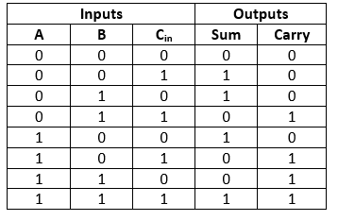
The Gate Level
Figure 6: Full Adder with circuit and truth table

Slide 16
The Gate Level
Sum of Product (SOP) and Product of Sum (POS)
s₀ = x₀y₀c₋₁ + x’₀y₀c’₋₁ + x’₀y’₀c₋₁ + x₀y’₀c’₋₁ ------- (1)
Equation (1) represents sum-of-products (SOP).
c₀ = (x₀ + c₋₁)(x₀ + y₀)(y₀ + c₋₁) -------- (2)
Equation (2) represents product-of-sum (POS).

Slide 17
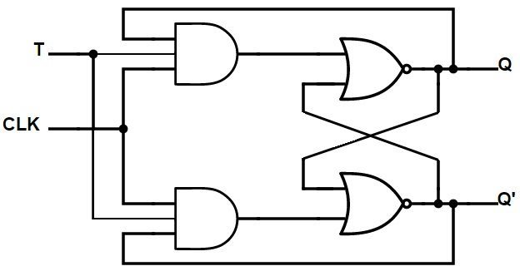
Flip-flops
By adding memory to a combinational circuit in the form of 1-bit storage elements called flip-flops, we obtain a sequential circuit. Flip-flops rely on an external clock signal CK to synchronize the time at which they respond to change on their data lines. They are also designed to be unaffected by transient signal changes (noise) produced by the combinational logic that feeds them.
Fig 7: Flip-flops

Slide 18
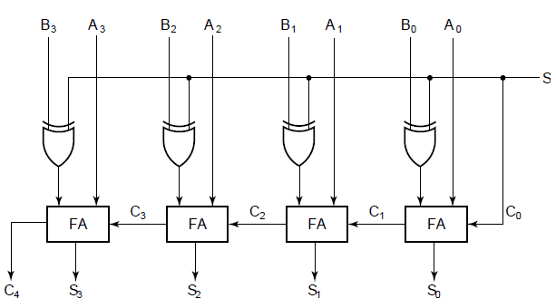
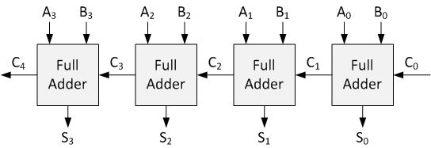
Flip-flops
Four bit ripple carry: a) logic structure;
b) high level symbol.

Slide 19
Flip-flops
Sequential circuits: A sequential circuit consists of a combinational circuit and a set of flip-flops. The combinational logic forms the computational or data processing part of the circuit. The flip-flops store information of the circuit’s past behavior; this stored information defines the circuits internal state. (output depends on present input and past input)

Slide 20
The register level
At the register or register transfer level, related information bits are grouped into ordered sets called words or vectors. The primitive (Modern) components are small combinational or sequential circuits intended to process or store words.

Slide 21
The register level
Register level Components:
Type | Component | Functions
Combinational | Word Gates | Logical (Boolean) Operation
 | Multiplexers | Data routing; general, combinational function
 | Decoder, encoder | Code checking and conversion
 | Adders | Addition and subtraction
 | Arithmetic Logic Unit | Numerical and logical operations
 | Programmable logic devices | General sequential functions.
Sequential | (Parallel) registers, Shift registers | Information storage; serial-parallel conversion
 | Counter, Programmable logic devices | Control/timing signal generation, General sequential functions.

Slide 22
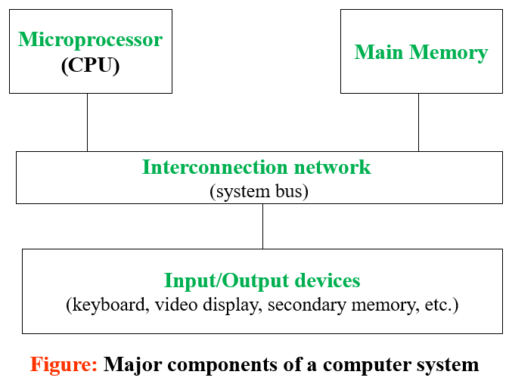
The Processor level
There are four main groups of processor level components:
- Processors
- Memories
- IO devices
- Interconnection networks

Slide 23
The Processor level
Main memory and IO system
System bus
Cache
Program Counter
PC
Instruction register
IR
Arithmetic
logic unit
Register
file
Address generation
Instruction
decoding
Program control
Unit (I - unit)
Datapath
E - unit
Control signals
Figure 10: Internal organization of a CPU and cache memory

Slide 24
The Processor level
Figure 10 shows the essential internal organization of a CPU at the register level. The CPU contains the logic needed to execute its particular instruction set and is divided into datapath and control unit.
The control part (I - unit) generates the address of instructions and data stored in external memory. In this particular system a cache memory is interposed between the main memory M and the CPU.
Each memory request generated by the CPU is first directed to the cache.

Slide 25
The Processor level
If the required information is not currently assigned to the cache, the request is redirected to M and cache is automatically updated from M.
The I – unit fetches instructions from the cache or M and decodes them to derive the control signals needed for their execution.
The CPU’s datapath (E - unit) has the arithmetic – logic circuits that execute most instructions; it has also a set of registers for temporary data storage.
The CPU manages a system bus, which is the main communication link among the CPU cache subsystem, main memory and the I/O devices.

Slide 26
The Processor level
In one clock cycle the CPU can perform a register-transfer operation, such as fetching an instruction word from M via the system bus and loading it into the instruction register IR. This operation can be expressed formally by
IR:= M(PC);
Where PC is the program counter used by the CPU to hold the expected address of the next instruction word. Once in the I-unit, an instruction is decoded to determine the actions needed for its execution.
The entire process of fetching, decoding and executing an instruction constitutes the CPU’s instruction cycle.

Slide 27
The Processor level
Memories: The memory part of a computer can be divided into several major subsystem.
- Main memory M, consisting of relatively fast storage ICs connected directly to, and controlled by, the CPU.
- Secondary memory, Consist of less expensive devices that have very high storage capacity. These devices often involve mechanical motion and so are much slower than M. They are generally connected indirectly (via M) to the CPU and form part of the computer’s I/O system.
- Other memory, many computer have a third type of memory called a cache, which is positioned between the CPU and main memory. Some or all of cache may be integrated on the same IC chip as the CPU itself.

Slide 28
The Processor Level (Cache memory)
Cache memory is a small amount of fast but expensive memory placed between the processor and main memory (512 KByte on the P-III processor). In some PCs there may be extra cache attached directly to the motherboard. When the processor attempts to read a word of main memory, a check is made first to determine if the word is in the cache. If it is, a copy of the word is transferred to the processor. If not, a block of main memory, consisting of a fixed number of words, is transferred into the cache and then a copy of the required work is transferred to the processor.
There are two types of cache memory:
External cache memory,
Internal cache memory
Processor
Word Transfer
Processor Cache
Block Transfer
Main Memory
Fig 11: Processor Cache Memory

Slide 29
The Processor level
I/O devices: Input-output devices are the means by which a computer communicates with the outside world.
A primary function of I/O devices is to act as data transducers.
I/O devices do not alter the information content or meaning of the data on which they act.
Since data is transferred and processed within a computer system in the form of digital electrical signals, input (output) devices transform other forms of information to (from) digital electrical signal.

Slide 30
The Processor level
Interconnection networks: Processor level components communicate by word-oriented buses. In systems with many components, communication may be controlled by a subsystem called an interconnection network; terms such as switching network, communications controller, and bus controller are also used in this context.
Internal Communication:
The System BUS: A bus is a set of parallel wires connecting two or more components of the computer.
The number of lines is referred to as the width of the bus. Bus lines are classified into three functional groups:
Control Bus
Data Bus
Address Bus

Slide 31
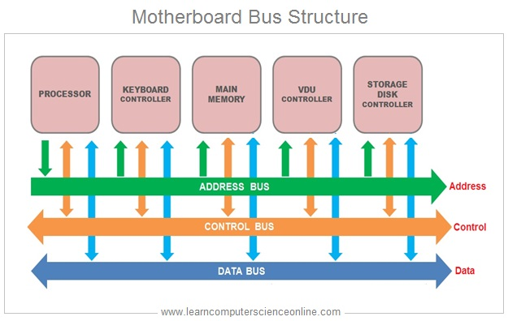
The Processor Level (System Bus)
Fig 12: System Bus

Slide 32
The Processor Level (Internal Communication)
Interrupts: An interrupt is a signal from some device/ source seeking the attention of the processor.
Types of Interrupts
Program
Timer
Input / Output
Hardware failure

