Slide 1
Lecture-5
Chapter-3.3
Computer Architecture and Organization- Jhon P. Hayes
Processor Basics
(Pipelining, Instruction Set Design)

Slide 2
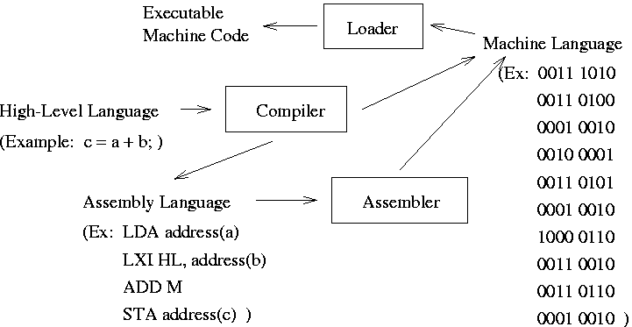
Computer Program Execution

Slide 3
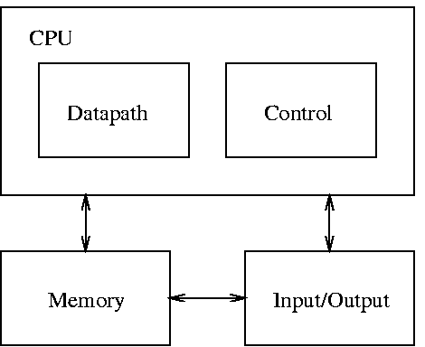
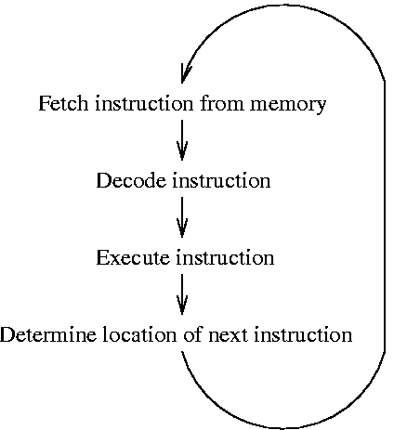
Block Diagram and Basic Operation
Block Diagram
Basic Operation
(Program Control Unit)
(Data Processing Unit)
ISR
Check for Interrupts

Slide 4
Instruction Set Design
Fixed versus Variable-Length Instruction Formats
  Fixed-length instruction format
    use same number of bits to represent all instructions
    leads to simpler (and faster) instruction decoding
    facilitates fast and effective prefetching of instructions
  Variable-length instruction format
    use different numbers of bits for different instructions
    can accommodate short and long instructions (requiring extra bits to represent data operands) without a waste of memory
    prefetching and decoding of instructions is more difficult

Slide 5
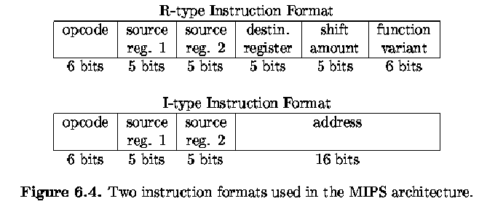
Example of fixed-length instruction formats used in the MIPS (Millions of Instruction Per Second) microprocessor
[Lee 2000]
MIPS = Microprocessor without Interlocked Pipeline Stages

Slide 6
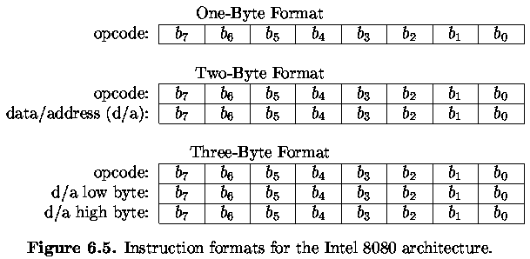
Variable-length instruction formats used in the Intel 8080 architecture
[Lee 2000]

Slide 7
Number of Data Operands
Zero-operand instructions
  data is accessed from the “stack” (a LIFO (last-in-first-out) queue)
One-operand instructions
  the accumulator (ACC) register is used as the default second data input and destination
Two-operand instructions
  one of the data inputs is the default destination
Three-operand instructions

Slide 8
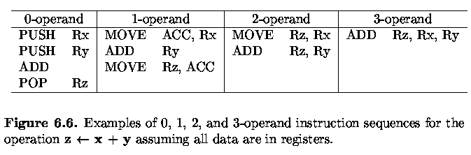

Slide 9
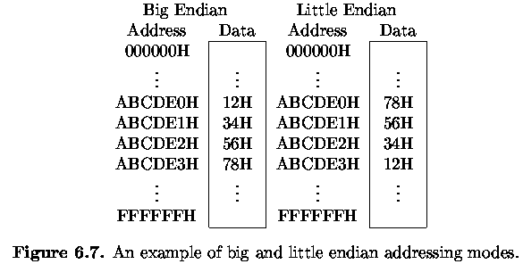
Endian Mode
Big-endian and little-endian are terms that describe the order in which a sequence of bytes are stored in computer memory.
Example Instruction: Store 12345678H, ABCDE0H
[Lee 2000]

Slide 10
Addressing Modes
Location of Data
register (or register-direct) addressing: R1
register indirect addressing: M[R1]
immediate addressing: data
direct (or absolute) addressing: M[address]
indirect addressing: M[M[address]]
implicit addressing: default location
relative & indexed addressing: M[R1+address]
pre-decrement, post-decrement, pre-increment, ...
For more details, read here

Slide 11
Modern CPUs
Employ a variety of speedup techniques
  cache memories
  special purpose instructions (e.g., test-and-set, MMX)
  redundant hardware modules -> superscalar, VLIW, ...
  support for parallel processing
  pipelining

Slide 12
Modern CPUs
There are two advanced features of the commercial microprocessor:
Reduced Instruction Set Computer (RISC) and
Complex Instruction Set Computer (CISC)
There are many way in which basic design of CPU can be improved. Most recent CPUs contain the following extensions which improve their performance and case of Programming.
        Multipurpose register set for storing data and address
        Additional data, instruction and address type
        Register to indicate computation status
        Program control stack
For more details on RISC vs CISC, read here

Slide 13
Pipeline
Modern CPUs have a variety of speedup techniques, including cache memories, and several forms of instruction level parallelism. Such parallelism may be present in the internal organization of DPU or in the overlapping of the operations carried out by the DPU and PCU. Overlapping of instruction fetching and execution is an example of instruction pipelining which is an important speedup feature of RISC processor.

Slide 14
Pipeline
Each instruction can be thought of as passing through two consecutive stages of processing: a fetch stage implemented mainly by PCU and an execution stage implemented mainly by DPU. Hence two instructions can be processed simultaneously in every CPU clock cycle, with one completing its fetch phase and other completing it’s execute phase. This Simultaneous process is called two stage instruction pipelines. [Fig 3.8]

Slide 15
Instruction Pipelining
I₁
Fetch
Execute
I₂
Fetch
Execute
I₃
Fetch
Execute
1
2
3
4
Fig 3.8: Overlapping instruction in a two stage instruction pipeline

Slide 16
Instruction Pipelining
The two principal number formats are fixed-point
and floating-point. Fixed-point formats allow a
limited range of values and have relatively simple
hardware requirements.
Floating-point numbers, on the other hand, allow a
much larger range of values but require either costly
processing hardware or lengthy software
implementations.

