Slide 1
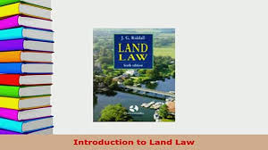

Slide 2
Introduction
Land law is a branch of law---
Right to use
Alienate
Exclude
Land law is both substantive and procedural
One of the common area of our daily life.

Slide 3
Scope of land law
Land + land rights + land management
Almost one hundred laws relating land in Bangladesh

Slide 4
Significance of Studying land law
Gaps in existing law and management
Traditional method of Record of rights
Land reform system- khas land/ revenue system
Land related cases mounting-
Beneficial for policy makers, judges, lawyers

Slide 5
What is Land?
Literal meaning immovable
Extended meaning rights in and over immovable
Osborn’s Concise Law Dictionary-
Blackstone-
SAT Act 1950 2(16)
Benefit arise to land, house and building
Judicial decisions

Slide 6
Types of Land
Agricultural
Non-Agricultural

