Slide 1

CHAPTER TWO-DEVELOPMENT OF LAND LAW

Slide 2
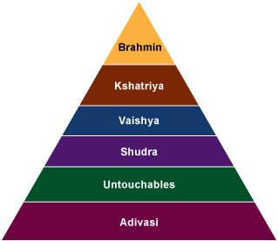
LAND DEVELOPMENT IN THE BENGAL DURING HINDU PERIOD
CLAN SYSTEM
KINSHIP SYSTEM
COMMON PROPERTY OF THE COMMUNITY

Slide 3
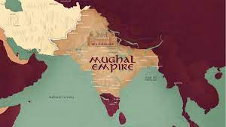
LAND ADMINISTRATION IN BENGAL DURING MUSLIM PERIOD
BAKHTIAR KHILIJI
MUGHAL RULE

Slide 4

LAND ADMINISTRATION IN BENGAL IN BRITISH PERIOD
QUINQUENNIAL & ANNUAL SETTLEMENT
PIT’S INDIA ACT
PERMANENT SEETTLEMENT
OPERATION OF PERMANENT SETTLEMENT
EVALUATION OF PERMANENT SETTLEMENT
MEASURES TO AMELIORATE PERMANENT SETTLEMENT

