Slide 1
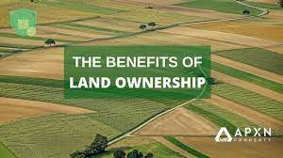
OWNERSHIP OF LAND

Slide 2
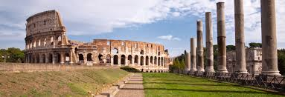
OWNERSHIP OF LAND IN ANCIENT PERIOD

Slide 3
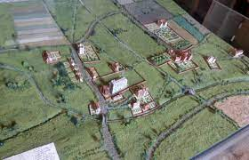
OWNERSHIP OF LAND IN MODERN PERIOD

Slide 4
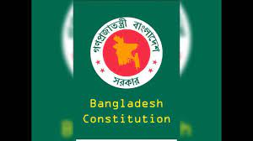
CONSTITUTIONAL PROVISIONS REGARDING OWNERSHIP OF LAND

