Slide 1
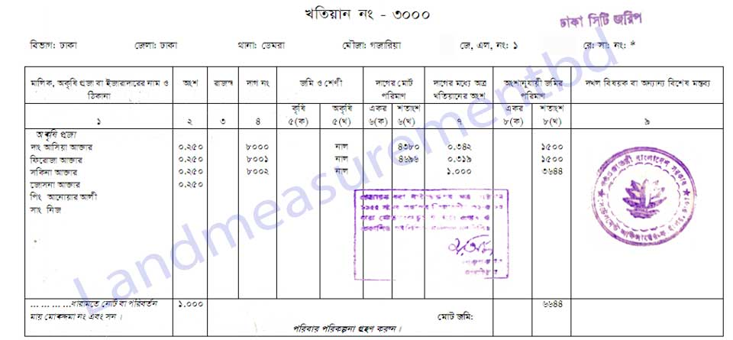
RECORD OF RIGHTS IN BANGLADESH

Slide 2
DEFINTION OF RECORD OF RIGHTS
IMPORTANCE OF RECORD OF RIGHTS

Slide 4
CLASSIFICATION OF RECORD OF RIGHTS
MUTATION KHATIYAN
SURVEY KHATIYAN-
C.S
R.S( OF C.S.)
S.A.
R.S
PROVISIONAL RECORD OF RIGHTS
PETTY RECORD OF RIGHTS

Slide 5
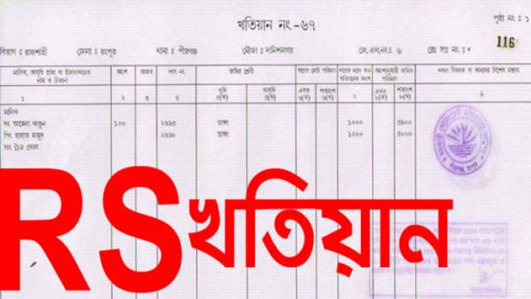

Slide 7
