Slide 1
ACQUISITION AND REQUISITION OF IMMOVABLE PROPERTY

Slide 2
LAWS GOVERNING THE ACQUISITION AND REQUISITION
DEFINING THE TERM ‘PUBLIC PURPOSE’

Slide 3
PROCEDURE FOR LAND ACQUISITION
LAND ALLOCATION COMMITTEE
APPLICATION TO THE COMMITTEE
FIELD VERIFICATION
ACQUSITION PROCEEDINGS
BAR TO JURISDICTION

Slide 4
CLAIM FOR COMPENSATION
FACTORS DETERMINING THE AMOUNT OF COMPENSATION

Slide 5
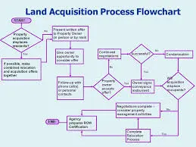
PROCEDURE FOR REQUISITION

