Slide 1
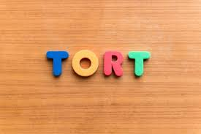

Slide 2
Introduction
What is tort
Elements of tort
Torts Distinct From Breach of Contract
Torts Distinct From Crime
Tort Distinct from Quasi-Contracts
Reasonable Man Explained

Slide 3
"Tort" comes from "Tortum" which means "to twist". What is twisted is the conduct of the wrong-doer, called the defendant. Such a twist causes a legal injury (a civil wrong)) to the plaintiff and the courts provide for a remedy to him in the law of Torts.

