Slide 1
BRAINSTORMING
&
QUAD CHART

Slide 2
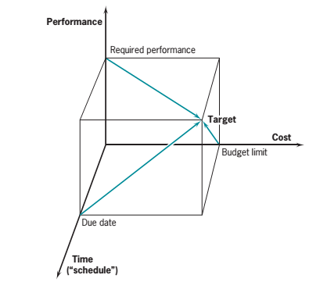
Why do we need PM tools & techniques?
Because we live in a world of limited resources and not enough time.
There will always be more to do than time and resources will allow.
Project Management tool & techniques, if used regularly & appropriately, help us make more effective use of our time.

Slide 3
TOOL#1
BRAINSTORMING

Slide 4
Brainstorming
Brainstorming was coined in the 1940s by Alex Osborne a US advertising executive.
It works by temporarily removing the social blocks which we all have which prevent us from being creative blocks such as:
  Feeling our ideas will be ridiculed
  Feeling we don’t know enough to voice an opinion
  Focusing on simple solutions rather than taking a risk
Brainstorming is essentially a method for being creative in groups, particularly useful for creative problem solving.
‘Popcorning’ is the new name for brainstorming

Slide 5
The Rules of Brainstorming
No judgement or criticism of an idea
Quantity of ideas is more important than quality
Freewheeling - rapid a spontaneous ideas
Mutating and combining ideas – one person’s idea stimulates ideas from another person
No answer or idea belongs to a person, they belong to the group
Answers and ideas must be produced rapidly

Slide 6
Brainstorming: Step by Step
Question or problem is posed
People in a group take turns to answer
Each suggestion is written down by a note taker
Repeat the process until the group run out of ideas
Select, filter and choose the most appropriate ideas.

Slide 7
TOOL#2
QUAD CHART

Slide 8
The QUAD chart
A very simple yet powerful tool.
Used to help us clarify exactly what a project is all about.

Slide 9
Project Management Simulation Exercise
“The Gourmet Breakfast”
We are going to use a relatively simple example of something that you should be familiar with in order for you to be able to understand and practice on a real life project.

Slide 10
The Problem
Just got up?
Feeling kind of hungry?
Fancy a nice breakfast ?
What choice do we have?

Slide 11
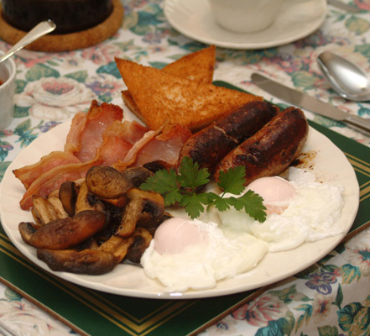
Let’s make a full cooked English breakfast

Slide 12
Class Exercise
“To produce a simple project plan for producing a full English Breakfast.”
We will be using this project to illustrate the use of the following:
  Quad Chart Analysis including
    Project Scoping
    Stakeholders and Stakeholder Analysis
    Desired Outcomes (Critical Success Factors)
    Secondary benefits

Slide 13
Why a breakfast?
We will use the Breakfast as it’s a simple example of something where you should all have a similar level of basic knowledge.
Let’s view making the breakfast as a project in its own right.
It meets most of the criteria for/attributes of a project doesn’t it? Does it? Let’s check

Slide 14
Attributes of a project
A start and a finish
1
Is a unique activity
2
May involve uncertainty and risk
3
Usually involves a team coming together
4
A budget
5
Non repetitive tasks
6
Use of resources
7
A single point of ultimate responsibility
8
Clearly defined team roles
9

Slide 15
The Quad Chart

Slide 16
Guided Tour
TITLE OF PROJECT – SNAPPY ACRONYM DESCRIPTOR
WHY IS PROJECT BEING DONE?
WHAT FOR?
WHAT IS THE RESULT?
WHO IS PROJECT FOR?
WHO WILL BENEFIT (OR NOT)?
WHO WILL IT INVOLVE?
GOALS!
WHAT MAKES THE
PROJECT A SUCCESS?
WHEN ARE WE FINISHED?
WHAT CAN BE MEASURED?
HOW DO I
MEASURE SUCCESS?

Slide 17
QUAD Example - Make A Cup of Tea
To make a cup of tea to quench the thirst and stimulate the mind
1. To make a cup of tea
1. The tea maker
2. The tea drinkers
2. To quench the thirst
3. To stimulate the mind
1. Audible noises of satisfaction from drinkers. Requests for a second cup
1. Made an acceptable cup of tea
2. Stimulated the mind
2. Increased conversation
Absence of snoring or yawning

Slide 18
Your Mission
1. To produce a simple project plan QUAD.
2. Do a brainstorm by yourself first and then in groups you will have a go at producing a QUAD chart.

Slide 19
Guided Tour
PROJECT NAME SNAPPY ACRONYM
WHY IS PROJECT BEING DONE?
WHAT FOR?
WHAT IS THE RESULT?
WHO IS PROJECT FOR?
WHO WILL BENEFIT (OR NOT)?
WHO WILL IT INVOLVE?
GOALS!
WHAT MAKES THE
PROJECT A SUCCESS?
WHEN ARE WE FINISHED?
WHAT CAN BE MEASURED?
HOW DO I
MEASURE SUCCESS?

Slide 20
Thank You

