Slide 1
Teambuilding

Slide 2
Building the Project Team
Teams often go through distinct stages in their development. These stages may happen very quickly or quite slowly. Some teams never quite move through all the stages and never work efficiently and effectively as a proper team.
Forming
Storming
Norming
Performing

Slide 3
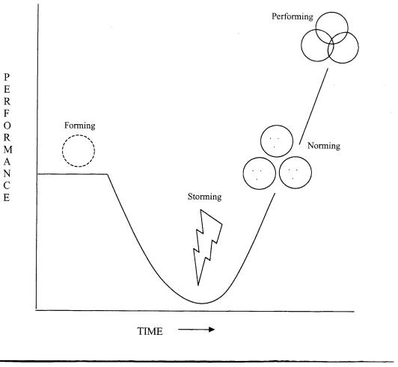
Tuckman’s Rainbow stages of team development

Slide 4
Stages of team development
Forming – initiation of the group, some anxiety amongst members as people try and establish their personal identity
Storming – members get to know each other more and put forward their opinions and views; there may be conflict and hostility, group starts to identify how it will work together
Norming – conflict and hostility controlled, members establish guidelines and standards of up the norms of acceptable behaviour and agreed standards of performance
Performing – when the group has created a structure and cohesiveness to work together effectively. Can now concentrate on achieving its tasks.

Slide 5
What Tuckman’s Rainbow implies
That teams do not just come together and start working at maximum efficiently straight away.
That it takes time for a team to work together (perform) well.
A project manager needs to allow time for this process when planning the project, particularly important for new teams.

