Slide 1
Convolution encoding
Professor Dr. A.K.M Fazlul Haque
Electronics and Telecommunication Engineering (ETE)
Daffodil International University

Slide 2
Convolution encoding
A convolutional code is a type of error-correcting code that generates parity symbols via the sliding application of a Boolean polynomial function to a data stream.

Slide 3
Convolution encoding

Slide 4
Convolution encoding
Convolution codes have memory that utilizes previous bits to encode or decode following bits (block codes are memory less)

Slide 5
Convolution codes
Convolutional codes are commonly specified by three parameters; (n,k,m)
n = number of output bits
k = number of input bits
m = number of memory registers

Slide 6
Convolution encoding
Each branch word Ui is made up of binary code symbols, often called channel symbols, channel bits or code bits

Slide 7
Convolution encoder
The constraint length represents the number of k- bit shifts over which a signal information bit can influence the encoder output.
The code symbols are used by the modulator to specify the waveforms to be transmitted over the channel.

Slide 8
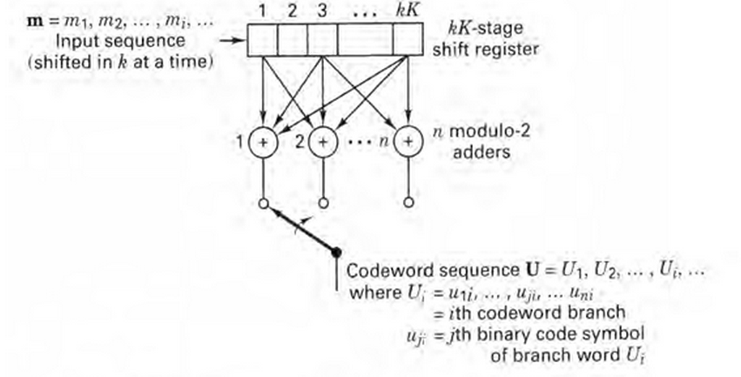
Convolution encoder (cont.)

Slide 9
Convolution encoding
The quantity k/n called the code rate, is a measure of the efficiency of the code.

Slide 10
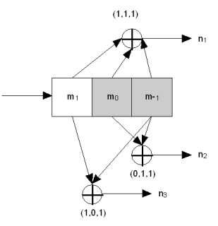
Example
n1 = m1 + m0 + m-1
n2 = m0 + m-1
n3 = m1 + m-1

Slide 11
Representation of convolution encoding
Shift Register
State diagram
Trellis diagram
Polynomial
Tree diagram

Slide 12
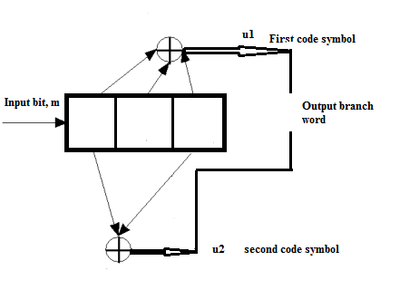
Shift Register
Shift Register representation is closest form of physical implementation of the encoder

Slide 13
Impulse response of the encoder
Impulse response is the response of the encoder to a single “one” bit that moves through it.
Branch word
Input sequence: 1 0 0
Output sequence: 11 10 11
Register contents | u1 | u2
100 | 1 | 1
010 | 1 | 0
001 | 1 | 1

Slide 14
State diagram
In most general sense the state consist of the smallest information that, together with current input to machine can predict the output of the machine.

Slide 15
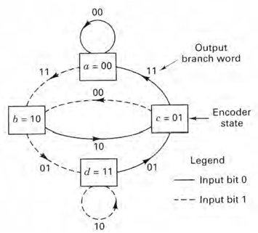
State diagram (cont.)

Slide 16
Example
Message sequence m = 1 1 0 1 1
K – 1 = 2
Input bit, mi | Register contents | State at time, ti | State at time, ti+1 | u1 | u2
- | 000 | 00 | 00 | - | -
1 | 100 | 00 | 10 | 1 | 1
1 | 110 | 10 | 11 | 0 | 1
0 | 011 | 11 | 01 | 0 | 1
1 | 101 | 01 | 10 | 0 | 0
1 | 110 | 10 | 11 | 0 | 1
0 | 011 | 11 | 01 | 0 | 1
0 | 001 | 01 | 00 | 1 | 1
Output sequence: U = 11 01 01 00 01 01 11

Slide 17
Polynomial representation
For Connection representation above we can have following Generator polynomials:
g1(x) = 1 + x + x^2
g2(x) = 1 + x^2
The output Sequence is found as follows:
U(x) = m(x) g1(x) interlaced with m(x) g2(x)

Slide 18
Example
m(X) g1(x) = $({1+X}^{2 }{) (1+X+X}^{2})$ = ${1+X+X}^{3}$+$X^{4}$
m(X) g2(x) = $({1+X}^{2}$ $) ({1+X}^{2}$ $)$ = $({1+X}^{4})$
m(X) g1(x) =${ 1+X+{0.X}^{2}+ X}^{3}+X^{4}$
m(X) g2(x) =${1+0.X+{0.X}^{2}+0.X}^{3}+X^{4}$
U(X) = (1,1) + (1,0)X + (0,0) $X^{2}$ + (1,0) $X^{3}$ + (1,1) $X^{4}$
U = 1 1 1 0 0 0 1 0 1 1

Slide 19
The Trellis diagram
The Trellis Diagram exploits a repetitive structure and a more manageable encoder description than that of Tree Diagram.

Slide 20
The Trellis diagram (cont.)
The dotted line shows input bit 1 and solid line shows input bit 0.

Slide 21
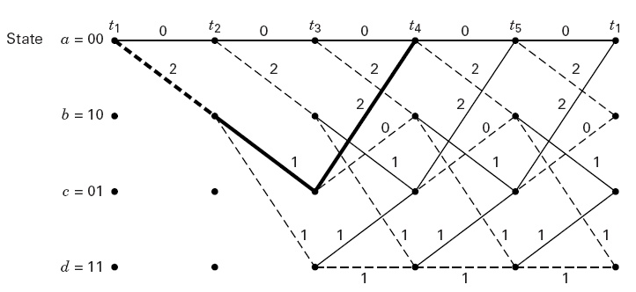
The Trellis diagram (cont.)

Slide 22
The Tree diagram
At each input bit time the encoding process can be described by traversing the diagram left to right with each tree branch describing an output branch word.

Slide 23
The Tree diagram (cont.)
The tree diagram adds the dimension of time to the state diagram

Slide 24
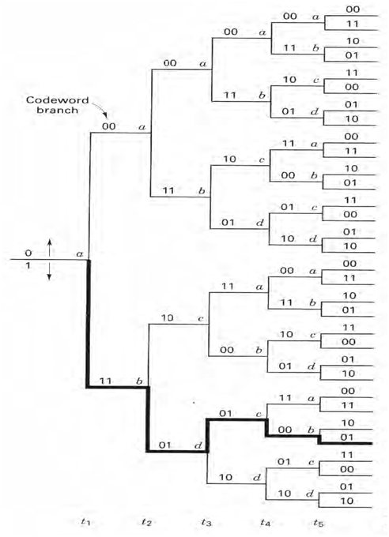
The Tree diagram (cont.)
For K=3 and Code rate= ½ we have

Slide 25
The Tree diagram (cont.)
If the input bit is a zero, the associated branch word moving in the upward direction.
If the input bit is a one, the associated branch word moving in the downward direction.

Slide 26
END

