Slide 1
Daffodil International University Dept. of CSE Information Security
Lecture 8
Personal Device Security-Antivirus

Slide 2
Personal Device Security-Antivirus
Device security refers to the protection of a devices' hardware and the data that it holds. It can be implemented using antivirus, passwords, encryption, and firewalls, and denying physical access to a computer's location.
An antivirus program is a software utility designed to protect computers or networks against computer viruses. There has been a continuous arms race between virus writers and writers of antivirus software since viruses first appeared. Example: CalmWin, McAfee, Kaspersky Anti-Virus
Features of Antivirus Software:
Background Scanning
Complete System Scan
Virus Definition

Slide 3
How does an Antivirus work?
Most programs will employ three types of detection devices:
Virus Definitions :
This is essentially the first method conventional antivirus software utilize to identify virus. The programs look for signatures to detect new malware.
Heuristic-based detection :
An antivirus packed with this type of detection can also detect viruses that have not yet been discovered and released.
Behavior-based detection :
An antivirus observes the behavior of programs running on the computer. The antivirus triggers a warning if a program begins to perform strange actions.
Data mining strategies :
This is one of the most recent patterns in recognizing a malware. With an arrangement of the traits of a program, Data mining finds if the file or an application is a malware.

Slide 4
How 3rd gen Antivirus works?
3rd gen Antivirus offers 360° security against online dangers by consolidating;
A capable antivirus,
An enterprise packet filtering firewall,
An host intrusion prevention system called HIPS.

Slide 5
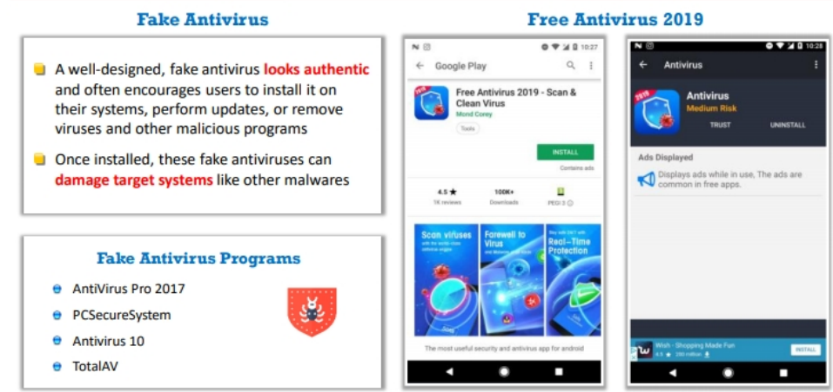
How to Infect Systems Using a Fake Antivirus

Slide 6
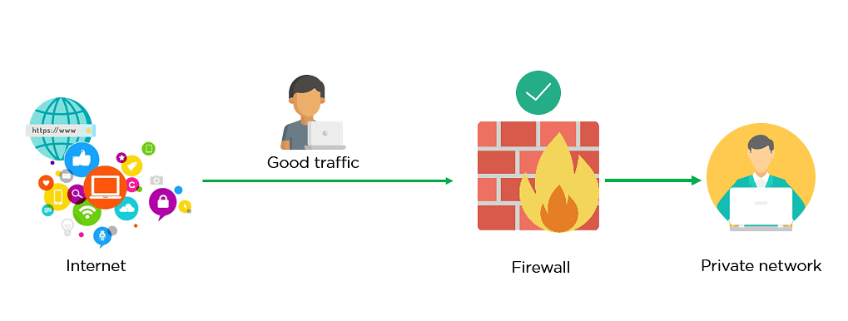
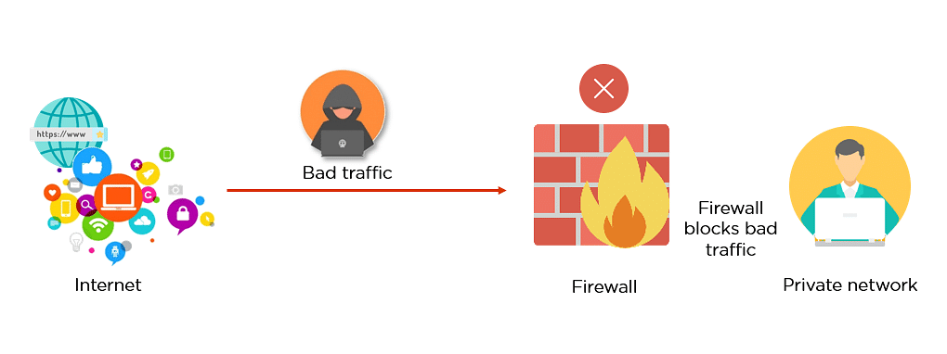
Personal Device Security-Firewall
In computing, a Firewall is a network security system that monitors and controls incoming and outgoing network traffic based on predetermined security rules.
A firewall typically establishes a barrier between a trusted network and an untrusted network, such as the Internet.
Fig: Firewall allowing Good Traffic
Fig: Firewall blocking Bad Traffic

Slide 7
How Does a Firewall Work
Think of the firewall like a gatekeeper at your computer’s entry point which only allows trusted sources, or IP addresses, to enter your network.
Distinguishes between good and malicious traffic
Allows or blocks specific data packets on pre-established security rules.
Rules are based on several aspects indicated by the packet data, like their source,
destination, content, and so on
Blocks traffic coming from suspicious sources to prevent cyberattacks.

Slide 8
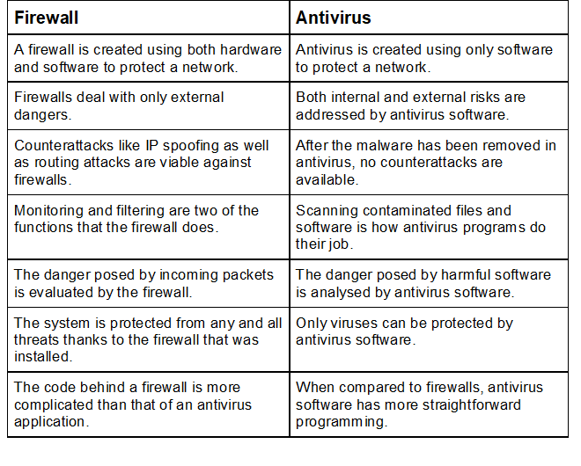
Differences between Anti-virus and Firewall

Slide 9
Thank You

