Slide 1
Daffodil International University Dept. of CSE Information Security
Lecture 9
Personal Device Security(Contd.)

Slide 2
Personal Device Security-Intrusion Detection System (IDS)
An Intrusion Detection System (IDS) is a monitoring system that detects suspicious activities and generates alerts when they are detected.

Slide 3
How an IDS detects an intrusion?

Slide 4
Personal Device Security-Intrusion Prevention System (IPS)
An intrusion prevention system (IPS) is a network security technology that continuously monitors network traffic for suspicious activity and takes steps to prevent it.

Slide 5
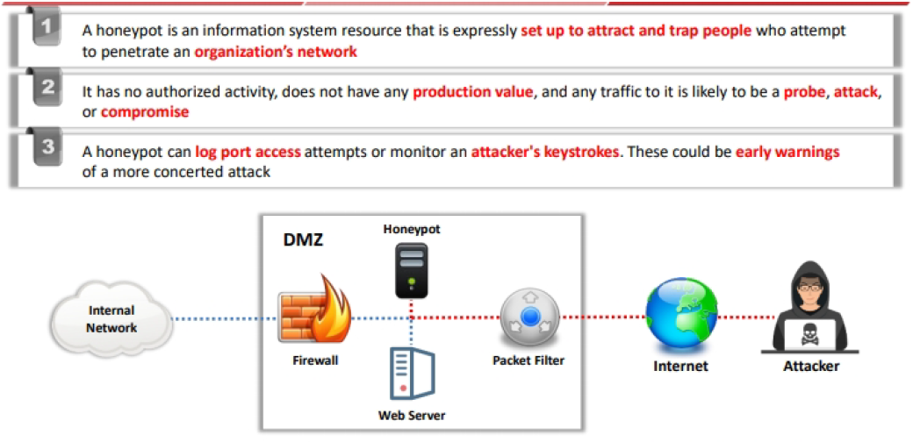
Personal Device Security- Honeypot
A honeypot in cyber security is a trap set to lure or trap hackers. This can be done by using a decoy or false data, a fake server, or a false user. A honeypot can help an administrator learn more about their hacker and attack patterns.
Fig: Honeypot Placement in a System

Slide 6
Cloud Security
Cloud Security is a set of control-based technologies & policies adapted to stick to regulatory compliances, rules & protect data application and cloud technology infrastructure.
Cloud Computing Security Risks
Security system misconfiguration
Denial-of-Service (DoS) attacks
Data loss due to cyber attacks
Unsecure access control points
Inadequate threat notifications and alerts
Cloud Security Controls
Detective Control
Preventive Control
Deterrent Control
Corrective Control

Slide 7
Mobile Device Security
Mobile Device Security refers to the measures designed to protect sensitive information stored on and transmitted by laptops, smartphones, tablets, wearables, and other portable devices
Mobile Device Security Risks
Unsafe apps
Unsafe operating systems
Unsafe connections
Lost devices
Use of public wi-fi
Social engineering
Mobile device Security Controls
Establish, share, and enforce clear policies and processes
Password protection
Leverage biometrics
Leverage biometrics
Mobile device encryption

Slide 8
IoT Security
IoT security is a subset of cybersecurity that focuses on protecting, monitoring and remediating threats related to the Internet of Things (IoT)— the network of connected devices equipped with sensors, software or other technologies to gather, store and share data via the internet.
IoT Security Risks
DoS and DDoS Attacks
Firmware Exploits
Credential Exploits
On-Path Attacks
IoT Security Controls
Staying up to date with all patching and OS updates
Using strong password practices
Enabling multi-factor authentication
Developing and implementing an IoT device policy
Consider implementing a cloud access security broker (CASB)
Monitoring all network devices
Encrypting all data
Implementing cybersecurity best practices

Slide 9
Thank You

