Slide 1
Daffodil International University Dept. of CSE Information Security
Lecture 10
Vulnerability Assessment and Penetration Testing - VAPT

Slide 2
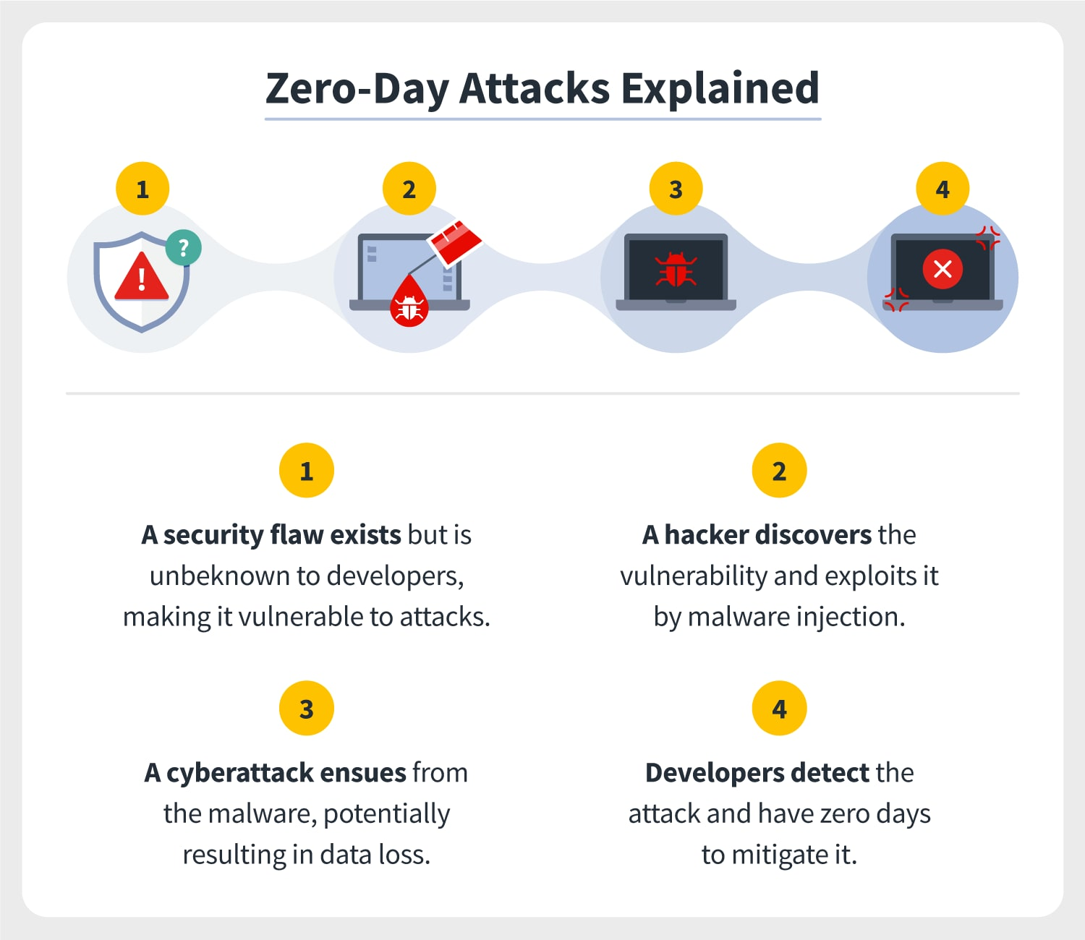
What is exploit?
An exploit is a piece of code, a chunk of data, or a sequence of commands that takes advantage of a software vulnerability or security flaw in an application or a system to cause unexpected behavior to occur.
What
at is a Zero-day Exploit?
A zero-day (0day) exploit is a cyber-attack targeting a software vulnerability which is unknown to the software vendor or to antivirus vendors.

Slide 3
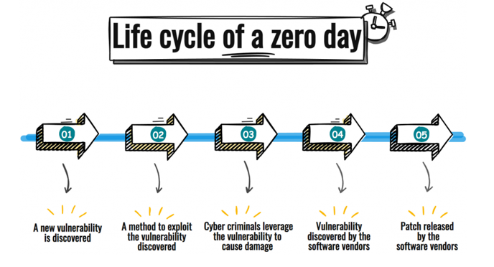
Typical properties of a zero-exploit
A flaw or vulnerability in a computer software.
Vulnerability was previously unknown to the software vendor.
There is no immediate fix available for the vulnerability.
The vulnerability is open to be exploited by the hackers.
Zero-day exploit example

Slide 4
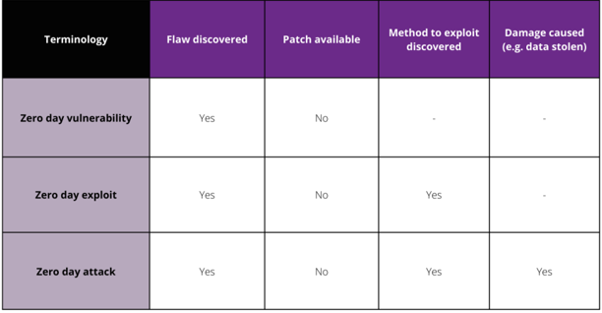
What is the difference between a zero-day vulnerability, a zero-day exploit and a zero-day attack?
A Zero-day vulnerability is simply a flaw that is discovered before the software vendor knows about it. There is no fix available for it.
A zero-day exploit indicates that the method to exploit the zero-day vulnerability has been discovered.
A zero-day attack leverages zero-day vulnerability to cause damage e.g. steal the data, bring down the systems.

Slide 5
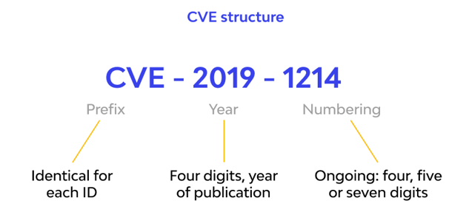
What is a CVE?
CVE, short for Common Vulnerabilities and Exposures, is a list of publicly disclosed computer security flaws. When someone refers to a CVE, they mean a security flaw that's been assigned a CVE ID number.
CVE ID Example:

Slide 6
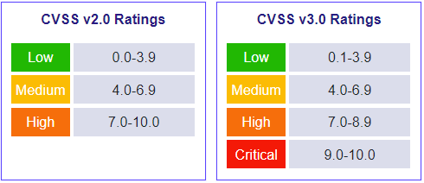
What is a CVSS?
The Common Vulnerability Scoring System (CVSS) is a free and open industry standard for assessing the severity of computer system security vulnerabilities.

Slide 7
Vulnerability Assessment and Penetration Testing (VAPT)
Vulnerability Assessment and Penetration Testing (VAPT) are two types of vulnerability testing. The tests have different strengths and are often combined to achieve a more complete vulnerability analysis.
In short, Penetration Testing and Vulnerability Assessments perform two different tasks, usually with different results, within the same area of focus.
Vulnerability Assessment Report
A vulnerability assessment report is a document that records all the vulnerabilities found in your systems during a vulnerability scan.
The report provides you with a list of the vulnerabilities indexed by severity along with suggestions for fixing the vulnerabilities.

Slide 10
Components of a Vulnerability Assessment Report
A vulnerability scan report is usually divided into 3 parts. Let us understand the significance of each segment.
The executive summary
The details of vulnerabilities
Details of the scan
Sample VAPT Report
https://www.getastra.com/blog/wp-content/uploads/2021/06/Astra-Security-Sample-VAPT-Report.pdf

Slide 11
Thank You

