Slide 1
Daffodil International University Dept. of CSE Information Security
Lecture 13
Introduction to Cryptography

Slide 2
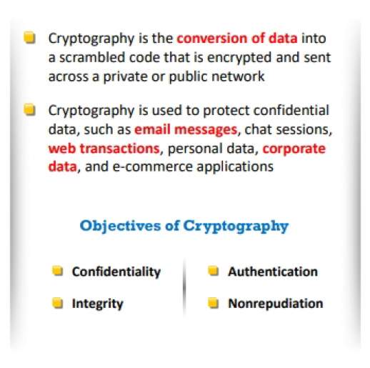
Cryptography
Cryptography is the practice of concealing information by converting plaintext (readable format) into ciphertext (unreadable format) using a key or encryption scheme.
Fig 1: Encryption Process

Slide 3
Types of Cryptography
Cryptography is categorized into two types according to the number of keys employed for encryption and decryption.
Symmetric Encryption Asymmetric Encryption

Slide 4
Symmetric Encryption
Sender and receiver use same digital key to encrypt and decrypt message
Requires different set of keys for each transaction
Strength of encryption
-Fixed Length of binary key used to encrypt data
Sending secret key is a challenge
Faster and consumes less computational energy than asymmetric key
■ Data Encryption Standard (DES)
The plaintext and cipher text is of 64 bits and 56 bit encryption key.
3DES is used to ensure security
■ Advanced Encryption Standard (AES)
Most widely used symmetric key encryption
Uses 128-, 192-, and 256-bit plaintext, cipher text and encryption keys
Other standards use keys with up to 2,048 bits

Slide 5
Encryption Algorithm- DES, AES
Data Encryption Standard (DES) and Advanced Encryption Standard (AES)

Slide 6
Asymmetric Encryption
Uses two mathematically related digital keys
❖ Public key (widely disseminated)
❖ Private key (kept secret by owner)
Both keys used to encrypt and decrypt message
Once key used to encrypt message, same key cannot be used to decrypt message
Sender uses recipient’s public key to encrypt message; recipient uses private key to decrypt it
Slower and consumes more computational energy
Ex: RSA, DSA Algorithm

Slide 7
Message Digest (One way Hash Function)
Mathematical algorithm that produces fixed-length number called message or hash digests. Ex: MD5, SHA.

Slide 8
Thank You

