Slide 1



Agriculture of
Bangladesh
MUNMUN SHABNAM BIPASHA
Department of Business Administration
Daffodil International University

Slide 2
Objectives of this Chapter
Investigate the contribution of Agriculture sector of Bangladesh.
Explore the common agricultural scenario of Bangladesh.
Identify the weakness of the Agricultural sectors of Bangladesh.
Suggest the measures to develop the Agricultural sector of Bangladesh.

Slide 3
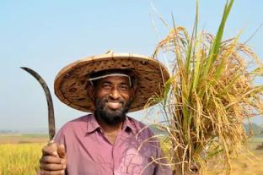
Bangladesh Agriculture at a Glance
Total area : 14.845million hectare
Forest : 2.599 million hectare
Cultivable land : 8.44 million hectare
Contribution of agriculture sector to GDP : 23.50%
Contribution of crop sector to GDP : 13.44%
Manpower in agriculture : 62%
Total food crop demand : 23.029 million metric ton
Total food crop production : 27.787 million metric ton
Net production : 24.569 million metric ton
Source: BBS, 2006 and Handbook Agricultural Statistics, MoA

Slide 4
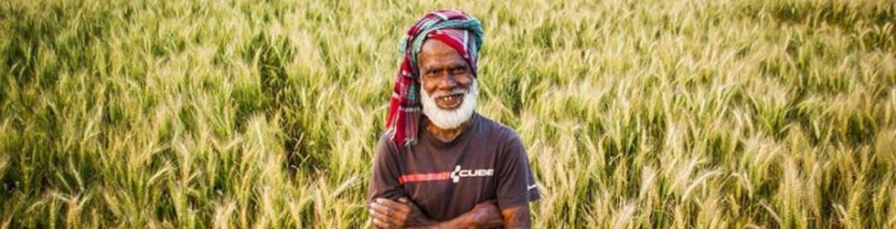
Agriculture or agricultural work
Agriculture means the activities relating to the production of vegetation and animal resources to meet the daily requirements of human beings. So agriculture includes such productive works which are related to the production of crops, rearing up of birds and animals, fisheries, a forestation etc. Agriculture is considered as the main profession in most of the developing countries of the modern world. In Bangladesh also agriculture is the main profession of its inhabitants.

Slide 5

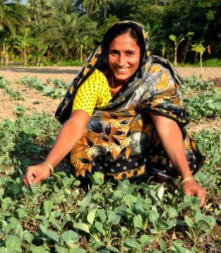
Subsistence agricultural work and agricultural work for commercial production
The agricultural work can be directed with two motives; Such as subsistence agriculture and agricultural work for commercial purpose.
1. Agricultural work for subsistence: From the agricultural work when one can mainly meet the self requirement, that agricultural work is known as subsistence agriculture. In the subsistence type of farming a nominal surplus remains after meeting the family expenditure by which farmer somehow continues agricultural work. The following features can be observed in subsistence agricultural farming as mentioned below:
Subsistence farming is meant for the survival of the self sand the members of the family only. So, this sort of agriculture is primarily administered for the consumption purpose of the family.
In this form of agriculture the farmers engage only his family members, No hired laborer is engaged.
In subsistence agriculture the owner himself takes part.
Those agricultural products are produced which are consumed by the members of the family themselves.

Slide 6
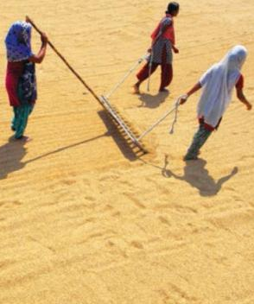
Subsistence agricultural work and agricultural work for commercial production
2. Agricultural Activities for Commercial Purpose: When agricultural production is undertaken and products are sold in the market with the Objective of earning profits is called agriculture for commercial purpose. Such agricultural activities are administered in such a way that profits can be earned through selling the markets. Agricultural activities for commercial purpose possess the following characteristics:
In the commercial production the owner himself does not take part in agricultural activities; rather he engages laborer on hire for agricultural activities.
In this sort of agriculture the main thrust is on profit, not consumption. For this efforts are made to make profit by selling whatever is produced. The family may not consume the produce. So in this type of farming family consumption does not get that much importance.
Basically for the sake of commercial purpose such agricultural activities are done. So those agricultural produce where prospect of profit is high are preferred.

Slide 7
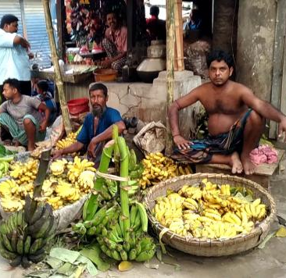
The comparative discussion on subsistence agriculture and agriculture for commercial purpose
Production: Substance farmers produce only to meet the requirements of their family. If there is small surplus, he earns insignificant income from their sale. As a result his saving is very low; due to lack of requisite security he cannot produce loans.
Risks: In most cases production of agriculture produce upon nature. In case of subsistence agriculture the farmer produce only for his survival. In this circumstance if there is any national calamity and loss of produce he faces the crisis.
Specialization: If a person does the same work again and again, the efficiency which is acquired is called specialization.
Marketing of products: The process through which the product from the agriculture fields reaches to final consumers is called marketing, if marketing of is perfect or well organized, the farmers get fair price of their products.

Slide 8

Opportunities of Agriculture in Bangladesh
Agricultural sector is the single largest contributor to GDP.
Crop production system is highly labor intensive and there is an abundance of labor in the country.
Agriculture is the largest source of employment for skilled and unskilled labor.
Favorable natural environment generally exists throughout the year for crop production.
Wide range of bio-diversity exists for different crops.
Different crops and agricultural commodities are the main sources of nutrition including protein, minerals and vitamins.
Agricultural commodities have comparatively higher value addition than non-agricultural commodities.

Slide 9
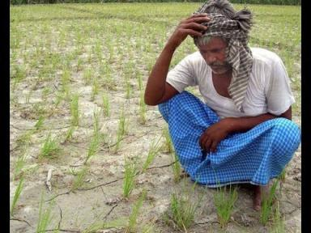
Constraints of Agriculture in Bangladesh
Agriculture is dependent on the nature and is risky.
Availability of cultivable land is decreasing.
Widespread poverty among the population engaged in agriculture.
Lack of required capital for agricultural activities.
Inadequacy of appropriate technology considering farmers socio-economic conditions.
Uncertainty of fair price of agricultural commodities due to underdeveloped marketing system.
Agricultural commodities are rapidly perishable and post harvest losses are too high.
Limited knowledge of common people about the nutritional value of agricultural commodities including vegetables and fruits.

Slide 10
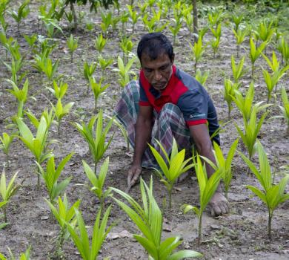
Issues and challenges of agriculture in Bangladesh
High level of rural poverty
Low agricultural productivity
Poorly functioning input and output markets
Lack of enabling rural investment climate
Weak rural institutions
Vulnerability to natural disasters

Slide 11
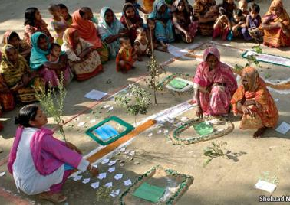
Priorities areas for agricultural development
1. Increasing agricultural productivity, diversification and value addition
Agricultural research and extension
Enabling rural business environment

Slide 12
Priorities areas for agricultural development
2. Improving factors markets access to assets and natural resources management
Agricultural land
Agricultural inputs (seeds, fertilizer, pesticides, etc.)
Rural finance
Natural Resources management
Water Resources Management
3. Strengthening Rural Institutions and Livelihood Support
Rural service delivery
Livelihood Support

Slide 13
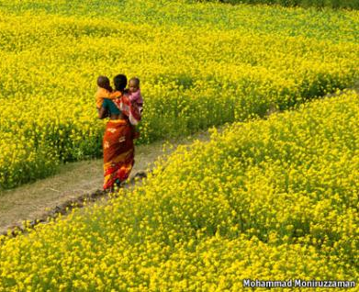
Importance of agriculture in Bangladesh
Main occupation
Supply of food
Supply of raw materials for industries
Increase the tendency to establish agriculture related industries
Supply of cloths
Supply of inputs for house making and supply of fuel
Establishment of medicine industry
Main source of national production
Helping the earning of foreign exchange
Increase public revenue
Creation of markets for industrial products
Rapid economic development

Slide 14
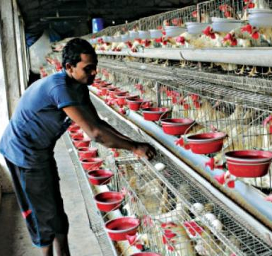
Characteristics of Agriculture in Bangladesh
Undeveloped production method
Low productivity
Cultivation for subsistence
Subdivision and fragmentation of holdings
Landless cultivators
Uncultivated land
Dependence on rainfall
The major portion of land is under the cultivation of food crops
Defective ownership of land
Absentee owners of land
Share cropping
Poor, unhealthy and illiterate peasants

Slide 15
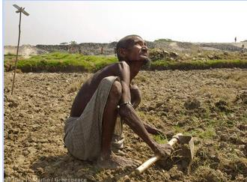
Causes of the backwardness of agriculture in Bangladesh
Old Method of Cultivation
Subdivision and Fragmentation of Holdings
Problem of Credit
Unequal Distribution of Land Ownership
Lack of Goods Seeds and Manure
Lack of Irrigation Facilities
Natural calamities
Decrease in the Fertility of Land
Attack of pest and Insects and Crop Diseases
Water stagnation and salinity of land
Weak rural infrastructure
Defective marketing system
Poverty and illiteracy of the peasant
Lack of subsidiary occupation
Absence of proper organization
Absence of well coordinated agricultural policy

Slide 16
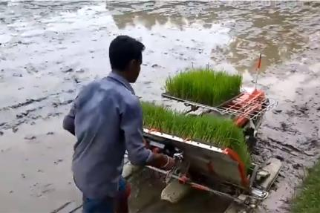
Modern technology in agriculture
The different aspects of use of modern technology in agriculture are below:
Use of high yielding verities of seeds
Use of fertilizer
Use of pesticides
Irrigation

Slide 17
Strengthening Bangladesh’s agricultural technology system to reduce rural poverty
The agricultural sector has performed reasonably well. However, the growth in the agricultural sector has stalled in the last few years. In the Poverty Reduction Strategy Paper (PRSP) document, the Government of Bangladesh has indicated the need to achieve 7% overall annual economic growth in order to achieve the Millennium Development Goal (MDG) of poverty reduction – a target which will not be possible unless the agricultural sector achieves at least 5% annual growth rate. Among the key constraints in achieving this objective are:
Agricultural land is actually declining and quality is deteriorating.
Agricultural productivity growth has either stagnated or declined.
Pace of diversification from low value cereals to high value commodities is slow.

Slide 18

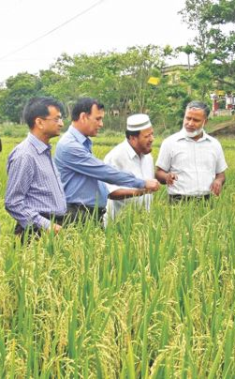
Strengthening Bangladesh’s agricultural technology system to reduce rural poverty
The proposed project will address the following issues:
Promoting institutional efficiency of agricultural research system: Enhancing the efficiency and effectiveness of the National Agricultural Research Systems (NARS) is vital to increase agricultural productivity.
Improving sustainability of funding for agricultural research: One major constraint to higher agricultural productivity is the low level of government expenditure on agricultural research.
Decentralizing the agricultural extension system: An agricultural extension system based on the bottom-up approach will be more responsive to farmers’ needs and is necessary to improve the overall performance of the agricultural sector.
Developing value chain and market linkages: An element of strengthening agricultural technology systems would be to promote the development of value chains of a few selected high value commodities based on comparative advantage, farmer preference and market demand.

Slide 19

Thank You

