Slide 1
CIRCULAR FLOW OF BANGLADESH

Slide 2
a study of economics in terms of whole systems especially with reference to general levels of output and income and to the interrelations among sectors of the economy.
Macroeconomics analyzes all aggregate indicators and the microeconomic factors that influence the economy. Government and corporations use macroeconomic models to help in formulating of economic policies and strategies.

Slide 3
Goals and Objectives
Low Inflation
Low Unemployment or Full Employment
Equilibrium in Balance of Payments
Fair Distribution of Income
Economic growth
Price stability

Slide 4
Economic growth is determined to establish a country's total production of goods and services. (GDP)
Full employment - The unemployment rate is calculated to establish the level of unemployment in a country.
Price stability - Economists are interested in what is happening to the prices of goods and services. They want to know what is happening to inflation. How do we calculate the inflation rate?
Income equality - Meaning, how is income distributed amongst individuals or households. Income equality is measured by the Gini coefficient and the Lorenz curve.
Balance of payment - This concerns a country's economic links with other countries. A country keeps record of its transactions, the amount of exports, imports, investment, savings and so on.

Slide 5
What Is a Closed Economy?
A closed economy is one that has no trade activity with outside economies. The closed economy is self-sufficient, which means no imports come into the country and no exports leave the country. The purpose of a closed economy is to provide domestic consumers with everything they need from within the country's borders.

Slide 6
Closed economies have no trade activity with outside economies.
There are no nations that have economies that are completely closed.
The need for raw materials that play a vital role as inputs to final goods makes closed economies inefficient.
A government may close off a specific industry from international competition through the use of quotas, subsidies, and tariffs.

Slide 7
Open economy
An open market is an economic system with no barriers to free-market activity. Anyone can participate in an open market, which is characterized by the absence of tariffs, taxes, licensing requirements, subsidies, unionization, and any other regulations or practices that interfere with naturally functioning operations.

Slide 8
Market-economy mostly free from trade barriers and where exports and imports form a large percentage of the GDP. No economy is totally open or closed in terms of trade restrictions, and all governments have varying degrees of control over movements of capital and labor.

Slide 9
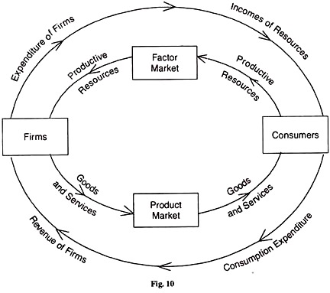
Circular flow of income

Slide 10
