Slide 1
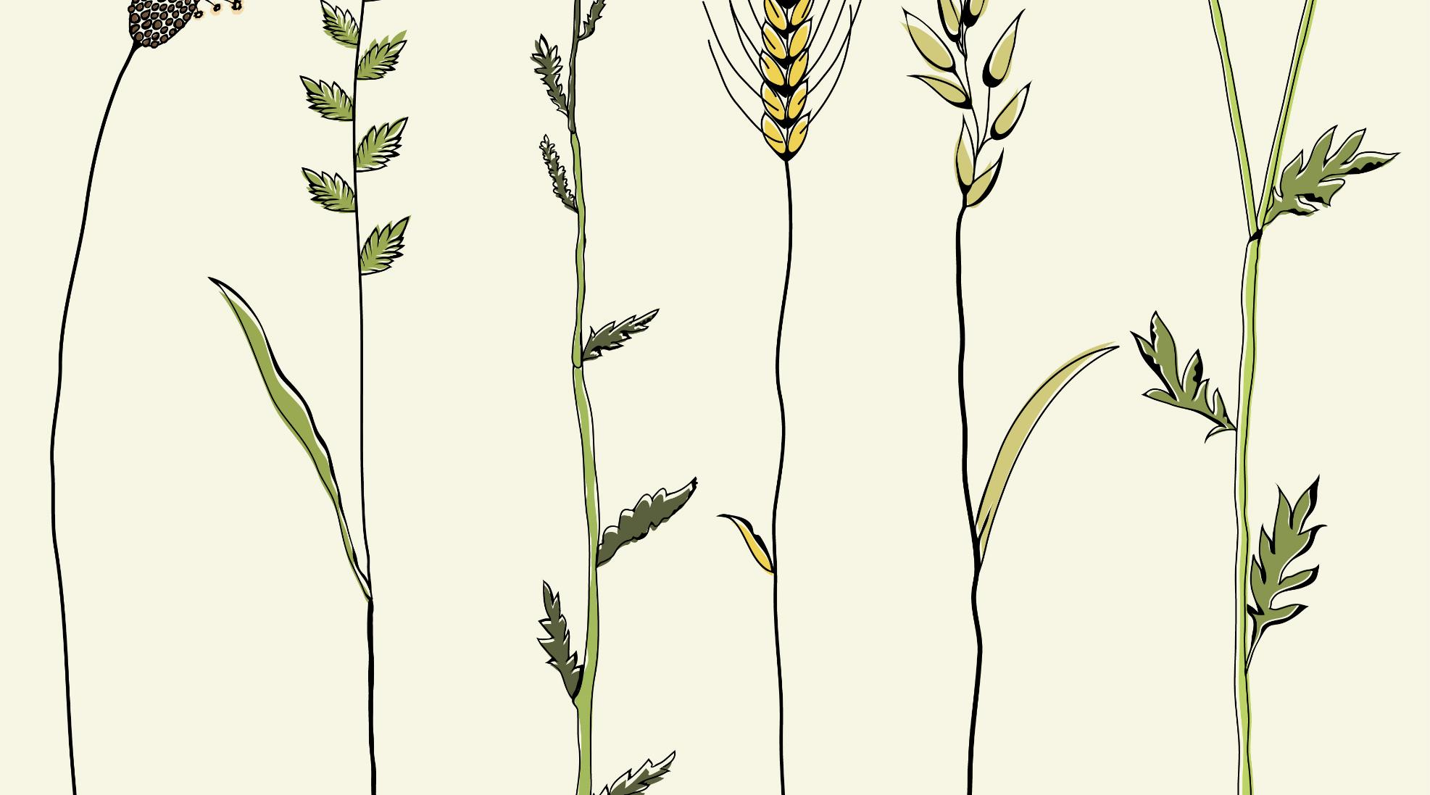
Poverty in Bangladesh 2021
Notes:
1

Slide 2
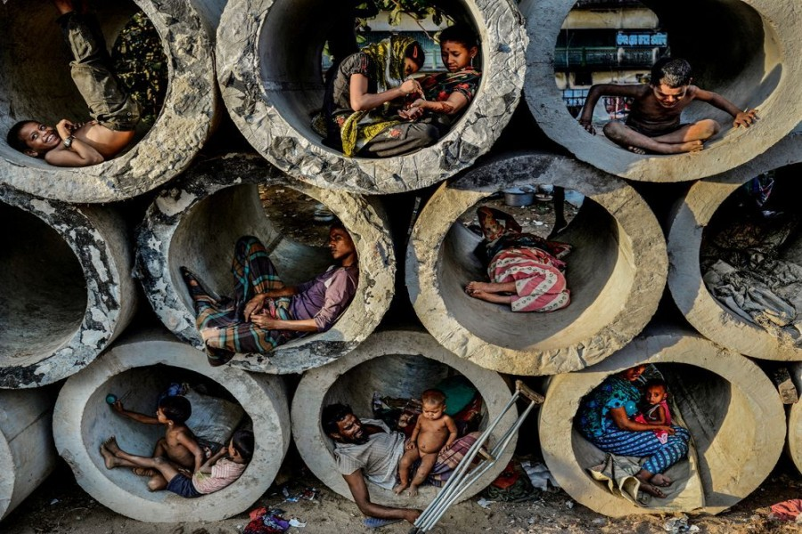

INTRODUCTION
Poverty is the pronounced deprivation of well-being. It is not being able to satisfy ones basic needs because one possesses insufficient money to buy services or lacks the access to services. Absolute poverty refers to the state of severe deprivation of basic human needs, which commonly includes food, water, sanitation, clothing, shelter, healthcare, education and information. Relative poverty refers to as being below some relative income threshold, where this threshold differs for each society or country. One may be relatively poor, without being in the state of absolute poverty; relative poverty is often considered as an indirect measure of income inequality.
Definition
Poverty is a state or condition in which a person or community lacks the financial resources and essentials for a minimum standard of living.
Notes:
2

Slide 3
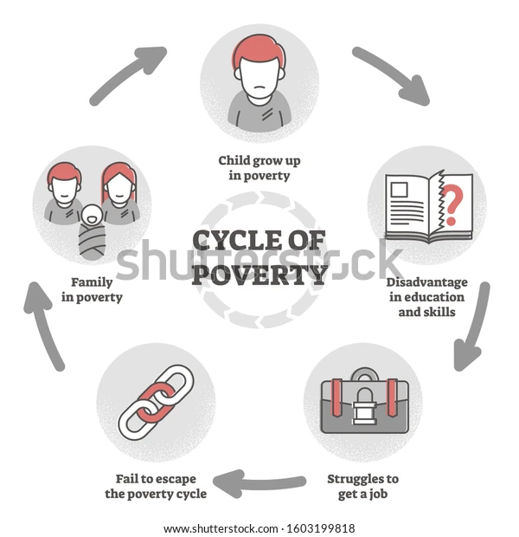

Slide 4
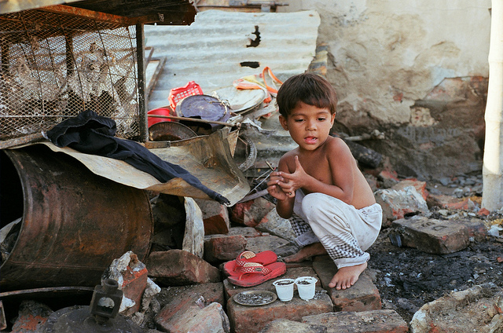
1. Absolute poverty.
2. Relative Poverty.
Type of Poverty
On the basis of social, economical and political aspects, there are different ways to identify the type of Poverty:
Notes:
4

Slide 5
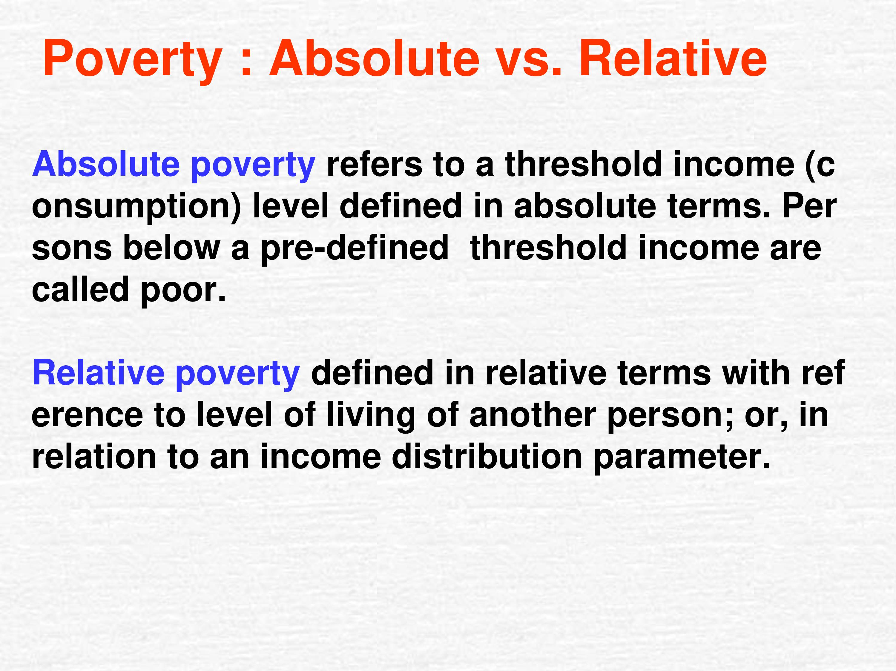

Slide 6
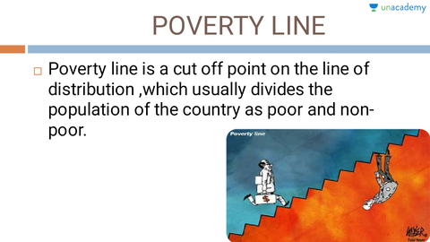
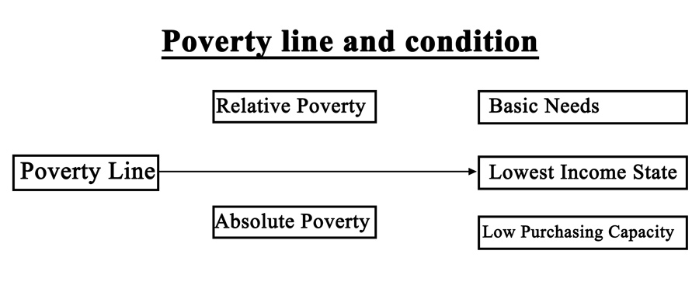

Slide 7
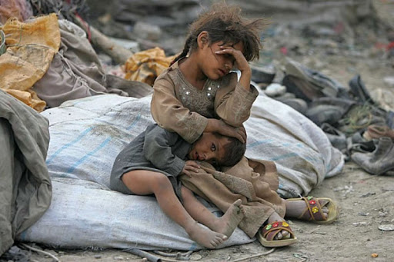
The most important one will be to take into account the impact of the long-persisting pandemic, especially, on the poverty situation. In truth, different studies conducted since the pandemic struck last year have come up with poverty figures that far outnumber those of the pre-pandemic times. Some recent estimates put the poverty rate at 42 per cent which is about twice the pre-pandemic rate at 21.6 per cent.
Notes:
7

Slide 8
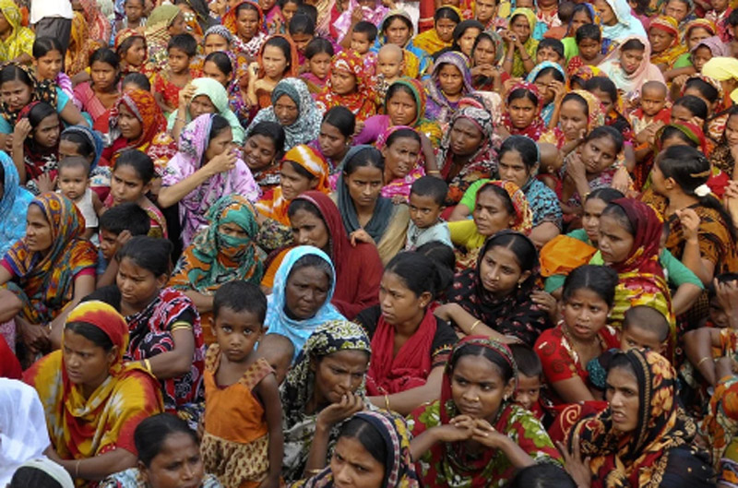
So, what is important is quality spending of the funds so allocated. That would require strengthening of the institutional capacity of the project implementing agencies concerned. Also, to improve things, strong monitoring and timely evaluation of those government agencies should be in place.
That apart, there should also be a well-defined policy on spending funds to mitigate poverty. Also, as part of the poverty reduction effort, the economists think, the government would do well to spend at least Tk. 51.32 billion per month. The amount, which is equivalent to 1.9 per cent of the country's average Gross Domestic Product (GDP), should be used for job creation and other related purposes.
Notes:
8

Slide 9
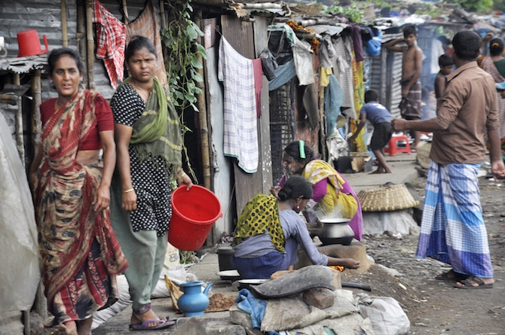
The survey also showed that one year into the Covid-19 pandemic, the poor across Bangladesh are still struggling with their livelihoods and facing emerging vulnerabilities, like mounting debt and dwindling savings. The situation of the urban slum dwellers is dire.
According to the findings of the survey, the employment scenario has improved from June, yet 8% of those who were employed before Covid-19 are currently out of work. The trend is particularly concerning for women — a third of the women employed before Covid-19 have remained unemployed since June.
In contrast, male unemployment came down from 16% to 6%.
In addition to the unemployment rate among female-headed households being five times higher than men, women also face greater re-entry constraints into labour markets, creating a double burden.
Notes:
9

Slide 10
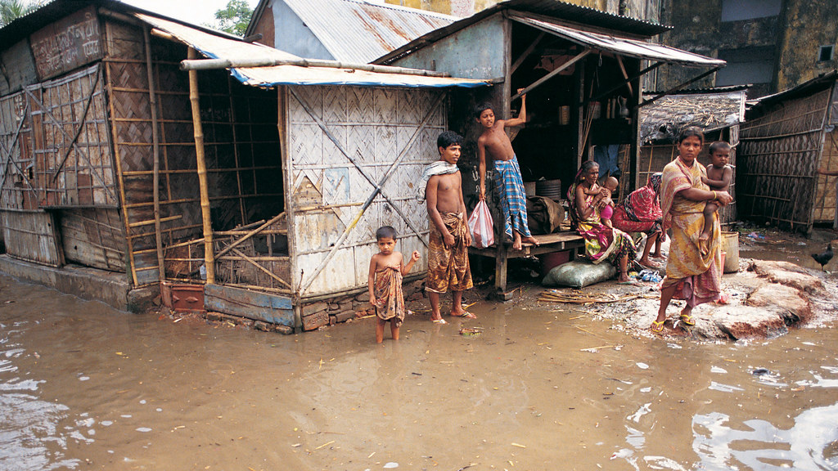
There are a few reasons behind the sudden and unprecedented rise in poverty in Bangladesh. First, the lockdown during March-May 2020 and the disruption of economic activities since the onset of Covid-19 resulted in unmatched havoc in the economy.
Notes:
10

Slide 11
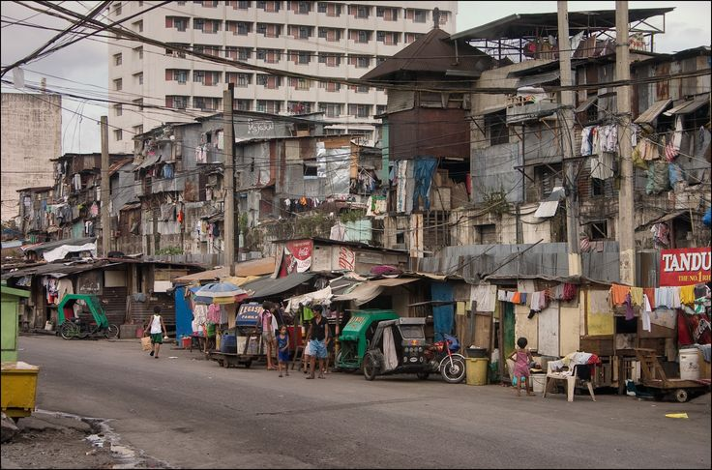
Second, Covid-19 also registered distressing effects on export-oriented sectors. In 2020, the dominant export sector, the readymade garments (RMG) industry, saw an unprecedented fall in export earnings by 17 percent. Recent surveys suggest that a large number of workers in the RMG sector also lost their jobs. Most other export sectors have also been negatively affected.
Notes:
11

Slide 12
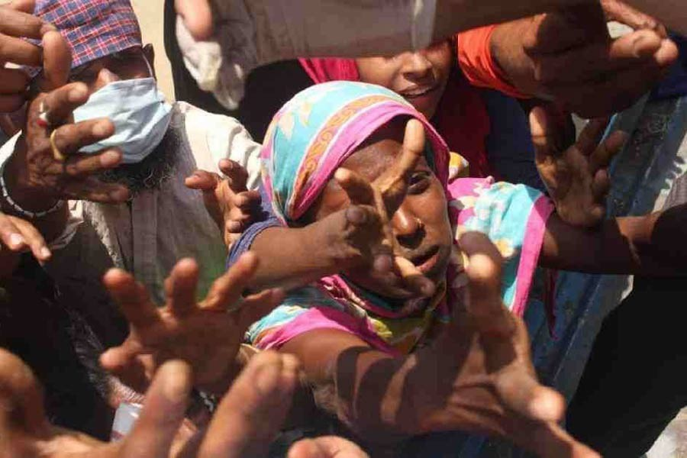
Third, despite that the official remittance inflow surged in 2020, SANEM's household survey showed that more than 80 percent of remittance-recipient households reported receiving less remittance during this period. This phenomenon indicates the possibility that the total amount of inflow of remittances, channeled through both formal and informal means, might have declined during most months in 2020. Informal channels of remittances remained clogged during the pandemic, and the demand for informal remittances also fell due to sluggish trade and tourism activities. All of these contributed to the sudden rise in poverty during the early months of the pandemic. Also, a high poverty rate persisted even by the end of 2020.
Notes:
12

Slide 13
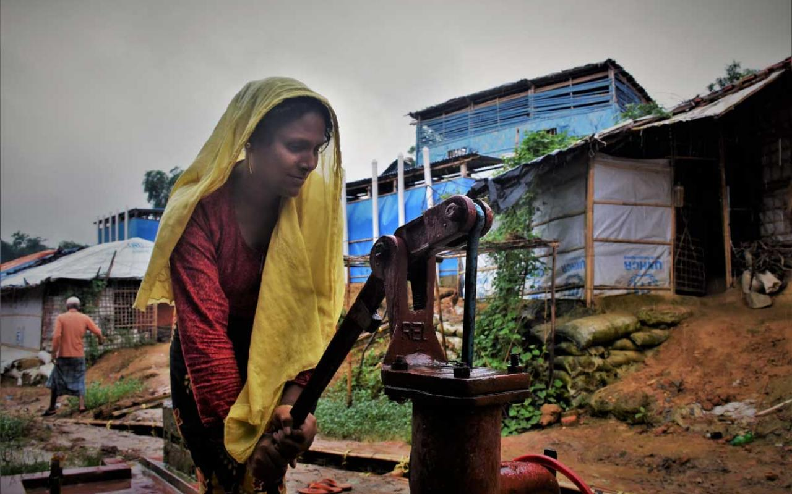
The policies and strategies for economic recovery should have a high priority for the revival of economic activities in domestic markets. The SMEs, in particular, should be given the utmost importance.
Social safety net coverage, including direct cash transfers and food assistance to the poor, should be widely expanded. However, there is a critical political economy issue related to the management of this expansion, since the country spends very little on social protection as a percentage of GDP.
Notes:
13

Slide 14



Students from distressed families are likely to bear a higher burden of this impact, and many of these students may permanently be out of the education system. Therefore, non-conventional, urgent and targeted programs are needed to address the agonies of students from these families.
The government should introduce new social safety net programs targeting the labour market. In this context, the employment guarantee scheme for a certain period of time for vulnerable populations can be seriously considered. The government should also form a Labour and Employment Commission to assess the current unprecedented situation and suggest necessary measures.
The Solution
14
Notes:
14

Slide 15

Thank You
Notes:
15

