Slide 1
Historical Background of Bangladesh
Liberation war of Bangladesh
Sunjida Khan
Senior Lecturer
Dept. of Business Administration
Daffodil International University

Slide 2
Objective of this class
Reveal the key grounds of the Six-Point Program
List-out the key demands of six-point program & their outcomes
Explore the context of liberation war: 1970 election
Explore the scenario of Bangladesh during the liberation war
Know the basic facts of the liberation of Bangladesh

Slide 3
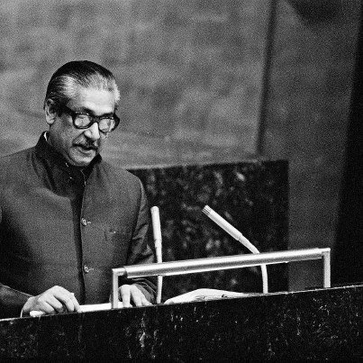
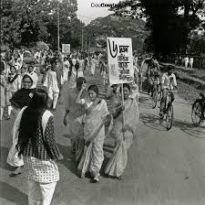
The Six-Point Movement
The Six-Point Program was a bold protest against the endless discrimination in economic, political and military sectors pursued against the people of Bengal by the Pakistani rulers. Under the leadership of Sheikh Mujibur Rahman, the Awami League played a historic role in redressing this discrimination and establishing the rights of the people of East Pakistan.
On 5 February 1966 opposition political parties met in a Conference in Lahore. In this Conference, Sheikh Mujib placed a Charter of Demands relating to political, economic and military rights of East Pakistan. This is known in history as the Six-Point Program.

Slide 4
Six Point were:
1. Formation and Nature of the Pakistan State: A true federal type of constitution shall have to be framed for Pakistan on the basis of the historic Lahore Resolution and the form of this Government will be Parliamentary. All elections should be held on the basis of universal adult franchise and direct voting and the sovereignty of the Legislatures shall be recognized.
2. Power of the central govt.: The Central Government shall have only two things, defense and foreign affairs; all other residuary powers shall rest with the provinces.
3. Power on currency: There shall be two separate but freely convertible currencies in the two regions of the country; or, one single currency for the whole country with the provision of two reserve banks in two provinces under a federal reserve bank.

Slide 5
Six Point were:
4. Power on revenue or tax collection: The regional governments shall have the authority to levy all taxes and, to collect them. There shall be a provision for paying the Central Government a portion of the revenues collected.
5. Power on foreign exchange: There should be separate accounts for the foreign exchange of the two regions. If necessary, the requirement of the Centre will be met by the two regions on the basis of equal rate or a rate as specified in the Constitution.
6. Separate military force: The federal states should have the authority to form regional armed forces or militia or Para-militia forces to protect the territories.

Slide 6
Outcomes of Six-Point Movement
For the People of East Pakistan
The oppressed and exploited people of East Pakistan welcomed this Six-Point Program as their Magna Carta or the Charter of Freedom. As a result, the popularity of the Six-Point Program increased day by day. Because-
a) It ensured Political Development (Point 1)
b) Administrative Development (Point 2)
c) Financial Development (Point 3,4,5)
d) Enlargement of Military Power (Point 6)
Finally,It was one of the major steps towards freedom of Bangladesh.
For the Government of Pakistan
The government became frightened at the popularity of the Six-Point demand and falsely termed the Six-Point demand as an anti-state Movement.
After this, the Government took recourse to repressive policy to check the Six-Point movement and arrested Sheikh Mujib along with many others on 8 May 1966. On 7 June 1966, a general hartal was called throughout the province for the release of the political prisoners.
The government imposed section 144 to prevent this hartal. But the people observed the hartal spontaneously.

Slide 7
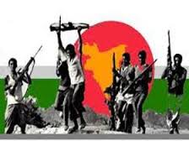
Liberation War of Bangladesh

Slide 8
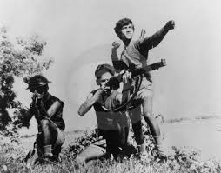
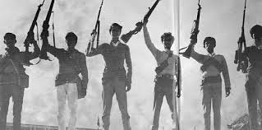
Background of the Liberation war
The Liberation war began on 26 March 1971 and ended with the liberation of Bangladesh on 16 December 1971. The armed struggle was the culmination of a series of events, situations and issues contributing to the progressively deteriorating relations between East and West Pakistan. The questions of land reforms, state language, inter-wing economic and administrative disparities, provincial autonomy, the defense of East Pakistan and many other consequential questions had been straining the relations between the two wings of Pakistan ever since independence of the country from Britain in 1947. [M.A. Rahim et. al., Bangladesher Itihas, P. 480]

Slide 9
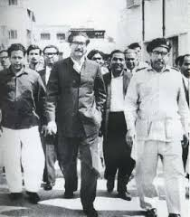
Background of the Liberation war
National Election in 1970: In the general elections held on 7 December 1970, the Awami League acquired an absolute majority. The Awami League secured 167 seats out of 169 National Assembly seats in East Pakistan (within total 313 seats) and won 288 out of 300 seats in the Provincial Assembly.
On 3rd January 1971, Shiekh Mujib conducted the oath of the peoples’ representatives’ at a meeting at the Race Course ground. Awami League members took an oath to frame a constitution on the basis of the six-point demand.
On 5th January, Zulfiker Ali Bhutto, the leader of the People’s Party, the majority party in West Pakistan, announced his readiness to form a coalition government at the centre with Awami League’s Parliamentary Party at a meeting of the members of the National Assembly of his party.
Seats | Parties
167 | Awami League
88 | Pakistan People's Party
44 | Other Parties
14 | Independents
313 | TOTAL
Figure: National Election 1970

Slide 10
Background of the Liberation war
On 27th January, Zulfiker Ali Bhutto arrived in Dhaka for talks with Mujib. The talks failed after three days of deliberations.
Announcement on 13 February, President Yahya Khan summoned the National Assembly to sit in Dhaka on 3rd March. But on 15 February, Bhutto announced that he would boycott the session and demanded that power be handed over to the majority parties in East Pakistan and West Pakistan.
In 16 February, Mujib was critical of Bhutto for putting forward such a demand and declared, “The demand of Bhutto sahib is totally illogical. Power is to be handed over to the majority party, the Awami League. The power now lies with the People of East Bengal.”
On 1st March, Yahya Khan abruptly postponed the National assembly session which prompted a storm of protest throughout Bangladesh. Sheikh Mujibur Rahman presided over a meeting of the Awami League working committee and called a countrywide general strike on 3rd March. After the success of the general Strike, He demanded that the President immediately transfer power to his party.

Slide 11
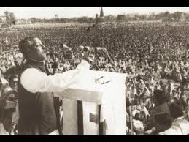
Historical Speech of 7 March
In this speech, he mentioned a further four-point condition to consider at the National Assembly Meeting on 25 March:
1. The immediate lifting of martial law.
2. Immediate withdrawal of all military personnel.
3. An inquiry into the loss of life.
4. Immediate transfer of power to the elected representative.
During this time, on 7 March Sheikh Mujibur Rahman made a historic address at a mammoth gathering at the Race Course which marked a turning point in the history of the Bengali nation. In his address, Sheikh Mujibur Rahman made specific charges against the Martial Law authorities which failed to transfer power to the elected representatives. At the end of his speech, he made a clarion call, saying:
“The struggle this time is the struggle for our emancipation,
The struggle this time is the struggle for independence.”

Slide 12
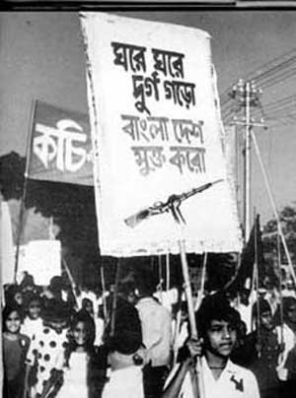
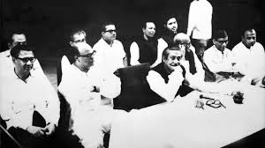
Background of the Liberation war
Sheikh Mujibur Rahman advised the people to prepare themselves for resistance movement against the enemy. He asked the people to start a non-cooperation movement against the government of Yahya Khan. The entire nation carried out his instructions. Every organization including government offices, courts, banks, insurance companies, mills and factories obeyed his order. In reality, he ruled an independent Bangladesh from 7 March to 25 March.
Meanwhile, President Yahya Khan and other leaders from West Pakistan came to Dhaka on 15 March to start a dialogue with Sheikh Mujib and his party. The dialogue began on the following day and continued intermittently down to 25 March morning. During the time, non-cooperation and hartals continued relentlessly. Students and leaders of various political parties had been declaring independence from March 2 and the spree continued down to 25 March.

Slide 13
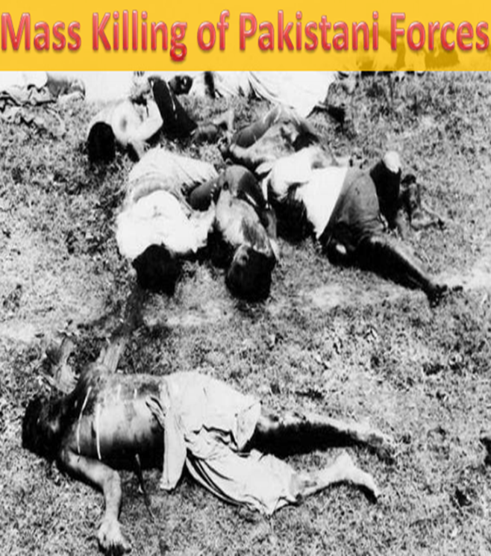
Operation Search light
While holding talks, the Pakistani military junta was bringing more troops to Bangladesh. No sooner the talks failed, the genocide began at mid-night of 25 March 1971, and the Pakistan army launched its brutal crackdown in Dhaka with operation Search Light. It was a planned military operation by Pakistan Army on 25th March. Before the beginning of the operation, all foreign journalists were systematically deported from East Pakistan. Although the violence focused on the provincial capital, Dhaka, it also affected all parts of East Pakistan. Residential halls of the University of Dhaka were particularly targeted. The only Hindu residential hall – the Jagannath Hall – was destroyed by the Pakistani armed forces, and an estimated 600 to 700 of its residents were murdered.
Source: Zunaid Kazi. "History : The Bangali Genocide, 1971

Slide 14
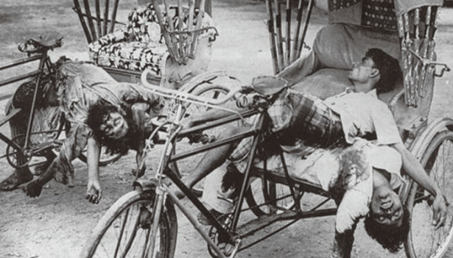
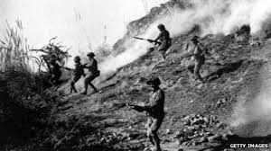
Operation Search light
The military forces killed everybody in sight on the footpath and destroyed everything on their way. The tanks roared through the streets of Dhaka blasting indiscriminately at the people and official and residential buildings. They gunned down clusters of settlements and set fire on them. The student halls of residence at Dhaka University were raided and numerous students residing there were brutally killed. They also killed many teachers of Dhaka University. The Hindu concentrated areas of old Dhaka were particularly targeted. They started killing the people, burnt their houses, looted their valuables and raped their women. The genocide that was perpetrated on the unarmed people was flashed in the world press.

Slide 15
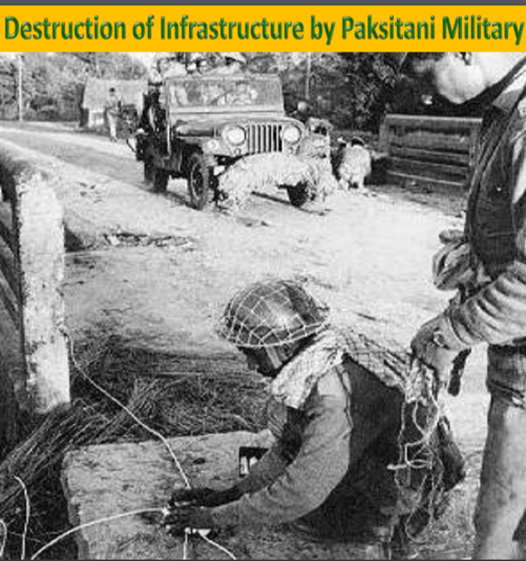
Genocide by Pakistani Army
According to the plan for operation Search Light two headquarters were established. Major General Rao Farman Ali with 57 Brigade under Brigedier Arbab was responsible for operation in Dhaka city and its suburbs while Major General Khadim Raja was given the responsibility of the rest of the province. Lieutenant General Tikka Khan assumed the overall charge of the operation.

Slide 16
Declaration of Independence
Moments after the crackdown began, Sheikh Mujibur Rahman declared independence at 12:30 a.m., 26 March. His declaration was transmitted through wireless to every place in the country. He said,
“This may be my last message; from this day onward Bangladesh is independent. I call upon the people of Bangladesh wherever you might be and with whatever you have, to resist the army of occupation to the last. Your struggle must go on until the last soldier of the Pakistan occupation army is expelled from the soil of Bangladesh. Final victory is ours.”
On 26 March 1971, Sheikh Mujibur Rahman was arrested from his Dhanmondi residence at 1:30 a.m.
Later Major Ziaur Rahman announced Bangladesh's independence on behalf of Sheikh Mujibur Rahman from Kalurghat radio station at Chittagong on 27th March’1971.
That was the historical background of the liberation war of Bangladesh.

Slide 17
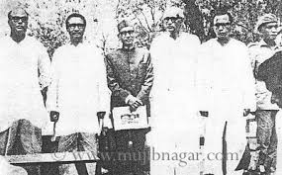
Provisional or Mujibnagar Government
The Provisional Government of the People's Republic of Bangladesh was established following the declaration of independence of East Pakistan on 10 April 1971. It was the supreme leadership of the Bangladeshi liberation movement. The provisional government was formed in the town of Mujibnagar (formerly Baidyanathtala). Its capital in exile was Calcutta. Its chief executive was Tajuddin Ahmad, the first Bangladeshi Prime Minister.
The Cabinet
President : Sheikh Mujibur Rahman
Vice President: Syed Nazrul Islam
Prime Minister: Tajuddin Ahmad
Defense Minister: Colonel M. A. G. Osmani
Finance Minister: Mansur Ali
Home Minister: A H M Qamaruzzaman
Foreign Minister: Khondaker Mostaq

Slide 18
Genesis of Mukti Bahini and Fight Back
The first attempt to coordinate war efforts was made in April 1971 in Teliapara (Sylhet), where a number of senior Bengali military commanders.
Later Mukti Bahini was dynamically formed by Bengali regulars and civilians after the proclamation of Bangladesh's independence.
Bangladesh divided into 11 sectors and 69 subsectors in order to consolidate war efforts. The position of commander in chief of the Bangladesh armed forces was given to Colonel M.A.G. Osmani.
The total number of fighters available at the moment included about 18000 regular forces, about 150 officers and around 130000 guerrillas. In addition to that, there were many independent forces of guerrillas.
Three brigades were formed in July, September and October and were named after respective commanders.
Z-force: Commander: Lt. Col. Ziaur Rahman
K-force: Commander: Lt. Col. Khaled Mosharraf
S-force: Commander: Lt. Col. K M Shafiullah
Besides Mukti Bahini, many other Bahinis were organized inside Bangladesh at different places to fight Pakistan Army. These Bahinis included Kader Bahini of Tangail, Mirza Bahini of Sirajganj, Akbar Bahini of Jhenaidah, Hemayet Bahini of Faridpur, Quddus Molla and Gafur Bahini of Barisal, and Aftab Bahini of Mymensingh.

Slide 19
Basics Of The War
Armed Conflict Lasted about 9 months – March 26, 1971 until December 16, 1971
Mujibnagar Government formed in mid April 1971. It was the government in exile of Bangladesh based in Kolkata, India, during the Bangladesh Liberation War.
In July, 1971 Bangladesh Forces (Mukti Bahini) was organized and formed for the independence struggle. There had 3 brigades and 11 sectors. M A G Osmani was Commander in Chief and Lt. Col Rab was Chief of Bangladesh Army Staff.
India declared war on West Pakistan after the Pakistani air force (PAF) struck Indian airfields on 3 December.
Finally Resulted in Bangladesh's victory from Pakistan on 16 December 1971.

Slide 20
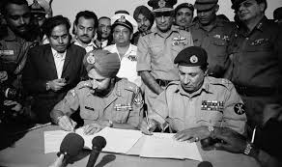
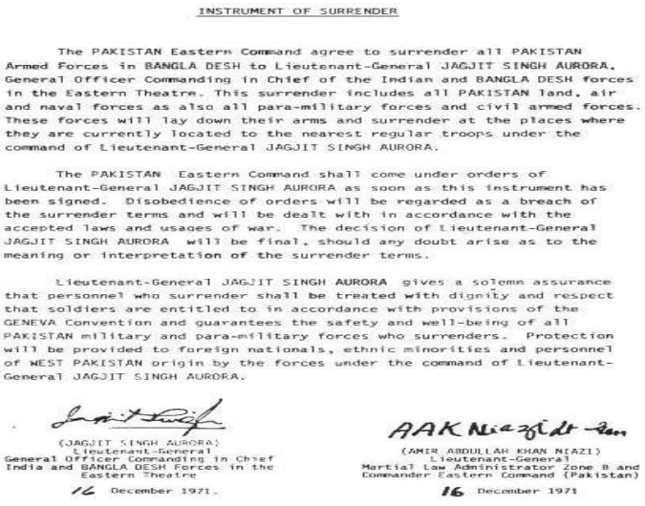
Surrender and aftermath
On 16 December 1971 at Racecourse Maidan, General Niazi signed the surrender document to joint forces Commander Lt. General Jagjit Singh Aurora.
It was the 22nd of December by the time the rest of the
Pakistani soldiers had surrendered all over Bangladesh.

Slide 21
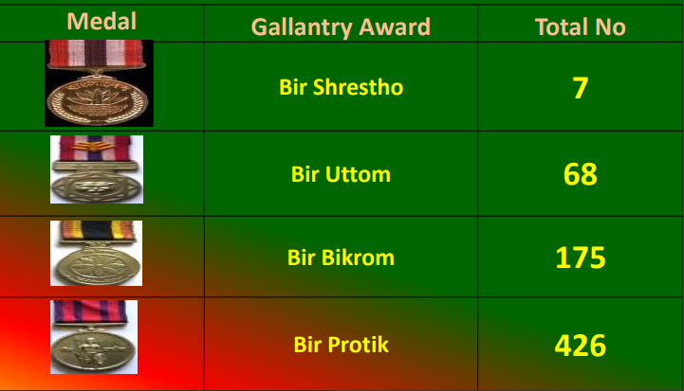
Gallantry Awards During Liberation War 1971

Slide 22
Role of UN, India, U.S.A and China in 1971
United Nations: UN condemned the human rights violations during and following Operation Searchlight, but it failed to defuse the situation politically before the start of the war. U. K. and France as a part of NATO supported the United Nations.
U.S.A: U.S supported Pakistan both politically and materially. US President Richard Nixon denied getting involved in the situation, saying that it was an internal matter. When Pakistan's defeat seemed certain, Nixon sent the aircraft carrier USS Enterprise to the Bay of Bengal.
U.S.SR: The Soviet Union supported Bangladesh and Indian armies, as well as the Mukti Bahini.
China: China supported Pakistan which as an ally of them and supplied arms.
India: Prime Minister Indira Gandhi toured a large number of countries in a bid to create awareness of the Pakistani atrocities against Bengalis. An estimated 10 million Bengalis got shelter in the Indian states of Assam and West Bengal. The Indian Prime Minister Indira Gandhi quickly decided that it was more effective to end the genocide by taking armed action against Pakistan. Finally, the Indian military directly involved with Mukti Bahini and fought against the Pakistan Army that prompted the surrender of the Pakistan Army quickly.

Slide 23
Chapter Related Questions
What was the historical background of Six-Point Movement?
What was Six-Point Program and what were they?
Explain the outcomes/significance of Six-Point Program.
‘Six-point Program was the Charter of Freedom’-explain this statement.
What was the historical background of the liberation war of Bangladesh?
Thank you all!!!

Slide 24
Long Live Bangladesh

