Slide 1
Daffodil International University
Dept. of CSE
Information Security
Lecture 6
AI and ML in Information Security

Slide 2
What’s the first thing you think of when you hear “artificial intelligence,” “machine learning” or “deep learning”?
?

Slide 3
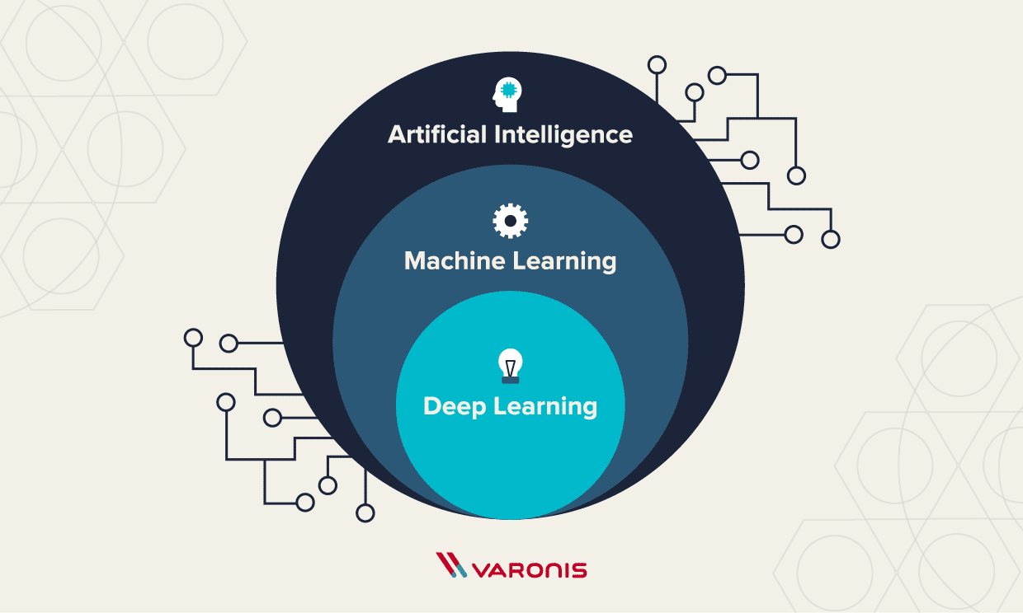
AI and ML in Information Security
An “intelligent” computer uses AI to think like a human and perform tasks on its own.AI analyzes relationships between threats like malicious files, suspicious IP addresses or insiders in seconds or minutes.
Machine learning is how a computer system develops its intelligence. Machine learning can detect malware in encrypted traffic by analyzing encrypted traffic data elements in common network telemetry.
Fig:1 Hierarchy of AI, ML and DL

Slide 4
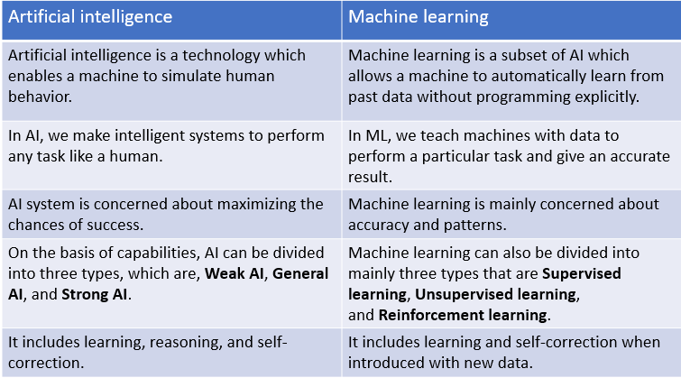
Comparisons between AI and ML
An “intelligent” computer uses AI to think like a human and perform tasks on its own. Machine learning is how a computer system develops its intelligence.
Table:1 Comparisons between AI and ML

Slide 5
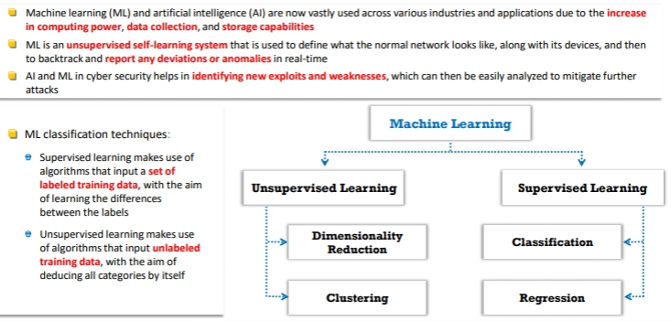
Role of AI and ML in Information Security
AI and ML are now vastly used across various industries due to the increase in computing power, data collection, and storage capabilities.
Helps to identify new exploits and weaknesses in cyber security, which can then be easily analyzed to mitigate further attacks
Helps to define how the normal network looks like along with its devices, and then to backtrack for reporting anomalies
Reduces the pressure on security professionals and alerts them.
Helps to analyze and process details and trends of various attacks.
Fig:2 Classification Techniques of ML

Slide 6
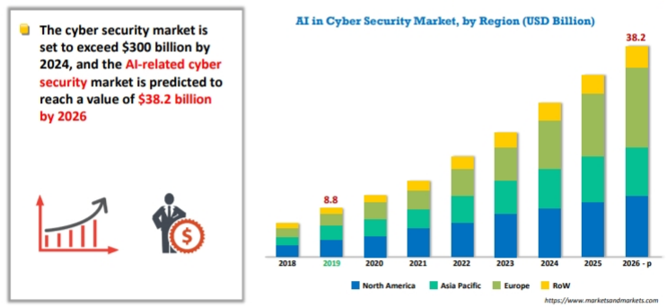
Role of AI and ML in Information Security(Contd.)
Fig:3 AI in Security Market

Slide 7
AI and ML Application Areas
Mobile security
Anti-fraud and identity management
Predictive intelligence
Behavioral analytics and anomaly
Automated security
Cyber-risk management
IoT security
Deception security

Slide 8
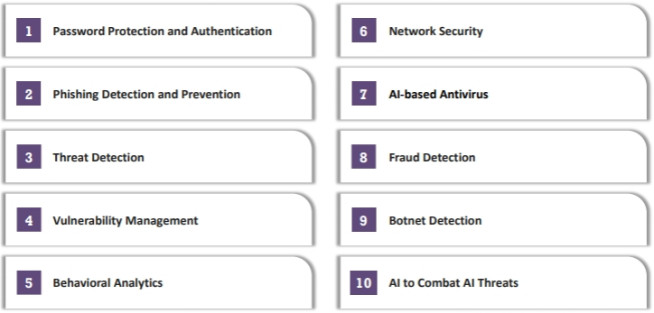
How Your Organization’s Security Can Benefit from AI and ML
Fig:4 Different ways that AI and ML safeguards Industry

Slide 9
Thank You

