Slide 1
Daffodil International University
Dept. of CSE
Information Security
Lecture 7
Malware

Slide 2
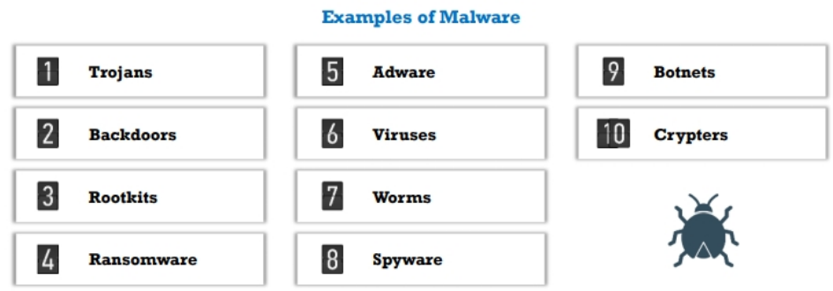
What is Malware?
Malware is malicious software that disables or damages computer systems and give limited or full control of the systems to the malware creator for the purpose of theft or fraud.
Fig 1: Types of Malware

Slide 3
What is Malware? (Contd.)
Malware programmers develop and use malwares to;

Slide 4
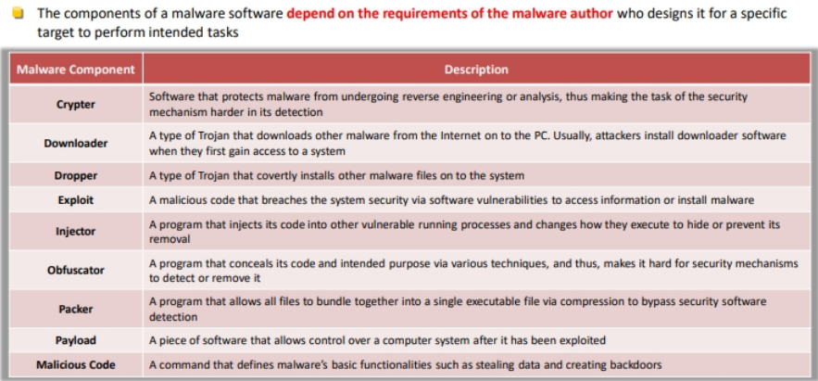
Malware Components
The components of the malware software depends on the requirements of the malware author who designs it for a
Specific target to perform intended tasks.
Table 1: Components of Malware

Slide 5
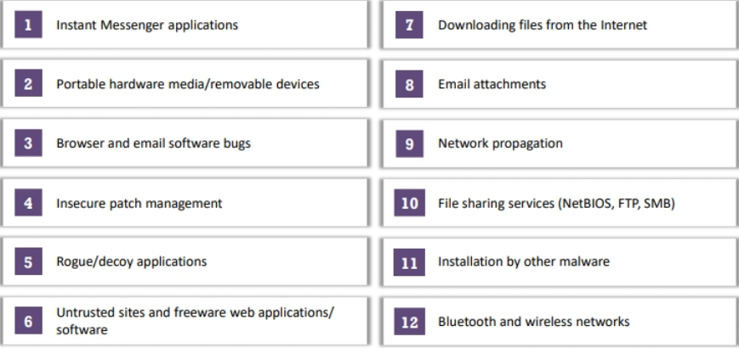
Ways for Malware to Enter

Slide 6
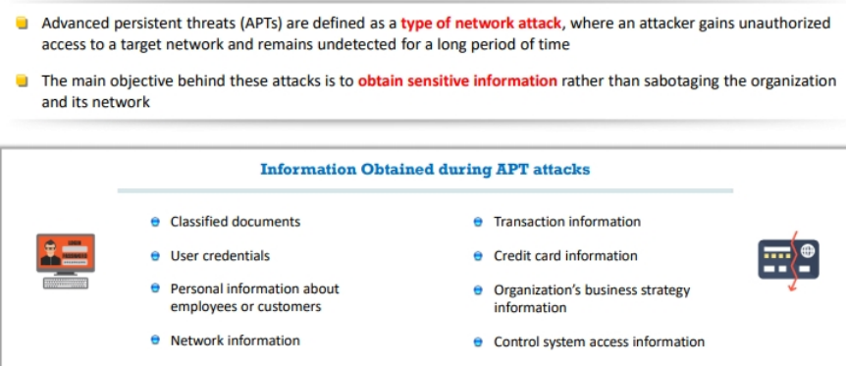
APT(Advanced Persistent Threats)
APTs are defined ad a type of network attack, where an attacker gains unauthorized access to a target network and remains undetected for a long period of time
The main objective behind these attacks is to obtain sensitive information rather than sabotaging the organization and its network

Slide 7
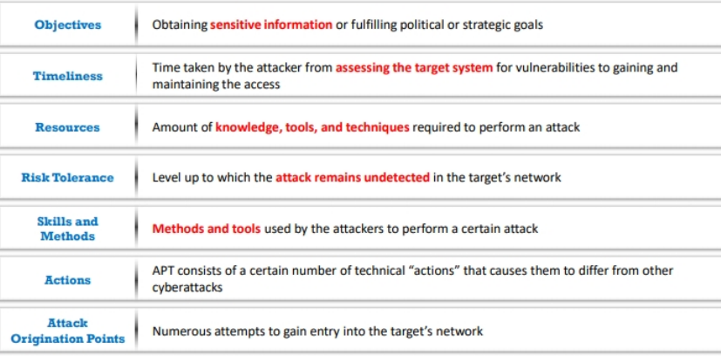
APT Characteristics

Slide 8
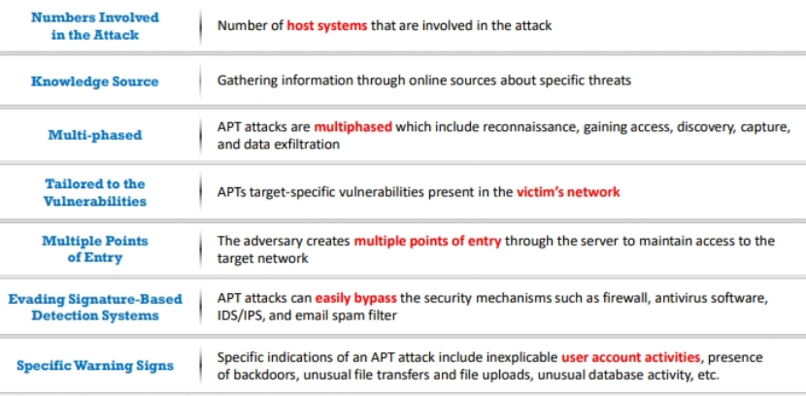
APT Characteristics(Contd.)

Slide 9
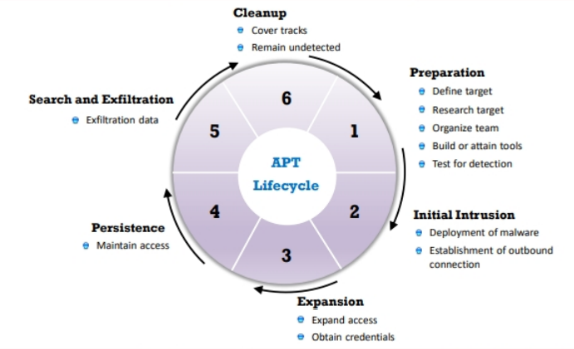
APT Lifecycle
Fig 2: APT Lifecycle

Slide 10
Best Practices to Defend Against Malware
Update all network, application, and device software promptly
When alerted to potential vulnerabilities, patch promptly
Boost your organization’s IT literacy with ongoing cybersecurity training so they recognize the threats posed by malware attacks
Architect a premium network security model
Avoid untrusted software and ensure that every device is protected by firewall
Avoid opening attachments received from unknown senders
Pay attention to the instructions while downloading files from internet
Consider anti-malware solutions that can aid your existing infrastructure
Understand malware is a reality; prepare for the worst, and plan your response to a malware attack

Slide 11
Thank You

