Slide 1
Basic Economics: Terms and definitions
Three Questions of an Economic Organization
Economic System
Microeconomics and Macroeconomics
Goods and Services
Cost Concept
Demand, Supply, Demand Supply Curves, Equilibrium
Elasticity of Demand
Utility, Total Utility (TU), Marginal Utility (MU)
Inflation
Gross Domestic Product (GDP) and Gross national Income (GNI)
Purchase Power Parity (PPP)
Per Capita Income (PCI)

Slide 2
Three Questions/Problems of economic Organization
Every society must have to determine what goods are produced, how these goods are made, and for whom these goods are produced. These three fundamental questions of economic organization- what, how and for whom are as crucial now a days.
What goods are produced and in what quantities?
A society must determine how much of each of the many possible goods and services it will make, and when they will be produced. Will we paddy or jute in our field? A few high breed paddy or much local paddy will produce? Will we use scarce resources to produce many consumption goods? Will we produce fewer consumption goods and more investment goods? Every society has to face this type of question or problem, We may call this problem as problem of choice.
How are goods produced?
A society must determine who will do the production, with what resources, and what production techniques they will use. Is electricity generated from natural gas, coal, solar or nuclear power?
For whom are goods produced? One key task for a society is to decide who gets to eat the fruit of the economic efforts. Or how is the national product divided among different households? Are many people poor or rich? Do high incomes go to teacher, Doctor, Businessman or landlords? These type of problem is called to be problem of distribution.

Slide 3
Economic System
One key task for Economics is to study and explain the different ways that a society can answer the question of what, how and for whom. Different societies are organized through alternative economic system and economic studies the different mechanism that a society can use to allocate its scarce resources. Different type of economic system prevails in different countries of the world. They are
  1. Market Economy
  2. Command Economy
  3. Mixed Economy.
Market Economy
A market economy is one in which individuals and private firms make the major decision about production and consumption. In this market consumers are sovereign. Firms produce the commodity that yield the highest profit. From here we can get answer of the question ‘What’. Firms use the techniques of production which are least costly. From here we can get answer of the question ‘How’. Consumption is determined by individual decisions. We get the answer of question for ‘whom’. Like united states of America, most of the democratic countries, economic question are solved by the market.
Example: - In the united states of America most economic question are solved by the market. Hence their economic system can be treated as Market Economy.

Slide 4
Economic System
Command Economy
A command Economy is one in which the government makes all decisions about production and distribution. Soviet Union during most off previous century, the government owns most of the means of production (land and capital); it also owns and directs the operations of enterprise in most industries; it is the employer of most workers and tells them how to do their jobs; and the government in a command economy decides how the output of the society is to be divided among different goods and services. In this economy, the government answers the major economic questions through its ownership of resources and its power to enforce decisions.
Example: -During the most of the 20th century Soviet Union is operated by Command Economy
Mixed Economy
In recent time no contemporary society falls completely into their market economy or command economy. Rather all exception of two or three, societies are mixed economies with element of market and command. Like market economy, here the private ownership of property, earning of profit and individual initiative prevail. But, there is also government control over the economic activities at the private level. Besides, some large scale and basic industries and important commercial venture are run in the public sector
Example: Though most decisions in the USA, UK and Japan are made in market place but the government plays an important role in modifying the functioning of the market. Mixed Economy also exits in Bangladesh where both market and government plays role simultaneously in production, distribution, consumption etc.

Slide 5
Economic Terms:
Micro Vs Macro
Microeconomics
Microeconomics: The branch of economics that studies the behavior of an individual consumer, firm, family is known as Microeconomics.
Macroeconomics
Macroeconomics: The branch of economics that studies the behavior of the whole economy, (both national and international) is known as Macroeconomics.

Slide 6
Microeconomics vs. Macroeconomics
Economic analysis is divided into two main branches microeconomics and macroeconomics.
Microeconomic
Greek word Micro means ‘small’. Microeconomic is the study of decisions of the people and business and the interaction of those decisions in markets. The goal of microeconomics is to explain the prices and quantities of individual goods and services. Microeconomic also studies the effect of government regulation and taxes on the prices and quantities of individual; goods and services.
Example: Microeconomic studies the factors that determine the prices and quantities of a product (say cement) of cement factory.
Macroeconomics
Macro means Big. Macroeconomic is the study of national economy as well as global Economy and the way that a Economic system work. The goal of macroeconomics is to explain general price level, national income, Employment, Production. Macroeconomics also studies the effect of Government actions-taxes, spending and the defect on total incomes and price level.
Example: Macroeconomic studies the forces that the average cost of living, the total value of production in a country.

Slide 7
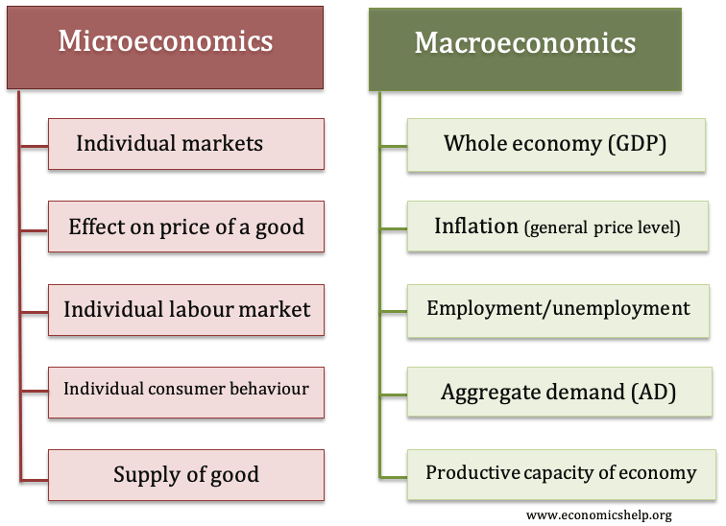
Examples of micro and macro economics

Slide 8
Goods and Services
There is a major difference between goods and services. Goods and services based on both tangible as well as intangible factors. Goods are basically objects or products which have to be manufactured, stored, transported, market and sold. Square Pharmaceutical, BMW, Adidas are some companies manufacturing goods.
Services on the other hand are output of individuals and they can be collective or individualistic action or performance by an individual. For example a barber or a chartered accountant is giving individual services. Airlines on the other hand have airplanes which are a produced but travelling by airplanes is a service (airlines are one of the most competitive service sectors today).
Thus the different between goods and services is based on tangibility. Where goods are tangible in nature, services are mostly intangible. The classic rules which defined services were intangibility, heterogeneity, perishability and variability. However, although the old rules are applicable even today, several new rules have been added to define the difference between goods and services.

Slide 9
BASIS FOR COMPARISON | GOODS | SERVICES
Meaning | Goods are the material items that can be seen, touched or felt and are ready for sale to the customers. | Services are amenities, facilities, benefits or help provided by other people.
Nature | Tangible | Intangible
Transfer of ownership | Yes | No
Evaluation | Very simple and easy | Complicated

Slide 10
Return | Goods can be returned. | Services cannot be returned back once they are provided.
Separable | Yes, goods can be separated from the seller | No, services cannot be separated from the service provider.
Variability | Identical | Diversified
Storage | Goods can be stored for use in future or multiple use. | Services cannot be stored.
Production and Consumption | There is a time lag between production and consumption of goods. | Production and Consumption of goods occurs simultaneously.

Slide 11
Goods
Normal Goods are goods for which demand goes up when income is higher and for which demand goes down when income is lower.
Inferior Goods are goods for which demand falls when income rises.
Substitutes are goods that can serve as replacements for one another; when the price of one increases, demand for the other goes up. Perfect substitutes are identical products.
Complements are goods that “go together”; a decrease in the price of one results in an increase in demand for the other, and vice versa.

Slide 12
Consumer Goods & Producer Goods
CONSUMER GOODS are tangible goods that are purchased for direct consumption to satisfy a human need or want. This is in contrast to producer goods, where are purchased as an input to produce another good.
PRODUCER GOODS/CAPITAL GOODS, also called intermediate goods, in economics, goods manufactured and used in further manufacturing processing or resale. Producer goods either become part of the final product or lose their distinct identity in the manufacturing stream
Consumer goods are those that are purchased for direct consumption. ‘Consumption’ in this context does not necessity mean consume, as in eat. There are plenty of consumer goods that no one would consider eating, such as clothes. Clothing is a goods purchased to satisfy a human need – the need to be clothed.
Another way to identify a consumer good is to think of a production line. The goods used as inputs at the beginning of the production line are not consumer goods; these would be considered capital or producer goods, and might include cloth, plastic, or other materials. The goods that is produced at the end of production line (the clothing line) is a consumer good. It’s a final end product made for a buyer to consume.

Slide 13
Types of Consumer Goods Consumers buy an enormous variety of products. Some are goods that will last for many years. Other items are consumed on the spot when we purchase them. To business people and economists, these are known as durable and non-durable goods. The production of durable and non – durable goods is the basis for important measures of economic trends.
  Durable goods tend to have a long useful life. For statistical purposes, a durable good is expected to last three years, according to the Economics and Statistics Administration. Goods consumed in a short time or that have useful lives of less than three years are classified as non- durable. The dividing line isn’t always rigid. For example, people sometimes use a piece of clothing for more than three years. Consumer durable goods include items like furniture, jewelry and cars. Large appliance such as stoves and washing machines are durable goods. The category also includes defense and commercial procurement of heavy equipment and assets like aircrafts, trucks and ships.
  Non-durable goods include food, medicines and other consumable, as well as products that last a limited lifetime such as clothing, shoes and small electronic devices.

Slide 14
Cost Concept
Cost: Cost, in common usage, the monetary value of goods and services that producers and consumers purchase. In a basic economic sense, cost is the measure of the alternative opportunities foregone in the choice of one goods or activity over others.
Total Cost (TC): Total cost of a firm is the sum total of all the explicit and implicit expenditures incurred for producing a given level of output. It represents the money value of the total resources required for production of goods and services.
Average Cost (AC): Average Cost is the cost per unit of output, that is average cost equals the total cost divided by the number of units produced (N). If TC = Tk. 500 and N = 50 then AC = Tk. 10.

Slide 15
Cost concept
Fixed cost (FC): Fixed cost are that part of the total cost of the firm which does not change with output. Expenditures on depreciation, rent of land and buildings, property taxes, and interest on bonds are example of fixed costs. Given a capacity, fixed cost remains the same irrespective of actual output.
Variable cost (VC): Variable cost on the other hand, change with changes in output. Examples of variable costs are wages and expenses on raw material.
Marginal cost (MC): Marginal cost is the extra cost of producing one additional unit. At a given level of output, one examines the additional cost being incurred in producing one extra unit and this yields the marginal cost. For example, it TC of producing 100 units is Tk. 10,000 and the TC of producing 101 units is Tk. 10,050, then MC at N = 101 equals Tk. 50. Marginal cost refers to the change in total cost associated with a one-unit change in output.

Slide 16
Actual Costs: Actual costs are those costs, which a firm incurs while producing or acquiring a goods or services like raw materials, labor, rent, etc. Suppose, we pay Tk. 400 per day to a worker whom we employ for 10 days, then the cost of labor is Tk. 4000
Explicit Cost: An explicit cost is a cost that occurs, is easily identified, and is accounted for in business documents or financial statements. It represents clear, obvious cash outflows that reduce a business's bottom-line profitability. Examples of explicit costs would be items such as wage expenses, rent, or lease costs; it is easy to identify the sources of those cash outflows and the business activities to which the expenses are attributed.
Implicit Cost: An implicit cost is any cost that has already occurred but is not necessarily shown or reported as a separate expense. It represents an opportunity cost that arises when a company allocates internal resources toward a project without any explicit compensation for the utilization of resources. This means that when a company allocates its resources, it always forgoes the ability to earn money off the use of the resources elsewhere.

Slide 17
Opportunity Cost
Opportunity cost is defined as the value of a resource in its next best use. For example, Mr. Rahim is currently working with a firm and earning TK 5 lakhs per year. He decides to quit his job and start his own small business. Although, the accounting cost of Mr. Rahim’s labor to his own business is 0, the opportunity cost is TK. 5 lakhs per year Therefore, the opportunity cost is the earnings he foregoes by working for his own firm.

Slide 18
Accounting Cost and Economics Cost
Accountants always have been concerned with firm’s financial statements. Accountants tend to take a retrospective look at firms finances because they keep trace of assets and liabilities and evaluate past performance. The accounting costs are useful for managing taxation needs as well as to calculate profit or loss of the firm. On the other hand, economists take forward-looking view of the firm. They are concerned with what cost is expected to be in the future and how the firm might be able to rearrange its resources to lower its costs and improve its profitability. They must therefore be concerned with opportunity cost. Since the only cost that matters for business decisions are the future costs, it is the economic costs that are used for decision-making. Accountants and economists both include explicit costs in their calculations.

Slide 19
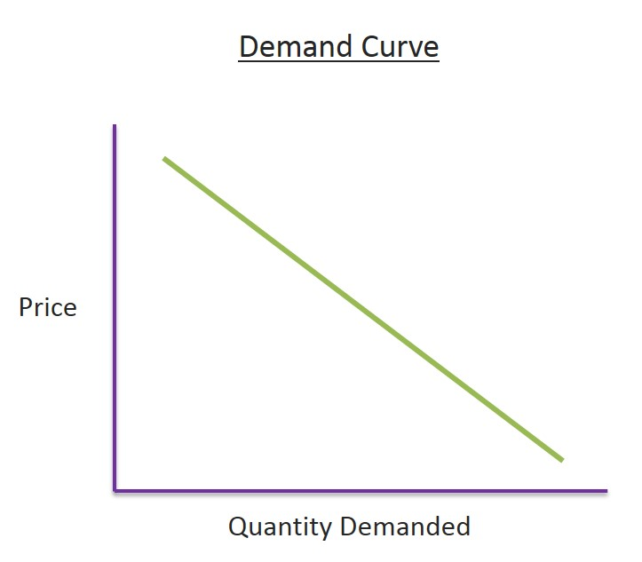
Demand and Supply
Demand: Demand in economics is the consumer's desire and ability to purchase a goods or services. It's the underlying force that drives economic growth and expansion. Without demand, no business would ever bother producing anything.
Price is inversely proportionate to demand, If price increase, demand will be lower

Slide 20
Determinants of Household Demand
A household’s decision about the quantity of a particular output to demand depends on:
The price of the product.
The income available to the household.
The household’s amount of accumulated wealth.
The prices of substitute products available to the household.
The household’s tastes and preferences.
The household’s expectations about future income, wealth, and prices.

Slide 21
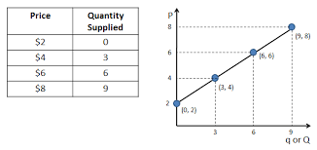
Supply
Supply: Supply means the quantities that a seller is willing and able to sell at different prices. It is obvious that if the price goes up, seller will offer more for sale.
But if the price goes down, seller will be reluctant to sell and will offer less to sell.

Slide 22
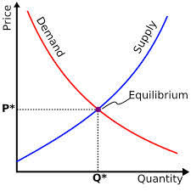
Demand-Supply Curve

Slide 23

The Law of Supply
The law of supply states that there is a positive relationship between price and quantity of a good supplied.
Higher price ensures greater quantity of supply.

Slide 24
Equilibrium
In economics, economic equilibrium is a state where economic forces such as supply and demand are balanced and in the absence of external influences the (equilibrium) values of economic variables will not change.
For example, in the standard textbook model of perfect competition, equilibrium occurs at the point at which quantity demanded and quantity supplied are equal.

Slide 25
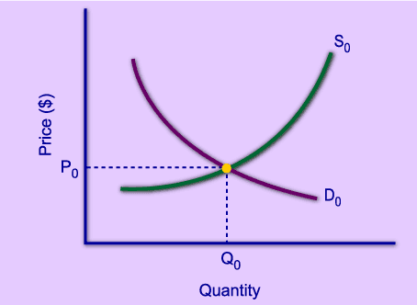
Market Equilibrium
The operation of the market depends on the interaction between buyers and sellers.
An equilibrium is the condition that exists when quantity supplied and quantity demanded are equal.
At equilibrium, there is no tendency for the market price to change.

Slide 26
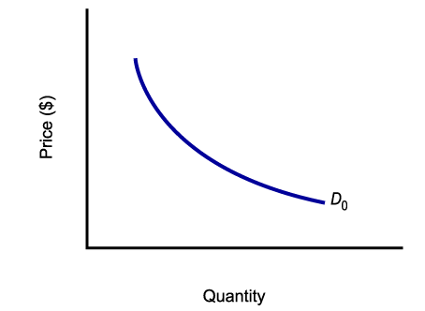
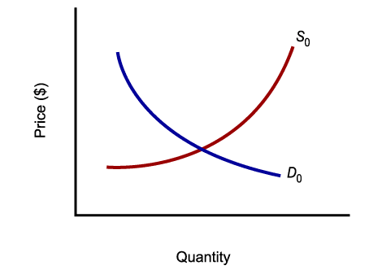
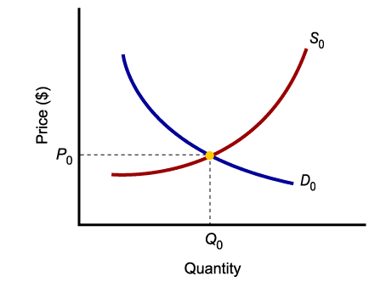
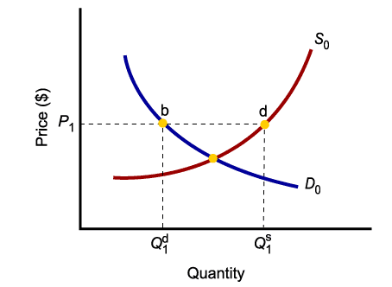
Market Equilibrium
Only in equilibrium is quantity supplied equal to quantity demanded.
At any price level other than P₀, the wishes of buyers and sellers do not coincide.

Slide 27
Elasticity of Demand
Elasticity of demand is an important variation on the concept of demand. Demand can be classified as 1.Elastic demand, 2. Inelastic demand 3.Unitary demand.
An elastic demand is one which the change in quantity demanded due to a change in price is large. An inelastic demand is one in which the change in quantity demanded due to a change in price is small.
The formula for computing elasticity of demand is:
(Q1-Q2) / (Q1+Q2)
(P1-P2) / (P1+P2)
If the formula creates a number greater than 1, the demand is elastic. In other words, quantity changes faster than price.
If the number is less than 1, demand is inelastic. In other words, quantity changes slower than price.
If the number is equal to 1, elasticity of demand is unitary. In other words, quantity changes at the same rate as price.

Slide 28
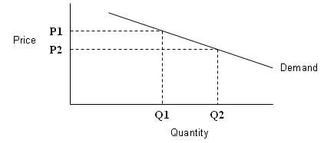
Elastic Demand
Elasticity of demand is illustrated here. Note that a change in price results in a large change in quantity demanded. An example of products with an elastic demand is consumer durables. These are items that are purchased infrequently, like a washing machine or an automobile, and can be postponed if price rises. For example, automobile rebates have been very successful in increasing automobile sales by reducing price.
Close substitutes for a product affect the elasticity of demand. If another product can easily be substituted for your product, consumers will quickly switch to the other product if the price of your product rises or the price of the other product declines. For example, beef, pork, poultry are all meat products. The declining price of poultry in recent years has been caused the consumption if poultry to increase, at the expense of beef and pork. So products with close substitutes tend to have elastic demand.

Slide 29
Problem1:
An example of computing elasticity of demand using the formula above is shown below. When the price decreases from $10 per unit to $8 per unit, the quantity sold increases from 30 units to 50 units..
Elasticity example
P1 = $10
P2 = $8
Q1 = 30
Q2 = 50
(Q1-Q2) / (Q1+Q2) _ (50-30) / (50+30) _ 20/80
(P1-P2) / (P1+P2) ($10-$8) / ($10+$8) $2/$18
1/4 _ 1x9 _ 9 _ 2.25
1/9 1x4 4

Slide 30
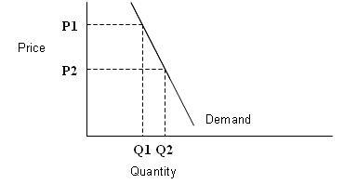
Inelastic Demand
Inelastic Demand:
Inelastic demand is shown in Figure, note that a change in price results in only a small change in quantity demanded. In other words, the quantity demanded is not very responsive to changes in price.
Examples of this are necessities like food and fuel. Consumers will not reduce their food purchases if food prices rise, although there may be shifts in the types of food they purchase. Also, consumers will not greatly change their driving behavior if gasoline prices rise.
Figure: Inelastic demand

Slide 31
Problem2
An example of computing inelasticity of demand using the formula above is shown below. When the price decreases from $12 to $6 (50%), the quantity of demand increases from 40 to only 50 (25%).
P1 = $12
P2 = $6
Q1 = 40
Q2 = 50
(Q1-Q2) / (Q1+Q2) _ (50-40) / (50+40) _ 10/90
(P1-P2) / (P1+P2) ($12-$6) / ($12+$6) $6/$18
1/9 _ 1x3 _ 3 _ .33
1/3 1x9 9
This does not mean that the demand for an individual producer is inelastic. For example, a rise in the price of gasoline at all stations may not reduce gasoline sales significantly. However, a rise of an individual station’s price will significantly affect that station’s sales.

Slide 32
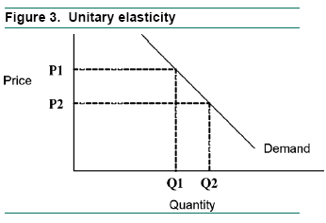
Unitary Elasticity:
If the elasticity coefficient is equal to one, demand is unitarily elastic as shown in Figure 3. For example, a 10% quantity change divided by 10% price change is one. This means that a one percent change in unitary occurs for every one percent change in price.

Slide 33
Utility/Total Utility and Marginal Utility
Utility: Utility is the satisfaction that a person derives from the consumption of a good or service.
Total utility - It is total psychological satisfaction which a consumer derives from the consumption of a commodity is known as total utility
Marginal utility - Marginal utility is the additional satisfaction a consumer gains from consuming one more unit of a good or service. Marginal utility is an important economic concept because economists use it to determine how much of an item a consumer will buy.
  When marginal utility is positive, total utility increases
  When marginal utility is zero, total utility is at maximum
  When marginal utility is negative, total utility decreases

Slide 34
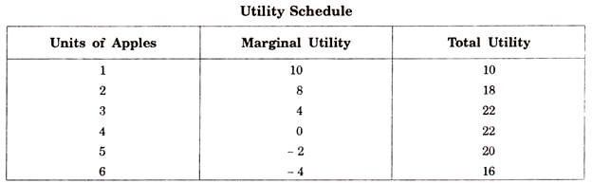
Relationship Between Total Utility And Marginal Utility

Slide 35
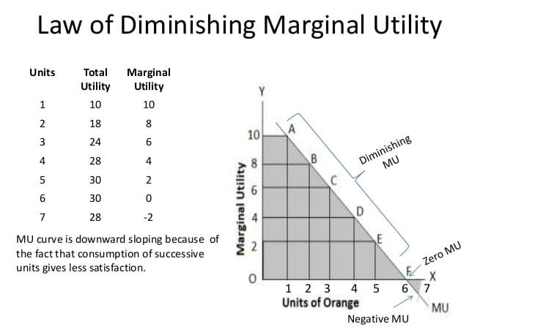
Utility Curve

Slide 36
Inflation
Definition: Inflation is the rate a price rises, and essentially how much the currency/dollar is worth at a given moment with regards to purchasing.
Inflation target: 2%
Walking inflation: above 2% but less than 10%
Running inflation: 10% - 20%
Hyper inflation: around 50% in a month
Measures: measured in two ways
a. Consumer Price Index (CPI): measures retail prices of goods and services, putting more than 80,000 purchasable items from hundreds of different categories into a "market basket" that groups them together.
b. Personal Composition Expenditures (PCE): Some analysts prefer to use PCE to CPI when measuring the inflation rate. The Personal Composition Expenditures price index measure the aforementioned core inflation, which is the inflation of goods and services excluding food, gas and oil.

Slide 37
Inflation
Causes: There are many different ways the inflation rate can rise, and they can be lumped into two different categories: Cost-push inflation and demand-pull inflation.
    Cost-push Inflation: prices are driven up by the rising costs to make or provide the goods and services. This can cause a supply shortage, but the demand for the goods and services has not decreased. Rise of wages also trigger cost-push inflation up.
    Demand –pull Inflation: demand-pull inflation can be the sort of inflation businesses dream about. often demand-pull inflation can develop as a result of too much money being made, devaluing the currency and requiring an increase in price.
Effects of Inflation: The impact of inflation affect many different groups when it hits. Not every group is affected the same way.
Generally in a period of mild inflation, job-seekers can benefit. Increased spending can mean increased demand, and companies may decide to hire new employees to better manage the new demand. If you have borrowed money from a lender, inflation could be convenient for you. With the currency devalued, what you borrowed a year or two ago is now the equivalent to a lower amount of money.
In this assumed manageable level of inflation, businesses that sell goods and services can benefit as well. A healthy amount of inflation is said to increase and incentivize spending more.
An unhealthy, unmanageable level, however, is disastrous for nearly everyone. If inflation spirals out of control, people lose faith in their currency. Financial institutions suffer as people pull their money out of them. Businesses suffer as their goods become too expensive for most people.

Slide 38
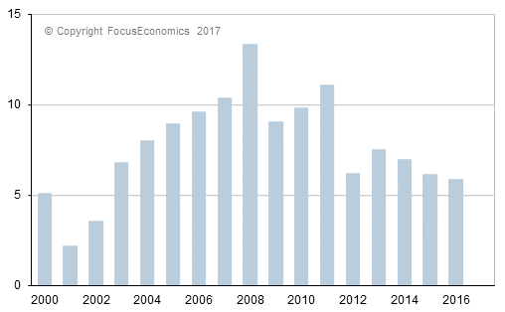
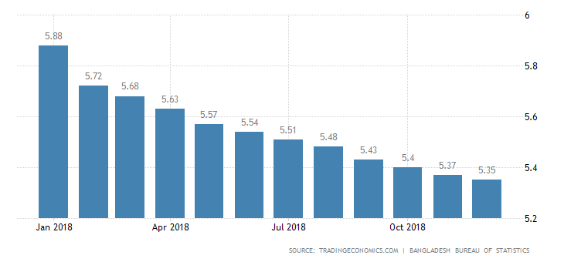
Inflation
Example: Bangladesh Inflation Rate (CPI)

Slide 39
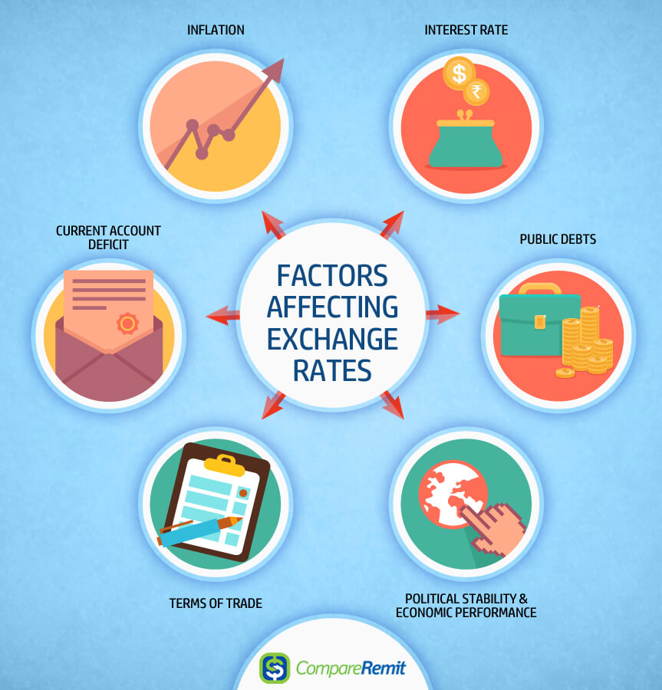

Slide 40
Gross Domestic Product (GDP)
Definition: Gross domestic product (GDP) is the monetary value of all the finished goods and services produced within a country's borders in a specific time period. Though GDP is usually calculated on an annual basis, it can be calculated on a quarterly basis as well.
GDP includes all private and public consumption, government outlays, investments, private inventories, paid-in construction costs and the foreign balance of trade ( exports are added, imports are subtracted). Put simply, GDP is a broad measurement of a nation’s overall economic activity.
Textile sector contributes more than 12% in GDP of Bangladesh.

Slide 41
How to Determine GDP
There are three primary methods by which GDP can be determined. All, when correctly calculated, should yield the same figure.
These three approaches are often termed
  A. the expenditure approach,
  B. the output (or production) approach and
  C. the income approach

Slide 42
How to Determine GDP
  A. the expenditure approach:
The expenditure approach or spending approach, which is the most common method, calculates the monies spent by the different groups that participate in the economy. For instance, consumers spend money to buy various goods and services and businesses spend money as they invest in their business activities (buying machinery, for instance). And governments also spend money. All these activities contribute to the GDP of a country. In addition, some of the goods and services that an economy makes are exported overseas, their net export. And some of the products and services that are consumed within the country are imports from overseas. The GDP calculation also accounts for spending on exports and imports.

Slide 43
The expenditure approach
A country's gross domestic product can be calculated using the following formula: GDP = C + G + I + NX.
C is equal to all private consumption, or consumer spending, in a nation's economy,
G is the sum of government spending,
I is the sum of all the country's investment, including businesses capital expenditure and
NX is the nation's total net exports, calculated as total exports minus total imports (NX = Exports - Imports).

Slide 44
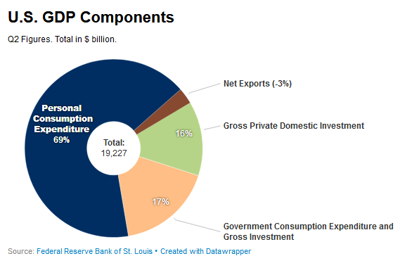
The expenditure approach

Slide 45
How to Determine GDP
  B. the output (or production) approach:
The production approach is something like the reverse of the expenditure approach. Instead of exclusively measuring input costs that feed economic activity, the production approach estimates the total value of economic output and deducts costs of intermediate goods that are consumed in the process, like those of materials and services.

Slide 46
How to Determine GDP
  C. the income approach:
  Income earned by all the factors of production in an economy includes the wages paid to labor, the rent earned by land, the return on capital in the form of interest, as well as an entrepreneur’s profits. An entrepreneur’s profits could be invested in his own business or it could be an investment in any outside business. All this constitutes national income, which is used both as an indicator of implied productivity and of implied expenditure.
  In addition, the income approach factors in some adjustments for some items that don’t show up in these payments made to factors of production. For one, there are some taxes – such as sales taxes and property taxes – that are classified as indirect business taxes. In addition, depreciation, which is a reserve that businesses set aside to account for the replacement of equipment that tends to wear down with use, is also added to the national income.

Slide 47
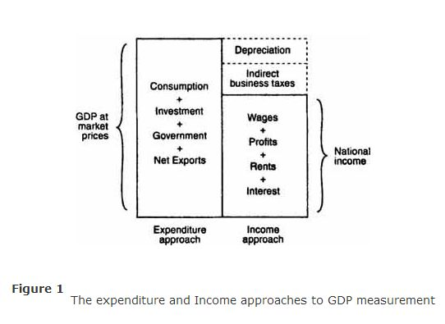
  The income approach:

Slide 48
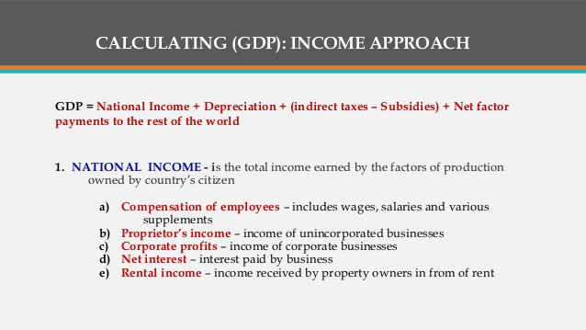
The income approach

Slide 49
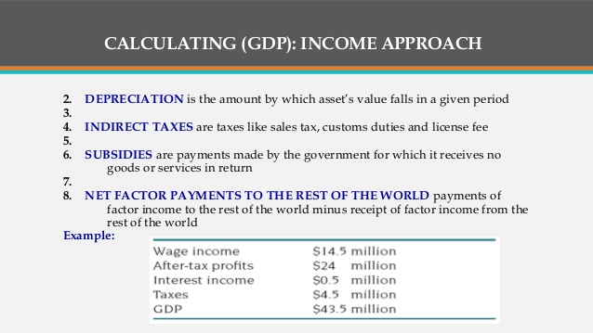
The income approach

Slide 50
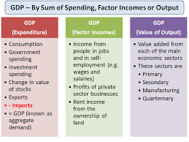

Slide 51
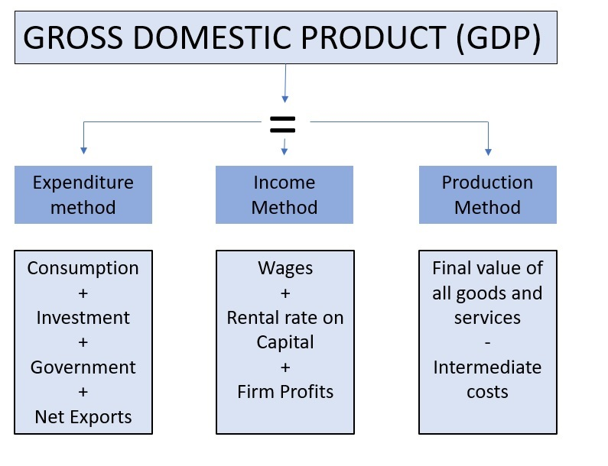

Slide 52
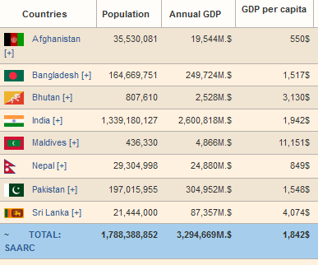
GDP of South Asian Countries

Slide 53
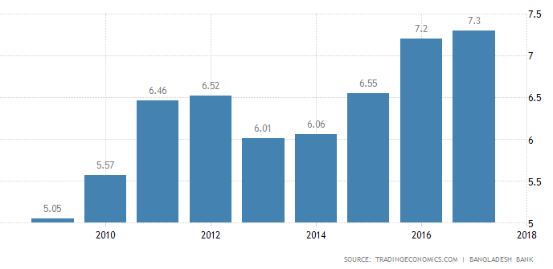
GDP Growth of Bangladesh

Slide 54
Top 10 Biggest GDP in the World
Rank | Country | Wealth ($ Trillions) | Change (2007-2017, %)
#1 | United States | $62.6 | 20%
#2 | China | $24.8 | 198%
#3 | Japan | $19.5 | 22%
#4 | United Kingdom | $9.9 | -2%
#5 | Germany | $9.7 | 0%
#6 | India | $8.2 | 160%
#7 | France | $6.6 | -11%
#8 | Canada | $6.4 | 25%
#9 | Australia | $6.1 | 83%
#10 | Italy | $4.3 | -19%

Slide 55
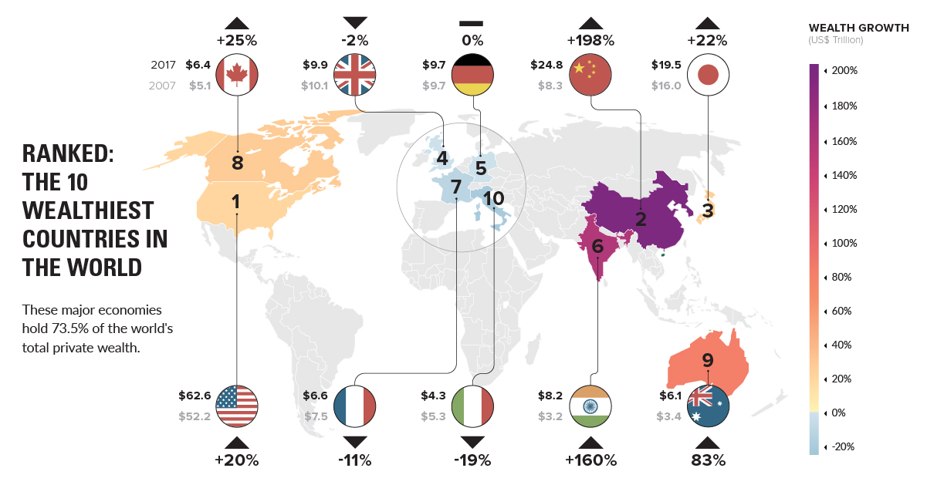
Wealthiest Countries in the World

Slide 56
Gross National Income (GNI)
The gross national income (GNI), previously known as gross national product (GNP), is the total domestic and foreign output claimed by residents of a country, consisting of gross domestic product (GDP), plus factor incomes earned by foreign residents, minus income earned in the domestic economy by nonresidents.

Slide 57
Purchasing power parity (PPP)
Concept:
Macroeconomic analysis relies on several different metrics to compare economic productivity and standards of living between countries and across time. One popular metric is purchasing power parity (PPP).
The concept is based on the law of one price, where in the absence of transaction costs and official trade barriers, identical goods will have the same price in different markets when the prices are expressed in the same currency.

Slide 58
Purchasing power parity (PPP)
Definition: Purchasing power parity (PPP) is an economic theory that compares different countries' currencies through a "basket of goods" approach. According to this concept, two currencies are in equilibrium or at par when a basket of goods (taking into account the exchange rate) is priced the same in both countries.
Measurement of PPP:
  Law of one price
  Big Mac Index
  iPad Index
  KFC Index

Slide 59
Per Capita Income
Per capita income (PCI) or average income measures the average income earned per person in a given area (city, region, country, etc.) in a specified year. It is calculated by dividing the area's total income by its total population.

Slide 60
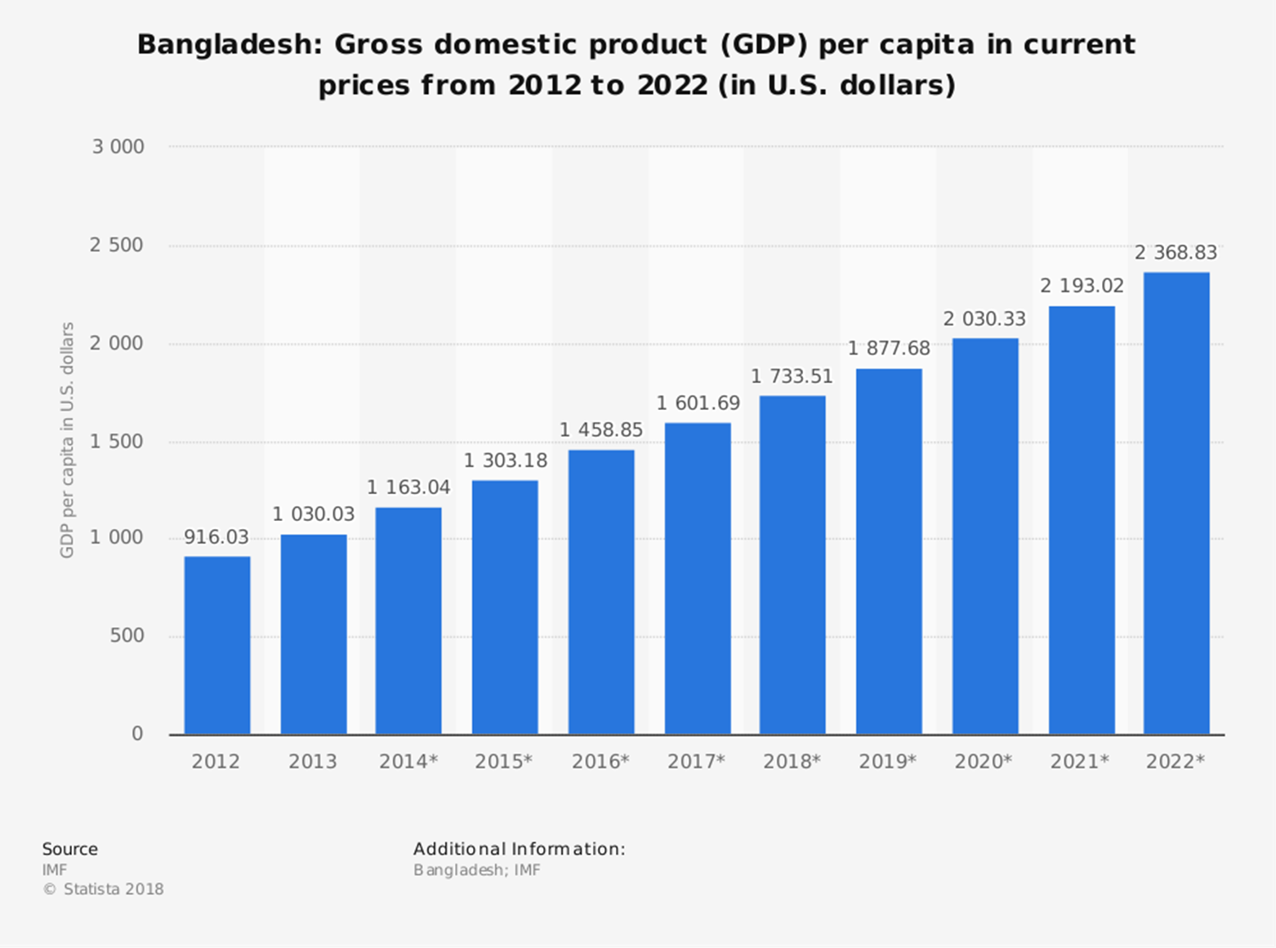
PCI of Bangladesh

Slide 61
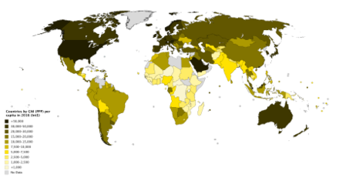
Countries by GNI (PPP) per capita in 2016

Slide 62
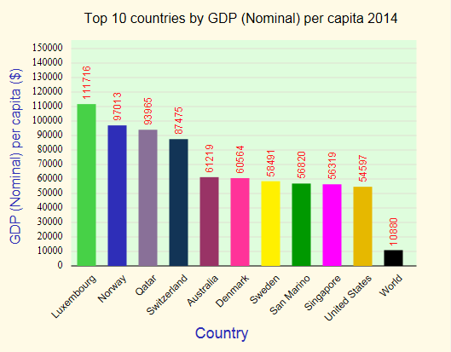
Top 10 countries in PCI

