Slide 1
Raw Material of Textiles: Fibers

Slide 2
Cotton
Soft, fluffy staple fiber
Grows in a ball
Almost pure cellulose

Slide 3
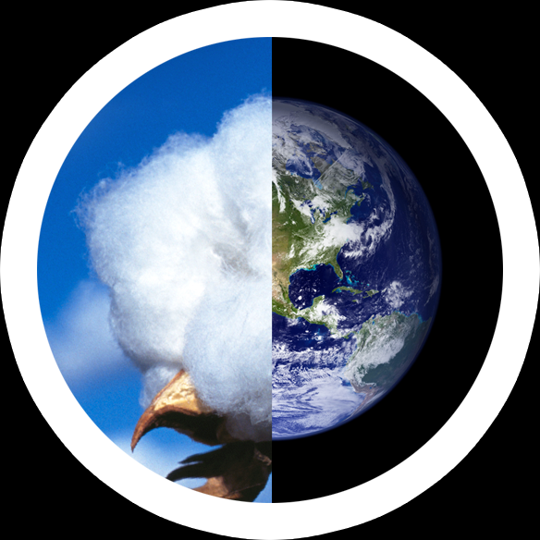
Cotton: Production
25 million tons or
110 million bales annually
2.5% of the world's arable(agricultural) land

Slide 4
Top Cotton Producing Countries in The World (2016/2017)
Rank | Country | Cotton production in thousand (Metric tons)
1. | China | 6,532
2 | India | 6,423
3 | USA | 3,553
4 | Pakistan | 2308
5 | Brazil | 1524
6 | Uzbekistan | 849
7 | Turkey | 697
8 | Australia | 501
9 | Turkmenistan | 332
10 | Mexico | 297

Slide 5
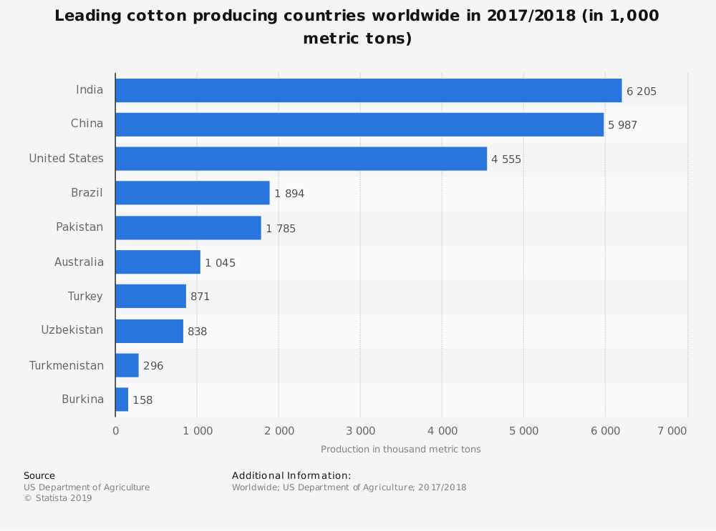
Top Cotton Producing Countries in The World (2017/2018)

Slide 6
Leading Cotton Exporter 2017/2018

Slide 7
Cotton Export in $
Global sales from cotton exports by country in 2017 totaled US$ 53.7 billion.
Overall, the value of cotton exports were down by an average -25.4% for all exporting countries since 2013 when cotton shipments were valued at $72 billion.
From a continental perspective, Asian suppliers generate the highest portion of worldwide cotton exports at 63.6% of the global total.
Sources in North America account for 14.7% trailed by suppliers in Europe at 11.4%.
Smaller percentages come from Africa (3.5%), Latin America excluding Mexico but including the Caribbean (3.4%) then Oceania led by Australia (3%).
The two-digit Harmonized Tariff System code prefix for cotton is 52. This broad classification includes raw cotton, cotton yarn, thread and woven fabrics

Slide 9
Cotton and Bangladesh Leading cotton importing countries in 2017/2018 (in 1,000 metric tones)*

Slide 10
Cotton and Bangladesh: Production
In 2017/2018, Bangladesh imported 8.28 million bales of cotton
The country produced 1.65 lakh bales of cotton 2017/2018 fiscal year, which is less than 3 percent of the annual demand for 10 million bales.
In 2016/2017, Cotton is grown in around 42 thousand hectares of land with a yearly production of nearly 1.5 lakh bales which is only 3 percent of the total quantity demanded by the textile and garments industries of Bangladesh.
In order to bump up local production, state-run Cotton Development Board is looking for new farming lands in hilly and swamp areas in various districts along with the existing farming areas in Jashore, Rangpur, Dinajpur, Rajshahi, Gazipur and Mymensingh.

Slide 11
Cotton and Bangladesh: Production
The board hopes to produce 2.5 lakh bales of cotton by 2021, which will meet nearly 5-7 percent of the local consumption.
Bangladesh’s cotton imports will continue to be commensurate with the expansion in spinning, according to the latest report of the United States Department of Agriculture.
About 97% of the total requirements are managed by importing raw cotton from Uzbekistan, India, Pakistan, Turkmenistan and some cotton growing Sub-Saharan (African) countries. It is thus obvious that Bangladesh needs an all out effort to expand the cotton production very rapidly.
<<https://www.thedailystar.net/business/news/bangladesh-now-depends-less-india-cotton-1743343>
>

Slide 12
Cotton and Bangladesh: Outsourcing 2017/2018

Slide 13
Cotton and Bangladesh: Outsourcing 2017/2018
African nations have surpassed India to become the largest source of cotton for Bangladesh as local spinners and millers look to cut down their dependence on a single source for their vital raw material.
In the FY 2017/2018, Bangladesh, the largest importer of cotton in the world, met 37.06 percent of its requirement for the white fibre from East and West African countries.
India accounted for 26.12 percent of the total cotton imports, down from more than 60 percent two years ago, according to data from the Bangladesh Textile Mills Association (BTMA).
Last year (FY 2017/2018), 11.35 percent of the cotton came from the CIS (Commonwealth of Independent States) countries, 11.14 percent from the US, 4.65 percent from Australia and 9.65 percent from the rest of the world.

Slide 14
Cotton and Bangladesh: Causes of Shifting from India to Africa in 2017/2018
The low quality of the Indian cotton is the main reason behind the falling imports from the neighboring country, said Monsoor Ahmed, secretary of the BTMA.
A section of Indian cotton traders also cannot maintain timely shipment and deliver the right quantity of cotton as per agreement, said Mehdi Ali, president of the Bangladesh Cotton Association.
For example, it is written in the letter of credit that there may be 3 to 4 percent less cotton than the amount agreed upon when the imported fibre is weighed in Bangladesh. But in many cases it is 10 to 15 percent less.
“This is a big loss for us. We can’t afford these kind of losses. This is another reason for moving away from India,” Ali added.
The concentration of moisture in the Indian cotton is higher than in other countries’, which makes it difficult to store in the warehouses for a long time.

Slide 16
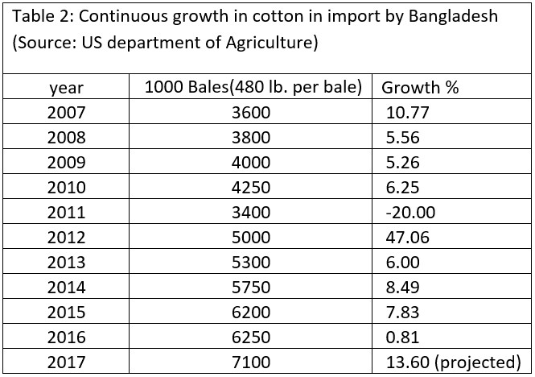
Increasing trend of Cotton import of Bangladesh

Slide 17
Cotton Import of Bangladesh
In MY 2018/19 cotton imports are forecast up to 7.9 million bales on expectations of increased export market demand for value-added products. Gradual development of the upstream supply chain, including spinning, dyeing, finishing, weaving and printing creates more demand for cotton to meet required needs of the RMG industry. MY 2017/18 imports estimate is raised to 7.4 million bales on anticipated stronger international demand and steady monthly import pace.
Bangladesh imports cotton from 42 countries around the world. Among them, India (26%) and Uzbekistan (16%) take the largest share of volume, followed by USA (9%), Mali (8%), Australia (7%), Turkmenistan (7%), Burkina Faso (5%), and others (Figure 2).
Nearly 80 percent of garments made in Bangladesh are sourced from cotton; the rest are made from viscose, polyester and other materials. Local spinners supply 90 percent of raw materials for knitwear and 40 percent for the woven garments sector.

Slide 21
Cotton Production in Bangladesh

Slide 22
Cotton production vs consumption of major players

Slide 23
Price of Cotton
The price shown is in U.S. Dollars per pound. The current price of cotton as of March 08, 2019 is $0.7349 per pound.
Historically, Cotton reached an all time high in March of 2011 and a record low of 5.66 in December of 1930.
Cotton is sold in bale,
Cotton bale weighs
396.6 pounds (180 kilograms) in Brazil,
730 pounds (331.1 kilograms) in Egypt and the UK,
392 pounds (177.8 kilograms) in Bangladesh, India, and Pakistan, and
480 pounds (217.7 kilograms) in the US.

Slide 24
Price of Cotton (Cents/lb)

Slide 25
Stock-to-use ratio

Slide 26
Stock to Use
The stocks to use ratio indicates the level of carryover stock for any given commodity as a percentage of the total demand or use. The mathematical formula for this relationship is as follows
(Beginning stock + Total Production – Total Use)/ Total Use
This can be simplified by consolidating the upper portion of the relationship to:
Carryover
-------------x100 = Stock to Use Ratio
Total Use

Slide 28
Yarn price list in local market of Bangladesh (Updated on 28.09.2018)
Carded Yarn | LC price/Kg
10/1 Carded 100% cotton yarn | 3.00 $
16/1 Carded 100% cotton yarn | 3.10 $
18/1 Carded 100% cotton yarn | 3.15 $
20/1 Carded 100% cotton yarn | 3.15 $
24/1 Carded 100% cotton yarn | 3.25 $
28/1 Carded 100% cotton yarn | 3.30 $
30/1 Carded 100% cotton yarn | 3.30 $
34/1 Carded 100% cotton yarn | 3.50 $
36/1 Carded 100% cotton yarn | 3.60 $
40% Carded 100% cotton yarn | 3.85 $

Slide 29
Combed Yarn
Combed yarn | LC Price
10/1 Combed 100% Cotton Yarn | 3.35 $
16/1 Combed 100% Cotton Yarn | 3.45 $
18/1 Combed 100% Cotton Yarn | 3.50 $
20/1 Combed 100% Cotton Yarn | 3.50 $
22/1 Combed 100% Cotton Yarn | 3.55 $
24/1 Combed 100% Cotton Yarn | 3.60 $
26/1 Combed 100% Cotton Yarn | 3.60 $
28/1 Combed 100% Cotton Yarn | 3.65 $
30/1 Combed 100% Cotton Yarn | 3.65 $
32/1 Combed 100% Cotton Yarn | 3.75 $
34/1 Combed 100% Cotton Yarn | 3.85 $
36/1 Combed 100% Cotton Yarn | 3.95 $
40/1 Combed 100% Cotton Yarn | 4.20 $

Slide 30
Polyester Top 10 polyester Exporters country
RANK | COUNTRY | EXPORTS(BILLION $)
1 | China | 2,210
2 | United States | 1,575
3 | Germany | 1,493
4 | United Kingdom | 813.2
5 | Japan | 697
6 | France | 578.6
7 | Netherlands | 576.9
8 | Korea, South | 557.3
9 | Russia | 515
10 | Italy | 474

Slide 31
Market Share

Slide 32
Top 10 polyester importers country
RANK | COUNTRY | IMPORTS(BILLION $)
1 | United States | 2,273
2 | China | 1,950
3 | Germany | 1,233
4 | United Kingdom | 782.5
5 | Japan | 766.6
6 | France | 659.8
7 | Hong Kong | 520.6
8 | South Korea | 516.6
9 | Netherlands | 511
10 | Canada | 471

Slide 33
Market Share

Slide 34
Use of Polyester in Garments:
Polyester is used in the manufacturing of all kinds of clothes and home furnishings like bedspreads, sheets, pillows, furniture, carpets and even curtains.
Industrial Uses of Polyester:
Polyester Staple Fiber(PSF): As textile fiber, Total Production was 17.9 million tons in 2018
Polyester Filament Yarn (PFY): As textile Yarn, Total Production was 37.5 million tons in 2018
While clothing used to be the most popular use of polyester and which made it a household name worldwide, there are many other uses polyester is put to.
PET: The most common use of polyester today is to make the plastic bottles that store our much beloved beverages. Shatterproof and cheap these bottles are an absolute boon to the beverages industry.
Mylar: An unusual and little known use of polyester is in the manufacturing of balloons. Not the rubber kind that you use for water balloons but the really pretty decorated ones that are gifted on special occasions. These are made of Mylar – a kind of polyester film manufactured by DuPont. The balloons are made of a composite of Mylar and aluminum foil.
Miscellaneous: Polyester is also used to manufacture high strength ropes, thread, hoses, sails, power belting and much more in industries.

Slide 36
Jute
Top jute cultivating& growing countries of the world:
Jute is not cultivated in all over the world. Special soil characteristics are required for the jute cultivation. Jute is specially cultivated sub-continent and surrounding countries
Bangladesh and west Bengal of India is the highest jute cultivating are. About 85% jute is cultivated in this area. Here, we have listed most growing countries name list they are-
India
Bangladesh
China
Myanmar
Uzbekistan
Nepal
Thailand
Vietnam
Egypt
Brazil

Slide 37
Top jute importing &exporting countries of the world:
China is the biggest trade market in the world. China dominated in the world trade market. Here, we have listed top jute importing countries name list. They are-
China
Pakistan
India
Nepal
Cote dlvoire
In the world trade, jute sector takes a great place. It is great news for the farmer who is growing jute because peoples are feeling the demand of natural fiber. Jute fibers are cheaper than cotton fiber. Here, we have listed most raw jute exporting countries name. They are-
Bangladesh
India
Kenya
Pakistan
Tanzania

Slide 38
Top jute producing countries& their share:
 | Country | Jute Production | %of World Total
01 | India | 19,910,000 m/t | 55.1%
02 | Bangladesh | 1,452,044 m/t | 41.9%
03 | China | 45,500 m/t | 1.3%
04 | Uzbekistan | 20,000 m/t | 0.57%
05 | Nepal | 14,424 m/t | 0.41%

Slide 39
Jute Pricing
Types of Jute | Price(BDT/kg)
BTC | 65
BTD | 55
BTE | 45
WTC | 62
WTD | 50
WTE | 40

Slide 40
Types of Jute
Bangla Tossa Clean (BTC): Uniform colour, golden/red.Tossa of finest texture, Very strong and very good luster. Completely free from any defects. Clean cut and well hackled.
Bangla Tossa (BTD) = X-1,2,3: Uniform Colour, Light golden to reddish.Tossa of fine texture, strong and good luster. Free from any blemish completely. Clean cut and well hackled.
Bangla Tossa-E (BTE): Any colour, any strength but free from perished fibre. Free from unfretted jute and stick but bark and hard center permissible. Rough cut and hackled.
Bangla Tossa Jute (Corchorus olitorius) Bangla White Jute (Corchorus capsularis)

Slide 41
Wool Top Exporting Countries
Country | Export value | Percent of total export
Australia | $1.94 B | 67%
New Zealand | $226 M | 7.8%
South Africa | $248 M | 8.6%
Uruguay | 64.4M | 2.2%
United Kindom | 54.4M | 1.9%
Argentina | 49.7M | 1.7%
Germany | 46.8M | 1.6%
Spain | 34.4M | 1.2%
Brazil | 30.6M | 1.1%
Peru | 21.8M | 0.75 %

Slide 42
Top Wool fibre importing countries
Country | Imprt value | Percent of total import
China | 2.13B | 72%
India | 242M | 8.2%
Czech Republic | 180M | 6.15%
Italy | 149M | 5%
Uruguay | 50.6M | 1.7%
Egypt | 40.6M | 1.4%
United kindom | 21.5M | 0.73%
Turkey | 19.2M | 0.65%
Germany | 12M | 0.41%
United states | 8.4M | 0.289%

Slide 43
Price comparison (US cents/lb)
Cotton | Polyester | Wool | Viscose | Nylon
70-80 | 60-70 | 600 | 100-110 | 160-170

Slide 48
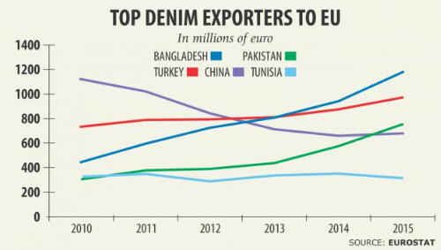
Denim
Bangladesh overtakes China as top denim supplier to EU

Slide 49
Bangladesh has overtaken China to become the largest denim supplier to the European Union -- a development that would give confidence to the country's garment sector as it looks to hit $50 billion in exports by 2021.
In the January-June period of 2016, Bangladesh exported €567.97 million worth of denim products to the 28-nation bloc -- enough to secure a 21.18 percent market share, the highest.
The country has also become the third largest denim supplier -- after China and Mexico -- to the US.
It exported $186.30 million worth of denim products to the US, registering a 12.03 percent market share, eclipsed only by China (26.04 percent) and Mexico (25.40 percent).

Slide 51
$50b RMG export target seems more challenging
Achieving the $50 billion export target by 2021 from readymade garment sector is becoming more challenging due to slow growth in RMG exports and other external factors, analysts and exporters said.Movements of buyers to Vietnam and other neighbouring countries, increased facilities to RMG sector in several Asian nations, gradual fall in prices and some domestic factors are affecting the competitive edge of Bangladeshi garment manufacturers in the international market.
In the last two years, production cost has increased by up to 17 percent due to gas crisis, devaluation of euro, price fall in EU and US market on the back of the US election and Brexit. As a result, we are gradually losing competitiveness in the global market.
Bangladeshi exporters have lost 7 percent market share in Canada, and 6 percent in the UK market in last one year.

Slide 52
Bangladesh apparel sector has 95% local investors: BGMEA
Over 95 per cent of the total investors in the Bangladesh apparel industry are local. Moreover, Bangladesh also has a number of foreign investors in textile and apparel sectors. The country encourages foreign investments in the areas of high value added items, non-traditional apparel items and in the primary textile industry, especially woven textiles
Bangladesh is also working on decreasing its dependency on imports as there has been a significant capacity building in the area of yarn and fabrics manufacturing, especially for knitwear items.
Around 80 per cent of the knitted fabrics are produced in Bangladesh. Denim production capacity has also got a significant boost in the last decade. Almost 50 per cent of the demand for denim fabric by our export oriented garment industry is being fulfilled by our local denim mills. Besides, Bangladesh produces almost 100 per cent of its accessories needed locally.
The country is dependent on external sources mostly for fibre, because it does not grow cotton or petrochemical products. It is lagging behind in woven fabric production, which has potentials for investment- BGMEA

Slide 53
Global yarn makers see Bangladesh as a potential market
Global textile and yarn makers see Bangladesh as a potential market despite the country's apparel export is facing challenges in some of its strong markets, including the United States and Europe.
Though fabrics and yarn are being locally made, Bangladesh still needs to import a good quantity to meet the growing demand.
In Bangladesh, local spinners meet over 90 percent demand for raw materials of the knitwear sector and over 40 percent demand of the woven sector.

Slide 54
China's Relocation Helps Bangladesh become top garment exporter
China can play a major role in making Bangladesh the world's top exporter of garments, according to analysts. Chinese industrialists are now planning to relocate their garments and textile industries, especially those manufacturing low-end apparel. These can be shifted to Bangladesh, where the government is planning to award a special economic zone to China.
If Bangladesh plays its cards correctly, it can emerge as the number 1 readymade garment exporter in the world in the next 10 years
China currently accounts for nearly 40 per cent share of global apparel consumption, which stood at $445 billion in 2015. In comparison, Bangladesh is far behind with around 6 per cent share.

Slide 55
Duty-free, not hurdle-free:
Bangladesh can significantly increase its exports to China's if only it would relax its rules of origin.
Stricter rules of origin in the Chinese market have made it hard for Bangladeshi manufacturers to increase exports significantly to the world's second largest economy, where Bangladesh and other 32 least developed countries (LDCs) enjoys a duty-free access
China's overall import was $1.3 trillion last year. Of which, $142 billion were from the LDCs. If Bangladesh can export 1 percent of the LDCs' export to China, the amount would be nearly $1.5 billion, just double the amount Bangladesh is exporting now
The rules of origin demand higher value addition of Bangladeshi products, meaning the goods should have 40 percent local contents.
Bangladeshi products enjoy duty-free access to the European Union market even if the goods are made of imported materials, while Canada gives the benefit on 25 percent local value addition.
Bangladesh's export to China will increase significantly if it (China) relaxes the rules of origin like what has been done by Canada

Slide 56
Efficiency of worker(Country)
Efficiency of worker(Country)
Efficiency ( % ) Analysis
60%
57%
50%
48%
46%
43%
39%
40%
39%
40%
30%
20%
10%
0%
India
Bangladesh
Vietnam
Indonesia
Pakistan
Cambodia
China

Slide 57
Machinery
Machinery import status:
Bangladesh Textile Mills Association ( BTMA ) president Tapan Choudhury said, “Bangladesh textile millers have imported machinery worth TK 71.19 billion in the last fiscal year of 2014-15, and 2013-14 it was TK 50.63 billion because many millers went for business expansion and development of the productivity.

Slide 58
Textile machinery import by Bangladesh.(Source: Bangladesh Textile Mills Association)
As per the association more than 1,300 spinning, weaving, dyeing, printing and finishing mills in the country have invested $ 4.0 billion and the sector’s contribution to the gross domestic product amounts to 13 percent and Bangladesh has a strong position in backward-linkage industry.

Slide 59
Top global garment exporters 2016

Slide 60
Bangladesh garment industry at a glance
$28.14 billion from garment export in 2016
Global market share 6.4%
RMG sector 82% of country’s total export
4.4 million workers
4000 garment factories
$50bn export target by 2021$50bn export target by 2021

