Slide 1
Management Basics
Project Management
Chapter
1

Slide 2
What is Management?
Management is the act of getting things done through people and having them do it willingly.
Management is the process by which a cooperative group directs actions of others toward common goals.
Management involves coordinating and overseeing the work activities of others so that their activities are completed efficiently and effectively.

Slide 3
Management has been defined in various ways.
Many eminent authors on the subject have defined the term “management”

Slide 4
1- Definitions:
According to James L Lundy
“Management is principally the task of planning, coordinating, motivating and controlling the efforts of others towards a specific objective”.
According to Peter F Drucker
“Management is a multi-purpose organ that manages a business and manages managers and manages workers and work”.

Slide 5
According to Stanley Vance
“Management is simply the process of decision-making and control over the actions of human beings for the purpose of attaining predetermined goals”.
According to Joseph Massie
« Managment is defined as the process by which a cooperative group directs action towards comon goals

Slide 6
From the above definitions,we conclude that management fulffils the following functions:
Formulation of objectives, plans and policies.
Collection of people, money, materials, machines and methods.
Direction and motivation of employees.
Coordination and Cooperation between employees.
Supervision and control of performance.

Slide 7
The Six Ms of Management
Men and Women
Money
Machines
Materials
Methods
Markets

Slide 8
Managerial Concerns
Efficiency & Effectiveness
  1. Efficiency
    “Doing things right”
      Getting the most output for the least inputs
  2. Effectiveness
    “Doing the right things”
      Attaining organizational goals

Slide 9
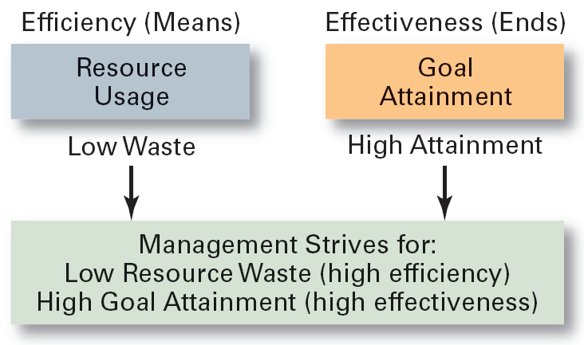
Exhibit 1–3 Effectiveness and Efficiency in Management

Slide 10
Managerial Objectives
Efficient use of resources
Customer Satisfaction
Reasonable profits so as to give a fair return on capital invested in bussiness
Survival and continuity of business
Enhancing goodwill or reputation of the enterprise

Slide 11
Characteristics
Management is a distinct process.
Management is an organized activity
Management aims at the accomplishment of predetermined objectives.
Management is both a science and an art.
Management is a group activity
Management principles are universal in nature
Management integrates human and other resources.

Slide 12
Concept of management-Raymond G. Leon
Management by Communication
Management by Systems
Management by Results
Management by Participation
Management by Motivation
Management by Exception
Management by Objectives

Slide 13




Features of Management
Continuous and never ending process.
Getting things done through people.
Oriented towards result.
Deals in group and not an individual activity.
Follows established principles or rules.
Multidisciplinary in nature.

Slide 14
Features of Management
Both an art and science.
Management is all pervasive.
Uses a professional approach in work.
Situational & dynamic in nature.
Management is intangible.
Aided but not replaced by computers.

Slide 15
Who Are Managers?
Manager: Someone who coordinates and oversees the work of other people so that organizational goals can be accomplished.
Managing is about:
✓ Getting things done through others
✓ Using scarce resources to best advantage
✓ Coping with change and uncertainty
✓ Achieving and delivering results

Slide 16
Classifying Managers
First-line Managers
Individuals who manage the work of non-managerial employees.
Middle Managers
Individuals who manage the work of first-line managers.
Top Managers
Individuals who are responsible for making organization-wide decisions and establishing plans and goals that affect the entire organization.

Slide 17
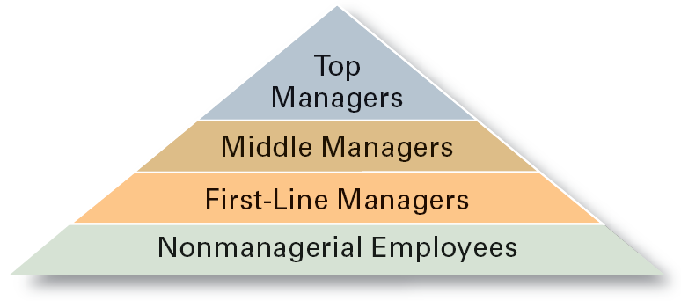
Exhibit 1–2 Managerial Levels

Slide 18
What Managers Do?
Three Approaches
A. Functions they perform.
B. Roles they play.
C. Skills they need.

Slide 19
A. Functions Managers Perform
Planning
Defining goals, establishing strategies to achieve goals, developing plans to integrate and coordinate activities.
Organizing
Arranging and structuring work to accomplish goals.
Leading
Working with and through people to accomplish goals.
Controlling
Monitoring, comparing, and correcting work.

Slide 20
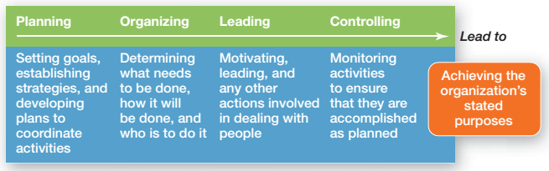
Exhibit 1–4 Management Functions

Slide 21
Management has been defined in various ways.
Many eminent authors on the subject have defined the term “management”

Slide 22
1- Definitions:
According to James L Lundy
“Management is principally the task of planning, coordinating, motivating and controlling the efforts of others towards a specific objective”.
According to Peter F Drucker
“Management is a multi-purpose organ that manages a business and manages managers and manages workers and work”.

Slide 23
According to Stanley Vance
“Management is simply the process of decision-making and control over the actions of human beings for the purpose of attaining predetermined goals”.
According to Joseph Massie
« Managment is defined as the process by which a cooperative group directs action towards comon goals

Slide 24
From the above definitions,we conclude that management fulffils the following functions:
Formulation of objectives, plans and policies.
Collection of people, money, materials, machines and methods.
Direction and motivation of employees.
Coordination and Cooperation between employees.
Supervision and control of performance.

Slide 25
1- Planning
It is the basic function of management.
It involves:
- Selection of goals.
- Establishment of strategies for the achievement of goals.
In selecting goals the manager should consider their feasibility.

Slide 26
2-Organizing
Organizing is deciding what jobs need to be done.
According to Henry Fayol,
“To organize a business is to provide it with everything useful for its functioning i.e. raw material, tools, capital and personnel”
Organizing involves:
Identification and classification of activities.
Assignment of tasks and duties.
Delegation of authority and responsibility.

Slide 27
3- Staffing
According to Kootz & O’Donell,
“The managerial function of staffing involves managing the organization’s structure through an effective
selection, appraisal & development of personnel ‘’.
Staffing involves:
Selection, Recruitment, and Placement in a position.
Training and development.
Remuneration.
Performance appraisal.
Promotions and transfer.

Slide 28
4- Directing
Through the Directing function a manager influences, guides, supervises, and motivates sub-ordinates for the achievement of the organizational goals.
Direction involves:
Supervision
Motivation
Leadership
Communication

Slide 29
5- Controlling
Controlling is the measurement and correction of the subordinates’performance
Controlling includes:
Establishment of a performance standard.
Measurement of performance.
Corrective action.

Slide 30
7- Management as a Process
As a process management consists of three aspects:
A social process
It makes useful and productive relationships among people in an organization.
An integrating process
It integrates human and financial resources to achieve the organizational purpose.
A continuous process
It is a never-ending process concerned with identification and solution of organizational problems.

Slide 31
8 -Management as an Activity.
“Management is what a manager does”.
Like various other activities performed by human beings management is also an activity because a manager is one who accomplishes objectives by directing the efforts of others.

Slide 32
Management as an activity includes:
The Informational activitiy: A communication link has to be maintained with subordinates and superiors for an effective functioning of the enterprise.
The Decisional activitiy: Managers are involved in decisions of different kinds. The decision made by one manager becomes the basis of action to be taken by other managers.
(E.g. A Sales Manager can decide for the media & content of advertising).
The Inter-personal activitiy: Managers have to interact with superiors and sub-ordinates to maintain good relations with all the organization’s members.

Slide 33
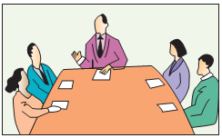

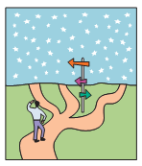
B. Roles Managers Play
Interpersonal roles
Figurehead, leader, liaison
Informational roles
Monitor, disseminator, spokesperson
Decisional roles
Entrepreneur, disturbance handler, resource allocator, negotiator

Slide 34
C. Skills Managers Need
Technical skills
Knowledge and proficiency in a specific field
Human skills
The ability to work well with other people
Conceptual skills
The ability to think & conceptualize about abstract and complex situations concerning the organization

Slide 35
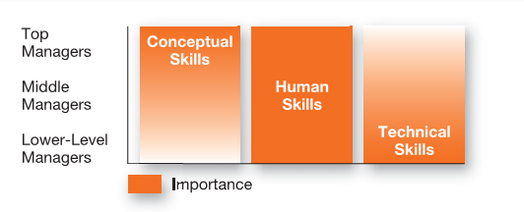
Exhibit 1–6 Skills Needed at Different
Management Levels (katz)

Slide 36
Thank You

