Slide 1
Project Life Cycle

Slide 2

Why do so many projects fail to meet expectations?
1. Lack of understanding of project management tools and an over reliance on project management software
2. Communication problems
3. Failure to adequately adjust to changes that occur during the course of the project

Slide 3

Why do so many projects fail to meet expectations?
Hughes notes that
Michalski (2000) observes that
“good communication is the key successful project management”.
many managers are apt to lose sight of the project. By focusing on the project management software and managing this rather than the actual project!

Slide 4
Remember
“If you fail to plan, you fail to do”.
“Proper Planning Prevents Poor performance”

Slide 5
The project manager’s adage
You can have any two of three things in a project:
You can get it done on time
You can get it done within budgeted cost
You can get it done properly/well
If you are willing to wait, you can get the job done right, within cost.
If you are willing to spend the money, you can get the job done on time.
Or you can get the job done on time and within budget; only it might not do what it was supposed to do.

Slide 6
Project Life Cycle
The Project Life Cycle refers to a logical sequence of activities to accomplish the project’s goals or objectives.
Regardless of scope or complexity, any project goes through a series of stages during its life.
There is first an Initiation or Birth phase, in which the outputs and critical success factors are defined, followed by a Planning phase, characterized by breaking down the project into smaller parts/tasks,
an Execution phase, in which the project plan is executed,
and lastly a Closure or Exit phase, that marks the completion of the project.

Slide 7
Project life cycle
Projects have beginnings, middle periods and endings.
Where you are in the project life cycle determines what you should be doing and what alternatives are available
Iron law of a life cycle: problems downstream are symptoms of neglect upstream.

Slide 8
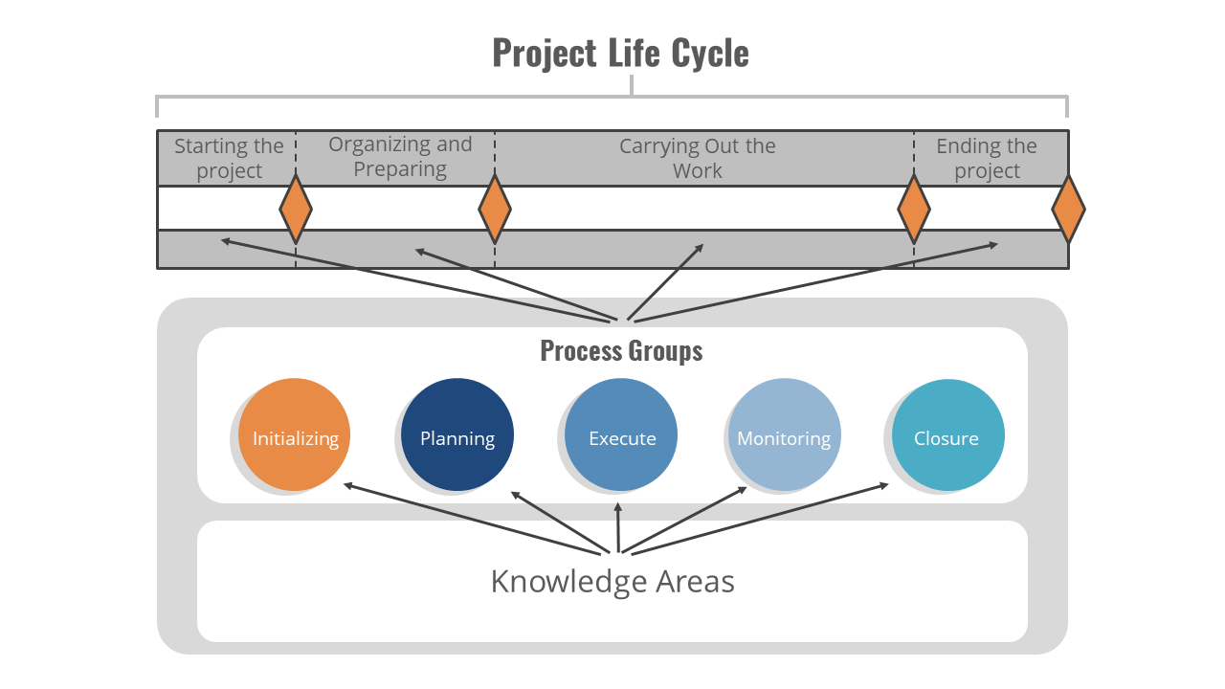
Project Life Cycle
Conception Phase (The Idea)
Definition Phase (The Plan)
Initiation Phase (The Team)
PLAN
Implementation Phase (The Work)
DO
Evaluation Phase (The Wrap-up)
REVIEW

Slide 9
Project Life cycle phases
Diverse project management tools and methodologies prevail in the different project cycle phases. Let’s take a closer look at what’s important in each one of these stages:
1) Initiation
In this first stage, the scope of the project is defined along with the approach to be taken to deliver the desired outputs. The project manager is appointed and in turn, he selects the team members based on their skills and experience.

Slide 10
Project Life cycle phases
2) Planning
The second phase should include a detailed identification and assignment of each task until the end of the project. It should also include a risk analysis and a definition of a criteria for the successful completion of each deliverable. The governance process is defined, stakeholders identified and reporting frequency and channels agreed.

Slide 11
The basic processes of the Project Planning Phase are:
Scope Planning: This specifies the in-scope requirements for the project.
Preparing the Work Breakdown Structure: This specifies the breakdown of the project into tasks and sub-tasks.
Organizational Breakdown Structure: This specifies who all in the organization need to be involved and referred for Project Completion.

Slide 12
Resource Planning: This specifies who will do what work at which time of the project.
Project Schedule Development: This specifies the entire schedule of the activities detailing their sequence of execution.
Budget Planning: This specifies the budgeted cost to be incurred in the completion of the Project.
Project Initiation Phase defines a few facilitating processes as well that are required for successful Project Completion.

Slide 13
Procurement Planning: Planning for procurement of all resources (staff and non-staff).
Communication Planning: Planning on the communication strategy with all project stakeholders.
Quality Planning: Planning for Quality Assurance to be applied to the Project.
Risk Management Planning: Charting the risks, contingency plan and mitigation strategies.
Configuration Management Planning: Defines how the various project artifacts will get stored.

Slide 14
Project Life cycle phases
3) Execution and controlling
The most important issue in this phase is to ensure project activities are properly executed and controlled. During the execution phase, the planned solution is implemented to solve the problem specified in the project's requirements. In product and system development, a design resulting in a specific set of product requirements is created. This convergence is measured by prototypes, testing, and reviews. As the execution phase progresses, groups across the organization become more deeply involved in planning for the final testing, production, and support.

Slide 15
Project Life cycle phases
4) Closure
In this last stage, the project manager must ensure that the project is brought to its proper completion.
The closure phase is characterized by a written formal project review report containing the following components: a formal acceptance of the final product by the client, Weighted Critical Measurements (matching the initial requirements specified by the client with the final delivered product), rewarding the team, a list of lessons learned, releasing project resources, and a formal project closure notification to higher management.

Slide 16
Planning allows to:
Ensure that people only work on activities which are needed, and do them correctly the first time, not waste time doing unnecessary activities.
Anticipate potential problems and take preventative action to deal with them before they happen.
Do things in the right order at the right time, which should prevent things going wrong later.

Slide 17
1. Conception phase
Essentially - What are we going to do?
For small projects an informal discussion might adequate
For larger projects, a more formal review and discussion processes required.
Key questions to answer should be:
(i) Should you do it? - What is the benefit and do the benefits outweigh the costs?
(ii) Can you do it? - Is it technically feasible and are there enough resources?

Slide 18
2. Definition phase
Review the reasons for the project.
Describing detail what results are to be produced.
Create a list of all the work to be performed.
Produce a detailed project schedule.
Calculate budgets.
Describe how risk is to be managed.
Identify any assumptions about the project.
Identify and define the roles of the project’s team members.

Slide 19
3. Initiation phase
Assign people to project roles, ensure they are available when needed.
01
Set up systems and accounts to track personnel information and financial expenditure.
03
Announce the project’s start, what it will produce. When it will start when it will finish
04
Give and explain all tasks to team members.
02

Slide 20
4. Implementation phase
Doing the tasks as laid out in your plan
Regularly comparing the actual performance with the plan
Knowing and anticipating when things are not going according to schedule
Fixing problems that arise
Keeping everyone informed

Slide 21
5. Evaluation phase
Get the customer’s approval of final results
There may be formal project hand over to the client
Complete any paperwork
Hold a post project evaluation to recognise achievements and discuss lessons learned

Slide 22
Project cycle management (PCM)
Is useful in designing, implementing and monitoring a plan or a project
A clear concise visual presentation of all the key components of a plan and a basis for monitoring
It clarifies:
  How the project will work
  What it is going to achieve
  What factors relate to its success
  How progress will be measured

Slide 23
PCM is result based
PCM requires the active participation of key stakeholders and aims to promote local ownership
PCM incorporates key assessment criteria into each stage of the project cycle
PCM requires the production of good quality key documents in each phase to support decision making

Slide 24
PCM helps to ensure that
Projects are part of the country policy objectives
Projects are relevant to the real problems of target groups / beneficiaries
  Clearly identified stakeholders (primary target groups and final beneficiaries)
Projects are feasible (objectives are realistic)
  Clearly defined coordination, management, financing arrangements, monitoring and evaluation
Benefits generated by projects are likely to be sustainable
Notes:
Before you evaluate what project you would like to implement, you will have to apply certain criteria on how to choose a project. And making shore that they will be able to serve certain role in the overall objectives that are stated in the mission/vision of a institute.
To be able to find out what an organization or an institution is capable of performing we need to analyse them. This is for example being done right now here in Sri Lanka by FAO (the team of Richard Banks)

Slide 25
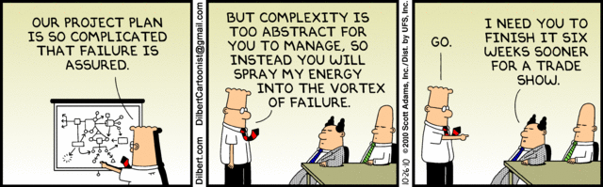
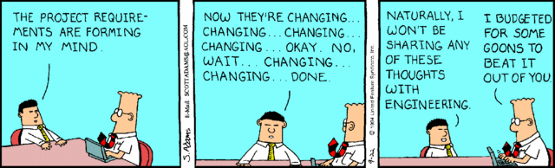
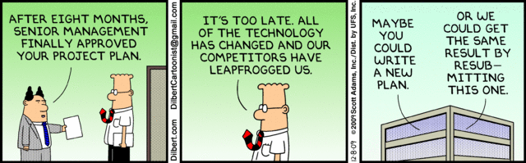
Fun with Dilbert

