Slide 1
CHEPTER-SIZING
Size:
A gelatinous film forming substance in solution or dispersion applied normally to warp but sometimes to weft, generally before weaving is called size.
Sizing:
A method of applying a gelatinous film forming substance on warp is sizing. This is the most important operation to attain maximum weaving efficiency especially for blended & filament yarns. It is called the heart of weaving.

Slide 2
Object of sizing:
1. To improve the weaveability of warp yarn by making it more resistant to action of weaving ie, absorption, friction, tension & flexing.
2. To maintain good fabric quality by reducing hairiness, weakness & by increasing smoothness, absorbency of yarn.
3. To improve the tensile or breaking strength of cellulosic yarns.
4. To increase the elasticity.
5. To increase the weight of yarn.

Slide 3
Requirement of sizing:
1. Sized warp must be sufficiently strong, smooth & elastic.
2. The sizing process must ensure the application of the required amount of size on the yarn or the required size regain.
3. The tensions of warp yarn at sizing must be regular & constant during all the warp unwinding from the warping beams.
4. The sizing process must be efficient, economical & must ensure the production of high quality sized warps.

Slide 4
Choice of Size ingredient:
1. It should give least amount of dust produce.
2. It should permits easy size removal in latter operation.
3. It should give good fabric characteristics.
4. The recipe should be compatible with the machinery.
5. The recipe should not cause any health hazard.
6. The recipe should not cause any degradation of textile material.
7. It should be cheap.
8. PH should be lies between 7-7.4(neutral condition)

Slide 5
Size ingredients & their function:
1. Adhesive: Generally starch of maize, corn, rice, potato & CMC, PVA, PVC are used as adhesive. Tamarin is used as adhesive on jute yarn.
Function: a) To improve strength. b) To improve abrasion resistance. c) To increase extensibility.
2. Lubricant or Softener: Mineral oil, linseed oil, coconut oil, vegitable oil, tallow, japan wax, vegitable wax are used as a lubricant.
Function: a) To make the yarn soft & slippery. b) To reduce stiffness.

Slide 6
3. Antiseptic or Antimildew agent: Salicylic acid, Zinc chloride, phenol carboxylic acid are used as antiseptic agent.
Function: a) It helps to store the yarn without damage. b) Protect yarn from bacteria or fungus formation.
4. Deliquescent or Hygroscopic Agent: Glycerin, calcium chloride, are used as deliquescent agent.
Function: a) Prevent brittleness of size. b) Helps to keep standard moisture regain.
5. Weighting agent: China clay, French chalk, sodium phosphate are used as weighting agent.
Function: a) Increase weight of yarn.

Slide 7
6. Wetting agent: Magnesium chloride, avirol, sulphanol A are used as wetting agent.
Function: a) Helps to wet yarn instantly.
7. Tinting agent: Blue is used as tinting agent.
Function: a)To increase lusture or brightness.
8. Antifoaming agent: Benzene, pyridine are used as antifoaming agent.
Function: a)To prevent foam formation.

Slide 8
Technological change due to Sizing:
1. Increase abrasion resistance.
2. Increase breaking strength.
3. Increase yarn smoothness.
4. Increase yarn stiffness.
5. Increase yarn elasticity.
6. Increase actual diameter but decrease apparent diameter.
7. Increase frictional resistance.
8. Decrease yarn hairiness.
9. Decrease yarn extension.
10. Decrease static electricity formation.

Slide 9
Types of sizing:
1. Pure sizing: This types of sizing is done for unbleached fabric. 3-10% size ingredients are used on the weight of fabric.
2. Light sizing: This types of sizing is used for Dyeing & Printing of woven fabric. 11-15% size ingredients are used on the weight of fabric.
3. Medium sizing: This types of sizing is used for increase of strength & weight of fabric. 16-40% size ingredients are used on the weight of fabric.
4. Heavy sizing: This types of sizing is used for increase the weight twisted & lower count yarn. Above 40% size ingredients are used on the weight of fabric.

Slide 10
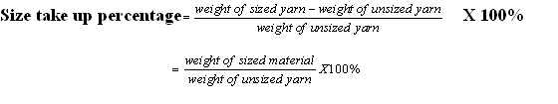
Size take up percentage:
The amount of size material added on the yarn surface is called size take up .

Slide 11
Size take up percentage depends on:
1. Higher twist: ↓
2. Finer count: ↓
3. Higher concentration: ↓
4. Higher viscosity: ↓
5. Lower flexibility: ↑
6. Higher immersion length: ↑
7. Higher squeeze roller pressure: ↓
8. Higher yarn speed: ↓
9. Higher staple length: ↓
10. Crystalline fibre: ↓
11. Amorphous fibre: ↑

Slide 12
Techniques of sizing:
* Slasher sizing
* Emulsion sizing
* Foam sizing
* Hot melt sizing
* Electrostatic sizing
* High pressure sizing
* Combined sizing
* Solvent sizing.

Slide 13
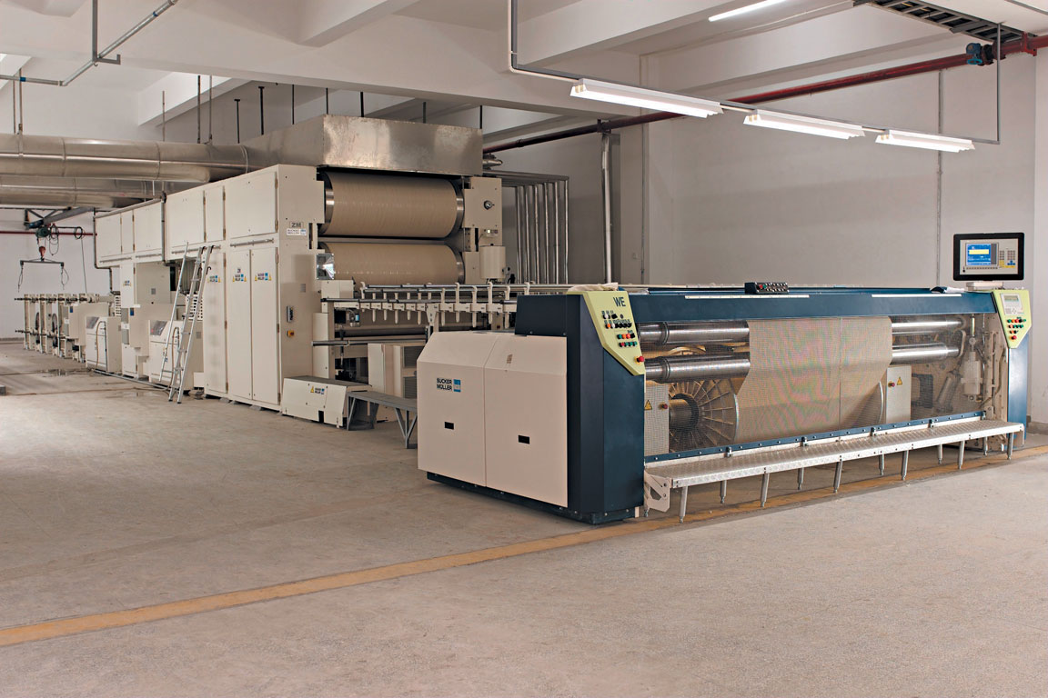

Slide 14
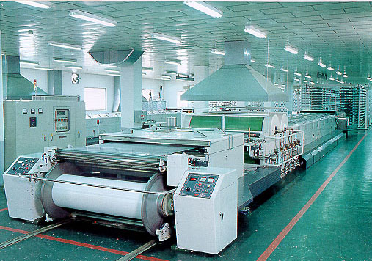

Slide 15
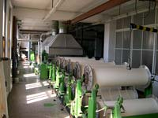
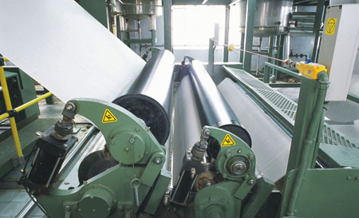

Slide 16
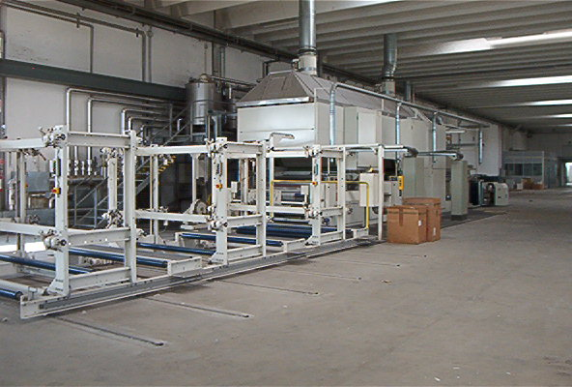

Slide 17
Slasher sizing
The slasher sizing machine is consists of the following seven units:
1. Back Beam Unit
2. Sizing Unit.
3. Drying Unit
4. Cooling Unit.
5. Dividing Unit
6. Measuring & Marking Unit.
7. Beaming Unit.

Slide 18
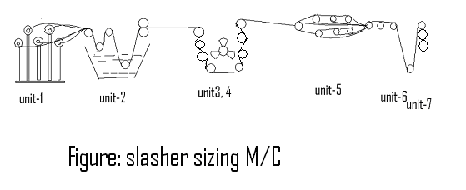

Slide 19
Back beam unit:
The unit contains frame which carries 8-20 beams to get wound, which may be arranged in various ways.
Sizing unit:
This unit contains guide roller, tension roller, size box, immersion roller, sizing roller, squeezing roller. Size recipe is reserved in reserved box & apply it on the yarn. Guide roller guides the yarn & tension roller maintains the uniform tension on yarn. The size box is used to apply the size liquor to the yarn. The size liquor is kept in size box. The warp sheet is guided through the solution by means of immersion roller. The squeeze roller removes excess size from the yarn.

Slide 20
Drying unit: It contains of heated cylinder over which warp sheet passes. There may be two or multi cylinder. Heated cylinder dries the yarn.
Cooling unit: This unit has cooling fan & guide roller. Cooling fan supplies cool air to dried warp sheet to cool it.
Dividing unit: In order to prevent adhesion between yarns, it is necessary to separate each sized ends from the others. For this purpose lease rod is used.
Measuring & Marking device: In this unit the length which is sized is measured by measuring roller & marked at a given distance.
Beaming unit: Finally sized warp is wound on a weavers beam

Slide 21
Drying system
1. Cylinder drying : a) Two cylinder, b) Multi cylinder.
2. Hot air drying.
3. Infrared drying.
4. Combined drying.
Size cooking equipments:
1. Motor.
2. Agitator: Size ingredients are mixed with the help of agitator in mixing tank.
3. Mixing tank: here size ingredients are mixed.
4. Pump: After mixing size mixer transfer to storage tank by pump.
5. Storage tank: Size mixer are store in storage tank.

Slide 22
Size cooking
1. Ordinary cooking.
2. Pressure cooking.
Ordinary cooking:
a. Add required amount of water.
b) Add required antiseptic with stirring.
c) Gradually add starch and stir for 30-45 min.
d) Continue steaming until correct viscosity is obtained.
e) Stop steaming.
f) Adjust PH between 6-8 by adding acid or alkali.
g) Transfer the size solution to the reserve tank and maintain temperature at 600 C.

Slide 23
Pressure cooking
a. Add required amount of water.
b) Add required antiseptic with stirring.
c) Gradually add starch and stir for 30-45 min.
d) Start steaming and raise temperature up to 130 C.
e) Add softener.
f) Continue steaming until correct viscosity is obtain.
g) Stop steaming.
h) Adjust PH between 6-8 adding acid or alkali.
i) Transfer the size solution to the reserve tank and maintain temperature at 60 C.

Slide 24
Faults of sizing
1. Sticky warp.
2. Gum spot.
3. Under slashed yarn.
4. Over slashed yarn.
5. Over dried yarn.
6. Non uniform sizing.
7. Cross or lost ends.
8. Improper boiled of yarn.
9. Incorrect warp length.
10. Dirty warp.
Dressing: The process of jute sizing is called dressing.

