Slide 1


Slide 2
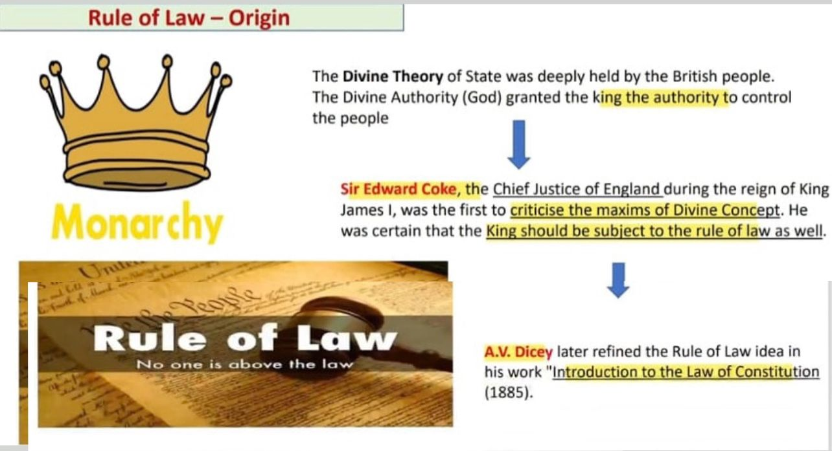

Slide 3
Dicey on Rule of Law
In the United Kingdom, the rule of law, at least historically, has been closely related to A.V. Dicey. Dicey’s perception of the rule of law was introduced in his book Introduction to the Study of the Law of the Constitution. According to Dicey, in line with the concept of Parliamentary Sovereignty, the rule of law is one of the twin pillars of the British Constitution. There are 3 conceptions of the rule of law which had been highlighted by Dicey.

Slide 4
Dicey on Rule of Law
The first aspect indicates that no man is punishable or can be lawfully made to suffer in body or deprived of their goods unless they had violated the law which has been established in an ordinary way and applied by an ordinary court. There is also an absolute supremacy or predominance of regular law over arbitrary power and the state could not act in an arbitrary manner which was unlawful.

Slide 5
Dicey on Rule of Law
The second aspect of Dicey’s conception of the rule of law indicates that in terms of the equality before the law, no man is above the law. Regardless of what an individual’s rank or condition is, he is subjected to the ordinary law of the realm and be bounded to the jurisdiction of the ordinary tribunals. As a result, no matter an ordinary private citizen or a state official breached the same law, they would be treated in the same way. It denoted that the state officials were not given any special privileges or protections from the law of the land. Thomas Fuller had also quoted that “Be you ever so high, the law is above you.”

Slide 6
Dicey on Rule of Law
The third aspect denotes that the principles of the constitution are the result of the ordinary law of the land. Dicey stated that Britain had a court-based constitution (in effect, a common law constitution), in the sense that decisions made by the judges directly resulted the principles of the constitution which concerning the rights of private persons. This reveals Dicey’s belief that the common law affords greater protection to the citizens than a written constitution.

Slide 7


Slide 8
The Constitution of Bangladesh in the preamble proclaims rule of law as the prime objective of the Constitution.
In fact, the Appellate Division identified the rule of law as a basic structure of the Constitution. At the beginning of the substantive provisions, notice is given in article 7 of the Constitution that rule of law is central to the governance of the Republic.
However, if we examine the provisions of the Constitution, we find that the entire constitutional regime is aimed at achieving the rule of law as it is understood in the present day.

Slide 9
Preamble
The rule of law is a basic feature of the Constitution of Bangladesh. It has been pledged in the preamble to the Constitution of Bangladesh that –
It shall be fundamental aim of the state to realize through the democratic process a socialist society, free from exploitation – a society in which the rule of law, fundamental human rights and freedom, equality and justice, political economic and social, will be secured for all citizens.

Slide 10
Representative Government
Before laying down the structure of the government, article 7 of the Constitution loudly speaks of representative government. Article 9 speaks about extension of representative character to the sphere of local government and article 11 provides for elected representatives at all levels of administration. Article 59 emphatically requires that the local government in every administrative unit of the Republic shall be entrusted to bodies composed of persons elected in accordance with law.

Slide 11


Slide 12
Election Commission
Again, a representative government becomes meaningless unless free and fair election to reflect the wishes of the people can be ensured. Therefore, the Constitution has entrusted the function of holding election to the Election Commission which has been declared to be independent in discharge of its functions. To ensure the independence of the Election Commission, it has been provided that the members of the Election Commission shall not be removed from their office except in like manner and on the grounds as a judge of the Supreme Court can be removed. In Shah Alam v. Mujibul Haq the Appellate Division held:

Slide 13
The Election Commission has been vested with plenary, supervisory and discretionary jurisdiction to oversee that an election is conducted honestly, justly and fairly and in accordance with the provision of law and in doing so it may pass any order, unless specifically barred, including an order for re-poll, acceptance/consolidation of result, review etc. on the basis of materials before it and the power of judicial review to challenge the order of the Election Commission cannot be invoked except on the very limited ground of total absence of jurisdiction (corum non judice) or malice in law.

Slide 14
Government to run in accordance with law
Besides providing for representative government, the Constitution clearly mandates that all government actions to be taken in accordance with the provisions of the Constitution and laws of the land. Thus every governmental action must have a legal basis, particularly when such action impinges on the rights or liberty of citizens. Articles 7 and 26 impose limitation on the legislature that no law which is inconsistent with any provision of the Constitution can be passed.

Slide 15
Equality before the law
As regards ‘equality before law’, Article 27 of the Constitution declares that:
all citizens are equal before the law irrespective of their status and position and any person howsoever high and mighty is amenable to the provisions of law.

Slide 16
The Constitution of Bangladesh declares that there will be no discrimination against any citizen on the ground only of race, religion, caste, sex or place of birth in respect of access to places of public entertainment or resort. All public functionaries are liable to be sued in the courts of law in the country when they infringe the rights and liberty of the individual citizens. The only exception is that of the President of the Republic who cannot be sued for actions taken by him or in his name. In such case the government can be sued by the individuals and article 146 of the Constitution clearly states the position.

Slide 17
However, it is to be said that equality under the provisions of the Constitution of Bangladesh does not imply mechanical equality or mathematical clarity. Discrimination or classification may be found or permitted in the constitution. However, it may be said that if a law provides any discrimination in favour of or against a class, the classification is to be made on a real difference having a clear basis on its subject matter.

Slide 18
Equal protection of law
Article 27 of the Constitution prohibits discriminatory laws and actions by the government and public functionaries. All laws which provide for or permit discriminatory treatment are void in view of the provision of article 26 of the Constitution. Article 27 requires that:
no person or class of persons shall be denied the same protection of laws which is enjoyed by other person or class of persons in like circumstances in their lives, liberty and pursuit of happiness

Slide 19
It is not sufficient to make provisions in law against discriminatory treatment. Sometimes it becomes necessary to enact the provisions like articles 28 and 29 which protected women or children or for the advancement of any backward section of citizens, specially to avoid any plea of discrimination.

Slide 20
Treatment in accordance with law
Rule of law requires that individuals should be dealt with in accordance with law. Article 31 of the Constitution prescribes protection of law as one of the fundamental rights. As regard right to protection of law, the Constitution of Bangladesh provides:
to enjoy the protection of the law, and to be treated in accordance with law, and only in accordance with law, is the inalienable right of every citizen, wherever he may be, and of every other person for the time being within Bangladesh, and in particular no action detrimental to the life, liberty, body, reputation or property of any person shall be taken except in accordance with law.

Slide 21
This article together with other fundamental rights incorporated in Chapter III of the Constitution recognizes the view of the rule of law that law does not mean any law passed by the legislature; such law must not be arbitrary, discriminatory or unreasonable.

Slide 22
Even though article 31 emphasizes the qualitative aspect of law, the framers of the Constitution provided in article 32, “No person shall be deprived of life or personal liberty save in accordance with law”. Therefore, article 32 will be strictly scrutinized when it relates to or deals with life or personal liberty. Life within the meaning of articles 31 and 32 means something more than mere animal existence. It comprehends the right to live consistently with human dignity and decency. It brings within its purview a right to live a healthy life and any serious health hazard brings into action the provisions of articles 31 and 32. The provision of article 32 amounts to a proposition that no person is to take the life of liberty of another person except under a law authorizing him to do so.

Slide 23
Protection of basic human rights
Part III of the Constitution have guaranteed 18 fundamental rights and Constitutional arrangement for their effective enforcement has been ensured in articles 44 and 102. We have already dealt with the equality clause and due process clause incorporated in the Constitution. Article 33 provides for safeguards as to arrest and detention, article 34 prohibits forced labour and article 35 provides protection in respect of trial and punishment.

Slide 24


Slide 25
Freedom of assembly, association and freedom of thought and conscience and of speech are guaranteed by articles 37, 38 and 39 respectively. Articles 40, 41 and 42 relate to freedom of profession or occupation, freedom of religion and right to property. Article 43 guarantees protection of home and correspondence.

Slide 26
On the other hand, article 44 of the Bangladesh Constitution guarantees the right to move the High Court Division in accordance with article 102 for the enforcement of the fundamental rights.
Moreover, in accordance with Articles 7, 26 and 102(2) of the constitution the Supreme Court exercises the power of judicial review whereby it can examine the extent and legality of the actions of both the executive and legislative and can declare any of their actions void if they do anything beyond their constitutional limits.

Slide 27
Protection in respect of arrest and detention
In this context, article 33(1) mandates:
no person who is arrested shall be detained in custody without being informed, as soon as may be of the grounds for such arrest, nor shall he be denied the right to consult and be defended by a legal practitioner of his choice.

Slide 28


Slide 29
Again Article 33(2) says:
every person who is arrested and detained in custody shall be produced before the nearest magistrate within a period of twenty four hours of such arrest, excluding the time necessary for the journey from the place of arrest to the court of the magistrate, and no such person shall be detained in custody beyond the said period without the authority of a magistrate.

Slide 30
Power of judicial review
Constitutional guarantees and declaration of rule of law are meaningless unless there is a body to supervise that the constitutional mandates are complied with. The Constitution makes provision for judicial review of laws and governmental action and invested the Supreme Court of Bangladesh with the power of judicial review under…

Slide 31
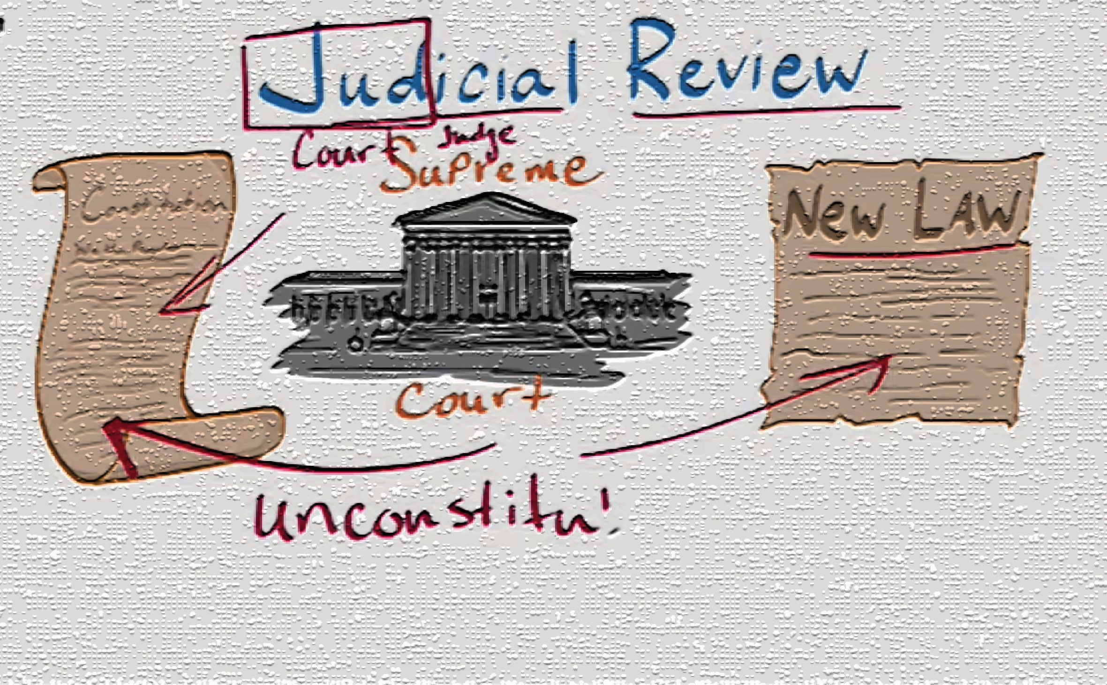

Slide 32
…. Articles 7 and 26 which gives the substantive law and article 102 gives the implementing law of it, for it provides for the procedure-how a law which is inconsistent with the provisions of the constitution can be declared unconstitutional by issuing prohibition, mandamus, and certiorari; and providing for appeal before the Appellate Division under article 103.

Slide 33
In the famous case of Anwar Hossain Chowdhury v. Bangladesh, the Appellate Division found this power of judicial review to be a basic feature of the Constitution which cannot be curtailed or modified even by amendment of the Constitution.

Slide 34
Administrative actions may be reviewed under constitutional provisions. Under Article 102(2) of the Constitution the Supreme Court can examine the validity of actions performed by any public officials or bodies.

Slide 35
Article 102 of the Constitution empowers the Supreme Court to exercise the power of judicial review on application by a person aggrieved. The phrase person aggrieved was interpreted to mean a person who has actually suffered any detriment and not a grief suffered generally as a member of the public. Such an interpretation resulted in many wrongs committed by public functionaries go unchallenged for want of any person aggrieved, a result not consistent with the rule of law.

Slide 36
In Dr. Mohiuddin Farooque v. Bangladesh, the Appellate Division reversed the position and permitted public interest litigation. Distinguishing its earlier decision, the court held:
In so far as it concerns public wrong or public injury or invasion of fundamental rights of an indeterminate number of people, any member of the public, being a citizen, suffering the common injury or common invasion in common with others or any citizen or an indigenous association, espousing that particular cause is a person aggrieved…

Slide 37
Independence of judiciary
An independent judiciary is, however, an important precondition for ensuring rule of law in a country. With regard to the executive branch, Article 22 of the Constitution provides that the State shall ensure separation of the judiciary from the executive organs of the State. Article 94(4) declares the independence of the judges of the Supreme Court in discharge of their judicial functions.

Slide 38
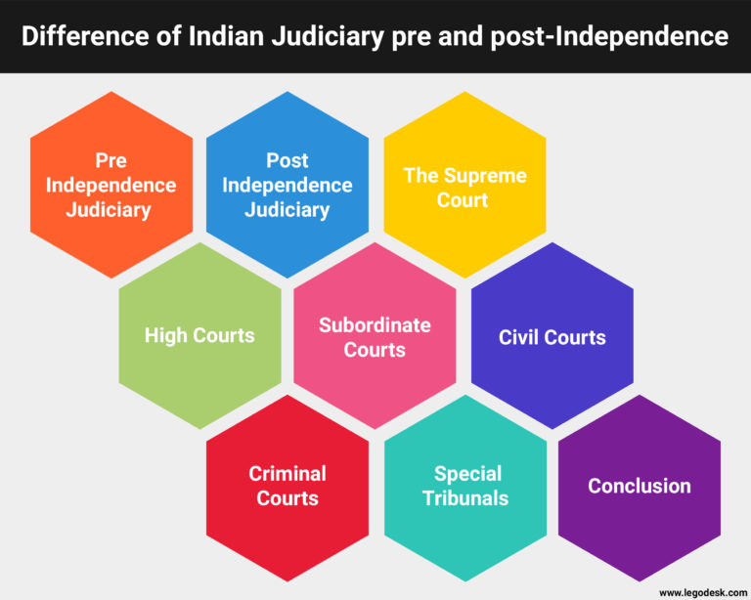

Slide 39
Article 96(5) provides that a judge of the Supreme Court can be removed from service only if he has ceased to be capable of properly performing the functions of his office by reason of physical or mental incapacity or he is guilty of gross misconduct. He can be removed by the President only after inquiry and hearing by the Supreme Judicial Council comprised of the Chief Justice and two senior most judges of the Appellate Division. Articles 96 and 147 provide the security of tenure and terms and conditions of service of the judges of the Supreme Court.

Slide 40
Case References
Role of Bangladesh Judiciary in Rule of Law

Slide 41
➢ Anwar Hossain Chowdhury Vs Bangladesh , 1989 BLD (spl) 1, Para 443
The rule of law is a basic feature of the constitution of Bangladesh.
➢ Mujibur Rahman Vs Bangladesh , 44 DLR (AD) 111
The constitution vests the executive power of the republic in the executive and the legislative power of the republic in parliament, Though there is no Specific vesting of the judicial power of the republic , it is vested in the judiciary .
➢ Secretary ,Ministry of Finance Vs Masder Hossain 2000 BLD (AD) 104

Slide 42
➢ University of Dacca vs Sajjad Hossain 34 DLR (AD) 1
No person shall be convicted of any offence except for violation of law in force at the time of commission of such offence. ( protection against ex post facto law)
➢ Dewan Obador Rahman vs State 7BLD (AD) 227
If any person trail under section 247 of Cr.PC by Magistrate, and a trail on the same offence in a court has been going on than such trial shall be brunt under the section 403 of the Cr.PC ( Protection against Double Jeopardy)

Slide 43
➢ Dr. Nurul Islam V. Bangladesh 33 DLR (AD) 201
The conferment of discretionary power by any statute without providing any guideline for the exercise of such power was held to be discriminatory ( Equality before the law)
➢ Abdul Latif Mirza v. Bangladesh, 31 DLR (AD) 1
Article 102 (2) (b) (1) gives a right to the detenue to move the High Court Division with a writ of Habeas Corpus.( Protection in respect of detention without trial )

Slide 44


