Slide 1
Martial Law: Supremacy of Guns?
Doctrine of Necessity
&
Doctrine of Efficacy

Slide 2
Constitutional Supremacy: How can guns be supreme?
Supremacy of the Constitution
Article 7 of the Constitution: Clause 1: All powers in the Republic belong to the people, and their exercise on behalf of the people shall be effected only under, and by the authority of, this Constitution.
Clause 2: This Constitution is, as the solemn expression of the will of the people, the supreme law of the Republic, and if any other law is inconsistent with this Constitution that other law shall, to the extent of the inconsistency, be void.

Slide 3

Martial Law?

Slide 4
Definition of Martial Law
Martial law is the imposition of direct military control of normal civilian functions by a government, especially in response to a temporary emergency such as invasion or major disaster, or in an occupied territory.
Martial Law in Pakistan
1958 (Iskander Mirza & Ayub Khan)
1969 (Yahya Khan)
1977 (Ziaul Hoque)
1999 (Pervez Musharraf)
Martial Law in Bangladesh
1975 (Khondokar Mushtaq Ahmed & Ziaur Rahman)
1982 (HM Ershad)
Wikipedia

Slide 5
Martial Law vis-à-vis Constitutional Supremacy
Normal State: Constitutional Supremacy
Martial Law: Abrogation or Suspension of Constitution
Constitution
of a State
Act of Parliament
Delegated Legislation
Martial Law Proclamation
Constitution
Other Laws

Slide 6
State v Dosso (1958)
The Pakistan Supreme Court’s use of Kelsen’s thesis in October 1958 in the cause celebre, State v. Dosso, has led to constitutional debates across the world on the legitimacy of coups. The court, presided over by Chief Justice Muhammad Munir, held that there had been a successful revolution by Mirza and, applying Hans Kelsen, declared that the document issued by him, Laws (Continuance in Force) Order (LCFO), was the law.
This order purported to avert the drastic consequences of an abrogated Constitution by continuing to recognise the pre-existent laws as valid unless expressly modified by the “martial law” government. The case came up for hearing on the sixth day after the coup. Ironically, the day after the judgment, General Ayub Khan removed Mirza and exiled him.

Slide 7
Kelsenian Theory
The Pakistan Supreme Court is credited with the first invocation of this thesis to uphold the validity of a coup headed by Iskandar Mirza, who was President of Pakistan under its first Constitution (1956). Since then, the theory has been applied in similar situations in other countries. In his main work, General Theory of Law and State (1946), Hans Kelsen advances his case for a Grundnorm from which the entire legal system derives its validity. He argued that a successful coup d’etat or revolution could create a new basic norm and, therefore, could be the supporting plank for a “new legal order”. Once the revolution was shown to be efficacious in nullifying the old basic norm, it had to be regarded as a law-creating fact giving validity to a “new legal order”.

Slide 8
Kelsenian Theory
State v. Dosso validated the imposition of martial law by invoking the Kelsenian theory and held that, “a victorious revolution was itself a law creating fact.” Although the application of Kelsenian theory in the facts and circumstances of that case has been subject of critical comment but the positive aspect of the judgment was that it unequivocally declared that the country would continue to be governed as nearly as possible under the Constitution which stood abrogated. (Province of East Pakistan v. Muhammad Mehdi Ali Khan Panni)

Slide 9
Asma Jilani v. Governmanet of Punjab (1972)
The decision of Dosso case was overruled. The doctrine of efficacy was also declared unsustainable. The Court states: “The principle laid down in Dosso’s case is wholly unsustainable and cannot be treated as good law either on the principle of stare decisis or even otherwise."

Slide 10
Halima Khatun v. Bangladesh
Justice Fazle Munim write: “What it appears from the Proclamation of August, 1975 is that, with the declaration of Martial Law, the constitution of Bangladesh has been made suborfinate to the Proclamation and any regulation or order as may be made by the President in pursuance thereof. Under the Proclamation, the constitution has lost its character as the supreme law of the country. There is no doubt, an express declaration in Article 7(2) of the constitution to the following effect, “This Constitution is, as the solemn expression of the will of the people, the supreme law of the Republic, and if any other law is inconsistent with this Constitution that other law shall, to the extent of the inconsistency, be void.” Ironically enough, this Article, though it still exists must be taken to have lost some of its importance and efficacy. In view of the Proclamation the Supremacy of the Constitution is no longer unqualified.”

Slide 11

The Supremacy of the Constitution as declared in Article 7 [of the constitution] was no longer unqualified

Slide 12
Seventh Amendment Judgment
The position of Halima Khatun Judgment was altered in the Seventh Amendment Judgment.

Slide 13
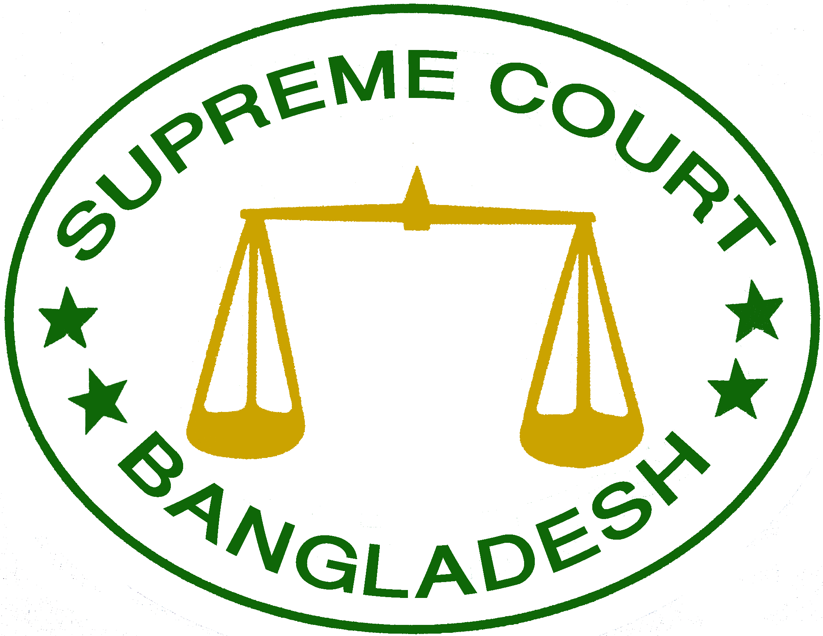
Seventh Amendment Judgment
These observations are preposterous. Let it be unquestionably declared that the supremacy of the constitution was unqualified, it is unqualified and it shall remain unqualified for all time to come.

Slide 14
Doctrines of Efficacy & Necessity in Pakistan!
When the writ petition was filed against the existing military regime, the petitioner lost the case!
State v. Dosso (1958)
Asma Jilani v. State of Punjab (1972)
Begum Nusrat Bhutto v. Chief of Army Staff & Federation of Pakistan (1977)
Syed Zafar Ali Shah v. Gen. Pervez Mosharraf (1999)

