Slide 1
Overview Of Projects

Slide 2
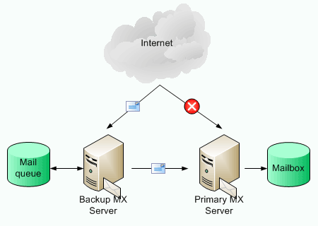
Setting up a Mail Server
A Mail Transfer Agent (MTA) is the program which receives and sends out the email from your server, and is therefore the key part. The default MTA in Ubuntu is Postfix, but exim4 is also fully supported and in the main repository.
Postfix - this guide explains how to set up Postfix.

Slide 3
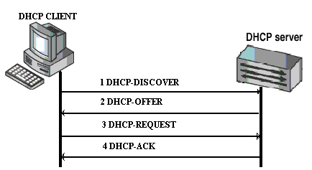
Setting up a DHCP(Dynamic Host Configuration Protocol)
The most common settings provided by a DHCP server to DHCP clients include:
IP address and netmask
IP address of the default-gateway to use
IP addresses of the DNS servers to use

Slide 4

Setting up a Web Server
A Web server is a software responsible for accepting HTTP requests from clients, which are known as Web browsers, and serving them HTTP responses along with optional data contents, which usually are Web pages such as HTML documents and linked objects (images, etc.).

Slide 5
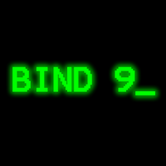
Setting up a DNS(Domain Name System) Server
Domain Name Service (DNS) is like a phone book for the Internet.
Suppose, you know a person’s name but don’t know their telephone number, you can simply look it up in a phone book.

Slide 6
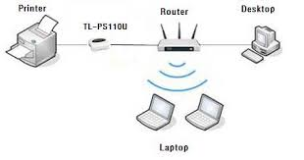
Setting up a Print Server
Ubuntu supports printer sharing over networks.
The primary mechanism for Ubuntu printing and print services is the Common UNIX Printing System (CUPS).

Slide 7
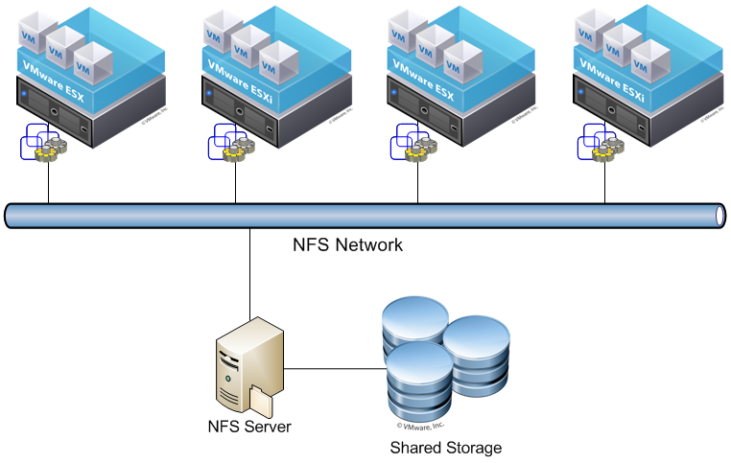
Setting up a NFS(Network File System) Server
NFS allows a system to share directories and files with others over a network.
By using NFS, users and programs can access files on remote systems almost as if they were local files.

Slide 8
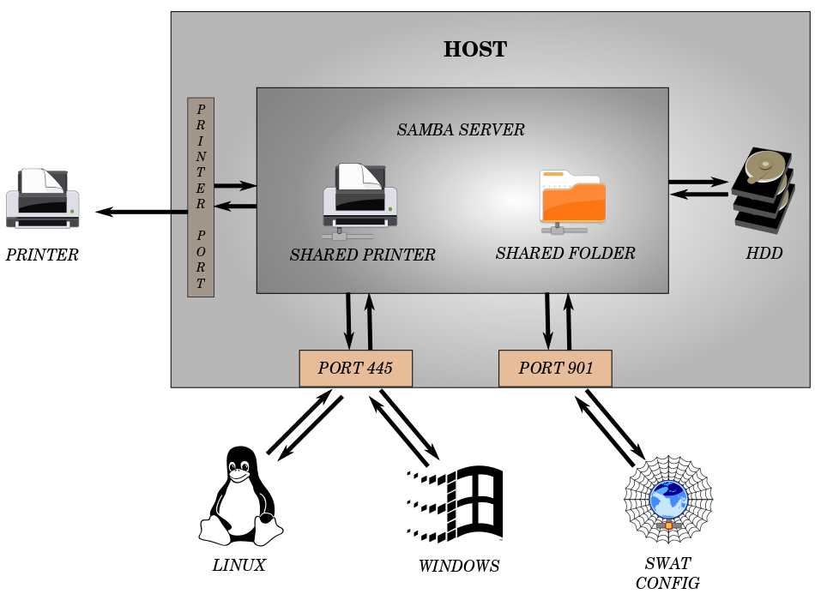
Setting up a Samba Server
Samba is an implementation of the Server Message Block (SMB)/Common Internet File System (CIFS) protocol.
Samba provides support for cross-platform file and printer sharing with Microsoft Windows, OS X, and other Unix systems.

Slide 9
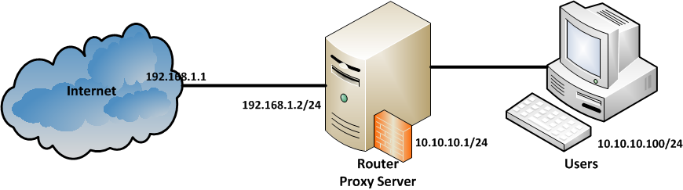
Setting up a Proxy server
Squid is a full-featured web proxy cache server application which provides proxy and cache services for Hyper Text Transport Protocol (HTTP), File Transfer Protocol (FTP), and other popular network protocols.

Slide 10
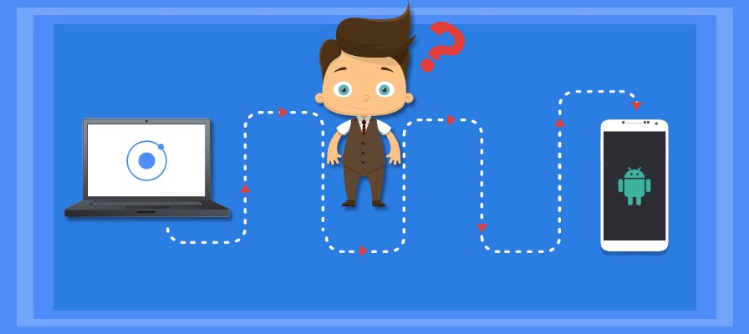
Android application
Android apps are written in the Java programming language.
The Android SDK tools compile your code along with any data and resource files into an APK, an Android package, which is an archive file with an .apk suffix.
One APK file contains all the contents of an Android app and is the file that Android-powered devices use to install the app.

Slide 11
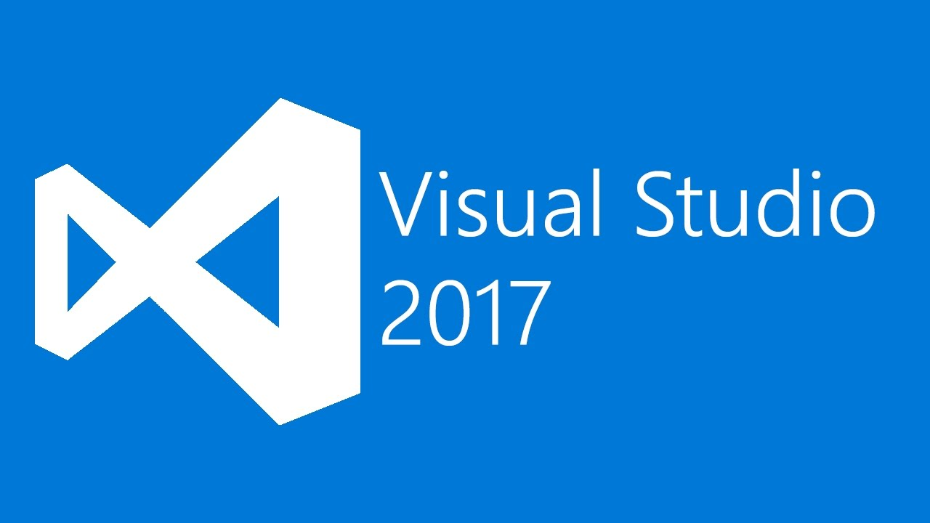
Windows application
Microsoft Visual Studio offers several ways to develop Windows-based applications that run locally on users' computers.
With Visual Studio, you can create Windows-based applications and user interfaces (UI) by using Windows Forms.

Slide 12
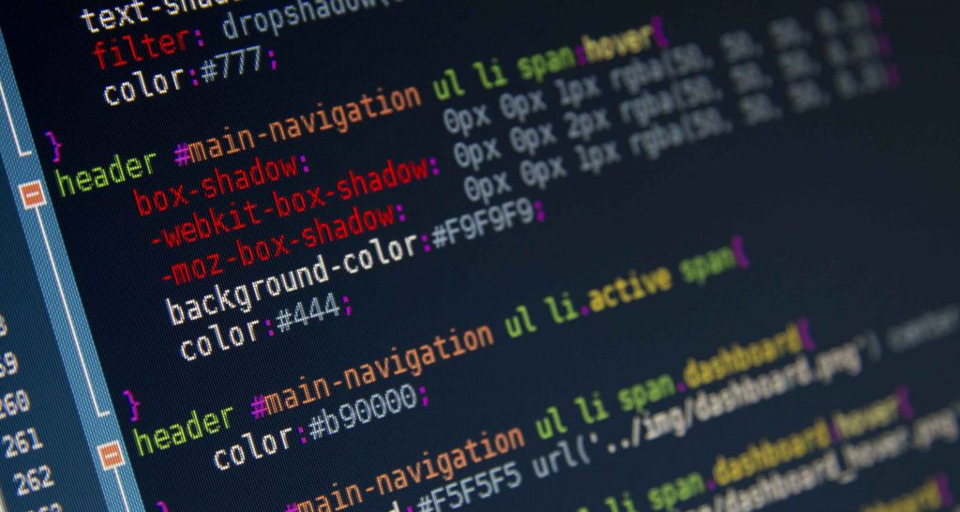
Shell command based work
Simply put, the shell is a program that takes commands from the keyboard and gives them to the operating system to perform.
In the old days, it was the only user interface available on a Unix-like system such as Linux.

Slide 13
THANK YOU ALL……………..

