Slide 1
Topic-6
Describing Data: Displaying and Exploring Data

Slide 2
Dot Plots
A dot plot, on the other hand, groups the data as little as possible, and we do not lose the identity of an individual observation.
To develop a dot plot, simply display a dot for each observation along a horizontal number line indicating the possible values of the data.
If there are identical observations or the observations are too close to be shown individually, the dots are “piled” on top of each other.
This allows us to see the shape of the distribution, the value about which the data tend to cluster, and the largest and smallest observations.
Dot plots are most useful for smaller data sets

Slide 3
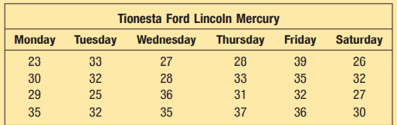
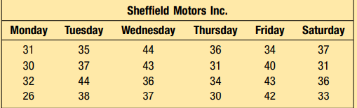
Dot Plots
The service departments at Tionesta Ford Lincoln Mercury and Sheffield Motors Inc., two of the four Applewood Auto Group dealerships, were both open 24 working days last month. Listed below is the number of vehicles serviced last month at the two dealerships. Construct dot plots and report summary statistics to compare the two dealerships.

Slide 4
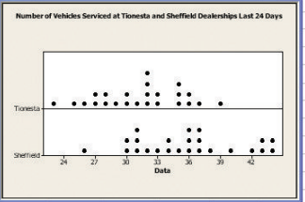
Dot Plots
Tionesta serviced the fewest cars in any day, 23.
Sheffield serviced 26 cars during their slowest day, which is 4 cars less than the next lowest day.
Tionesta serviced exactly 32 cars on four different days.
The numbers of cars serviced cluster around 36 for Sheffield and 32 for Tionesta.

Slide 5
Stem and Leaf Displays
A statistical technique to present a set of data. Each numerical value is divided into two parts. The leading digit(s) becomes the stem and the trailing digit the leaf. The stems are located along the vertical axis, and the leaf values are stacked against each other along the horizontal axis

Slide 6
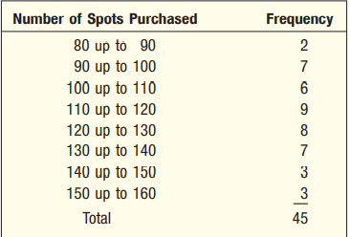
Why need Stem and Leaf Displays?
There are two disadvantages of organizing the data into a frequency distribution:
Lose the exact identity of each value and
Not sure how the values within each class are distributed.
In the above example, we would not know the identity of the values in the 90 up to 100 class.

Slide 7
Stem and Leaf Displays
One technique that is used to display quantitative information in a condensed form is the stem-and-leaf display.
An advantage of the stem-and-leaf display over a frequency distribution is that we do not lose the identity of each observation

Slide 8
Stem and Leaf Displays
Suppose the seven observations in the 90 up to 100 class are: 96, 94, 93, 94, 95, 96, and 97.
The stem value is the leading digit or digits, in this case 9.
The leaves are the trailing digits.

Slide 9


Stem and Leaf Displays
The values in the 90 up to 100 class would appear as follows:
It is also customary to sort the values within each stem from smallest to largest. Thus, the second row of the stem-and-leaf display would appear as follows:

Slide 10
Stem and Leaf Displays
With the stem-and-leaf display, we can quickly observe that there were two dealers that purchased 94 spots and that the number of spots purchased ranged from 93 to 97.
A stem-and-leaf display is similar to a frequency distribution with more information, that is, the identity of the observations is preserved

Slide 11
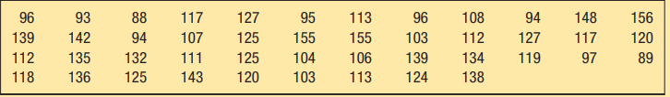
Stem and Leaf Displays
Number of Advertising Spots Purchased by Members of the Greater Buffalo Automobile Dealers Association

Slide 12
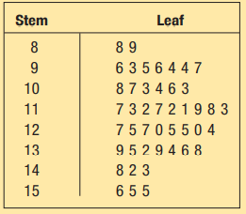
Stem and Leaf Displays
The smallest number of spots purchased is 88.
So the first stem value 8.
The largest number is 156
So the stem values begin at 8 and continue to 15.
The first number in is 96, which will have a stem value of 9 and a leaf value of 6.

Slide 13
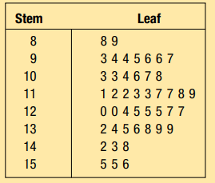
Stem and Leaf Displays
The usual procedure is to sort the leaf values from the smallest to largest.

Slide 14
Conclusions from the stem-and-leaf display
First, the minimum number of spots purchased is 88 and the maximum is 156.
Two dealers purchased less than 90 spots, and three purchased 150 or more.
You can observe that the three dealers who purchased more than 150 spots actually purchased 155, 155, and 156 spots.
The concentration of the number of spots is between 110 and 130.

Slide 15
Conclusions from the stem-and-leaf display
There were nine dealers who purchased between 110 and 119 spots and eight who purchased between 120 and 129 spots.
We can also tell that within the 120 to 129 group the actual number of spots purchased was spread evenly throughout. That is, two dealers purchased 120 spots, one dealer purchased 124 spots, three dealers purchased 125 spots, and two purchased 127 spots.

Slide 16
Dot plot vs Stem-and-leaf chart
For presenting data, especially with a large number of observations, you will find dot plots are more frequently used.
You will see dot plots in analytical literature, marketing reports, and occasionally in annual reports.
If you are doing a quick analysis for yourself, stem-and-leaf tallies are handy and easy, particularly on a smaller set of data.

Slide 17
Thank You!

