Slide 1
Topic-7
Measures Of Skewness

Slide 2
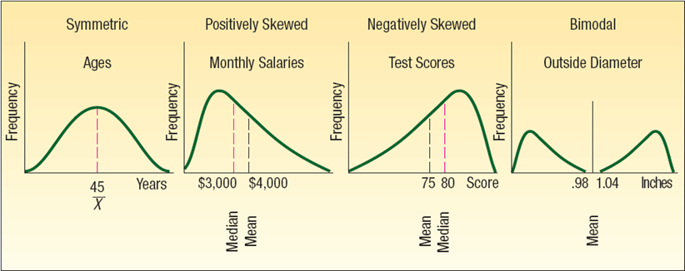
Skewness
Another characteristic of a set of data is the shape.
There are four shapes commonly observed: symmetric, positively skewed, negatively skewed, bimodal

Slide 3
Skewness
In a symmetric set of observations the mean and median are equal and the data values are evenly spread around these values.
The skewness for any symmetric data should have a skewness near zero.

Slide 4
Skewness
A set of values is skewed to the right or positively skewed if there is a single peak and the values extend much further to the right of the peak than to the left of the peak. In this case, the mean is larger than the median.
Example: Think of the salaries of those employed in a small company of about 100 people. The president and a few top executives would have very large salaries relative to the other workers and hence the distribution of salaries would exhibit positive skewness.

Slide 5
Skewness
In a negatively skewed distribution there is a single peak but the observations extend further to the left, in the negative direction, than to the right. In a negatively skewed distribution, the mean is smaller than the median.
Example of negatively skewed data could be the exam scores of a group of college students who took a relatively simple exam. If you draw a curve of the group of students' exam scores on a graph, the curve is likely to be skewed to the left.

Slide 6
Skewness
A bimodal distribution will have two or more peaks. This is often the case when the values are from two or more populations.
For example, the number of customers who visit a restaurant each hour follows a bimodal distribution since people tend to eat out during two distinct times: lunch and dinner. This underlying human behavior is what causes the bimodal distribution

Slide 7
The coefficient of skewness
The coefficient of skewness can range from -3 up to 3.
A value near -3, indicates considerable negative skewness.
A value such as 1.63 indicates moderate positive skewness.
A value of 0, which will occur when the mean and median are equal, indicates the distribution is symmetrical and that there is no skewness present.

Slide 9

EXAMPLE
Following are the earnings per share for a sample of 15 software companies for the year 2007. The earnings per share are arranged from smallest to largest.
Compute the mean, median, and standard deviation. Find the coefficient of skewness using Pearson’s estimate. What is your conclusion regarding the shape of the distribution?

Slide 11
Thank You!

