Slide 1
Topic 8
Measures Of Kurtosis

Slide 2
Kurtosis
Kurtosis is a measure of the combined weight of a distribution's tails relative to the center of the distribution.
It is another measure of a shape of a frequency curve.
While Skewness identify the extent of asymmetry, kurtosis measures the degree of peak of a frequency distribution.

Slide 3
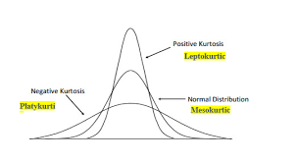
Kurtosis
When the peak of a curve becomes relatively high, then that curve is called Leptokurtic.
When the curve is flat topped, then it is called Platykurtic.
The normal curve is called Mesokurtic.

Slide 4
Thank You!

