Slide 1
Discrimination towards East Pakistan (1947 – 1971)
Rokunuzzaman Biswas
Lecturer
History of the Emergence of Bangladesh

Slide 2
Condition of East Pakistan
Pakistan emerged in accordance with the proposals made in the Lahore Resolution
East Pakistan did not get the status of a separate state
As time marched on the gap between the two countries became wider
They considered East Pakistan as its colony
East Pakistan started logging behind due to the oppressive rule of West Pakistan.

Slide 3
Political Discrimination
They defied democracy & autonomy
The national leaders were oppressed & sent in jail
Removed the elected government of Juktafront from the power unlawfully
Imposed Martial Law in 1958
East Pakistan had a very few representatives in the cabinet
Among 9 heads of government only 3 were Bangalees
Among 221 ministers, the Bagalees were 95

Slide 4
Administrative Discrimination
Capital was set up in Karachi in 1947
State Bank, Ministries, Secretariats were in West Pakistan
All the head offices were in West Pakistan
West Pakistanies got employment in a large scale in all government offices
Government job was not easy for the Bangalee students
In 1956, 2900 Bangalees among 42000 employees
(48-63) 346 CSP officers where Bangalees were only 126
Among 69 ambassadors, only 9 were Bangalees

Slide 5
In the Defence Sector
Discrimination in the Army, Navy, & Air Force
Punjabis had been occupying the top post
Quota system: 60% Punjabis, 35% Pathans
In 1955, among 2211 army officers Bangalees were only 82
In 1966, among 17 top ranking officials, there was only one Bangalee
Among 5 lakhs soldiers, Bangalees were only 20000 .

Slide 6
Economic Disparity
Head offices of banks, insurances, & commercial organizations were in West Pakistan
Money was laundered to West Pakistan
All types of planning were designed in West Pakistan
Most of the mills & factories were set up in West Pakistan
In 1956 West Pakistan received 500 crore at the budget where as East Pakistan got ony 113 crore
development expenditure was as low as 20%
Foreign aids : 388 cr in East Pakistan, 906 cr in West Pakistan

Slide 7
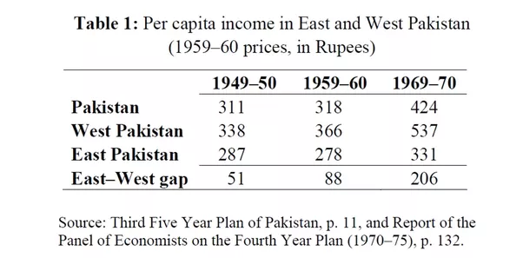
Per Capita Income

Slide 8
Disparity in Education
Took massive plan for the spread of education in West Pakistan
Attempted to replace Bangla with Urdu as the medium of education
1955-67: 2084m Rs for West Pakistan, where as 797m Rs for East Pakistan.
West Pakistan gained 35,287 additional primary schools, East Pakistan declined by a total of 902
Scholarships: East Pakistan got only 5 out of 35.

Slide 9
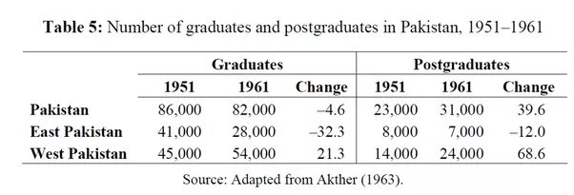
Graduates & Postgraduates

Slide 10
Cultural Disparity
Language issue: Bangla 56.40%, Urdu 3.27%,Punjabi 28.55%, others 11.78%
Ban on Tagore’s songs
Pahela Baishakh

Slide 11
Social Disparity:
Due to the economic and planning disparities of the government, the social life of the two regions of Pakistan was of two types. Their aim was to keep the Bengalis destitute and diseased so that they would not be able to be active in politics. The price of rice was 18 rupees in West Pakistan and 50 rupees in East Pakistan. The price of wheat was 10 rupees in West Pakistan and 35 rupees in East Pakistan.

