Slide 1


Slide 2
Chapter 4
Consumer Buying Behavior and Decision Making
McGraw-Hill/Irwin
Copyright © 2004 by The McGraw-Hill Companies, Inc. All rights reserved.

Slide 3
After studying this chapter, you should be able to:
Discuss the importance of consumer behavior.
Understand consumer decision making and some of the important influences on those decisions.
Distinguish between low-involvement and high-involvement consumer behavior.
Understand how attitudes influence consumer purchases.

Slide 4
After studying this chapter, you should be able to:
Appreciate how the social environment affects consumer behavior.
Recognize many of the individual consumer differences that influence purchase decisions and behavior.
Recognize the outcomes of consumers’ decisions to purchase or not to purchase and how they affect marketing success.

Slide 5

The Nature of Consumer Behavior and Decision Making
Consumer Behavior:
  The mental and emotional processes and physical activities people engage in when they select, purchase, use, and dispose of products or services to satisfy particular needs and desires.

Slide 6
The Nature of Consumer
Behavior and Decision Making
Factors important to understanding consumer markets and consumer behavior:
  The size of the consumer market.
  Changes in consumer shopping habits and purchase decisions.
  Emphasis on consumer-oriented marketing.
  The design of effective marketing strategy.

Slide 7

Growing Consumer Markets
New retail line-ups
    “Price-centric”
    Lifestyle
    “Occasion-centric”
Outdoor living market.
Consumer electronics.
Enhanced experience businesses.

Slide 8
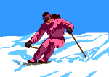
Growing Consumer Markets
Anti-aging products and services.
Health as a national hobby.
High-end sports apparel and equipment.
Safe packaging, pure contents, and “green” concerns.

Slide 9
Consumer Behavior and the Design of Marketing Strategy
Brand Equity:
  The marketplace value of a brand.
Service Recovery:
  Winning back consumers who defect.

Slide 10

Understanding E-Customers
The 10 Most Important Website Attributes:
  Product representation
  Product prices
  Product selection
  On time delivery
  Ease of ordering
  Product information
  Level and quality of consumer support
  Product shopping and handling
  Posted privacy policy
  Site navigation and appearance

Slide 11
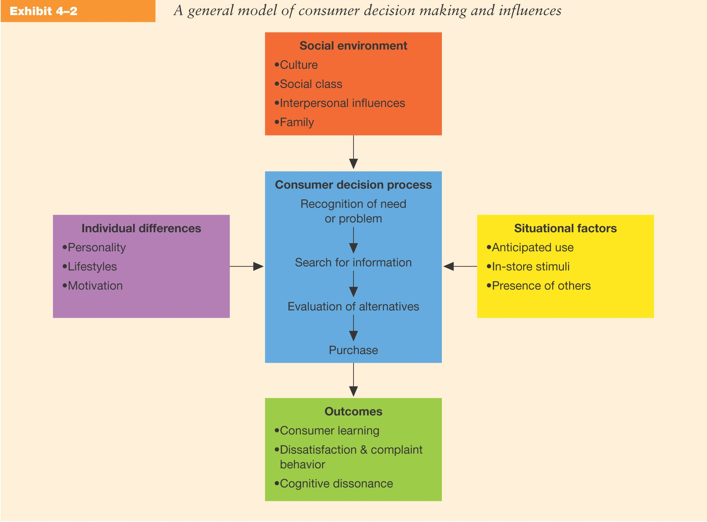
Consumer Decision Making

Slide 12
High- and Low-Involvement Decisions
Involvement:
  The level of importance or interest generated by a product or a decision.
Consumer Information Processing:
  The cognitive processes by which consumers interpret and integrate information from the environment.

Slide 13

High-and Low-Involvement Decisions
High-involvement Decisions:
  Characterized by high levels of importance thorough information processing, and substantial differences between alternatives.
Low-involvement Decisions:
  Occur when relatively little personal interest, relevance, or importance is associated with a purchase.

Slide 14
Types of Consumer Choices
Six Generic Consumer Behavior Choices:
  Product
  Brand
  Shopping area
  Store type
  Store
  Nonstore source (catalogs, PC, & TV shopping)

Slide 15

Attitudes
Consumer Attitudes:
  Learned predispositions to respond favorably or unfavorably to a product or brand.
Attitudes have valence; they can be positive, negative, or neutral.
Strong attitudes are resistant to change.
Attitudes can erode over time if not reinforce.

Slide 16

Attitudes – Marketing Implications
Attitudes are based on beliefs consumers hold about the attributes or features (price, level of services, quality) of the products they are evaluating.
Attitudes are primary causes of behavior causing consumers to buy or not buy products

Slide 17

Experiential Choices
Consumers frequently make choices based on their emotions and feelings.
Affect Referral:
  Consumers elicit from memory their overall evaluations of products and choose the alternative for which they have the most positive feelings.

Slide 18
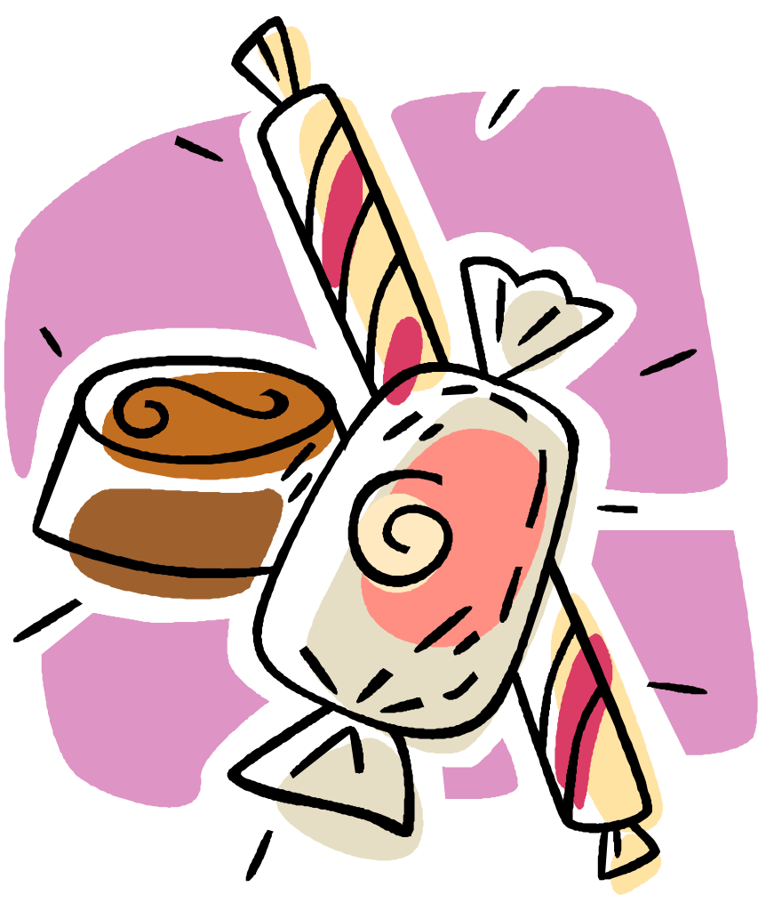
Experiential Choices
Impulse Purchases:
  Choices made on the spur of the moment, often without prior problem recognition.
Time-inconsistent Choices:
  Choices consumers make which act against their own better judgment and engage in behavior they would normally reject.

Slide 19
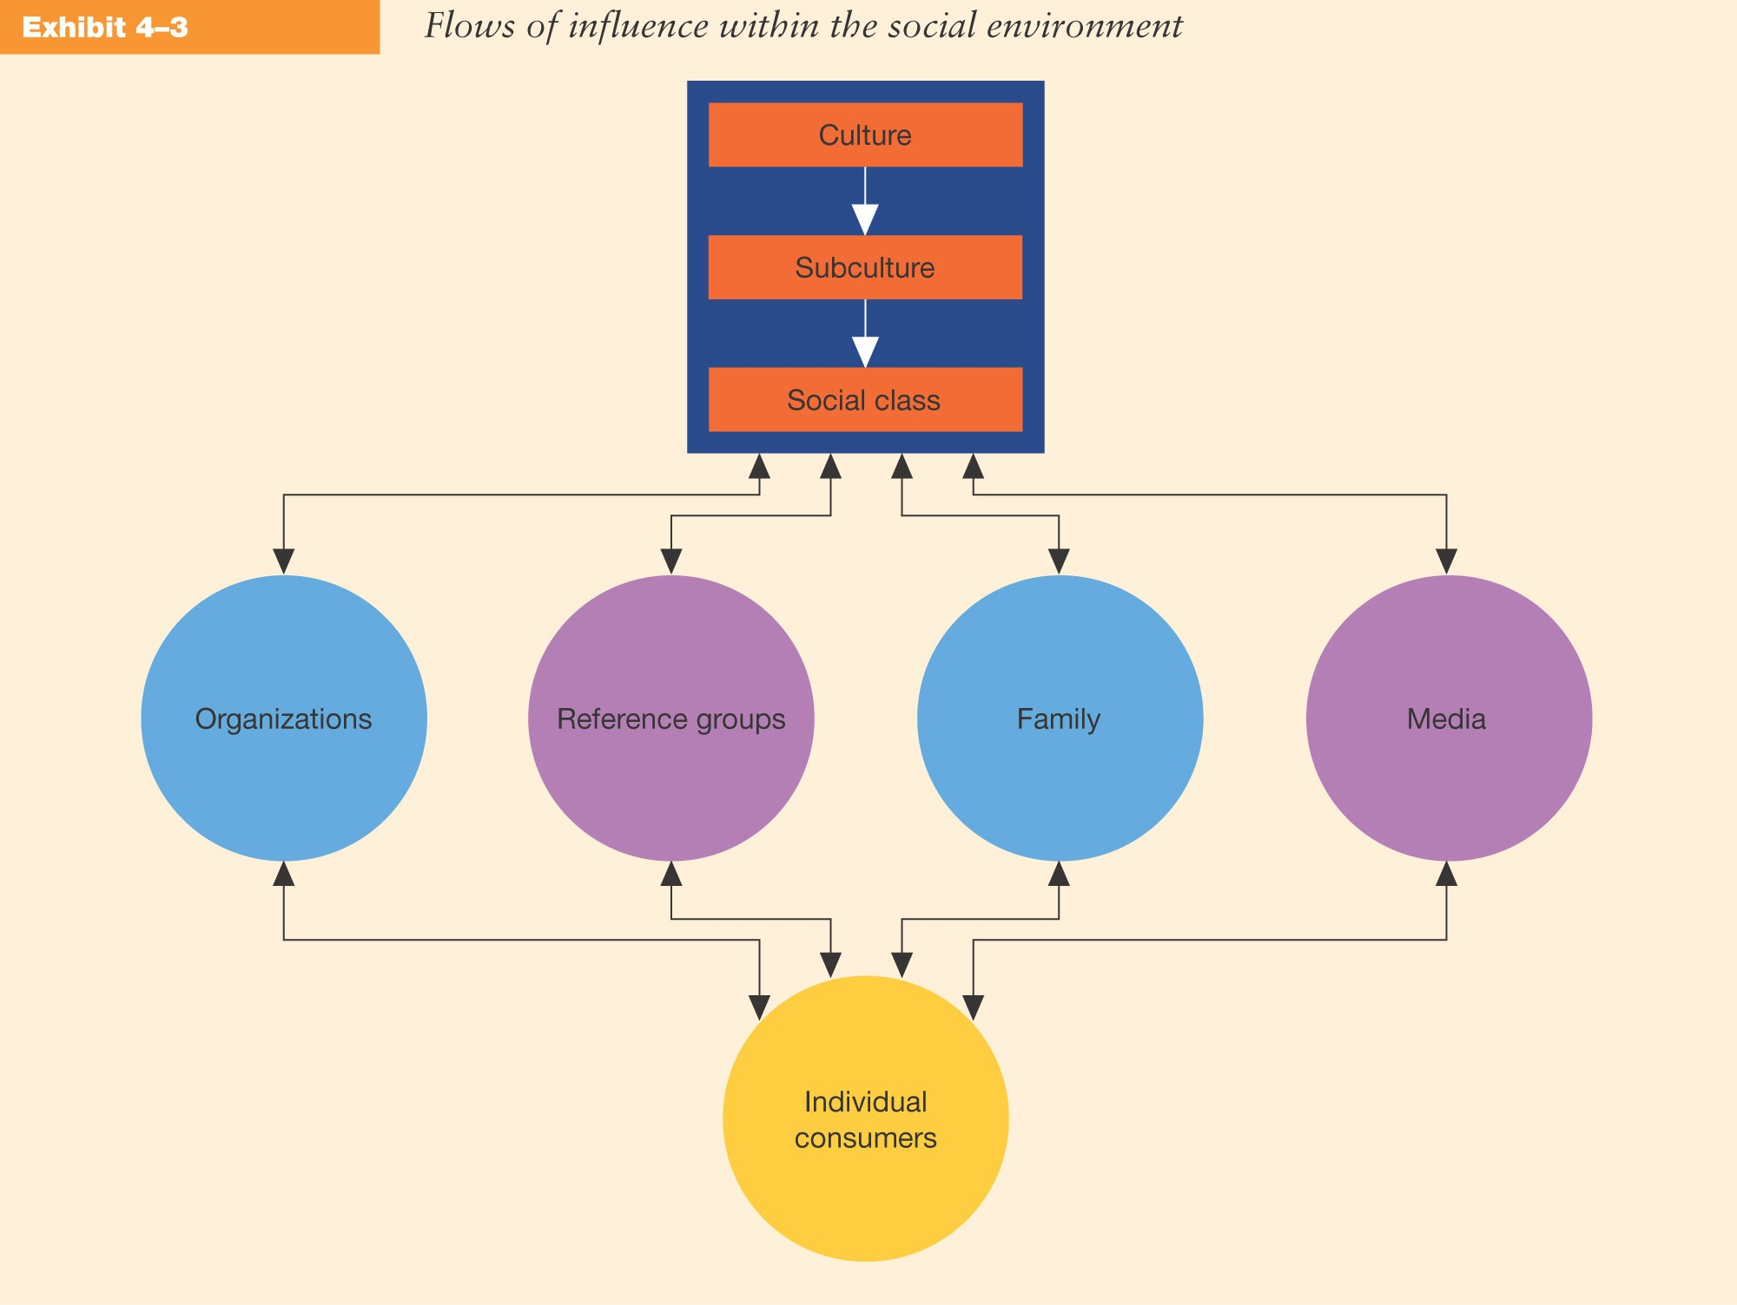
Influence of the Social Environment

Slide 20
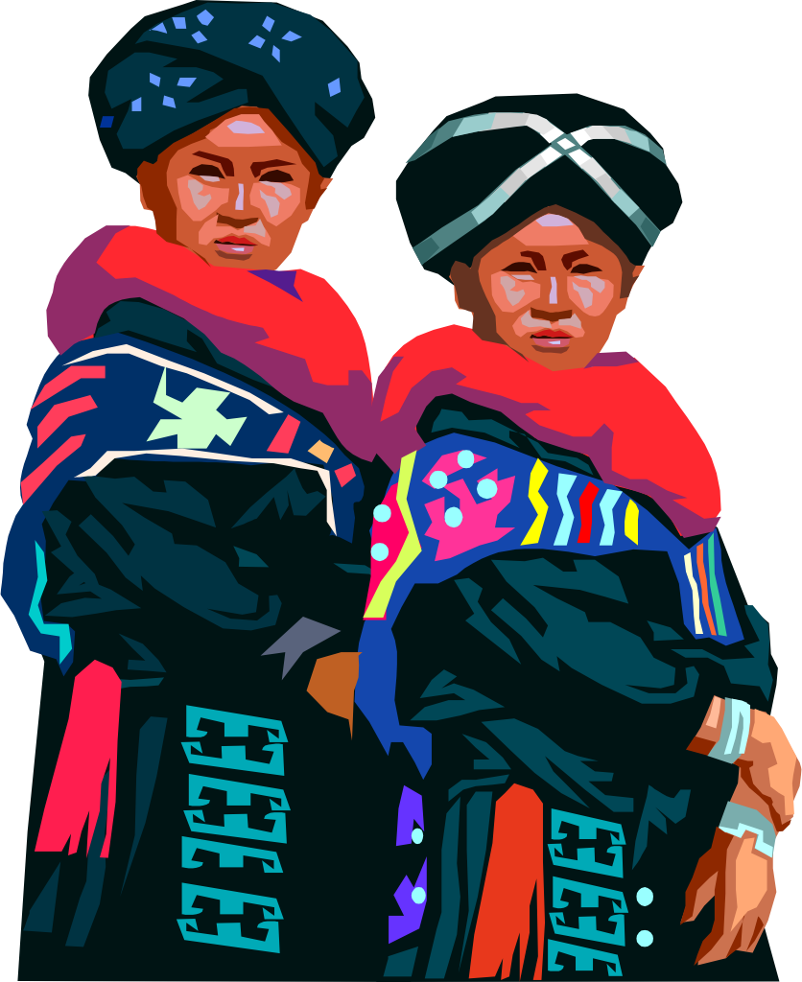
Cultural Influences
Culture:
  The values, ideas, attitudes, and symbols that people adopt to communicate, interpret, and interact as members of society.
Culture is learned and transmitted from one generation to the next.

Slide 21
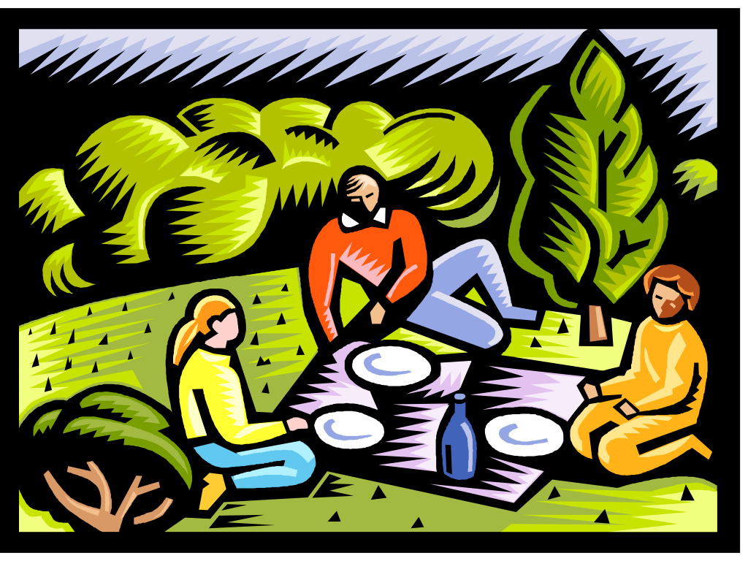

Cultural Influences
Socialization:
  The process of absorbing a culture
Consumer Socialization:
  When socialization is applied to marketing and consumer behavior.

Slide 22
Values
Values:
  Shared beliefs or cultural norms about what is important or right.
Cultural values directly influence how
Consumers view and use individual
products, brands, and services.

Slide 23
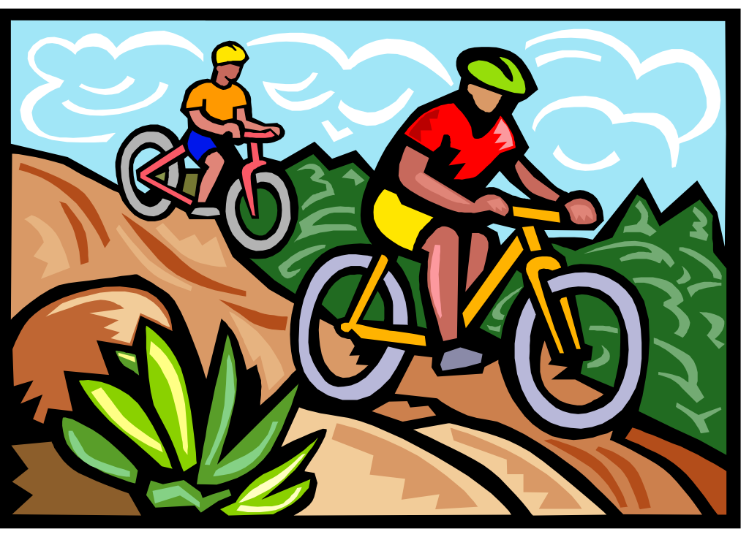
Values
The List of Values (LOV):
    • Self-respect
    • Warm relationships
    • Self-fulfillment
    • Sense of belonging
    • Respect from others
    • Excitement
    • Security
    • Sense of accomplishment
    • Fun and enjoyment in life

Slide 24

Values
Values and Lifestyles (VALS):
  Identifies eight market segments that share similar end values.

Slide 25
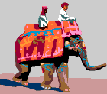
Subcultures
Ethnic Patterns:
  The norms and values of specific groups or subcultures within a society.

Slide 26

Subcultures
Demographic characteristics used to identify subcultures:
  Nationality - Hispanics, Italians
  Race - African-American, American Indian, Asian
  Region - New England, the South
  Age - Elderly, teenager
  Religion - Catholic, Jewish, fundamentalist

Slide 27

Social Class Influences
Social Classes:
  Relatively homogeneous divisions within a society that contain people with similar values, needs, lifestyles, and behavior.

Slide 28
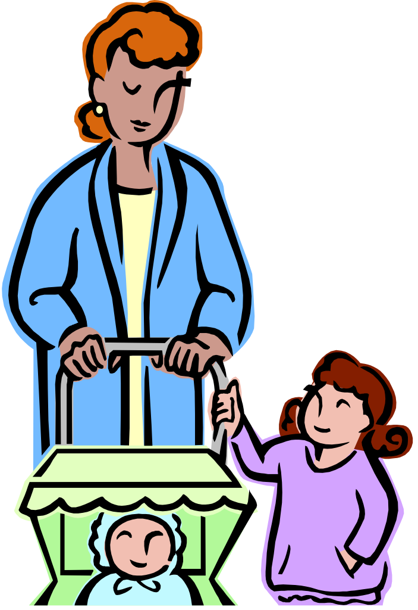
Family Influences and the Family Life Cycle
Family influences play two important roles in:
  The socialization of people.
  Affecting individual purchase decisions.

Slide 29
Family Influences and the Family Life Cycle
Family Life Cycle:
  The sequence of steps a family goes through:
    From young, to
    Single adults, to
    Married couples whose children have left home, to
    The retired survivor

Slide 30
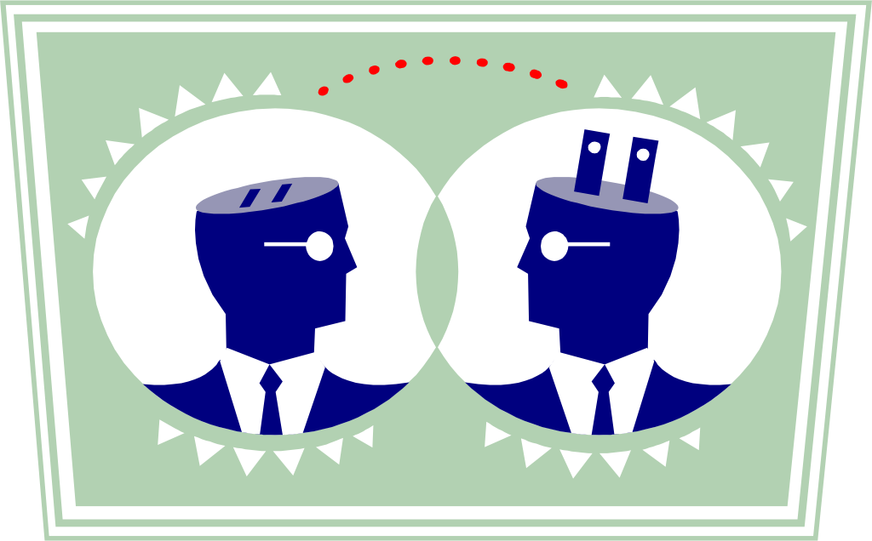
Interpersonal Influences
Reference Groups:
  Those others look to for help and guidance including friends, co-workers, and others.

Slide 31
Interpersonal Influence Processes
Three Types of Interpersonal Processes:
  Informational influence is based on the consumer’s desire to make informed choices and reduce uncertainty.
  Utilitarian influence is reflected in compliance with the expectations, real or imagined, of others – referred to as norms.
  Value-expressive influence stems from a desire to enhance self-concept through identification with others.

Slide 32
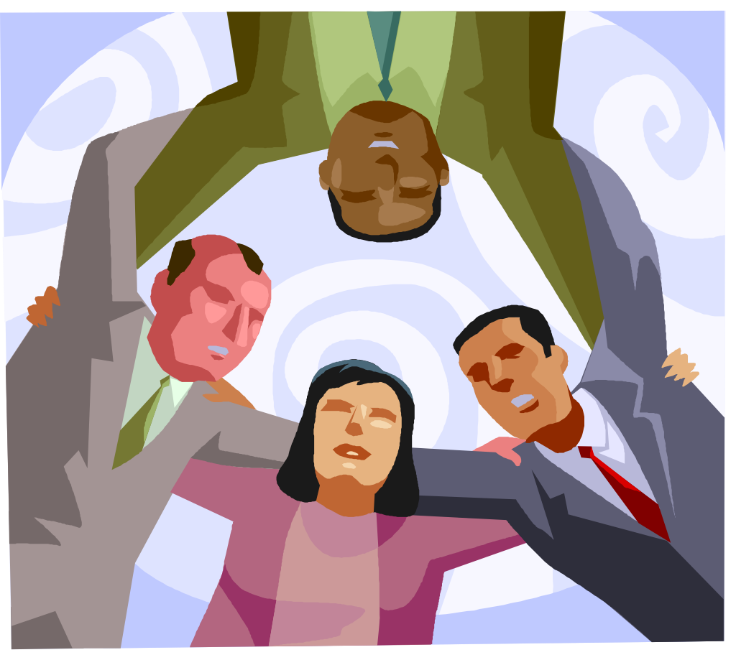
Interpersonal Influence Processes
Normative Influence:
  A combination of Utilitarian and Value-Expressive Influence.

Slide 33

Individual Differences
Sources of Individual Differences Influencing Consumer Behavior:
  Word-of-mouth communications
  Personality
  Lifestyles and psychographics
  Motivation

Slide 34
Word-of-Mouth Communications
Opinion Leaders:
  Influence consumer behavior through
  word-of-mouth communications.
Market Mavens:
  Consumers who know about many kinds of products,
  places to shop, and other facts of the market, and they
  like to share this information with other consumers.

Slide 35

Personality
Personality:
  Reflects a person’s consistent response to his or her environment.
Personality traits related to consumer behavior:
  Extroversion
  self-esteem
  dogmatism (closed-mindedness)
  aggressiveness

Slide 36

Personality
Self-Concept:
  The overall perception and feeling that one has about herself or himself.

Slide 37
Lifestyles and Psychographics
Lifestyle:
  Describes a person’s pattern of living as expressed in activities, interests, and opinions (AIO statements).
Psychographics:
  Divide a market into lifestyle segments on the basis of consumer interests, values, opinions, personality characteristics, attitudes, and demographics.

Slide 38
Motivation
Motivation:
  Refers to a state or condition within a person that prompts goal-directed behavior.
Maslow’s Hierarchy:
  Self-actualization Needs - Art, books, recreation
  Esteem Needs - Clothing, home furnishings
  Love and Belonging Needs - Mementos, gifts, photos
  Safety Needs - Burglar alarms, seat belts
  Physiological Needs - Food, heat, shelter

Slide 39
Situational Factors
Consumers purchase goods
for use in certain situations.
The anticipated use
influences choice.
Situational factors can
inhibit as well as motivate.

Slide 40

Situational Factors
Consumers buy products with anticipated uses in mind.

Slide 41
Consumer Behavior Outcomes
Consumer Learning happens when changes
occur in knowledge or behavior patterns.
Marketers influence consumers by imparting knowledge
through advertising, product labels, and personal selling.
Marketers hope consumers will attend to, comprehend,
and then remember these messages

Slide 42
Consumer Satisfaction, Dissatisfaction, and Complaint Behavior
Satisfaction and dissatisfaction describe the positive, neutral, or negative feelings that may occur after purchase.
Consumer complaints are overt expressions of dissatisfaction.
Firms adopting a customer value perspective must employ marketing communications that convey realistic expectations.

Slide 43
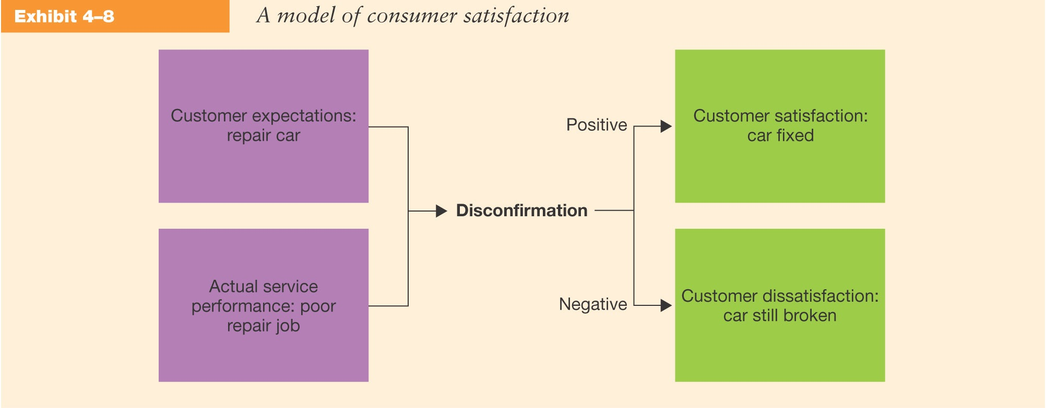
A Model of Consumer Satisfaction

Slide 44
Findings of Customer
Satisfaction Research
Satisfaction judgements evolve and are changeable as products are used.
Satisfaction judgments have a social component determined by the satisfaction of others in the household.
Emotions are important and yield insights beyond simple comparison standards, such as expectations and performance.
Product satisfaction is also related to quality of life and life satisfaction.

Slide 45
Customer Complaints
Voice Responses
(seeking satisfaction directly from the seller)
Private Responses
(bad-mouthing to friends)
Third-party Responses
(taking legal action, filing complaints
with consumer affairs agencies)

Slide 46
Cognitive Dissonance
Cognitive Dissonance:
A form of postpurchase doubt about the appropriateness of a decision.
Cognitive Dissonance occurs when:
  Decisions are major
  The purchase is important
  Perceived risk is high
  The purchase is visible
  The decision involves a long-term commitment

Slide 47
Ethical and Social Issues in Consumer Behavior
Unethical consumer behaviors include
shoplifting and abuse of return policies
Consumers are increasingly incorporating
social concerns into their buying decisions

Slide 48
Ethical and Social Issues in Business Behavior
Standards of Business Behavior Evaluation
Corporate Social
Responsibility
Business Ethics

