Slide 1

Basics for business communication

Slide 2
Business Communication
Author: Flatley, Lesikar
Edition: 11th Edition,2017
Publisher: McGraw-Hill
Prepared By: Samia Shanjabin

Slide 3

Contents
Communication
Types of business communication
Understanding workplace communication
Factors related to workplace communication
The role of communication in business

Slide 4
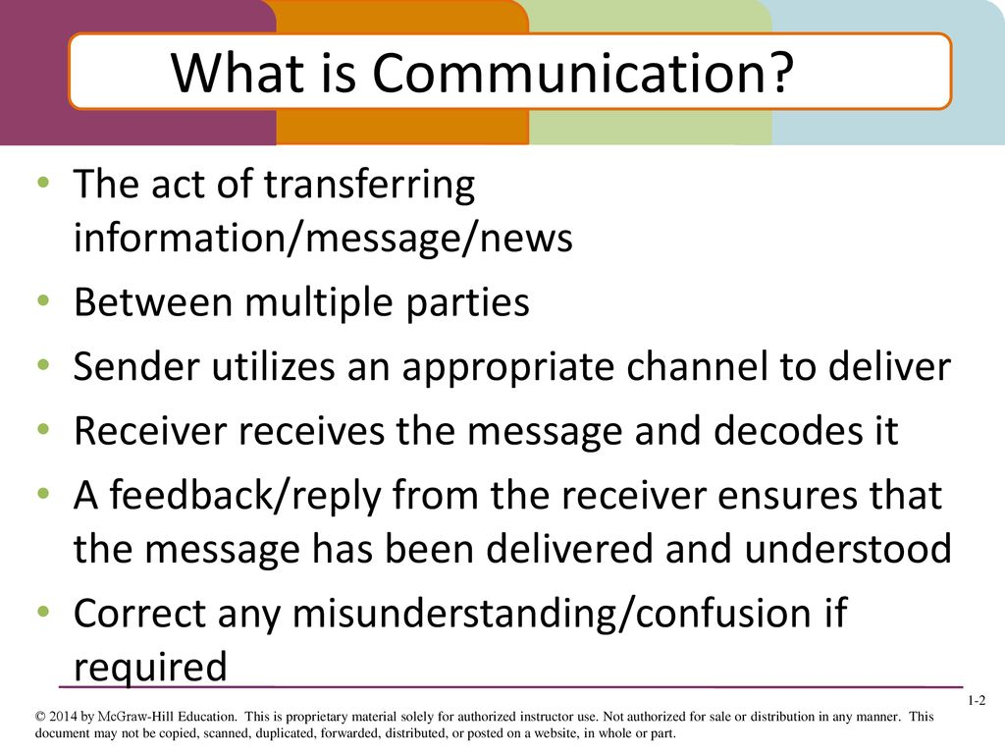
Communication

Slide 5
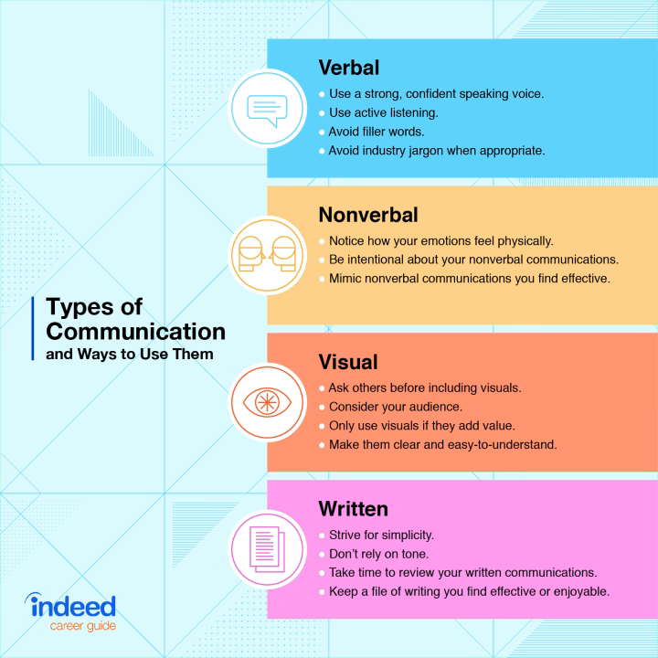
Types of business communication

Slide 6
Understanding workplace communication
To listen actively for the subtext of employees’ words.
To persuade rather than command.
To target the right words to the audience of the communication.
To react to the content and not to the employees’ manner of expressing themselves.
To let people know that criticism is welcome.
Make the intentions clear before acting.
Always assume that employees take responsibility for what they say.

Slide 7
Factors related to workplace communication
The effectiveness of the managers and supervisors in the organization is enhanced by their aptitude for communication. When managers and supervisors are better understood and appreciated, they are followed and supported. The following are the four factors which are related to the workplace communication (Fig 1) and which help organizations in the achievement of their goals.

Slide 8
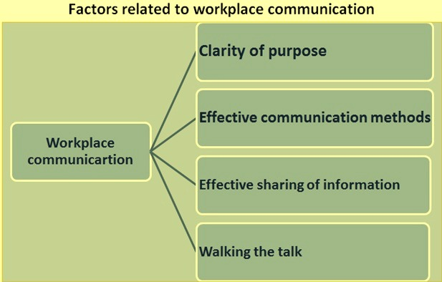

Slide 9

Factors related to workplace communication
1. Clarity of purpose – Successful organizations and initiatives focus on a few key messages. Managements of the successful organizations are consistent in their messages and ensure that every employee involved understands the goals and how to achieve them.
2. Effective communication methods -The level of trust and openness in various key activities is also critical for success. Employees at all levels can ask for information and receive honest, useful answers.

Slide 10
Factors related to workplace communication
3. Effective sharing of information – Information sharing is effective when systems and networks enable managers, supervisors, and employees to have the right information at the right time to do their jobs, to share opinions and discuss ideas, and to circulate best practices and learn from each other.
4. Walking the talk – Managers and supervisors must also be good communicators themselves, so that they can convey their ideas convincingly. Their behavior must be consistent with what they are saying, both formally and informally.

Slide 11
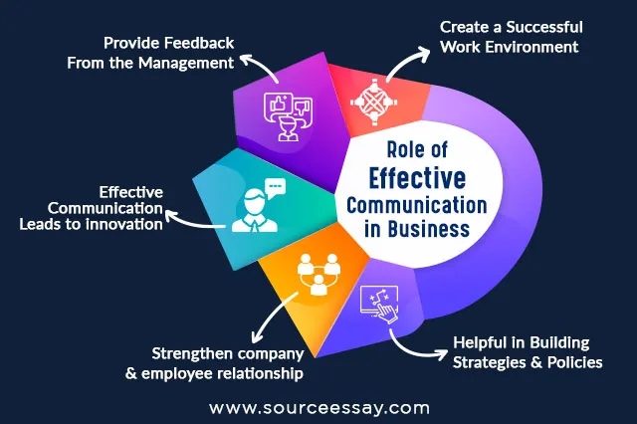

Slide 12


