Slide 1


Slide 2
The Charter of 1600
The first East India Company was incorporated in England under a Charter granted by Queen Elizabeth I on 31 December 1600
It was given the exclusive right of trading in all parts of Asia, Africa and America. The charter was granted for 15 years.
The charter also granted legislative power to the company to make bye-laws, ordinance etc.

Slide 3
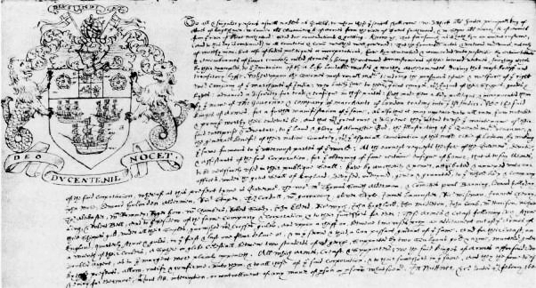

Slide 5
Treaty with Emperor Jahangir
In 1618, the East India Company entered into a treaty with the Mughal Emperor Jahangir and this proved a turning point in the legal history of India.
The order (Firman) of the Emperor provided that the Mughal Qazi/ Governor of the relevant place will protect the English people from all sorts of oppression and injury.

Slide 6
The Charter of 1615
The Charter empowered the company to punish its servants for capital offences (willful murder and mutiny) on long voyages by a jury of 12 servants of the company.
The company was given this power to maintain order and discipline on board during the voyage.

Slide 7
