Slide 1


Slide 2
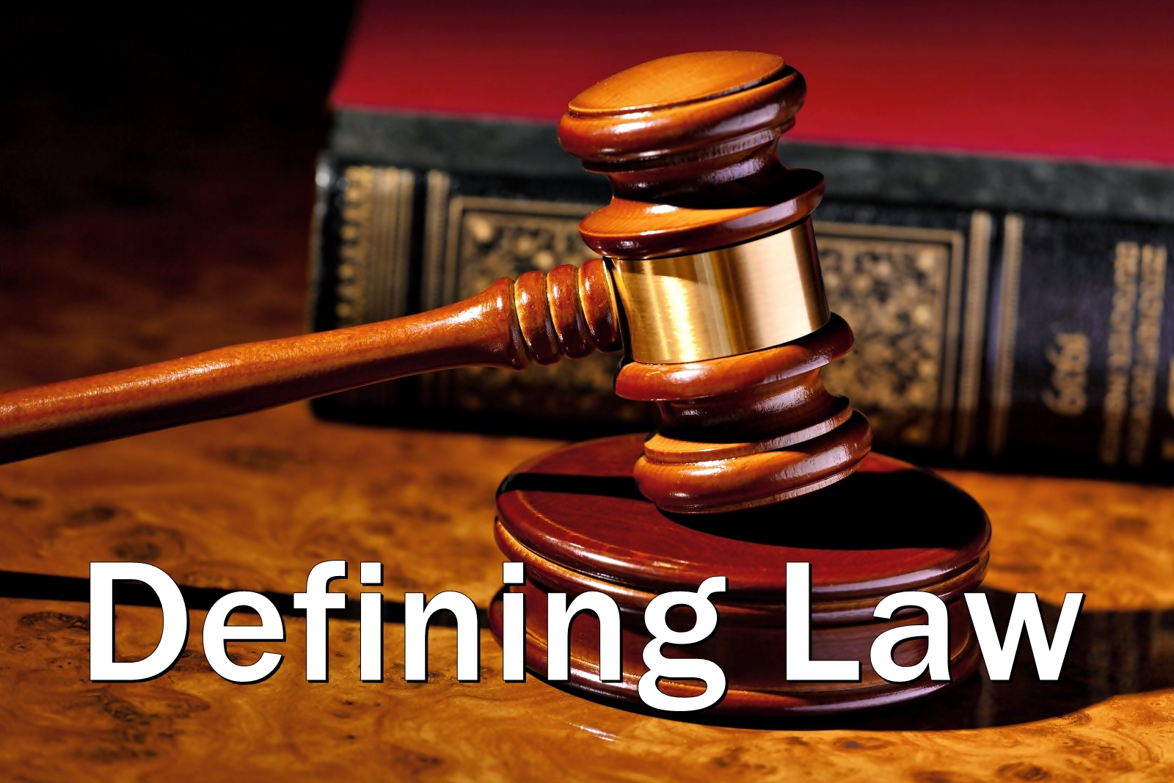

Slide 3
1. Law is a system of rules that are created and enforced through social or governmental institutions to regulate the behavior of individuals.
2. Austin said that law is the command of sovereign backed by sanctions.
3. Salmond defined law as the body of principles recognized and applied by the state in the administration of justice.

Slide 4
4. Article 152 of the Bangladesh Constitution provides that, “Law means any act, ordinance, order, rule, regulation, bye-law, notification or other legal instrument and any custom or usage, having the force of law in Bangladesh.”

Slide 5


Slide 6
1. To maintain peace in the society.
2. Justice Holmes said “The object of law is not the punishment of sins but to prevent criminal activities’’.
3. To enable individual to have the maximum of freedom.
4. Law avoids the dangers of arbitrary, biased and dishonest decisions because law is certain and it is known. It is not enough that justice should be done but it is also important that it is seen to be done.

Slide 7
5. Legislature represents the wisdom of the people and therefore a law made by the legislature is much safer because collective decision making is better and more reliable than individual decision making.
6. Laws provide uniformity and certainty of administration of justice

Slide 8
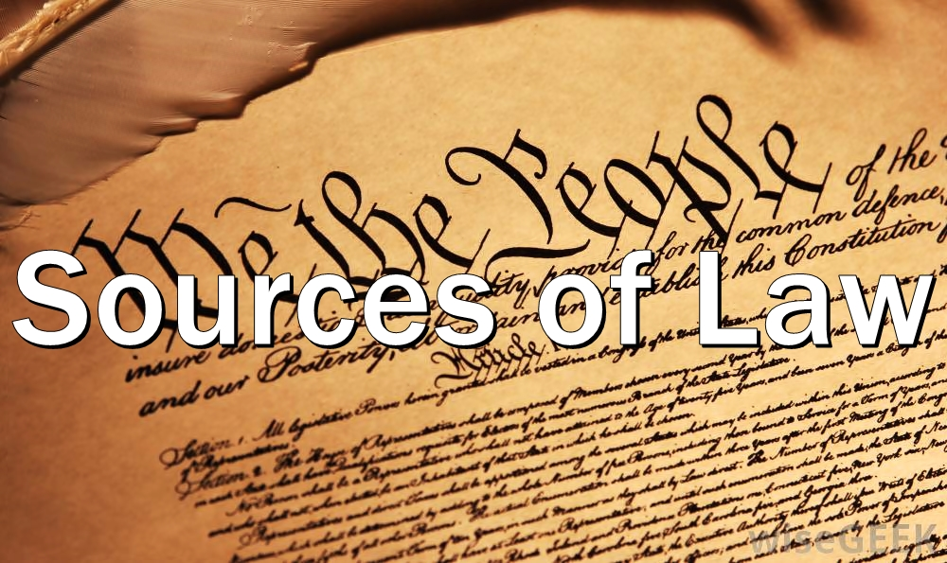

Slide 9
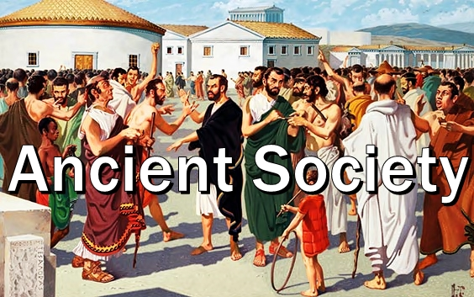

Slide 10
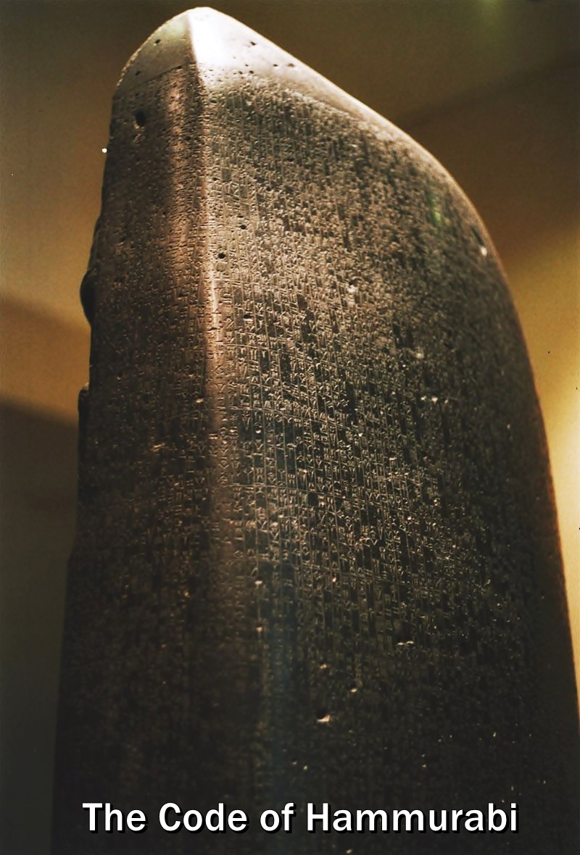

Slide 11
The Code of Hammurabi is a well-preserved Babylonian code of law of ancient Mesopotamia, dated back to about 1754 BC . The sixth Babylonian king, Hammurabi, enacted the code, and partial copies exist on a 2.25 meter (7.5 ft) stone stele and consists of 282 laws.

Slide 12
One of the written doctrine was the Doctrine of “lex talionis,” or the laws of retribution, sometimes better known as “an eye for an eye.”
The Code of Hammurabi includes many harsh punishments, sometimes demanding the removal of the guilty party’s tongue, hands, breasts, eye or ear. But the code is also one of the earliest examples of an accused person being considered “innocent until proven guilty”.

Slide 13
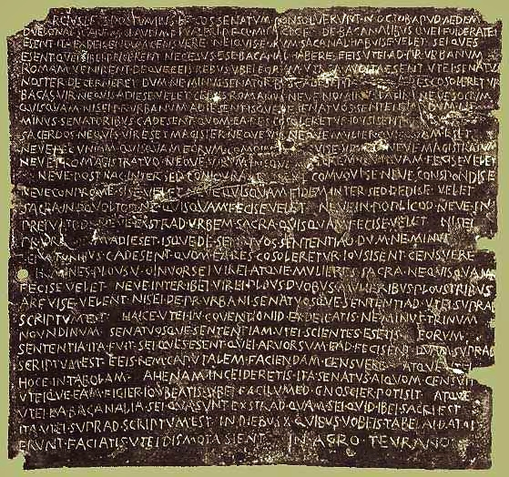

Slide 14
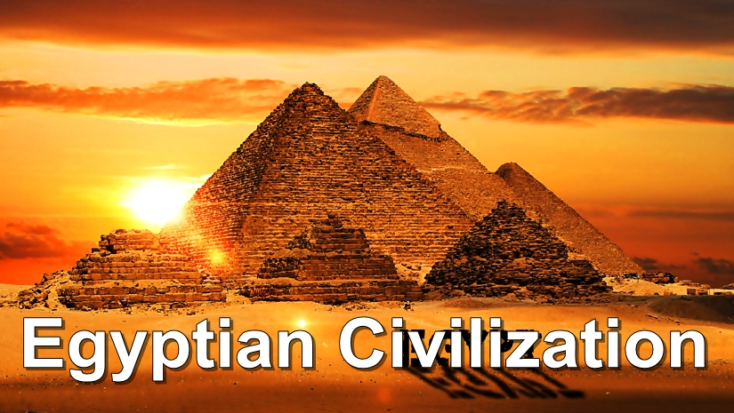

Slide 15
Egyptians did not have professional judges. In fact there was no word for judge in the Egyptian language. Even though no book of laws from ancient Egypt have been found, court records show that Egyptian law was usually based on a common-sense approach. In fact Egyptian law encouraged reaching agreements to resolve conflicts rather than sticking to a complicated set of laws.

Slide 16
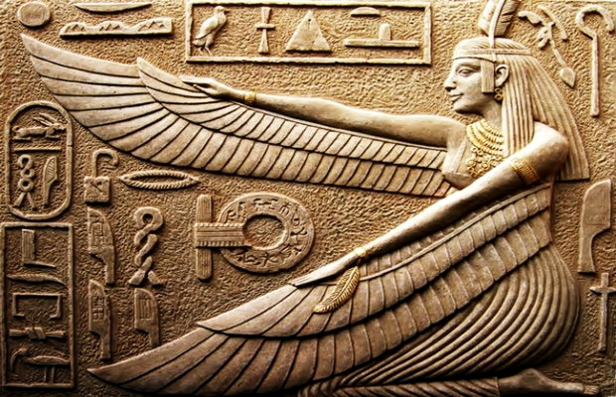
Justice was represented by Goddess Maat and the feather of justice was above her head.

Slide 17
The ancient Egyptians viewed men and women, including people from all social classes except slaves, as essentially equal under the law, and even the lowliest peasant was entitled to petition for redress.

Slide 18
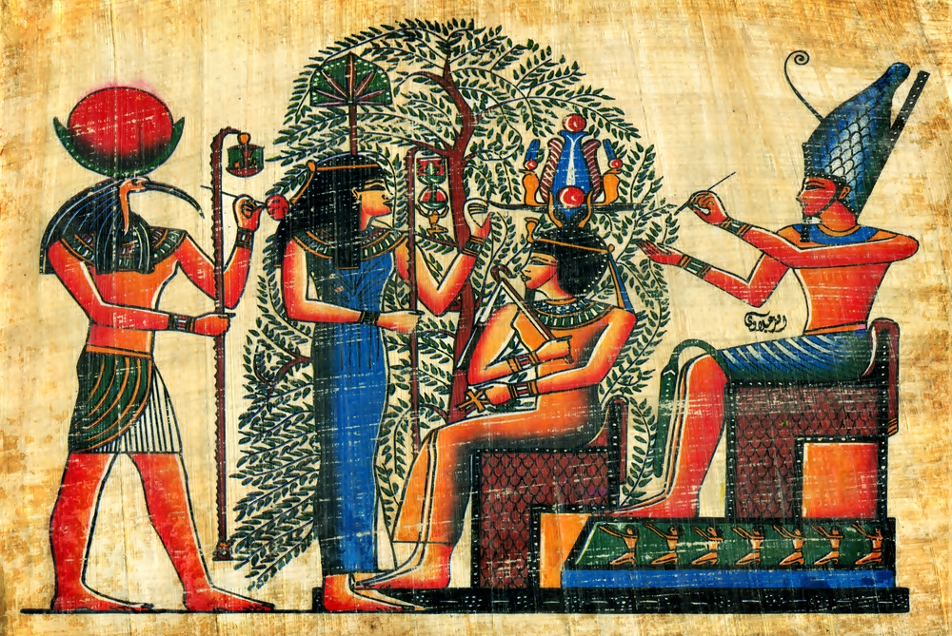

Slide 19
The head of the legal system was officially the pharaoh, who was responsible for enacting laws, delivering justice, and maintaining law and order.

Slide 20
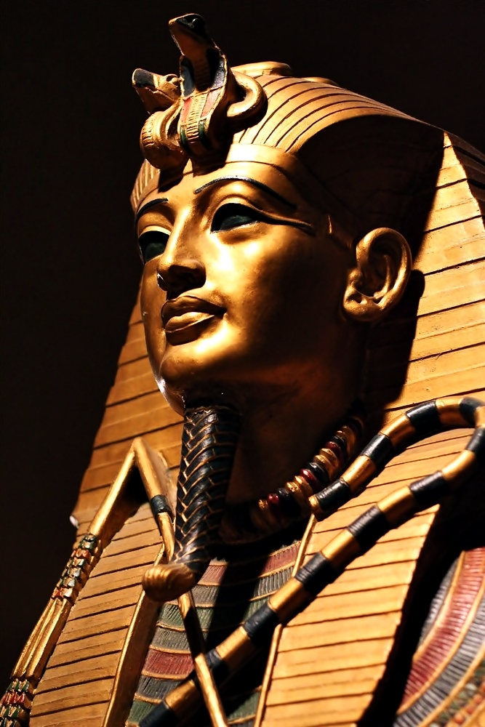

Slide 21
Punishment for minor crimes involved either imposition of fines, beatings, facial mutilation, or exile, depending on the severity of the offense. Serious crimes such as murder and tomb robbery were punished by execution, carried out by decapitation, drowning, or impaling the criminal on a stake. Punishment could also be extended to the criminal's family.

Slide 22


Slide 23
After the Dark Ages (900 BC), the Ancient Greeks had no official laws or punishments. Murders were settled by members of the victim's family, who would then go and kill the murderer.
Around 620 BC Draco, the lawgiver, wrote the first known written law of Ancient Greece. Law was classified into 4 categories namely:
Tort law, Family law, Public law and Procedural law

Slide 24
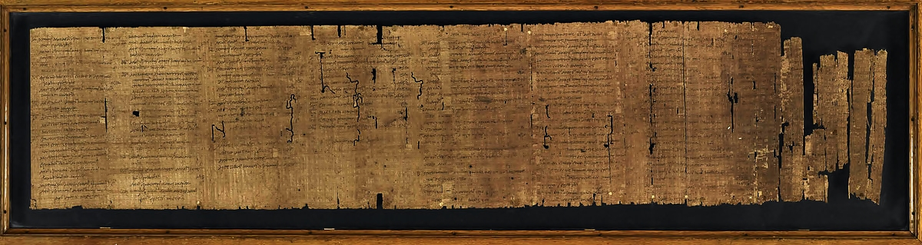
The Aristotelian Constitution of the Athenians

Slide 25
Law Makers
Law givers were not rulers or kings, but appointed officials whose only job was to write laws. The officials in the government wanted to make sure that law givers would not take sides or be a part of just one group, otherwise laws might be unfair. Because of this, law givers were not a part of normal government, and they were considered political outsiders.

Slide 26
Draco
One of the most famous law givers in Athens was Draco. His homicide law is the first known written law of Ancient Greece. Draco earned a reputation for being extremely severe with his punishments, and it is even argued that he set death as the penalty for all offenses. He served as law giver until he was succeeded by Solon in about 594 BC.

Slide 27
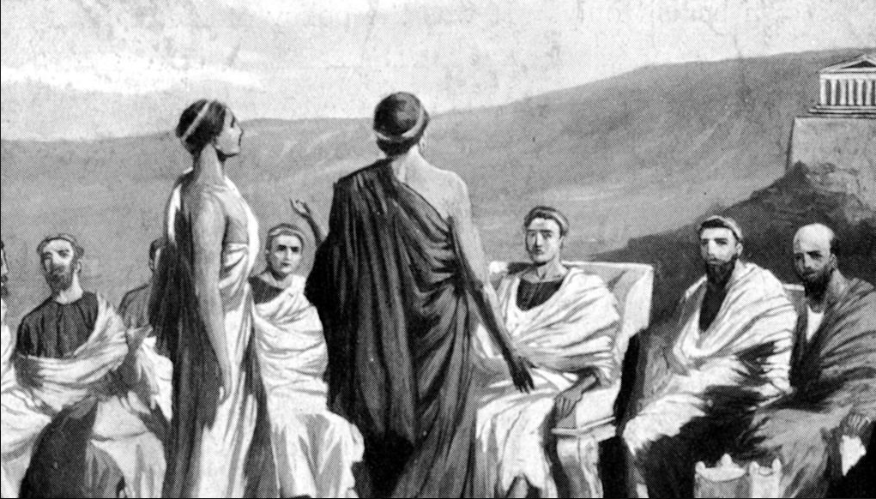
Court of Areopagus, founded by Draco around gather atop the Hill of Ares for a meeting concerning either law, morals or education of the people.

Slide 28
Solon
Solon was appointed law giver in Athens because he did not take any sides. He was known to be a fair man, and so he had full support from all of the various political parties. When he replaced Draco, Solon threw out all of the old laws except for the homicide law, and he created many new laws, especially in the categories of tort and family laws.

Slide 29
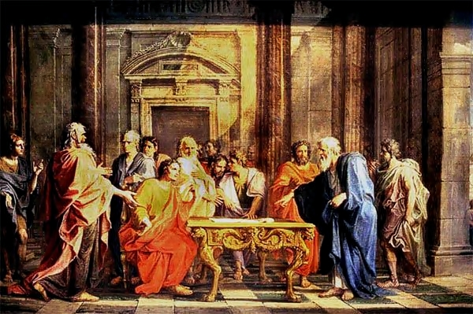
Solon defends his laws against criticism from Athenian citizens, painting by Noel Coypel,1699

Slide 30
Courts and Judicial System
Ancient Greek courts were cheap and run by what people today would call amateurs. Court officials were paid little and most trials were completed in the same day, private cases even more quickly.

Slide 31
There were no "professional" court officials, no lawyers, and no official judges. A normal case consisted of two "litigants," one who argued that an unlawful act was committed, and the other argued his defense. The audience, or "jurors," would vote for one side or the other. The result was either a guilty or not guilty, after which another vote by the jury would decide the punishment.

Slide 32
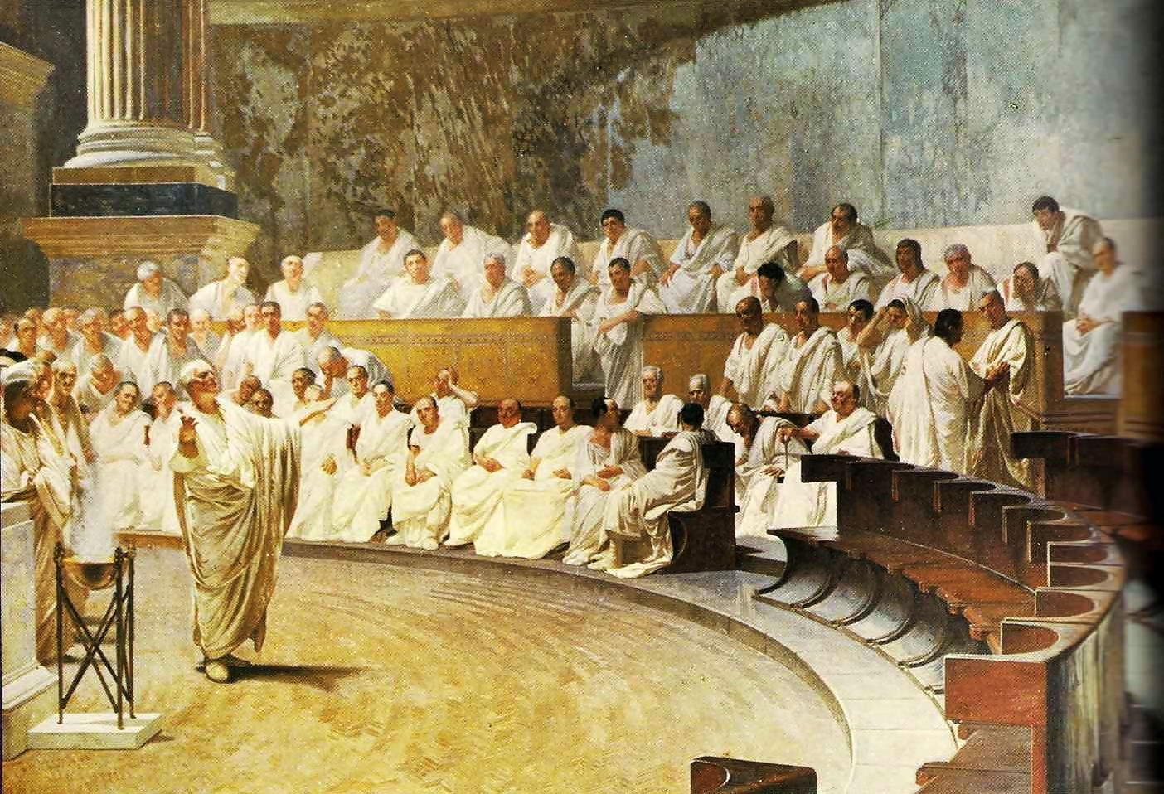

Slide 33
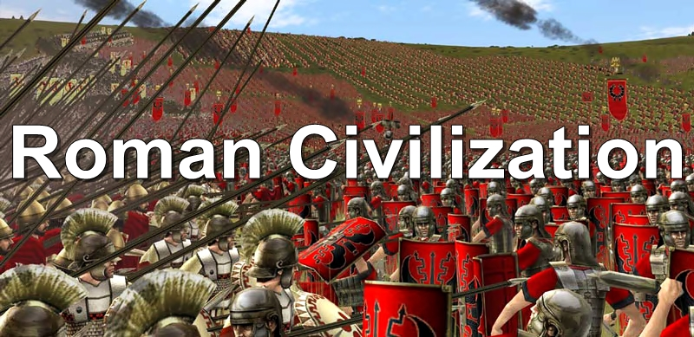

Slide 34
Roman law was perhaps Rome's greatest contribution to mankind. The Romans borrowed from the Greeks the notion that laws were ways in which individuals could be protected from each other and the power of the state.
The Romans decided to put more trust in written laws than in the whims of their human rulers.

Slide 35
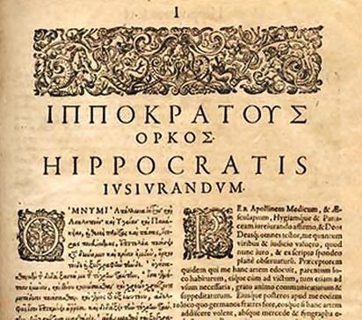

Slide 36
Roman law defined property, contracts and crimes. People who were found guilty of crimes and legal authorities who lost their positions for abusing the laws were imprisoned or placed in chains. In the colonies, "Roman citizens had the right to appeal legal cases to Rome, while the others had to rely on local magistrates.’’
Most popular law was the “The Twelve Tables”

Slide 37
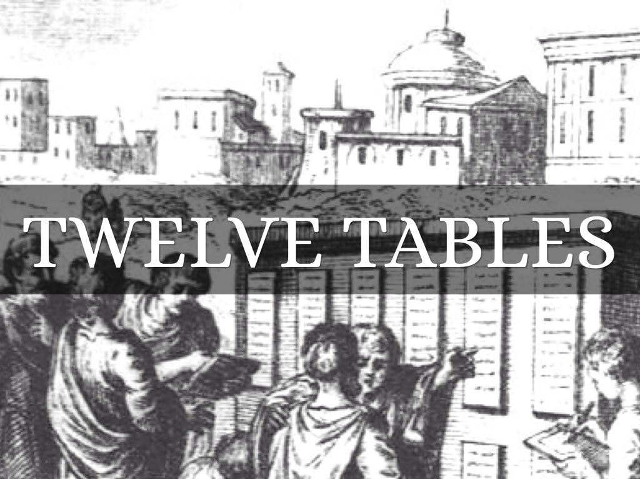

Slide 38


Slide 39
Table I
1. If anyone summons a man before the magistrate, he must go. If the man summoned does not go, let the one summoning him call the bystanders to witness and then take him by force.
Table IV
1. A dreadfully deformed child shall be quickly killed.
2. If a father sell his son three times, the son shall be free from his father.

Slide 40
Table V
1. Females should remain in guardianship even when they have attained their majority.
Table VII
9. Should a tree on a neighbor's farm be bend crooked by the wind and lean over your farm, you may take legal action for removal of that tree.
Table VIII
26. No person shall hold meetings by night in the city.

Slide 41
Ancient Roman Lawyers
Rome is considered the home of the first bona-fide professional lawyers (men who argued cases for clients before magistrates as opposed to clients representing themselves). Lawyer-like speech writers in ancient Greece helped clients prepare arguments but did not argue their cases.

Slide 42
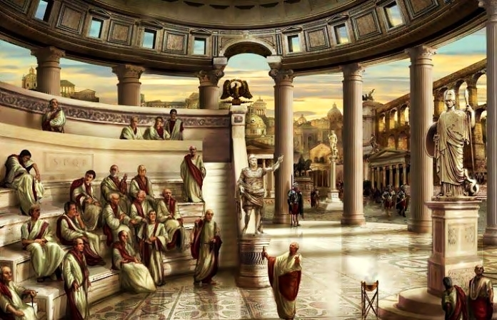

Slide 43
Criticism of Roman Lawyers
"The most salable item in the public market is a lawyers' crookedness," wrote the historian Tacitus, "Pretend you purposely murdered your mother; they'll promise their extensive special divinings in the law will get you off if they think you have money."
Martial wrote: "With a judge to pay off and a lawyer to pay," Settle the debt is my advise; much cheaper that way."
.

Slide 44
Punishment in Ancient Rome
Crucifixion was a favorite form of Roman punishment. That's what the Romans did to Jesus.
The Emperors had no tolerance for people who revolted. In A.D. 70, Titus put down a Jewish revolt and punished rebellious Jewish peoples by salting agricultural land, slaughtered and enslaved thousands of Jews.
Wooden soles were sometimes strapped to the feet of prisoners, making escape difficult.

Slide 45
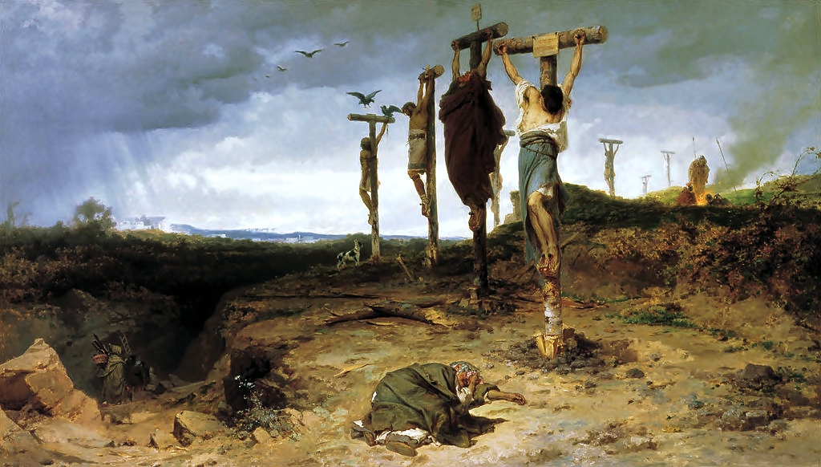

Slide 46


Slide 47
According to Salmond
Salmond was of the view that the two main sources of law were formal and material.
1. Formal sources are those sources from which the law derives its force and validity. E.g. the will of the State as manifested in statutes and judicial decision.

Slide 48
2. Material sources could be sub-divided into:
(a) Historical sources: (b) Legal sources:
(i) Legislation
(ii) Precedent
(iii) Custom
(iv) Agreement
(v) Professional opinion

Slide 49


Slide 50
Magna Carta is a charter agreed to by King John of England to make peace between the unpopular King and a group of rebel barons.
Clause 39
This clause established the idea that people could only be judged according to the law, and that even the king himself had to follow the law.
“Equality before Law” and “Equal Treatment of Law” originated from this clause

Slide 51
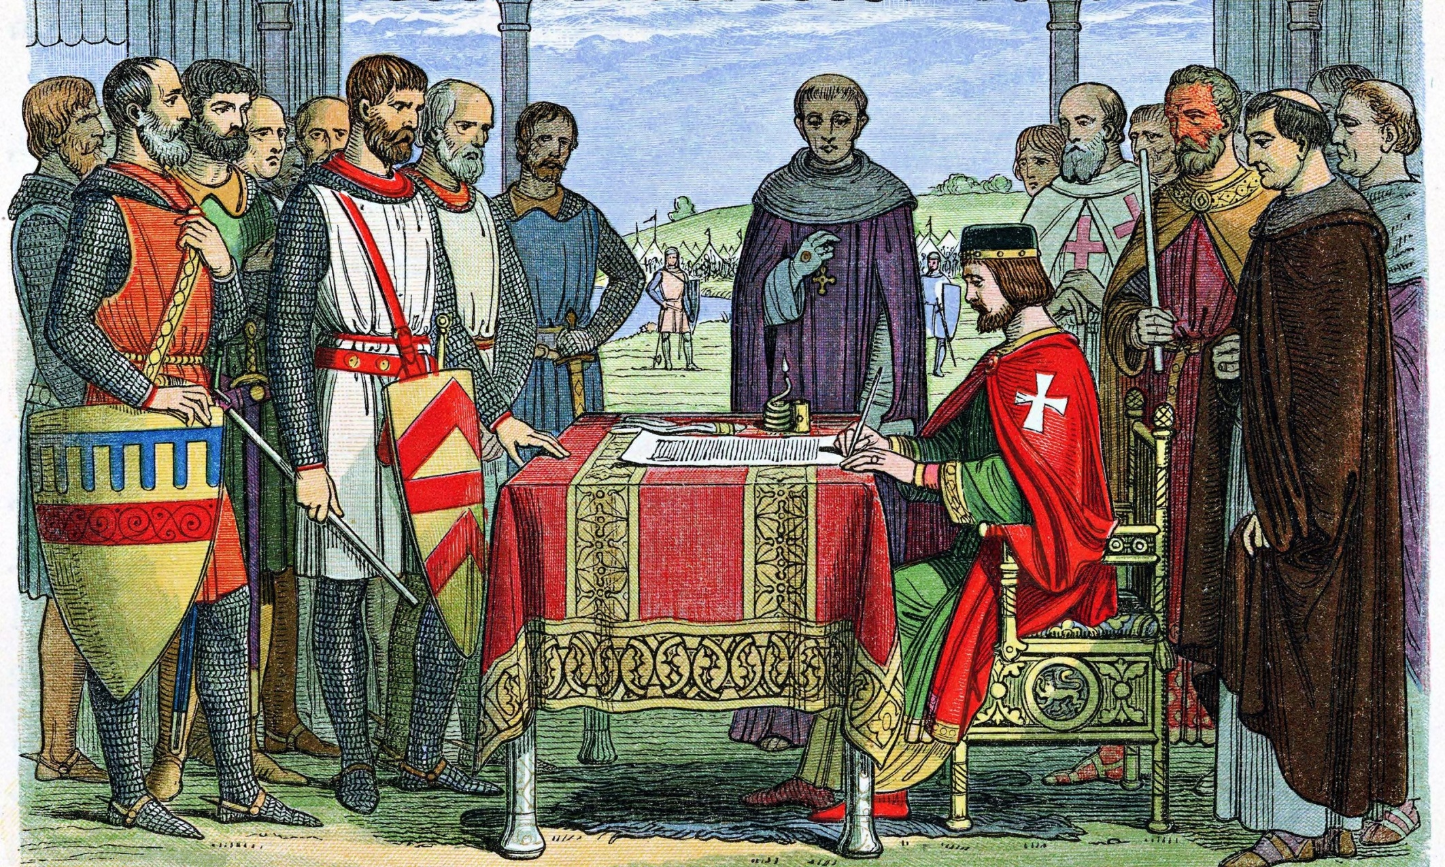

Slide 52
Clause 40
It ensures that nobody will be deprived of their rights to stand before a court and get justice without any interference.
“Right to justice”, “Right to fair trail”, “Equal access to law” originated from this clause.

Slide 53
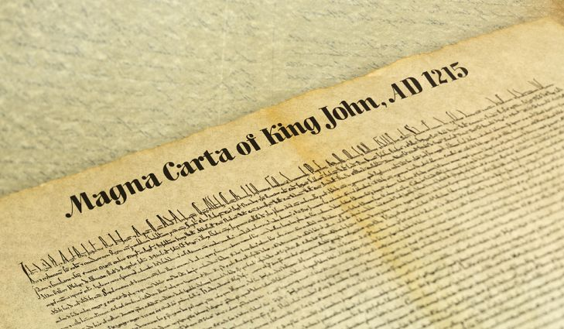

Slide 54
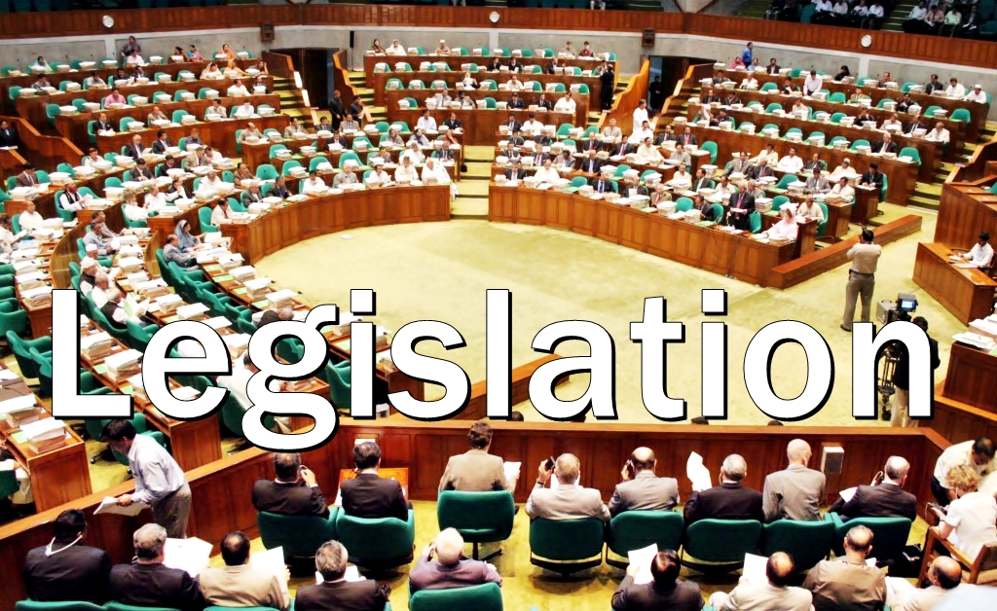

Slide 55
Laws made by the State Parliament are called Acts (or statutes or, more generally, legislation)
Parliament made law is binding on all courts and judges. Courts cannot overrule or challenge an Act unless they hold it to be unconstitutional. Only parliament can amend or repeal a legislation by two-third majority votes.

Slide 56
Types of Legislation
1. Supreme Legislation
A Supreme or a Superior Legislation is that which proceeds from the sovereign power of the state. It cannot be repealed, annulled or controlled by any other legislative authority.

Slide 57
2. Subordinate /Delegated Legislation
It is well-known that the main function of the executive is to enforce the law. In case of Delegated Legislation, executive frames the provisions of law. This is also known as executive legislation. The executive makes laws in the form of orders, by laws etc.

Slide 58
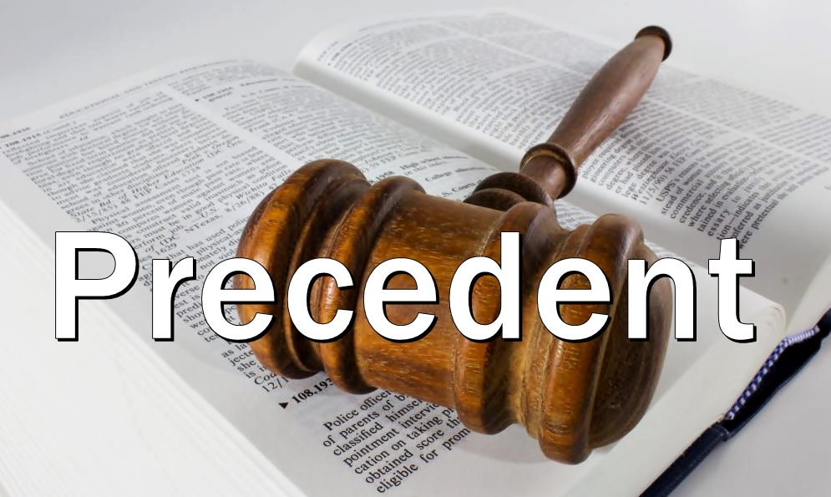

Slide 59
In common law legal systems, a precedent is a principle or rule established in a previous legal case that is either binding on or persuasive for a court or other tribunal when deciding subsequent cases with similar issues or facts.
In Bangladesh, the judgment rendered by Supreme Court is binding on all the subordinate courts and the tribunals within the territory of the country.

Slide 60
Classification
1. Authoritative Precedent
Judges must follow the precedent whether they approve of it or not. They are classified as Legal Sources.
2. Persuasive Precedent
Judges are under no obligation to follow but which they will take precedence into consideration and to which they will attach such weight as it seems proper to them.

Slide 61
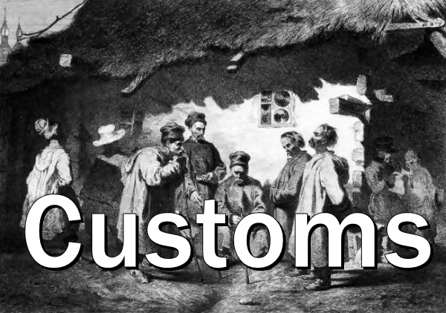

Slide 62
Custom in law is the established pattern of behavior that can be objectively verified within a particular social setting.
Customary law (also, consuetudinary or unofficial law) exists where:
1. a certain legal practice is observed and
2. the relevant actors consider it to be law (opinio juris)
Indian law recognizes many Indian social customs are legally valid, such as various forms of the Hindu marriage ceremony.

Slide 63
Ingredients of Custom
1. Antiquity
2. Continuous in nature
3. Peaceful Enjoyment
4. Obligatory Force
5. Certainty
6. Consistency
7. Reasonableness

Slide 64
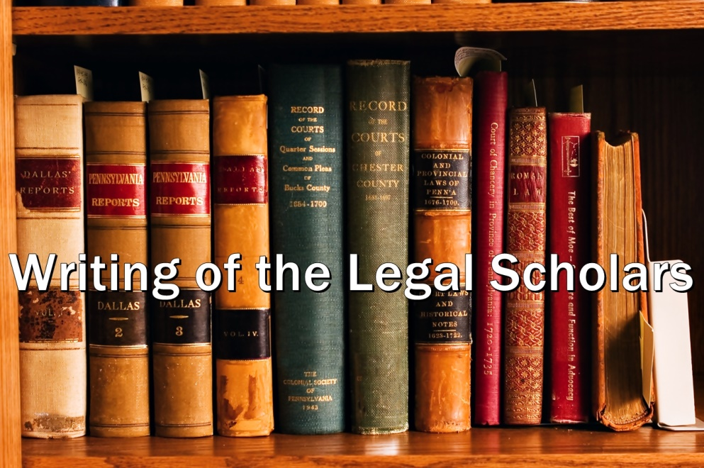

Slide 65


Slide 66


Slide 67
Peace and Justice System in Bangladesh

Slide 68
Administration of Justice
The administration of justice has been defined as the maintenance of rights, suppression of wrongs and thus upholding justice within a political community by means of physical force of the State. The law and justice of the State are absolutely necessary for peace, order, and stability.

Slide 69
Administration of Justice
The administration of justice is the modern and civilized substitute for the primitive practices of private vengeance, and violent self-help. In ancient time a man took revenge of the wrong committed to him either himself or with the help of his friends and tribes. In those days every man was judge of his own cause and might was made the sole measure of right.

Slide 70
Administration of Justice
In course of time private vengeance has been transmitted into administration of criminal justice while civil justice has taken the place of violent self-help. At the very outset, the administration of justice was an optional remedy. But, later on with gradual development of government power, the state suppressed the ancient and barbaric system with strong hand and laid down peremptory principles and declared that all disputes must be submitted to the courts of law for settlement.

Slide 71
AJ involves two parties
Administration of justice involves two parties: (1) Plaintiff or plaintiffs claiming certain rights; and (2) defendant or defendants alleged to have committed certain wrongs.

Slide 72
Civil and Criminal Justice
Administration of justice can be divided into two parts: (1) administration of civil justice; and (2) administration of criminal justice.
Civil Justice: Civil justice is concerned with the enforcement of rights in civil proceedings; where the plaintiff claims a right against a defendant, who is alleged to have committed a wrong.

Slide 73
Civil Justice
The court secures this right for the plaintiff by compelling the defendant to perform a duty. Hence administration of civil justice is primarily concerned with the plaintiff and remedy of his rights. So, civil justice is remedial in nature.

Slide 74
Criminal Justice
Criminal justice is concerned with the punishment of the wrong, legally which is called crime. In a criminal proceeding the complainant or the prosecutor on behalf of the complainant claims no right but makes an allegation that the accused has committed a wrong on the complainant. Here the court does not require that the accused to perform a duty but punishes him/her if the offence is proved to have committed without any reasonable doubt. Criminal justice is therefore penal in nature.

Slide 75
Civil and Criminal Justice
Some writers are not content with the procedural distinction between crimes and civil wrongs. According to Blackstone, crimes are public wrongs and affect the whole community, while the civil injuries are private wrongs.

Slide 76
Civil and Criminal Justice
Salmond considers the view of Blackstone insufficient for the following reasons:
All public wrongs are not crimes. For example, refusal to pay taxes is an offence against the state, but it is a civil wrong and not a crime.
Many crimes may be prosecuted at the suit filed by private person, yet the proceedings are criminal in nature. For example, criminal libel, offences relating to marriage.

Slide 77
Civil and Criminal Justice
The distinction between civil wrong and crimes relates to the legal consequences of acts.
Civil justice is administered according to one set of forms and criminal justice according to another set.
Civil justice is administered in one set on courts and criminal justice in different type of courts.

Slide 78
Civil Justice
Civil proceedings, if successful, result in a judgment in favor of the plaintiff which may be for damages, or payment of debt, or penalty (in a penal action), or in an injunction, or decree of specific performance or delivery of possession of land or decree of divorce or in a writ of any form or in other forms of relief known distinctively as civil.

Slide 79
Criminal Justice
Criminal proceedings, if successful, result in the punishment of the accused ranging from hanging to a fine or in binding over to keep peace or even a release with admonition.

Slide 80
Purpose of Criminal Justice
There are four purposes of criminal justice:
1. Retributive Punishment: In all cases of punishment the main object is to gratify the desire of human beings for vengeance, both in their individual and corporate capacity. Retributive punishment gratifies the instinct of retaliation which exists not merely in the individual wronged as well as in the society at large by way of sympathetic extension.

Slide 81
Purposes of CJ
2. Deterrent Punishment: The chief end of the law of crime is to make the criminal an example and warning to other like-minded to think about the consequences before making an attempt to commit any crime.

Slide 82
Purposes of CJ
3. Preventive Punishment: One of the purpose of criminal justice is to prevent the repetition of crime by the wrong doer.
4. Reformative Punishment: The advocates of reformative philosophy consider the wrong-doers as patient. So, they should be given opportunity to correct themselves. Probation and parole are instruments to implement reformative justice.

Slide 83
Different Branches of Criminal Justice System
1. Police;
2. Public Prosecutor;
3. Criminal Court; and
4. Prison.
(Probation officer, Parole officer, Parole Board.)

Slide 84


