Slide 1
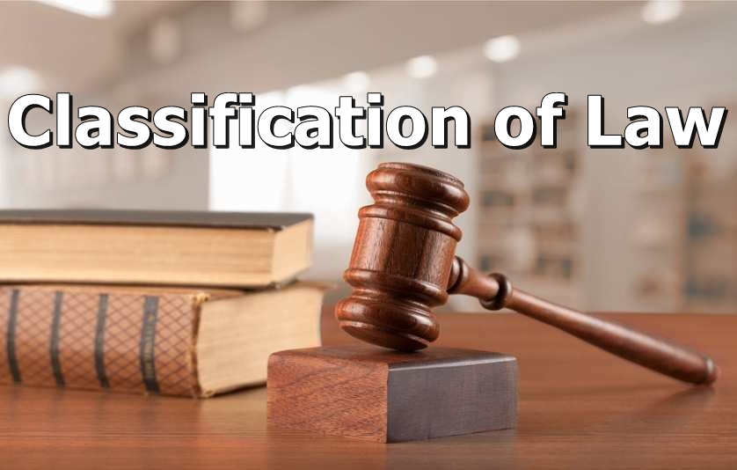

Slide 2


Slide 3
The word eternal means something that would last forever. Eternal laws are laws that have applied since the beginning of time and would exist till the end of time. These laws cannot be changed. A very good example of eternal law is the law of gravity.

Slide 4
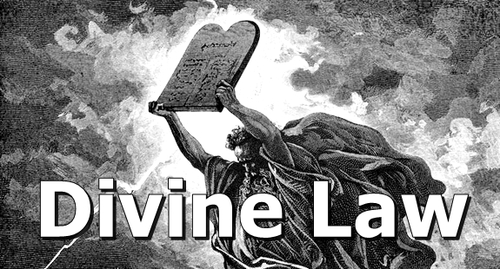

Slide 5
Divine Law is referred to as laws made by a deity to govern the affairs of man. A good example of divine law can be found in Islamic law as postulated in the Q’uran.

Slide 6
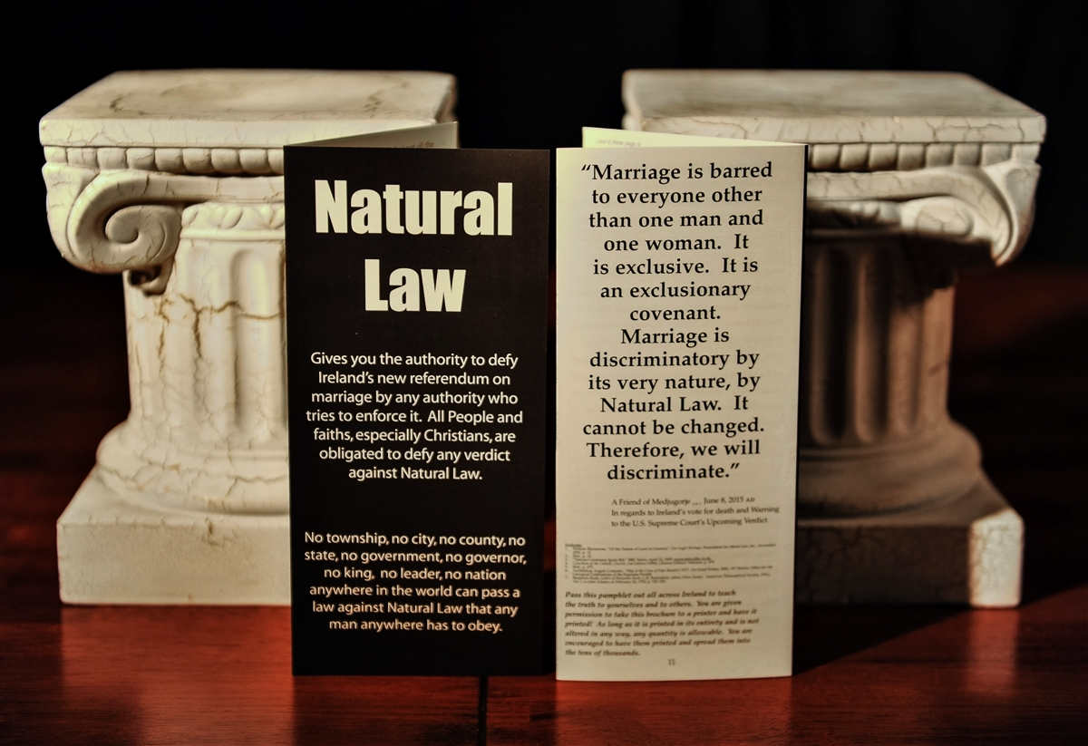

Slide 7
Natural law is said to be the guide which positive law must follow in order for it to be valid. If Positive Law is at variance with natural law, it could lead to injustice in the society. For example, it is accepted in all cultures that murder is wrong and should be punished.

Slide 8


Slide 9
Positive Law can also be regarded as human law. These are laws made by man in order to guide the conduct of members of the society. They are laws made by persons given the authority to do so either directly or indirectly by the society. Legal positivism doesn’t concern itself with morals. Once a law has been enacted by persons in authority, it is valid.

Slide 10
The following are the major classifications of positive law:
• Public and Private Law
• Civil Law and Criminal Law
• Substantive and Procedural Law
• Municipal and International Law
• Written and Unwritten Law

Slide 11
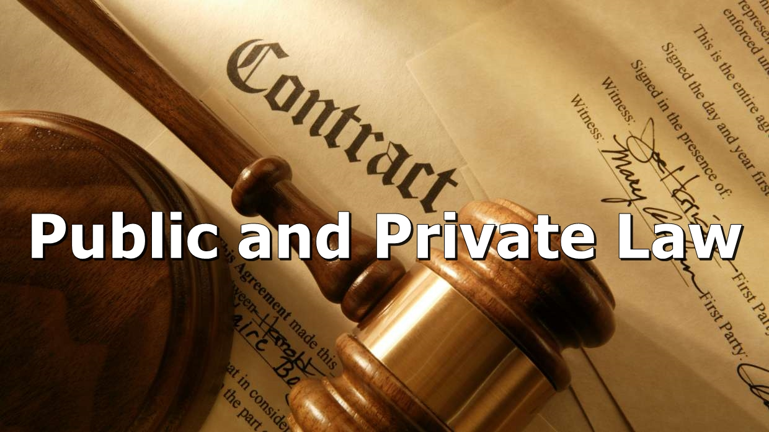

Slide 12
Public Law
Public Law can be defined as that aspect of Law that deals with the relationship between the state, its citizens, and other states. It is one that governs the relationship between a higher party — the state — and a lower one, the citizens. Examples of public law include Constitutional Law, Criminal Law, and International Law and so on.

Slide 13
THE CONSTITUTION OF THE PEOPLE’S REPUBLIC OF BANGLADESH
Article: 27
Equality before law
“All citizens are equal before law and are entitled to equal protection of law.”

Slide 14
THE PENAL CODE, 1860
Section: 275
Sale of adulterated drugs
“Whoever, knowing any drug or medical preparation to have been adulterated in such a manner as to lessen its efficacy, …. sells the same… shall be punished with imprisonment of either description for a term which may extend to six months, or with fine which may extend to one thousand taka, or with both.”

Slide 15
Private Law
Private law, on the other hand, is that category of the law that concerns itself with the relationship amongst private citizens. Examples include the Law of Contract, and the Law of Trust and so on.

Slide 16
The Contract Act, 1872
Section: 64
When a contact becomes void, any person who has received any advantage under such agreement or contract is bound to restore it, or to make compensation for it to the person from whom he received it.

Slide 17
The Trust Act, 1882
Section: 11
The trustee is bound to fulfil the purpose of the trust, and to obey the directions of the author of the trust given at the time of its creation…

Slide 18


Slide 19
Civil law
Civil law deals with the relationship between citizens and provides means for remedies if the right of a citizen is breached. Examples of civil law include the Law of Contract, the Law of Torts, Family Law etc.

Slide 20
THE MUSLIM FAMILY LAWS ORDINANCE, 1961
Section: 9 (1)
Maintenance
“If any husband fails to maintain his wife adequately, or where there are more wives than one, fails to maintain them equitably, the wife, or all or any of the wives, may in addition to seeking, any other legal remedy available apply to the Chairman who shall constitute an Arbitration Council to determine the matter, and the Arbitration Council may issue a certificate specifying the amount which shall be paid as maintenance by the husband.”

Slide 21
পিতা-মাতার ভরণ-পোষণ আইন, ২০১৩
ধারা ৩ (৩)
পিতা-মাতার ভরণ-পোষণ নিশ্চিত করিবার ক্ষেত্রে প্রত্যেক সন্তানকে পিতা-মাতার একইসঙ্গে একই স্থানে বসবাস নিশ্চিত করিতে হইবে।
ধারা ৫ (১)
পিতা-মাতার ভরণ-পোষণ না করিবার দণ্ড অনূর্ধ্ব ১ (এক) লক্ষ টাকা অর্থদণ্ডে বা উক্ত অর্থদণ্ড অনাদায়ের ক্ষেত্রে অনূর্ধ্ব ৩ (তিন) মাস কারাদণ্ডে দণ্ডিত হইবে।

Slide 22
Criminal Law
Criminal Law, on the other hand, can be referred to as that aspect of Law that regulates crime in the society. It punishes acts which are considered harmful to the society at large. An example of criminal law is the Penal Code 1860, The Arms Act, 1878, The Narcotics Control Act, 2018.

Slide 23
The Arms Act, 1878
Section 19
Whoever manufactures, converts or sells, imports or exports any arms, ammunition, military equipment's illegally shall be punished with imprisonment for life or any other rigorous imprisonment which shall not be less then seven years.

Slide 24
The Narcotics Control Act, 2018
Section 37
Whoever possess any equipment necessary for manufacturing narcotics shall be punished by imprisonment for a term of minimum 2 years up to 10 years and fine.

Slide 25
Standard of Proof

Slide 26
Criminal Cases:
When treating a criminal case, the standard of proof to be used is proof beyond reasonable doubt. Also, the burden of proof does not shift from the prosecution. What this means is that before a conviction can be gotten, the state has to prove the commission of the crime to be beyond reasonable doubt.

Slide 27
Civil Cases:
On the other hand, in civil cases, the standard of proof is on the balance of probabilities. Also, the burden of proof shifts between both parties when they need to establish their case. Judgment normally goes in favor of the particular party that has been able to prove its case more successfully.

Slide 28
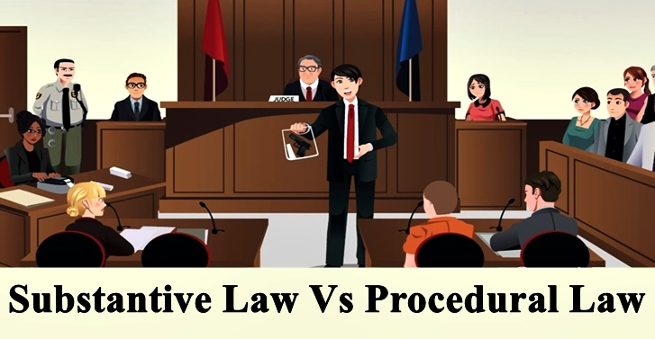

Slide 29
Substantive law deals with the rights, duties and liabilities of the parties to the suit. It explains the parties to understand their rights. It also defines the crime or wrong and also their remedies. When a particular law defines rights or crimes or any status, it is called substantive law.
For Example: Penal law, Law of Property, Specific Relief Act, etc. is substantive law.

Slide 30
Procedural law deals with the process of litigation of the suit. It explains the parties to understand the means and method to achieve their rights. When a particular law determines the outlines the procedure of litigation, it is called procedural law.
For Example: Civil Procedure Code, Criminal Procedural Code etc. are procedural law.

Slide 31
Notice:
The distinction between the substantive and procedural law is not an always easy and clear-cut. The same law may be procedural as well as substantive.
For Example: Evidence Act.

Slide 32
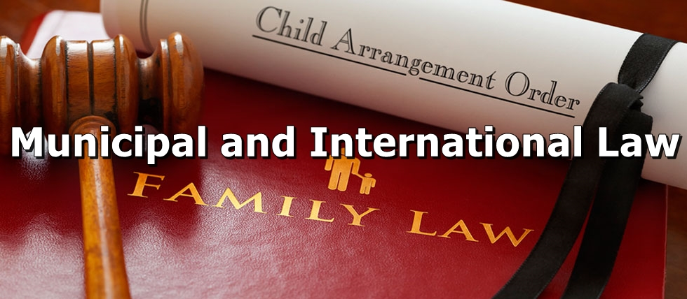

Slide 33
Municipal/Domestic law is the aspect of law which emanates from and has effect on members of a specific state.
International law, on the other hand, is the law between countries. It regulates the relationship between different independent countries and is usually in the form of treaties, international customs etc. Examples of International law include the Universal Declaration of Human Rights and the Convention on the Elimination of all Forms of Discrimination Against Women (CEDAW) etc.

Slide 34
It should be noted that International treaties cannot have the force of law in Bangladesh except they are enacted by the National Assembly.

Slide 35


Slide 36
International law refers to the collection of laws that are accepted between countries as the laws that will govern the activities that they engage in with one another.
Types of International Law
1. Public International Law
Public international law is one example of international law, and it deals with those nations and persons that may be affected by those particular laws like:

Slide 37


Slide 38


Slide 39


Slide 40
2. Private International Law
Private international law is different from public international law in that it governs private conflicts between individuals, rather than between the states.
For instance, if Company A operates in both the U.S. and Canada, and a legal dispute arises, then private international law will determine which country has jurisdiction over the dispute and, consequently, which laws should be taken into account when arguing the facts of the case.

Slide 41
3. Supra-national Law
Supranational law refers to the situation wherein nations surrender to the court their right to make certain judicial decisions. The decisions made by a court appointed by supranational law take priority over the decisions that are made by national courts.
The European Court of Justice rules over all of the courts within the member states of the EU in accordance with European Union law.

Slide 42
4. International Criminal Law
International criminal law is a subject of public international law that works to punish those who commit crimes of a more severe nature that often attack large groups of people. Examples of crimes that would be handled by international criminal law include:
1. Genocide
2. Crimes against humanity
3. War crimes
4. Crime of Aggression

Slide 43
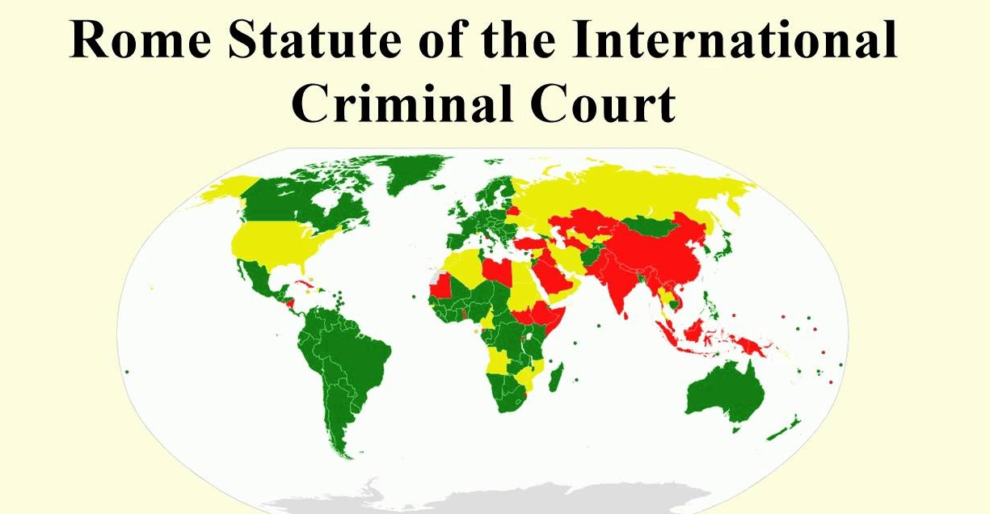

Slide 44


Slide 45
A law would not be regarded as written just because it is written down in a document. Written laws are those laws that have been validly enacted by the legislature of a country.
Unwritten laws, on the other hand, are those laws that are not enacted by the legislature. They include both customary and case law. Customary Law as part of its basic characteristic is generally unwritten. Case law, though written down in a documentary format, would be regarded as unwritten law based on the fact that it is not enacted by the legislature.

Slide 46
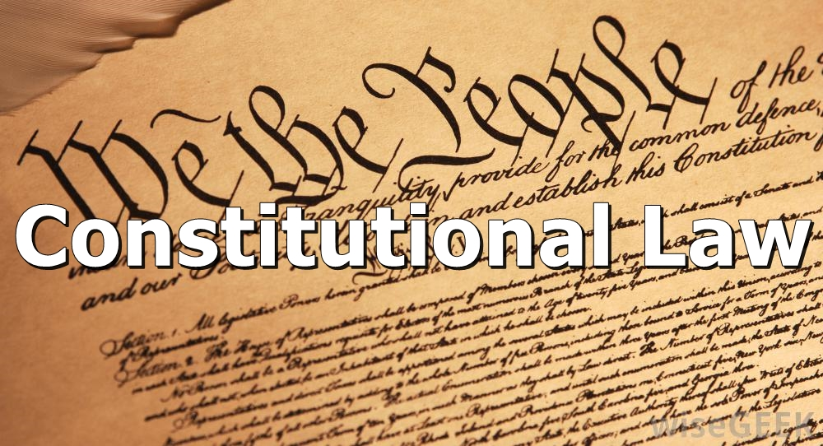

Slide 47
The fundamental law, written or unwritten, that establishes the character of a government by defining the basic principles to which a society must conform; by describing the organization of the government and regulation, distribution, and limitations on the functions of different government departments; and by prescribing the extent and manner of the exercise of its sovereign powers. The Constitution is the supreme law of the land, and any law that is inconsistent with the provisions of the Constitution is, to the extent of the inconsistency, of no force or effect.

Slide 48


Slide 49
Types of Constitution
1. Written Constitution:
A written constitution means a constitution written in the form of a book or a series of documents combined in the form of a book. It is formulated and adopted by a constituent assembly or a council or a legislature.

Slide 50
2. Unwritten Constitution:
An unwritten constitution is one which is neither drafted nor enacted by a Constituent Assembly and nor even written in the form of a book. It is found in several historical charters, laws and conventions. It is a product of slow and gradual evolution. The government is organized and it functions in accordance with several well settled, but not wholly written rules and conventions.

Slide 51
3. Flexible Constitution:
A Flexible Constitution is one which can be easily amended. Constitutional amendments are passed in the same manner by which an ordinary law is passed. British Constitution presents a classic example of a most flexible constitution. The British Parliament is a sovereign parliament which can make or amend any law or constitutional law by a simple majority.

Slide 52
4. Rigid Constitution:
The Rigid Constitution is one which cannot be easily amended. Its method of amendment is difficult. For amending it, the legislature has to pass an amendment bill by a specific, usually big, majority of 2/3rd or 3/4th. For passing or amending an ordinary law, the legislature usually passes the law by a simple majority of its members.

Slide 53
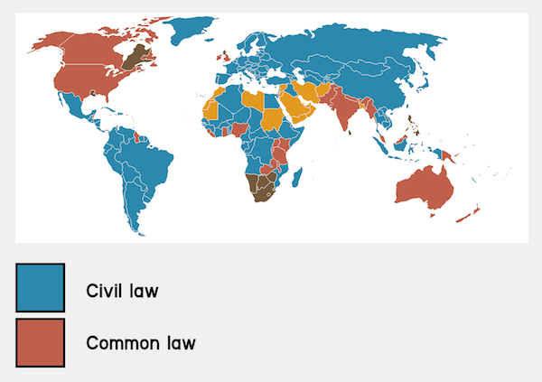

Slide 54
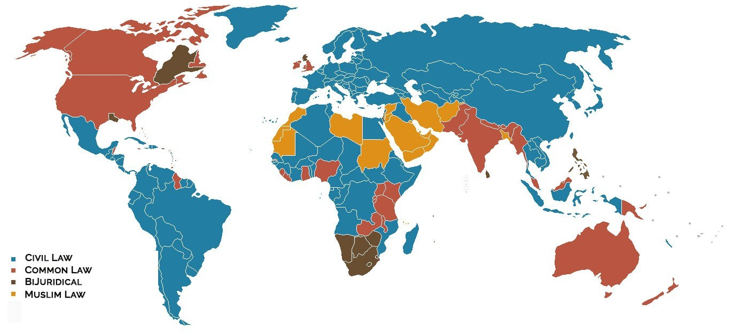

Slide 55
 | Civil Law | Common Law
Countries | Spain, China, Japan, Germany, most African nations. | United States, England, Australia, Canada, India, Bangladesh.
Constitution | Always | Not Always
Precedent | Only used to determine administrative of constitutional court matters. | Used to rule on future or present cases.
Role of judges | Chief investigator; makes rulings, usually non-binding to 3rd parties. The judge often brings the formal charge. | Makes rulings; sets precedent; referee between lawyers. Most judges rarely inquire extensively into matters before them, instead relying on arguments presented by the parties.
Type of argument and role of lawyers | Inquisitorial. Judges, not lawyers, ask questions and demand evidence. Lawyers present arguments based on the evidence the court finds. | Adversarial. Lawyers ask questions of witnesses, demand production of evidence, and present cases based on the evidence they have gathered.
Legal System | Core principles of the legal system are codified into a referable system which serves as the primary source of law. | Legal system characterized by case law, which is law developed by judges through decisions of courts and similar tribunals.

Slide 56


