Slide 1
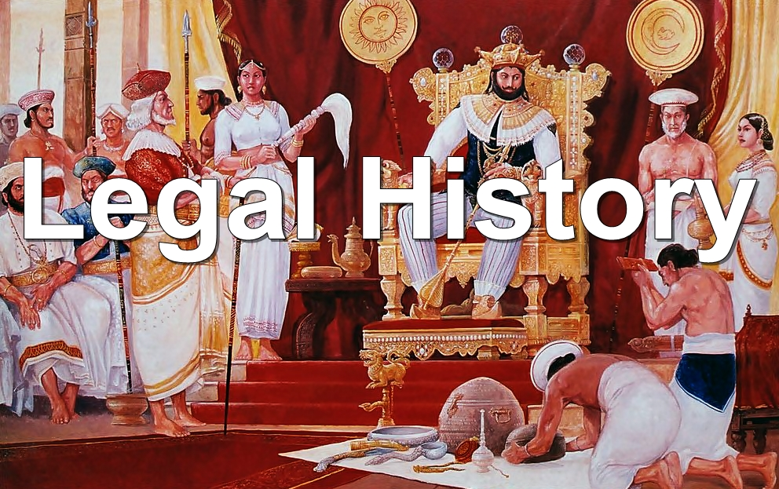

Slide 2
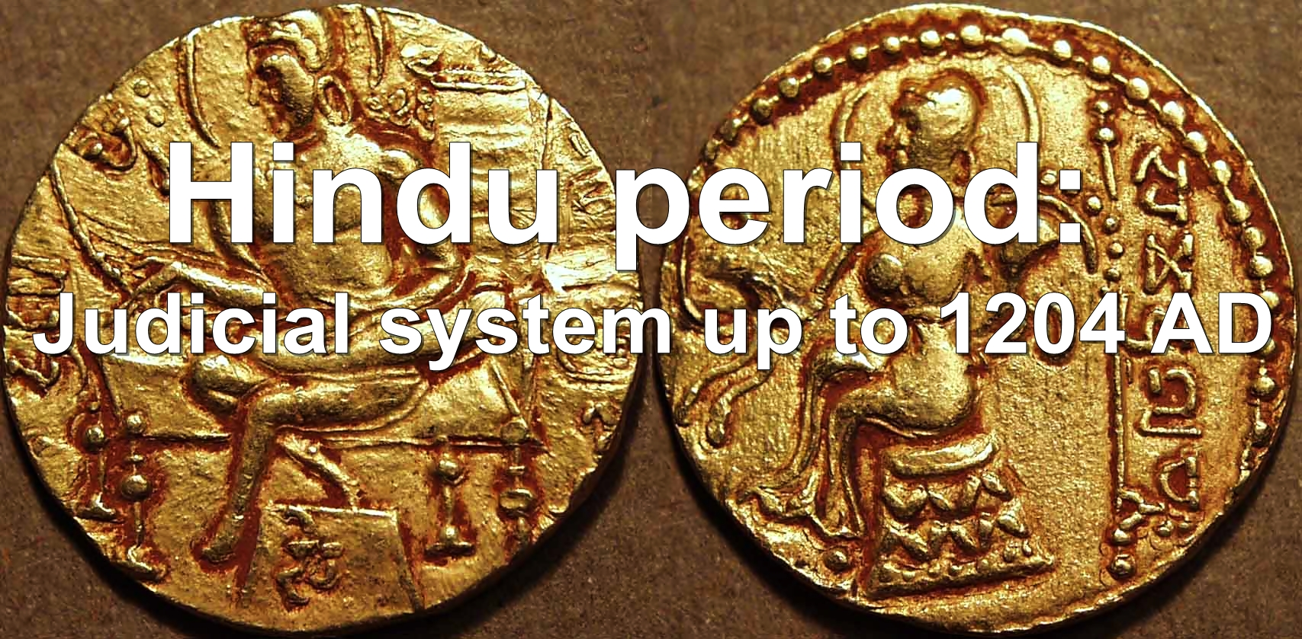

Slide 3
Legal history of India can conveniently be studied under four important periods namely:
1. Hindu period (Extends nearly 1500 years before and after the beginning of the Christian era)
2. Muslim period (Begins with the first major invasion by Muslims in 1100 A.D)
3. British period (Begins with the consolidation of the British power in the middle of the 18th century and lasted for nearly 200 years)
4. After Independence/Modern period (Began with the withdrawal of the British government on 15th August, 1947, when India was declared Independent)

Slide 4
Hindu Period:
In ancient Indian Hindu society, institutions and beliefs gradually developed and a definite shape was given to them during the Hindu period. Many important beliefs and doctrines of recent days are deep rooted in the ancient Hindu ideology. To understand properly the judicial system of India we can consider briefly three important factors:
1. The social institutions and religious philosophy of ancient India.
2. Political system and institutions of ancient India.
3. Administrative units of ancient India.

Slide 5
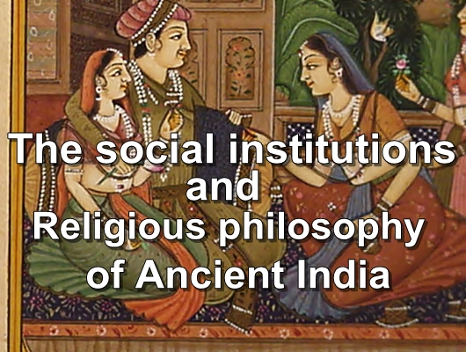

Slide 6
To determine the social and religious order two important concepts may be stated namely:
(i) Caste system: The caste system was one of the most rigid and unique system ever developed in any part of the world. A caste was a social group constituted only by the persons who specifically born in it. There were mainly four castes. Each of them had different lawful activities and functions dominating all social activities.

Slide 7
Brahmin: The Brahmins were considered the most superior caste. The scholars and priests of the Hindus belonged to this caste. They had prerogatives and privileges secured by the law not held by other sections of Hindu society.
Kshatriyas: They were the nobles and warriors. Rulers of various states and kingdoms mostly belonged to this caste.

Slide 8
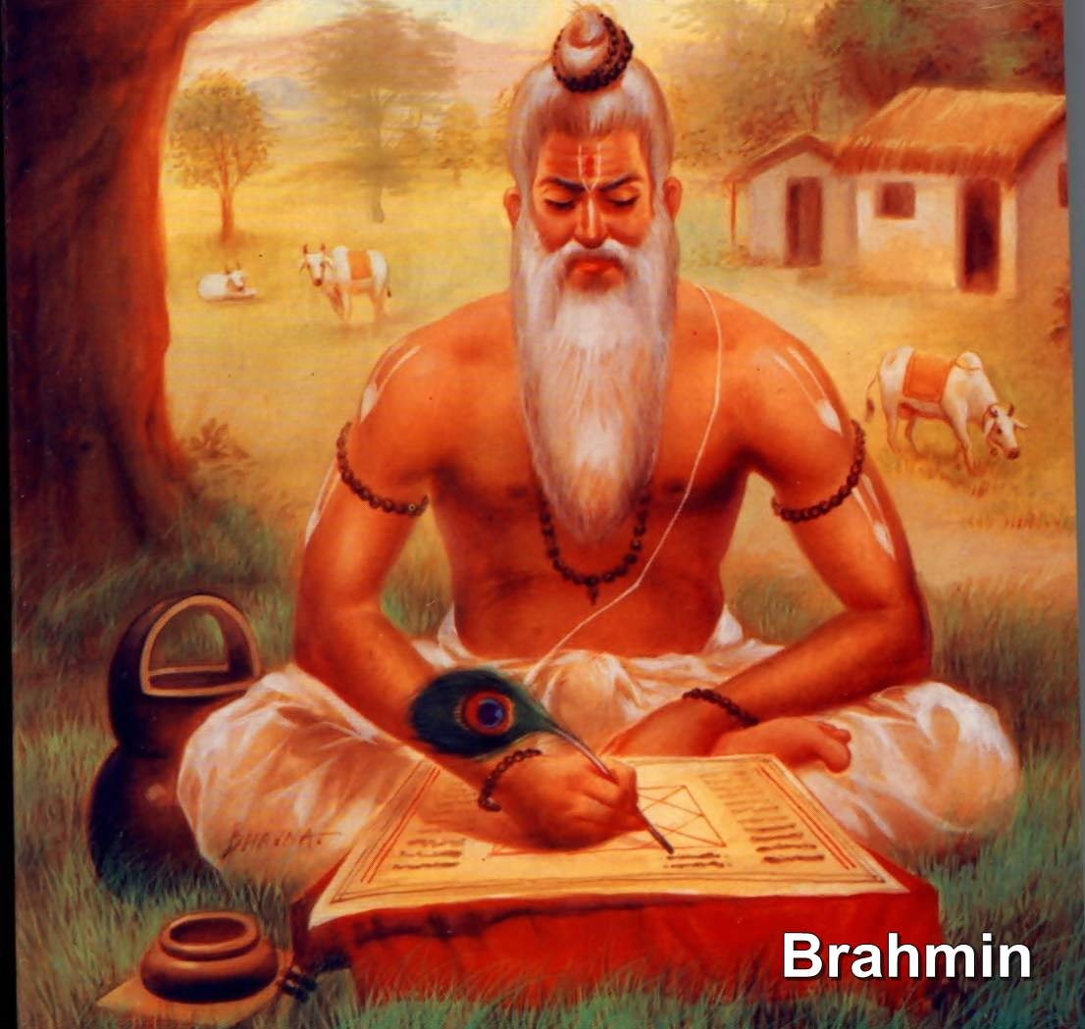

Slide 9
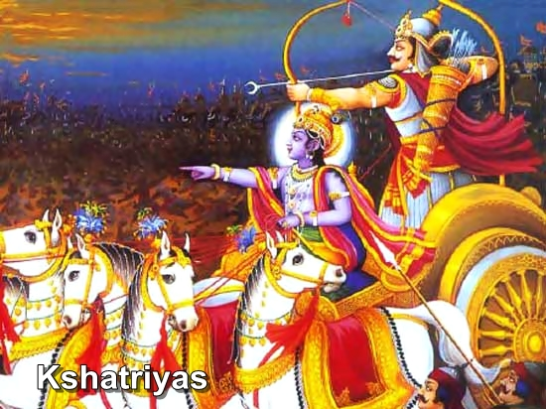

Slide 10
Vaishya: The vaishyas were mostly merchants and traders.
Sudra: The sudras were the workers and ranked lowest.
The three upper classes were the elite of the society. Caste was determined the pattern of life amongst the Hindus relating to their status, living, marriage, profession and social obligations.

Slide 11
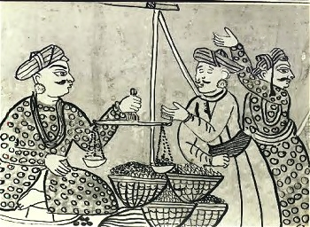
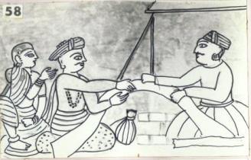
Vaishya

Slide 12
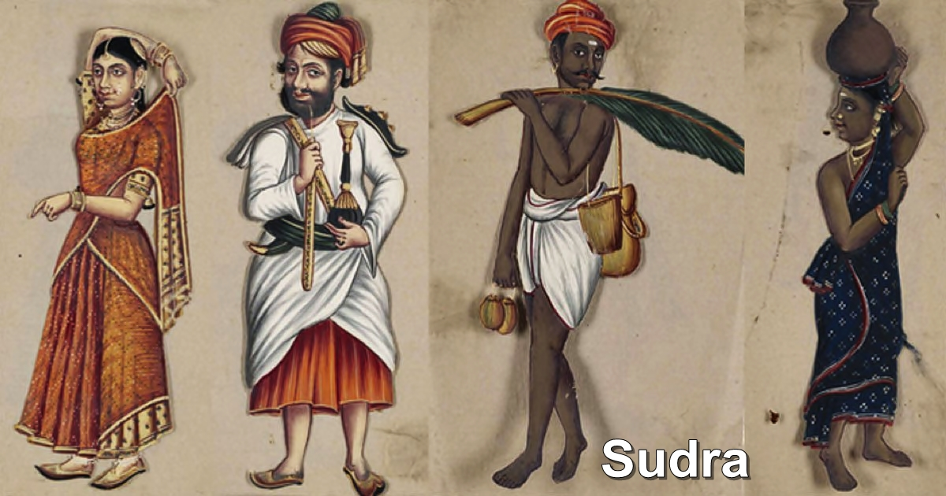

Slide 13
Caste consciousness become absolute and reached its peak in caste panchayats. Each caste panchayat was regarded as a supreme authority for the particular caste in each village. Though the caste system was conservative but it gave stability to Indian society.

Slide 14
(ii) Joint family system:
Joint family system was another important institution which determined the social order amongst Hindus in ancient India. A family was regarded as a unit of the Hindu social system. An ancient family included parents, children, grandchildren, uncles and their decedents and their collaterals on the male side.
The social group had common dwelling and enjoyed their estate in common.

Slide 15
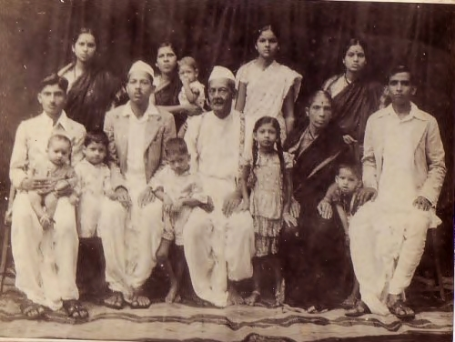

Slide 16
At the head of the family, there was the patriarch (Karta), whose authority was absolute over the members of his family. He represented his family before the law and claimed absolute obedience from them. The family group was bound together by ‘Sradha’ ceremony. A number of families constituted a sect, gram, or village which became an administrative unit also.

Slide 17
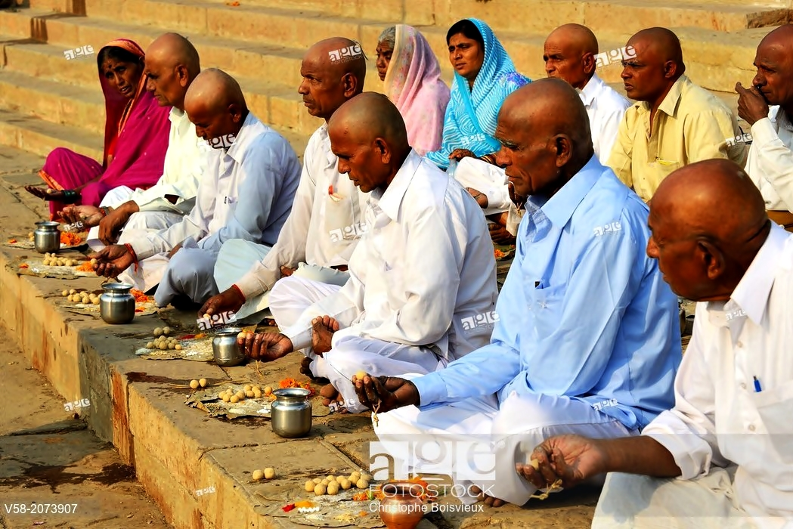

Slide 18
The concept of family created private property which in turn created disputes and struggles necessitated law and a controlling authority. In later centuries problems concerning the division of land and inheritance came in for special attention. Thus two systems of family law, namely, “Mitakshara” and “Dayabhaga” become the basis of civil law.

Slide 19
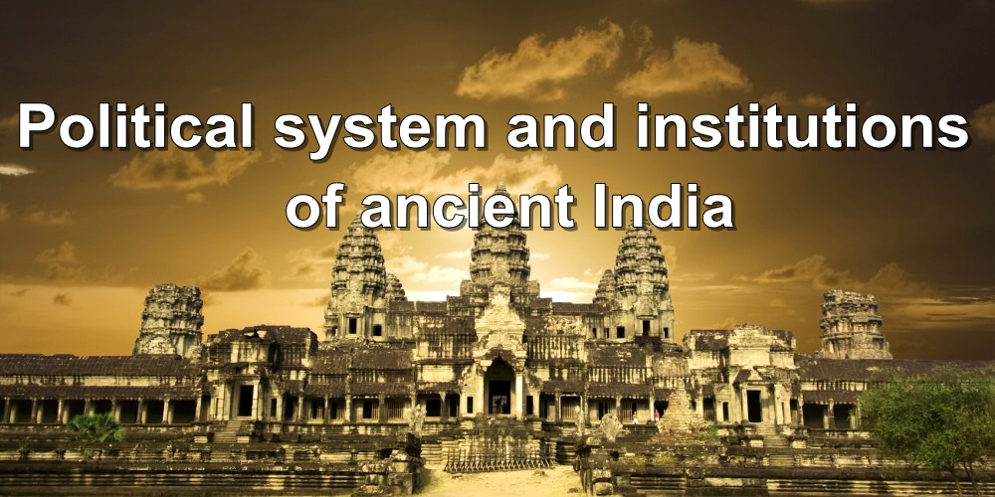

Slide 20
There were various and complex political system in ancient India. India was divided into different independent states, some monarchies and the rest tribal republic. Monarchy in various forms was prevailing in ancient Hindu period.
(i) Dharmashastras: In the concept of Dharmashastras (Hindu political science) the concept of dharma was very important. The word dharma came to mean the privileges, duties and obligations of a man. It also includes citizens conduct standard as member of one of the castes and as a person in a particular stage of life.

Slide 21
This concept had established a duty based society. Its postulate was not only the duty of individual towards the society but also the duty of the ruler towards the individuals and the society. The English doctrine of “King can do no wrong” was not accepted and the king himself was subject to law.
The Dharmashastras imposed upon the king to look upon the people as God (Praja Vishnu) and serve them with love.

Slide 22
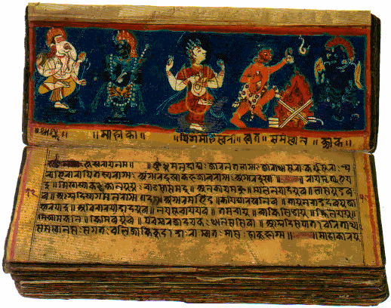

Slide 23
The Dharmashastras emerged from the literary tradition of the Vedas (Rig, Yajur, Sāma, and Atharva). Each Veda is further divided into two categories namely the Saṃhitā which is a collection of mantra verses and the Brahmanas which are prose texts that explain the meaning of the Samhita verses.

Slide 24
(ii) Kautilya’s Saptang Theory of State:
The Mauryan era of ancient India gave the world a significant treatise, the Arthashastra of Kautilya. It was settled that the king should receive one-sixth of the grain and one-tenth of merchandise and gold, as his due. It was the revenue which made it possible for the king to ensure the security and prosperity of his subjects. People agreed to pay taxes and he ruled by one person in order that they might be able to enjoy well-being and security.

Slide 25
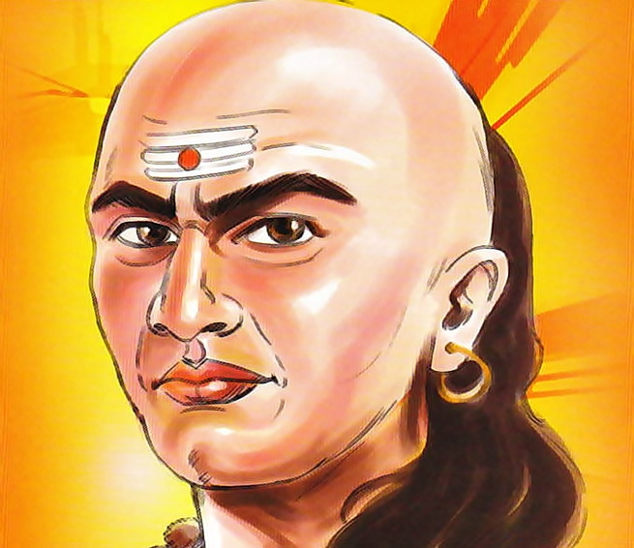

Slide 26
Kautilya enumerated seven prakritis or essential organs of the state. They are as follow:
• Swami (The Ruler)
• Amatya (The Minister)
• Janapada (The Population)
• Durga (The Fortified Capital)
• Kosha (The Treasury)
• Danda (The Army)
• Mitra (Ally and Friend)

Slide 27
Swami/The King was the supreme authority of his state. He protected the purity of class, caste and the family system as well as maintained the social order. In tribal kingdom, the king was assisted by a court of elders of the tribe and by the village headman.

Slide 28
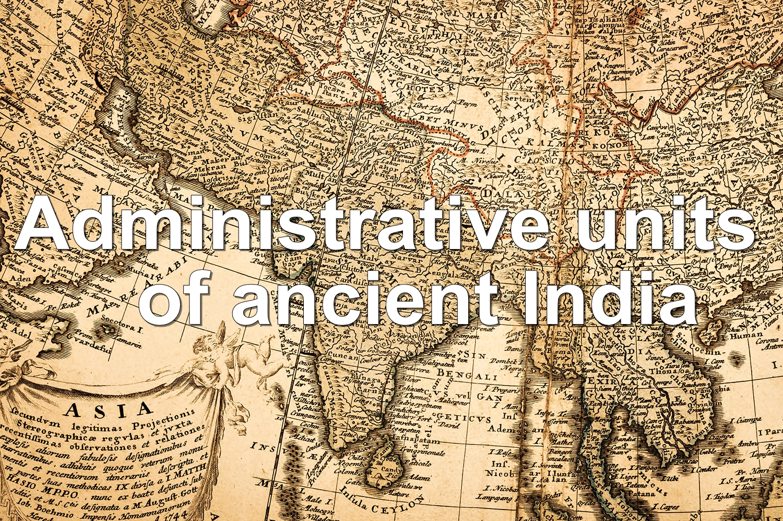

Slide 29

Indian Subcontinent
Different Independent States
(King, Chief Priest, Chief Military Commander)
Provinces/ Districts
(Governors appointed by the King according to their status)
Cities
(Nagaraka/Purpala – like Mayor of the city corporation)
Villages
(Village Headman/ Panchayat)

Slide 30
Various independent states existed in ancient India and King was the head of and supreme authority in each states. The king was assisted by his chief priest (Purohita) and military commander (Senani).
Separate Governors, according to their status were appointed with different designations for each Province/ District by the King and in some places their appointment was hereditary.

Slide 31
The cities were known as “Janapada-Sandhisu” and administered by a separate governor namely Nagaraka/ Purpala (like Mayor of the City Corporation).
There were large numbers of villages all over India. Each village consisted of a village headman and village council/ village panchayat. They assisted the district authorities in controlling the village the village administration and the office of the village headman was mostly hereditary.

Slide 32
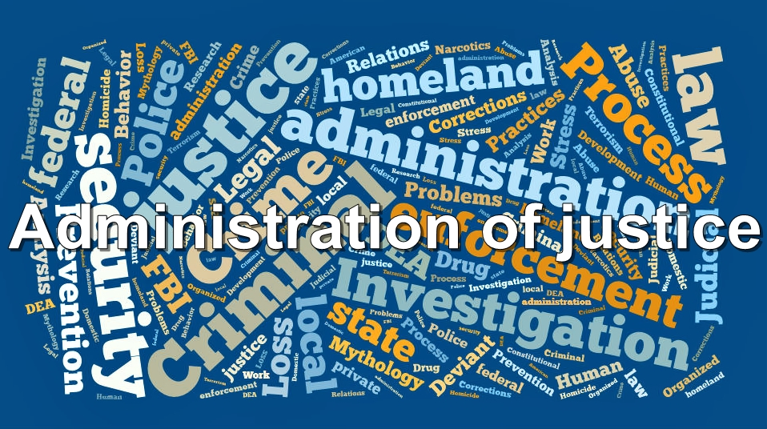

Slide 33
1. Kings Court:
King was regarded as the supreme justice and was respected as the Lord of Dharma. The Kings Court was the highest court of appeal as well as an original court in cases of vital importance to the state. In Kings Court the King was advised by a learned Brahmin known as chief justice. Apart from the chief justice the court consisted of a board of judges to assist him. All the judges in the board belonged to three upper castes (Brahmins, Khastriya, Baisya) preferably Brahmins.

Slide 34
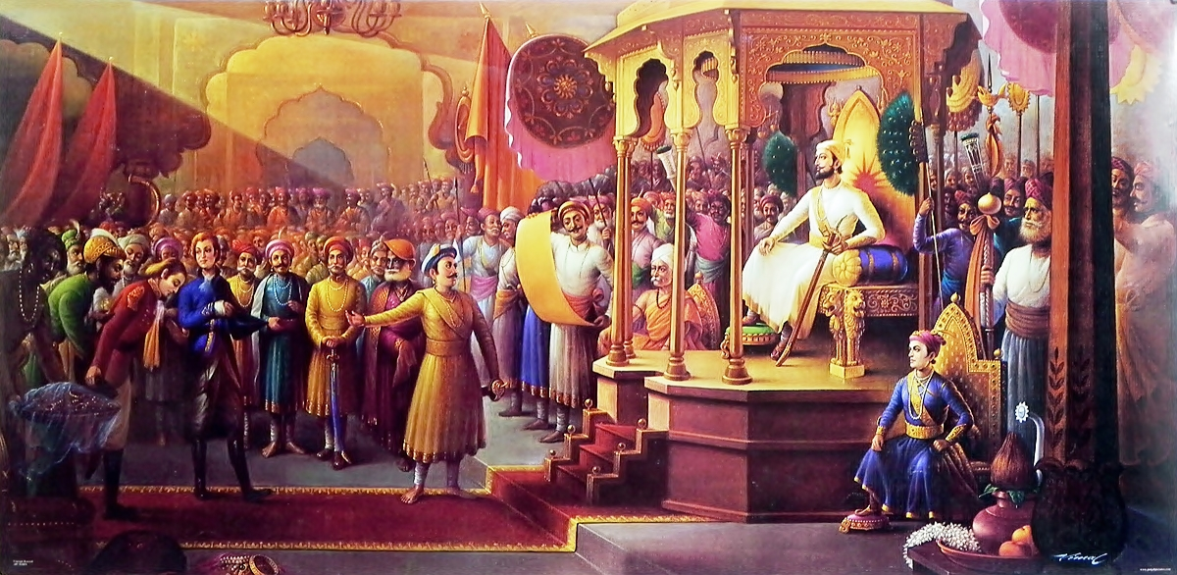

Slide 35
2. Province/District Court:
The provincial or district courts administered by the Governor/ Nagaraka under the authority of the King.
3. Village Court:
The local village councils or Kulani, similar to modern Panchayats, was constituted at village level .The council consisted of a board of five or more members for administration of justice to villagers. The council dealt with petty civil and criminal cases.

Slide 36
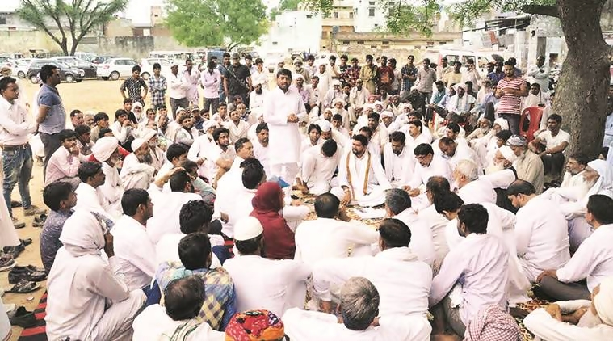

Slide 37
4. Arbitration Council:
There were councils consisting of a president and three/five members and dealt with the disputes amongst member of various associations of trader or artisans (Sreni).
5. Family Courts:
Family courts were also established due to the prevailing institution of the joint family system. To decide civil disputes amongst family member’s assemblies were made up of groups of families in the same village.

Slide 38
6. Special Courts:
In certain cases separate courts with special territorial jurisdiction used to be formed among judges who were members of the Kings court.
The court was moveable and held under the royal signet in the absence of the king.

Slide 39
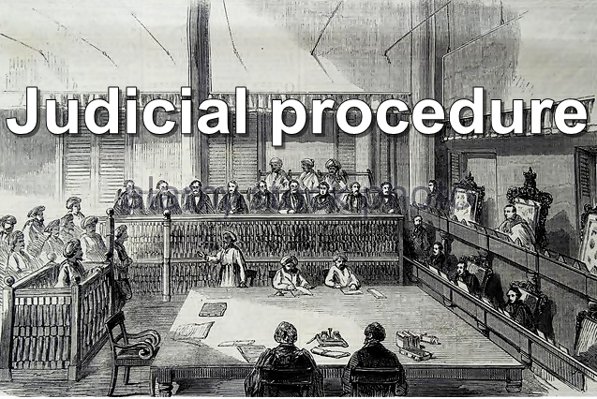

Slide 40
1. Proceeding of a Suit:
According to Brihaspati a suit/trial consisted of four parts:
(a) Poorvapaksha (The plaint)
(b) Uttar (The reply)
(c) Kriya (The trial and investigation of dispute by the court)
(d) Nirnaya (The verdict/decision)

Slide 41
2. Appointment of Judges:
The appointment of chief justice and other judges depends on caste. The chief justice was mandatorily appointed from Brahmins. A Sudra was forbidden to be appointed as judge. Appointment was made from among the persons who were highly qualified and learned in law. Women were not allowed to hold the office of a judge. Judges were required to take the oath of impartiality when deciding disputes between citizens.

Slide 42
3. Precedent:
The decision of the King’s court was binding on all lower courts. The principle of law declared by higher courts were taken into consideration by the lower courts while deciding cases.

Slide 43
4. Evidence:
During the course of proceeding both the parties were required to prove their case by producing evidence. Ordinarily, evidence was based on any or all the four sources namely:
(a) documents
(b) witnesses
(c) possession incriminating objects
(d) circumstantial evidence

Slide 44
5. Witnesses:
In civil suits, the social status and qualification of the witness was always enquired into by the court. Witnesses were required to take an oath before the court. False witnesses were severely fined by the courts.

Slide 45
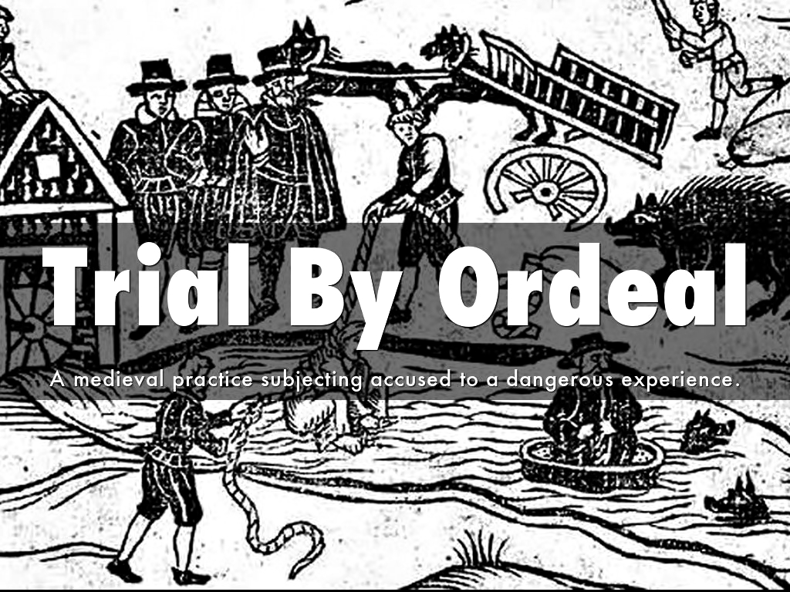

Slide 46
Only in cases of high treason or very serious offences the trial by ordeal was applied. It was a method to determine the guilt of a person.
1. Ordeal of Balance: (Dhata)
2. Ordeal of Fire: (Agni)
3. Ordeal of water: (Kosa)
4. Ordeal of poison: (Bisa)
5. Ordeal of Rice-Grains
6. Ordeal of Fountain-cheese

Slide 47
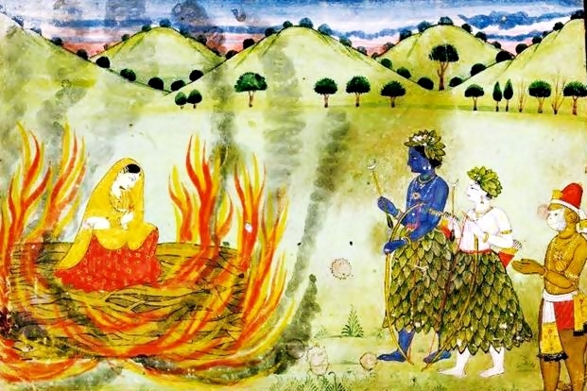

Slide 48
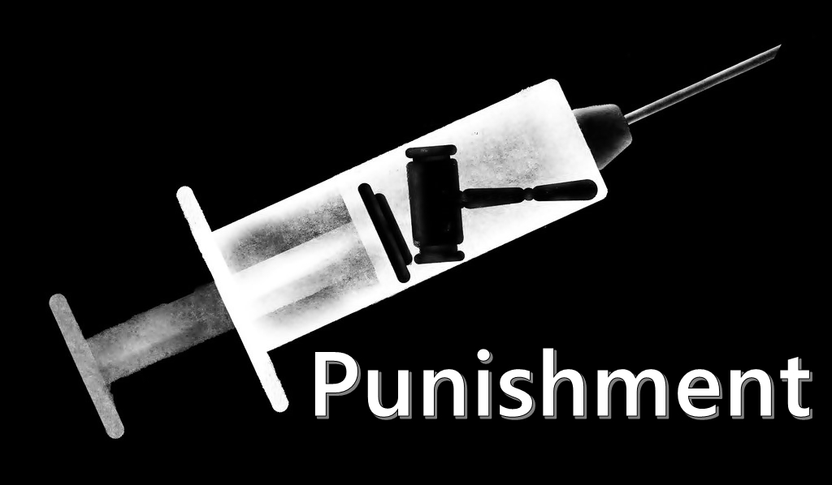

Slide 49
Punishment was considered to be a sort of redemption which removed impurities from the offender and reformed his character.
According to Manu, men who have been punished by the King will go to heaven becoming pure.

Slide 50
The Dandaviveka quotes following factors must be taken into consideration:
1. The offenders caste
2. The value of the thing
3. Gravity of the offence and manner used to commit the offence
4. Age and ability (to pay) of the offender
5. Nature of the offence (whether repeated or first time)

Slide 51
Exemption from punishment:
1. An old man over 80 years
2. A boy below 16 years
3. Women and person suffering from diseases are to be given half prayaschitta
4. Child less than 5 years
5. Brahmin offender was exempted from death or corporal punishment

Slide 52
Punishment for Theft: Death and in certain cases the whole village was held responsible
Punishment for Adultery and Rape: Fine considering the caste position.
Punishment for Murder: Fine according to caste position and death penalty.
Form of Capital punishment: Roasting alive, drowning, trampling by elephant, devouring by dogs, cutting into pieces etc.

Slide 53
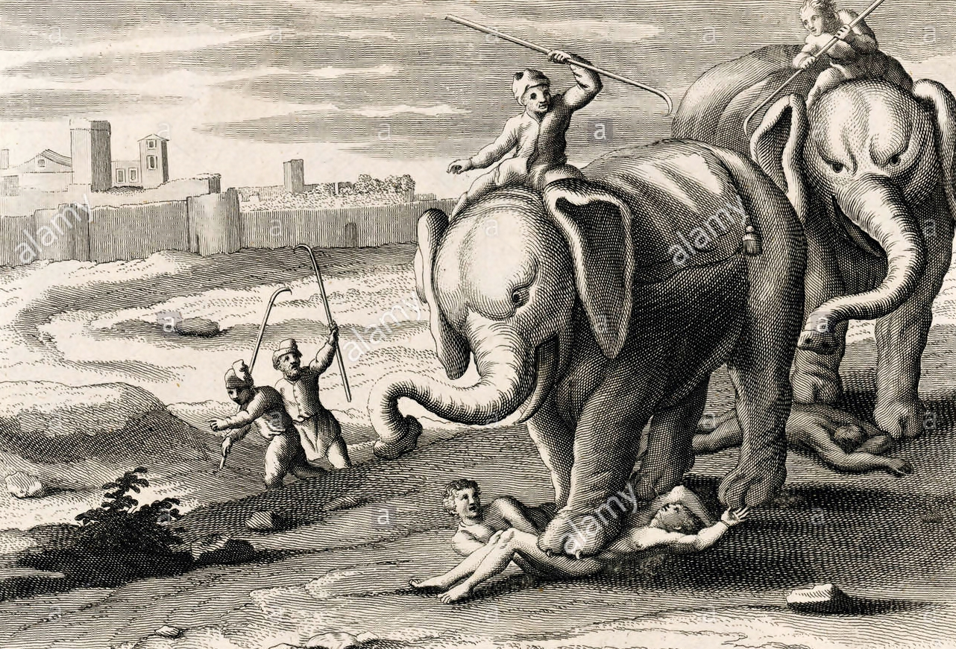

Slide 54


