Slide 1
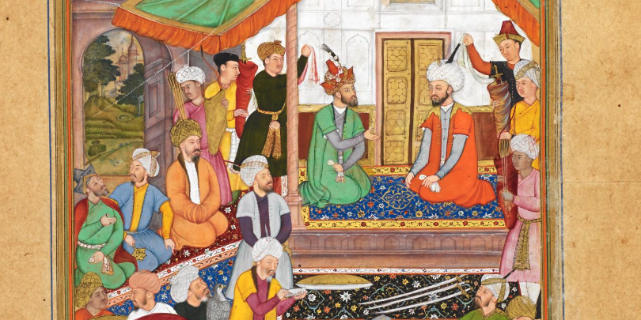
Muslim Period (Part 1)

Slide 2
1. How Islam reached to Hindu dominated India?
2. Did Islam reach India during Prophet SM lifetime and first Chaliphs?
3. What was the position of Islam during Umayyad and Abbasid regimes?

Slide 3
How Islam reached to Hindu dominated India
Military way of invasion
Mohammad Bin Qasem-a military leader under Umayyad period (the conquer of India)
Sultan Mohammad Gazni
2. Non-military way of commercial explorations and economic migration, teaching of Islam-other ways

Slide 4
Advent of Isalm in India in line with different time frames (8th century, 10th century, 13th century, 16th century-1206)
The period of Indo-Arab trade relation
The period of direct military contact with the center of Islam
The period of Ghaznavid dynasty when Islam had spread throughout India
The period of Ghaurid dynasty
The period of Delhi Sultanate
6. The period of Mongol rulers started by Emperor Babur

Slide 5
Did Islam reach India during Prophet SM lifetime and first Chaliphs?
Ratan Hindi became Muslim and became a companion of Prophet SM.
“India and Arab in Prophetic Mission era” a book written by Mobarakbouri.
Muslims reached Bambaeii by the way of Bahrain in the time of the government of Omar, as so they reached Debil, Bohruj, and Gujarat in Sindh (same).

Slide 6
What was the position of Islam during Umayyad and Abbasid regimes?
Different Islamic Regimes after Prophet
Four Caliphs (Non-military way of spreading Islam)
Umayyad-Muawiya-yazid ibn Muawiya (660-740)
Abbasid (740-1400)
Ottoman Empire (1400-1920)
What about Islamic Golden Age

Slide 7
Islamic Golden Age and Islamic Contribution to Different Fields of Study
The golden age of Islam, Khan Academy <https://www.khanacademy.org/humanities/world-history/medieval-times/cross-cultural-diffusion-of-knowledge/a/the-golden-age-of-islam>
List of Islamic scholars described as father or founder of a field <Wiki>
Islamic Golden Age <Wiki>

Slide 8
Contributions of Islamic scholars to the scientific enterprise
<https://files.eric.ed.gov/fulltext/EJ854295.pdf>

Slide 9
Thanks

