Slide 1
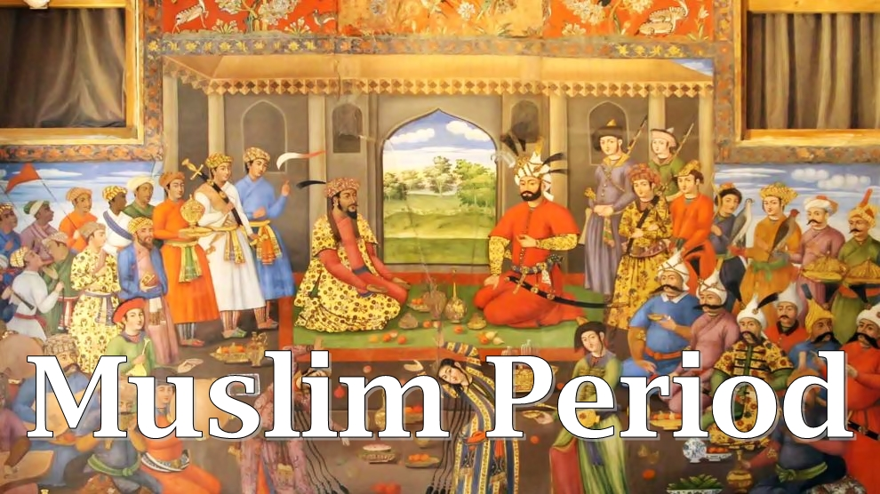

Slide 2
The causes of the downfall of Hindu Kingdoms
1. Disunity among Hindu kingdoms
2. Lack of strong leadership
3. Lust for supremacy and struggles for increasing their own supremacy
4. Caste system
5. Lack of awareness among the rulers, unpaotic and politically disunited

Slide 3
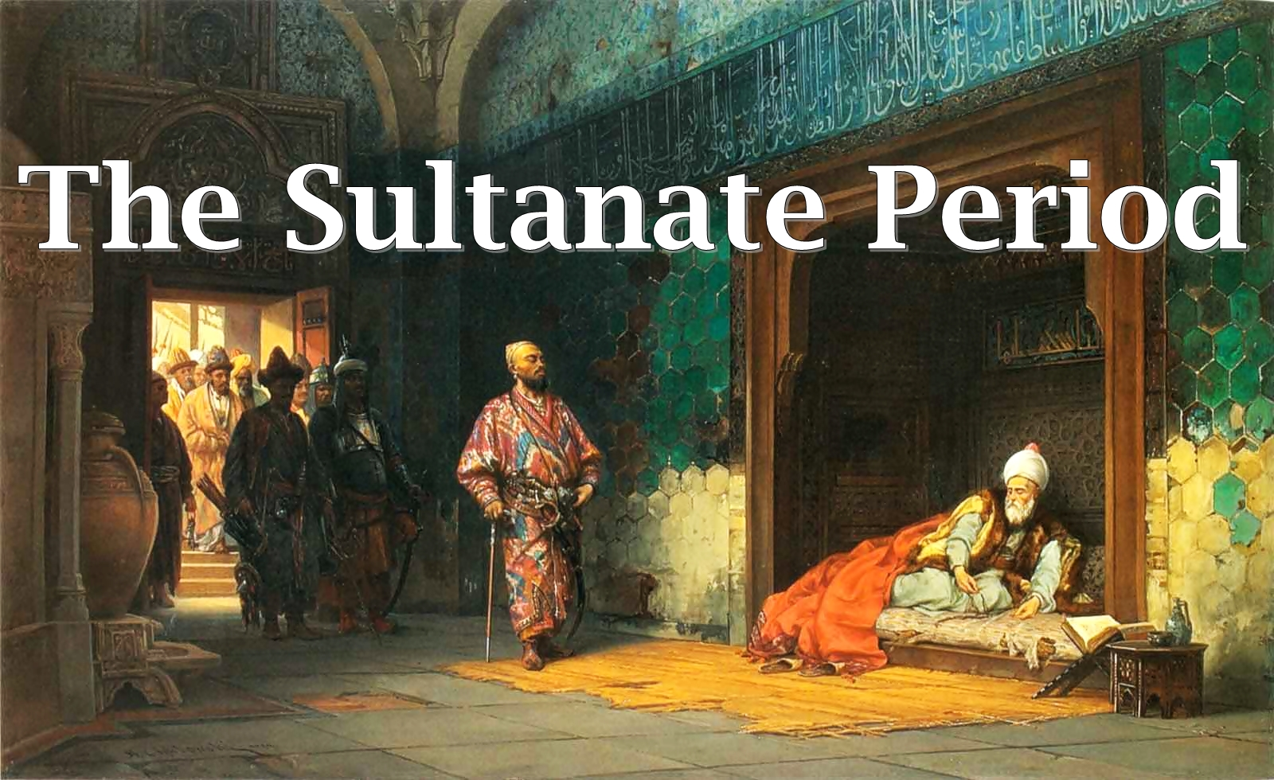

Slide 4
The Sultanate Period (1206-1626)
The Sultan and his Chief Minister (Wazir) were head of the civil administration of Sultanate.
The Sultan being head of the justice was the supreme authority to administer justice in his kingdom.
All the major courts required to seek Sultan’s prior approval before awarding capital punishment.

Slide 5
Administrative Units
Central Capital
Provinces
District
Parganah
Village

Slide 6
Central Capital
1. King’s Court (Presided over by the Sultan and had both original & appellate jurisdiction over all cases within the realm. Two Muftis highly qualified in law assisted the Sultan)
2. The Court of Diwan-e-Muzalim ( Highest court of criminal appeal. Presided over by the Sultan but he seldom sat in it and in his absence the Chief Justice presided over it)

Slide 7
3. The Court of Diwan-e-Risalat (Highest court of civill appeal. Presided over by the Sultan but he seldom sat in it and in his absence the Chief Justice presided over it)
4. Sadre Jahan Court (In 1248, Sultan Nasir Uddin being dissatisfied with the Chief justice created this court superior of Sadre Jahans Court . The ecclesiastical cases were transferred to this court and occasionally presided over the king’s court)

Slide 8
5. Court of the Chief Justice (It was established in 1206 and presided over by the Qazi-ul-Quzat/ Chief Justice. It dealt with all kind of cases.)
6. The Court of Diwan-e-Siyasat (Constituted to deal with cases of rebels and high treason. Courts main purpose was to deal with criminal prosecution. It was established by Muhammad Tughlaq and continued up to 1351)

Slide 9
Officer of the Court
1. Mufti: A lawyer attached to the court appointed by the Chief Justice in the name of sultan.
2. Pandit: A Brahmin lawyer appointed to explain personal laws of Hindus in civil cases and status same as mufti.
3. Mohtasib: He was in charge of prosecutions on original side and in appeal he answered for the prosecution.
4. Dadbak: Administrative officer of the court such as Sherestadar, Peshkar, Peon etc.

Slide 10
Provinces
1. Adalat Nazim Subah /Governor’s Court (The Governor or Nazim was head of this court and Sultan was represented by him. Both original and appellate jurisdiction and appeal from this court lay to the Central Appellate court)
2. Governor’s Bench (The Governor, while exercising his appellate jurisdiction sat with Qazi-e-Subah constituting a Bench to hear appeals)

Slide 11
3. Adalat Qazi-e-Subah (The Chief provincial Qazi was head of this court. It had original civil and criminal jurisdiction as well. It heard appeals from decisions of the Qazis of the District and also had supervisory power. There were four court officials)
4. The Court of Diwan-e-Subah (Diwan-e-Subah was head of this court. It had both original and appellate jurisdiction in all revenue matters)

Slide 12
5. The Court of Sadre Subah (This was the Chief ecclesiastical court in the province and dealt with the matters relating to grant of stipend, lands etc.)

Slide 13
Districts
1. The Court of District Qazi (The District Qazi was head of this court. It had the jurisdiction to try all civil and criminal matters. Empowered to hear appeal from the decisions of the Parganah Qazis, Kotwals and Village Panchayat)
2. The Court of Dadbaks (Assistant court to the Court of District Qazi’s)

Slide 14
3. The Court of Faujders (Jurisdiction to try petty criminal cases concerning security and suspected criminals. Appeal from this court to court of Nazim-e-Subah)
4. The Court of Sadre (Dealt with cases concerning grant of land and registration of land. Appeals from this court lay to the court of Sadre Subah.)

Slide 15
5. The Court of Amils (Jurisdiction on land revenue cases)
6. The Court of Kotwals (The court was authorized to try police and petty criminal cases)

Slide 16
Parganah
1. The Court of Qazi-e-Parganah (The court had all the powers of a District Qazi in all civil and criminal cases but no appellate jurisdiction)
2. The Court of Kotwal (Authorized to try petty criminal cases and the Kotwal was the principal executive officer of the town)

Slide 17
Village
1. Panchayat (For each village there was a village assembly or Panchayat. It was constituted by five leading men to look after the executive and judicial affairs. The Sarpanch/ chairman was appointed by the Nazim or the Faujder. The Panchayats decided civil and criminal cases of purely local characters)

Slide 18
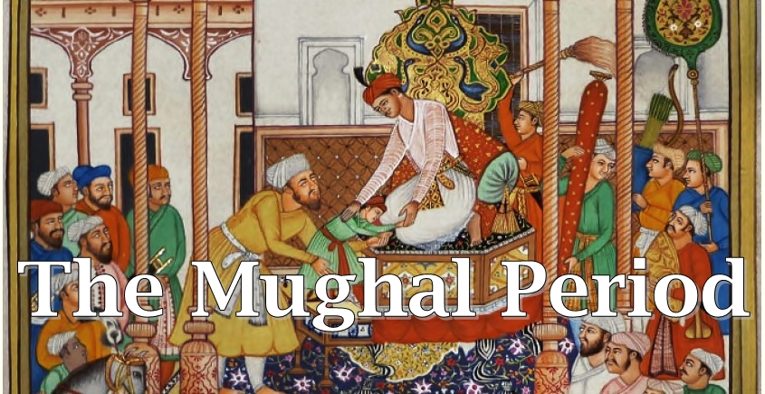

Slide 19
The Mughal Period (1526-1862)
Babar founded Mughal empire after defeating Ibrahim Lodi at Panipath in 1526. Mughal emperors were absolutely moranchs and the Emperor was the supreme authority and in him the entire executive, judicial and military power resided. The Emperor was considered as the “Fountain of Justice”.

Slide 20
Administrative Units
Imperial Capital
Provinces
District/Sarkers
Parganah
Village

Slide 21
Imperial Capital
1. The Emperors Court (Presided over by the Emperor and highest court of the empire. Both civil and criminal original jurisdiction. While hearing appeal the Emperor presided over a Bench consisting of the Chief Justice and other Judges)
2. The Court of Chief Justice (Presided over by the Qazi-ul-Quzat/Chief Justice. It had Original jurisdiction in both civil and criminal cases along with the appellate jurisdiction from provincial court. The Chief Justice was assisted by two Qazies and there were four court officials namely: Daroga-e-Adalat, Mufti, Mohtasib and Mir Adils)

Slide 22
3. The Chief Revenue Court (It was the highest court of appeal to decide revenue cases. It was also assisted by the four court officials)
4. The Court of Qazi of Delhi (It sat in the absence of Qazi-ul-Quzat to decide civil and criminal matters and status was same. From the decision of this court an appeal was allowed to the court of Chief Justice.)

Slide 23
5. The Court of Qazi-e-Askar (It was specially constituted to decide cases of the military area in the capital. The court moved from place to place with the troops)

Slide 24
Provinces
1. The Governor’s Court/Adalat-e-Nazim-e-Subah (The Governor/ Nazim-e-Subah was the head of this Court. It had original jurisdiction in all cases arising in the provincial capital and also empowered to hear appeals. Appeal from this court lay to Emperor’s court.
2. The Provincial chief Appellate Court/Adalat-e-Qazi-e-Subah (Qazi-e-Subah was the head of this court. It had original civil and criminal jurisdiction)

Slide 25
3. Provincial Chief Revenue Court/Adalat-e-Diwan-e-Subah (The Diwan-e-Subah was the head of this court. It had original and appellate jurisdiction in all revenue matters.)

Slide 26
Court at District
1. The Court of District Qazi (Presided over by the Qazi-e-Sarkar and he was the principal judicial officer in a district. Jurisdiction in both civil and criminal cases and in religious matters. Appeals from this court lay to Qazi-e-Subah. There were six court officials namely: Daroga-e-Adalat, Mir Adil, Mufti, Pandit, Mohtasib and Vakil-e-Shariyat.)

Slide 27
2. Faujdar-e-Adalat (Presided over by a Faujder. Jurisdiction over cases relating to riot and state security. Appeal from this court lay to Governor’s Court)
3. Kotwal-e-Adalat (Presided over by Kotwal-e-Shahar. It decided cases similar to under modern Police Act and had appellate jurisdiction. Appeal from this court lay to the District court.)

Slide 28
4. Amalguzari Kachehri (It was presided over by the Amalguzar and decided all revenue cases. An appeal from this court was allowed to the Diwan-e-Subah)

Slide 29
Parganah
1. Qazi-e-Parganah’s Court (Jurisdiction over all civil and criminal cases within its original jurisdiction. It had no apellate jurisdiction. Appeals from this court lay to the court of District Qazi.
2. Court of Kotwals: (Presided over by Kotwal-e-Parganah and decided petty criminal cases. Appeal from this court lay to the Court of District Qazi)

Slide 30
3. Amin-e-Parganah (Presided over by an Amin decided all revenue matters. Appeal from this court lay to the District Amalguzar)

Slide 31
Village
It was similar to the village courts under the Sultanate. In every village there was a Panchayat to administer justice in all petty civil and criminal cases. The meeting was held in a public place and presided over by the Sarpanch (Village headman).
The Panchayat was composed of five panchs elected by the villagers and no appeal was allowed from the decision of the Panchayat.

Slide 32
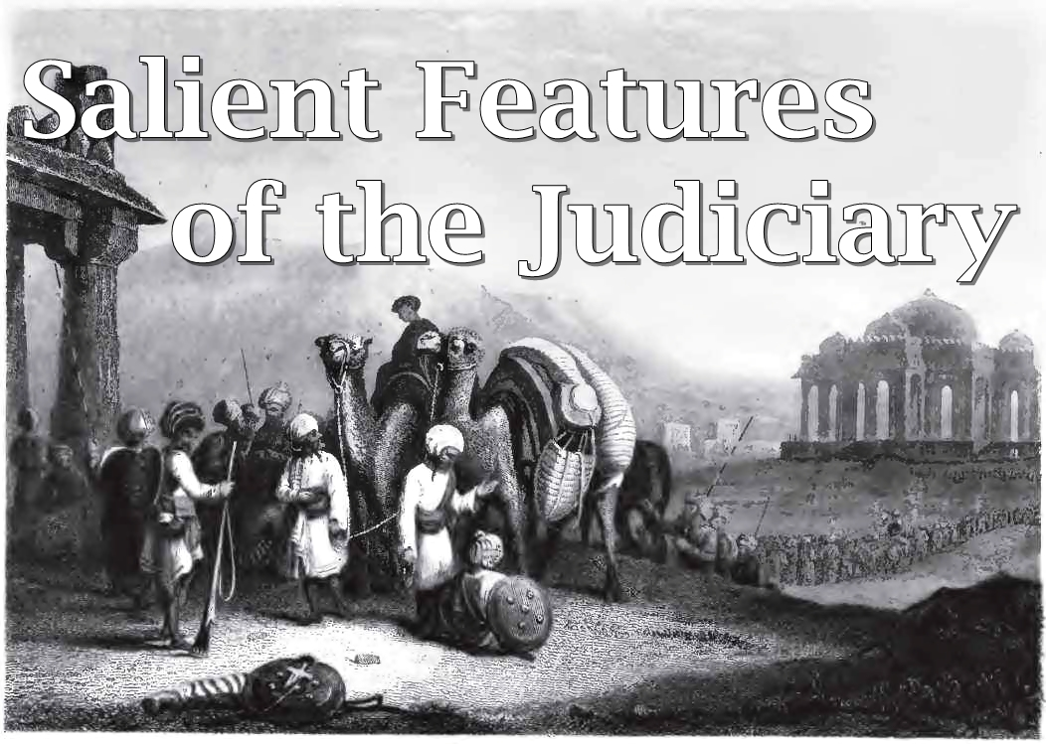

Slide 33
Procedural Code
The judicial procedure was regulated by two Muslim Codes namely:
1. Fiqh-e-Firoz Shahi
2. Fatwa-e-Alamgiri

Slide 34
Evidence
All those who believed in God were competent witness. Oaths were administered to all witnesses.
Women were also competent witness but atleast two women witnesses were required to prove a fact for which the evidence of one man was sufficient.
The principle of Estoppel and Res-judicata were also recognized.

Slide 35
Representation by Lawyers
Litigants were represented by the lawyers known as Vakils.
During the reign of Shah Jahan government advocates were appointed to defend civil suits against the state.
During Aurangzeb’s region, whole time lawyers were appointed in every district known as Vakil-e- Sarkar

Slide 36
Trial by Ordeal
The Muslim law prohibited the use of trial by ordeal to determine the guilt of a person. It was not favored either by the Sultans or by the Mughal Rulers.
Emperor Akbar tried to encourage the system most probably in order to please the Rajputs. The Muslim law experts strongly opposed this move and therefore Akbar gave up the idea.

Slide 37
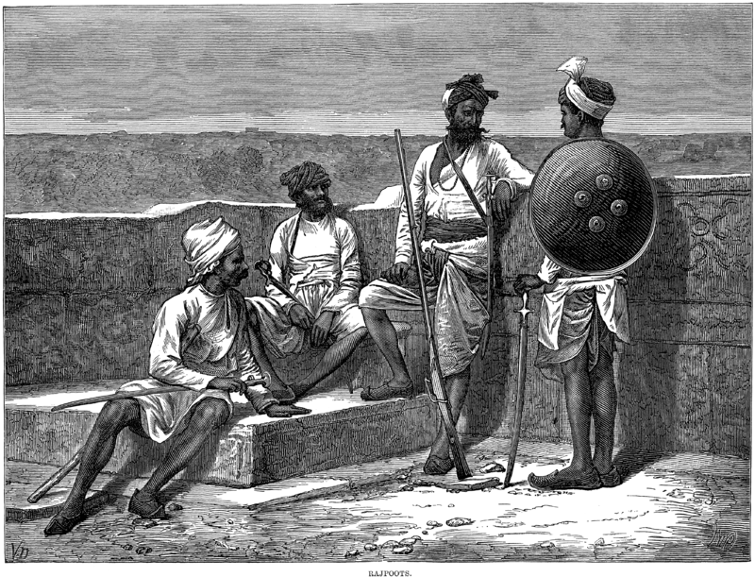

Slide 38
Crimes
The Muslim Criminal law broadly classified crimes under three heads:
1. Crime against God
2. Crime against King
3. Crime against private individual

Slide 39
Punishments
1. Hadd (fixed penalties)
Specific punishment for specific crime like: theft, robbery, drunkness, whoredom etc. No compensation was granted under it.
Stoning to death was prescribed for adultery or drinking wine, cutting of the right hand in case of theft etc.

Slide 40
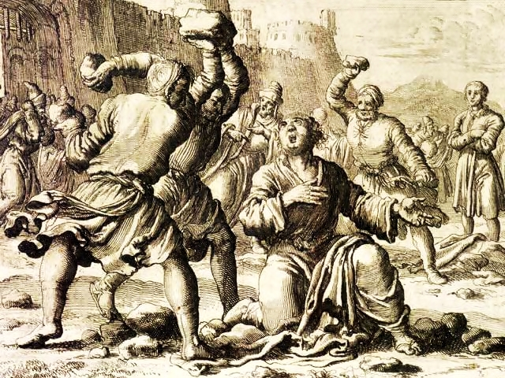

Slide 41
2. Tazir (Discretionary Punishment)
It was applicable to all crimes which were not classified under “Hadd” and includes counterfeiting coins, gambling, causing injury etc.
The courts exercised their discretion in awarding suitable punishment to the criminals. The courts were free to invent new methods of punishing the criminals.

Slide 42
3. Qiyas (Retaliation)
Qias meant, in principle, life for life and limb for limb. It was applied to cases of willful killing and certain types grave wounding.

Slide 43


Slide 44
4. Diya (Blood Money)
It was sort of blood money paid by the man who killed another man if the murderer can convinced the victim and in that case he is not sentenced to death for his offence.
In cases where Qias was available, it could be exchanged with Diya or blood money when the next of kin of the victim was satisfied with compensation for price of blood.

Slide 45
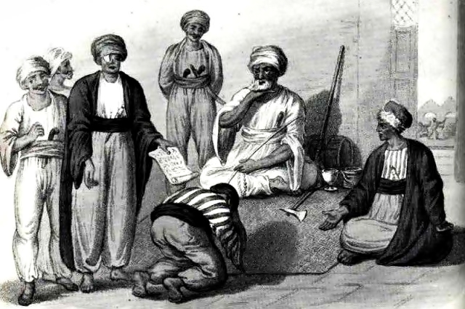

Slide 46
Punishment for Treason
Muslim law considered “Treason” (Ghadr) as a crime against God and religion and state. The punishment was mostly death and no consideration was shown for their rank, religion or caste. Only the ruler was empowered to consider a mercy petition.

Slide 47
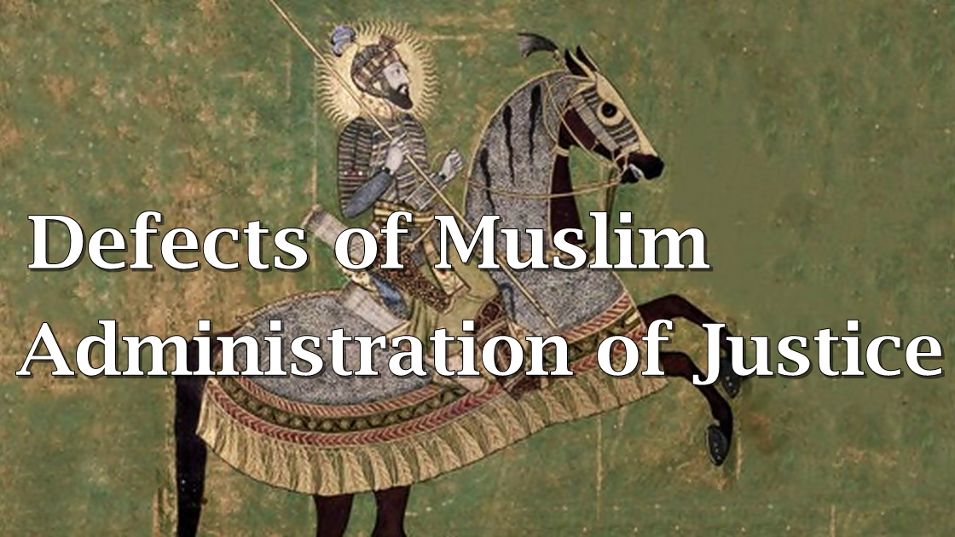

Slide 48
1. No separation of Judiciary
The emperor who was the head of the government was also the fountain of justice and administered justice accordingly.
There was no separation between executive and judiciary.

Slide 49
2. Uncertainty and non-uniformity
Muslim family law was not certain and uniform.
The law laid down in Hedaya and Fatwa-e-Alamgiri was mostly conflicting.
There were differences of opinions among Muslim jurists.

Slide 50
3. No differences between public law and private law
The Muslim criminal law didn’t draw any distinction between public law and private law. Criminal law was regarded as a breach of private law. It had not developed the idea that crime was crime was an offence not only against the injured individuals but also against the society as well.

Slide 51
4. The Defective practice of Diya and Blood money
In many cases the murderer escaped simply by paying money to the relatives of the murdered person.
In cases where murdered person left no heirs to punish the murderer/to demand blood money, a minor heir was to wait till he attained majority for punishing the murderer/demanding the blood-money.

Slide 52
5. No prosecution with state initiatives
State never took any initiative to punish the criminals or murderer for committing murder unless the heir of the murdered person claims before the court.
6. No consideration on criminal intention
Muslim law tried to distinguish between murder and culpable homicide but it did not consider the intention of the culprit. It considered on the method of weapons used in committing the crime.

Slide 53
7. Defect regarding Tazir
The law of Tazir, which provided for discretionary punishment was also very vague which gave too much power to the judge. Even innocent persons were punished by the courts while on the other hand it ledd to corruption and justice.
Punishment could be unduly severe or ridiculously light as there was no standard or measure for them.

Slide 54
8. Defective Evidence Law
No Muslim could be given capital punishment on the evidence of an infidel.
Evidence of 1 Muslim was regarded as equvalent to 2 Hindus. Evidence of 1 man was regarded as equivalent to 2 women.
For rape or illicit intercourse, evidence of four eye witnesses was necessary.

Slide 55


