Slide 1
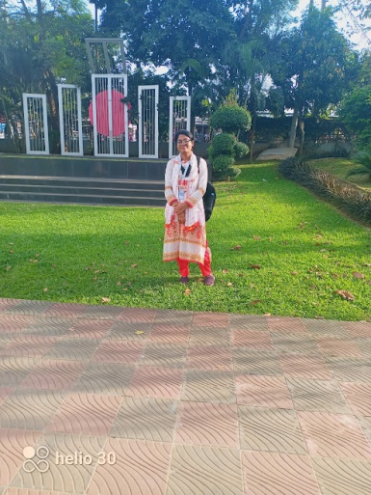
RAYHANA MAHMUD
mahmud2308131055@diu.edu.bd
01794699789
Ssc(2020)
GPA:4.39
KURMITOLAHIGHSCHOOLANDCOLLEGE
EDUCATION
HSC2022
KURMITOLAHIGHSCHOOLANDCOLLEGE
GPA:4.75
LLB(HONS)
DAFFODILS INTERNATIONAL UNIVERSITY(2023-2027)
EXPERIENCE
SKILL
FLUENT IN ENGLISH AND BANGLA
COMMUNICATION EASILY
WORK IN TEAM
REFERENCE
AMRIN CHOWDHURY

