Slide 1


Slide 2
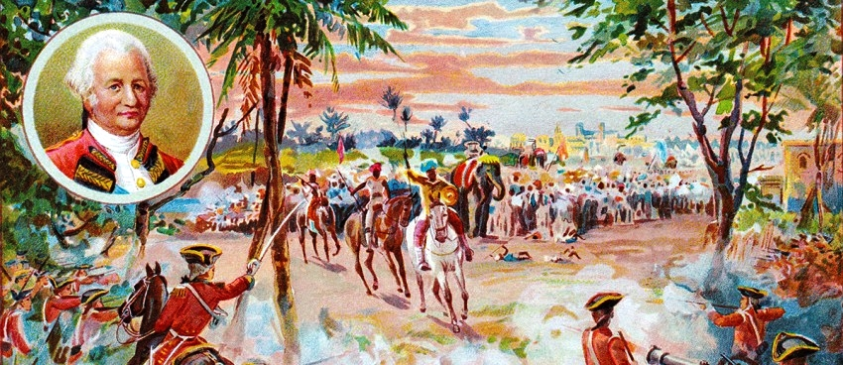
After the Battle of Plassey in 1757, the real authority of the Nawabs of Bengal passed to English company.

Slide 3
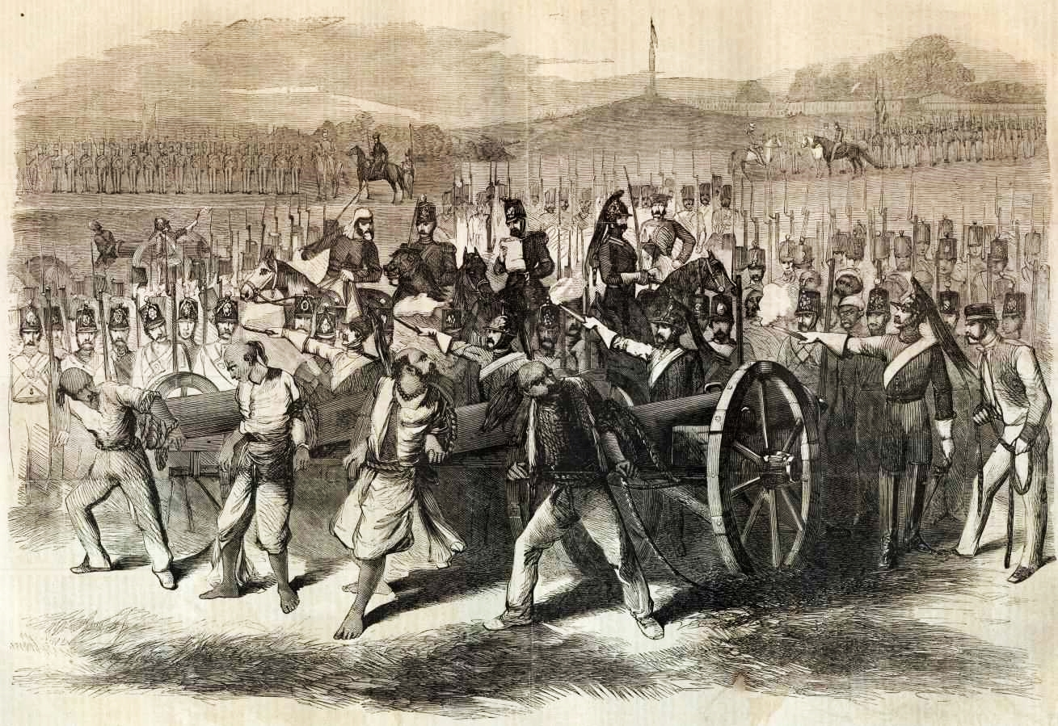

Slide 4
At the historic battle of Buxar in 1764, the Emperor of India was defeated. It had far reaching political effects in that it strengthened the British power in India and death blow to the sovereignty of the Mughal emperor.

Slide 5
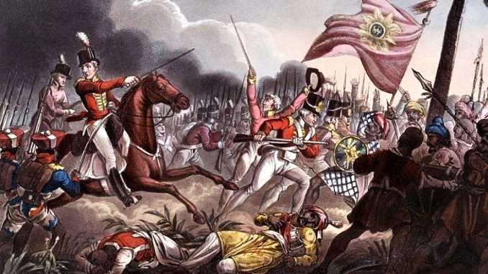

Slide 6
Diwani
The term used for fiscal administration and meant the collection of revenue and administration of civil justice.
After wining the wars the Diwany right was transferred to the English company.
In 1765, Mughal emperor Shah Alam who still claimed sovereignty transferred the Diwani of Bengal, Bihar and Orissa to the British company in lieu of 26 lakhs rupees anually.

Slide 7
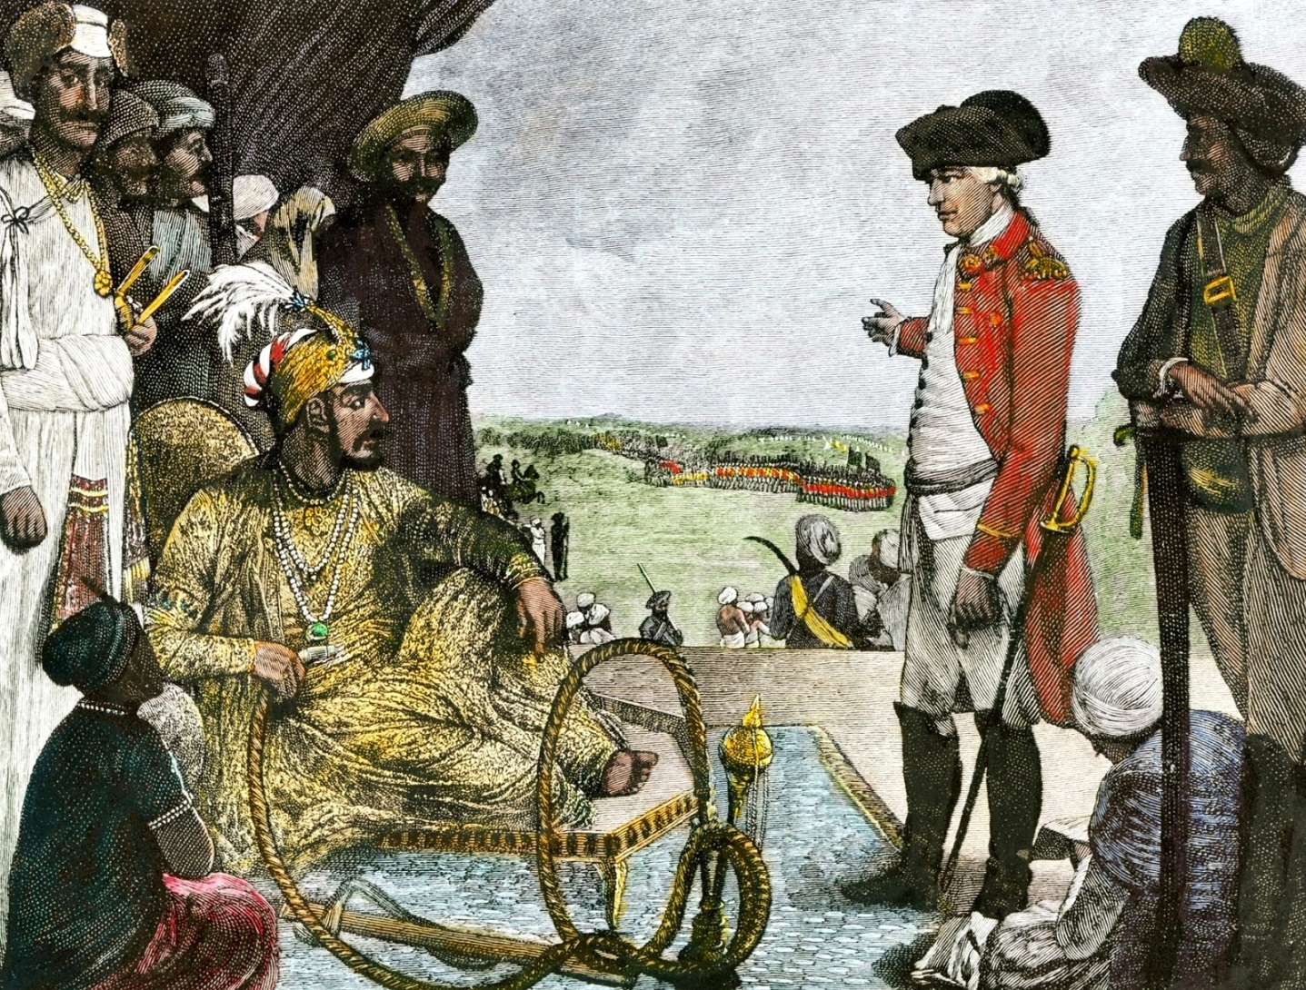

Slide 8
Dual System of Government
Company decided to execute its Diwani functions through the natives instead of English servants. Two separate English officers were appointed to supervise the working of the native officers. The power of civil and revenue administration was conferred to the company while the administration of criminal justice still remained with the Nawab/the Nizam. The maintenance of army was taken over by the company.

Slide 9
Entire territories of Bengal, Bihar and Orissa was divided into two areas:
1. Murshidabad (Reza Khan was appointed as Diwan of Murshidabad)
2. Patna (Raja Shitab Roy was appointed as Diwan)
Diwan were responsible for revenue collection and administering civil justice.

Slide 10
This typical division of power and responsibilities (Executive, Revenue and Judicial) between the Nawab and the Company became famous as the “Dual Government” introduced by Clive.

Slide 11
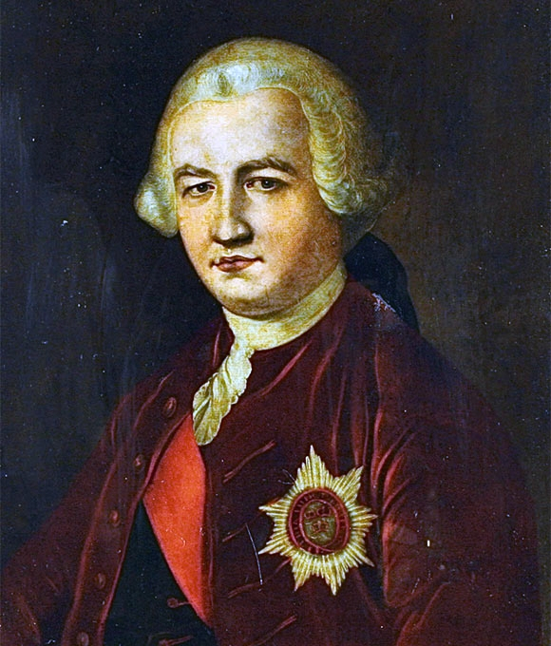

Slide 12
Judicial Plan of Warren Hastings 1772

Slide 13
After assumption of power, Warren Hastings observed that courts had become the instrument of power rather than justice. He wanted to eradicate the evils in judicial administration and revenue collection.
The Committee of Circuit , under Warren Hastings as its chairman, prepared the first judicial plan on August 15, 1772. In order to execute his plan Hastings divided the entire territory of Bengal, Bihar and Orissa into several districts.

Slide 14
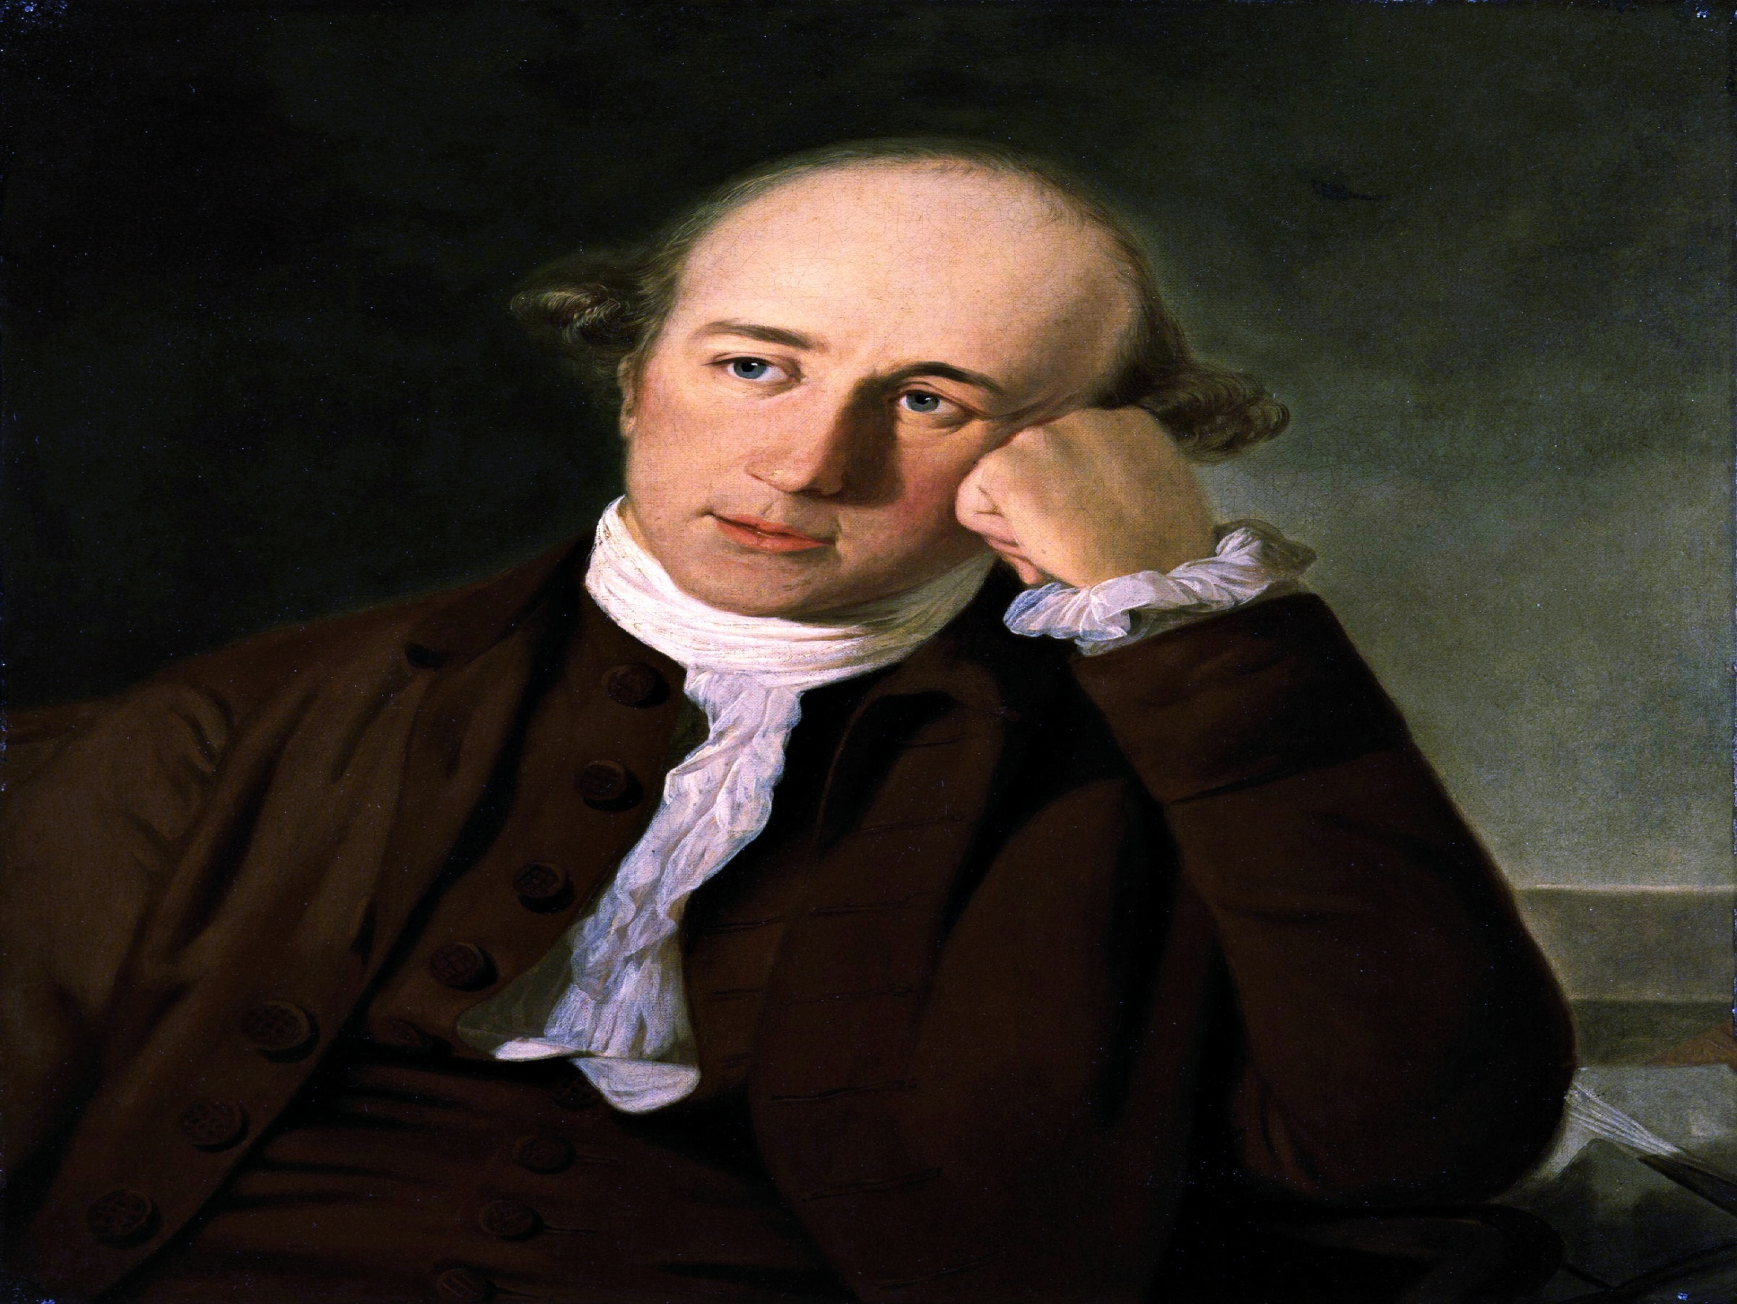

Slide 15
Collector for Each District
The District was selected as the unit for the collection of revenue and for the administration of civil and criminal justice. In each district an English officer called “Collector” of the district, was appointed. His primary duty was to control the collection of revenue.
Board of Revenue was established in Calcutta comprised of Governor and councilors.

Slide 16
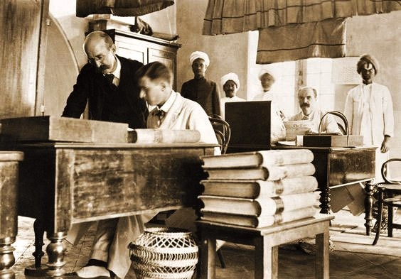

Slide 17
Civil Administration of Justice
Three types of Civil courts were established namely:
1. Sadar Dewani Adalat
2. Moffusil Diwani Adalat
3. Small Causes Court

Slide 18
1. Sadar Dewani Adalat
At Calcutta, one Sadar Diwani Adalat (Court of Superior jurisdiction) was established. It was the chief court of appeal and was empowered to hear appeals from all district Mofussil Diwani Adalats in such cases where the valuation of the suit was more than 500 Rupees.
The court comprised of Governor as its President and at least two councilors.

Slide 19
2. Moffusil Diwani Adalat
As regards the administration of civil justice in each district a Mofussil Diwani Adalat was established. District collector presided over it. It was empowered to decide all civil cases dealing with personal property, inheritance, caste, marriage, debts, disputes accounts, contracts, partnership and demands of rents.
Its decision was final in all suits up to the valuation of 500 Rupees.

Slide 20
Qazi and Pandits assisted the judges of the Moffusil Diwani Adalat for explaining personal laws of Hindus and Muslims.

Slide 21
3. Small Causes Court
The Head farmers of Parganas were authorized to decide petty disputes relating to property up to the value of ten Rupees.

Slide 22
Special Features:
1. For providing easy access to justice, Collectors were directed to place a complaint box at the door of each court so that the litigant can lodge their petition.
2. Cases pending for more than 12 years would not be actionable.
3. The parties indulging in groundless litigation would be punished at the discretion of the Sadar Diwani Adalat.

Slide 23
4. The plan promoted the arbitration by consent of the parties in matters of contract, partnership, debts, disputed accounts etc.
5. In cases of inheritance, caste and religious usages, the law of Quran for Muslim and law of Shastras for Hindus were binding.

Slide 24
Criminal Administration of Justice
Two Criminal Courts were established:
1. Sadar Nizamat Adalat
2. Mofussil Foujdari Adalat

Slide 25
1. Sadar Nizamat Adalat
A Sadar Nizamat Adalat was established at Calcutta to hear Appeals from the Moffusil Faujdari Adalats of the districts and to control their working. It was presided over by a Daroga or Chief officer appointed by the Nawab. A Chief Qazi, a Chief Mufti and three Maulvies were to assist the Daroga in performing his duties.

Slide 26
Capital punishment awarded by Moffusil Foujdari Adalat had to approved by the Sadar Nizamat Adalat.
Fines over Rs. 100 were to be confirmed by the Sadar Nizamat Adalat.
Forfeiture and confiscation were the exclusive jurisdiction of the Sadar Nizamat Adalat.

Slide 27
2. Mofussil Foujdari Adalat
In the field of criminal justice, the plan provided for the for the establishment of a Moffusil Faujdari Adalat in each in each district for the trial of all crimes and misdemeanors.
It was the court of criminal jurisdiction established in each district.
The court presided over by the Qazi and a Mufti and assisted by two Maulvies, who were appointed to expound law.

Slide 28
The collector was authorized to supervise the working of the court.
The court had full power to decide and punish all criminal cases. However, in capital cases, the proceedings of the court had to be submitted to the Sadar Nizamat Adalat for conformation and finally to the Nawab for sentence.

Slide 29
Personal Laws safeguarded
Warren Hastings decide all cases according to the laws of the Quran with regard to the Mohammedans and the laws of the Shastra with respect to Hindus.
Warren Hastings made constant effort to convince the Directors that the people of India were not savages, that their customs should be respected.

Slide 30
Mohammedan law was contained in a digest prepared by the Indian courts. Hindu law wasn't systematically codified. Warren Hastings therefore, invited to Calcutta ten of the most learned Pundits in the country and commissioned them to prepare a digest for the guidance and convenience of the civil courts.

Slide 31
It is, therefore, clear that by safeguarding the personal laws of the natives of India, Warren Hastings showed his far-sightedness and the legal historians considered it, one of the wisest steps ever taken by Warren Hastings.

Slide 32
Other Procedural Safeguards
There were also some other procedural safeguards. If the defendant was found to evade or delay his reply, the court passed judgment against him. The hearing of a case was to be made in open courts. In certain cases parties were to submit to arbitration and the award became the decree of Diwani Adalat.

Slide 33
Demerits of Judicial Plan of 1772
Despite the merits of the judicial plan of 1772, it had certain demerits which are stated as follows:
1. Over centralization of powers:
One of the major defect of the plan that there was over centralization of power in a single officials, namely the Collector. He was overburdened with heavy work of revenue collection, Civil judge and a Magistrate in his district.

Slide 34
2. Failed to ensure safeguards for all communities:
It was based on an innocent assumption of Hasting that Indian population consisted of only the Hindus and Muslims.
There were other communities and races for which there was no provision made in the judicial plan.

Slide 35
3. Defective controlling mechanism:
In the absence of adequate means of communications it was almost impossible for the government at Calcutta to keep a constant watch on the working of the Collectors of the districts.
In absence of an effective control, the controllers indulged in private trading and misused their position and power for personal gain.

Slide 36
4. Misinterpretation of personal laws:
The judges of the courts being Englishmen did not have knowledge of personal laws of Hindus and Muslims.
Native law officers could easily misguide the judges by interpreting wrongly the provisions of the Quran and Shastra.

Slide 37
5. No separation between revenue collection and civil administration:
The function of revenue collection and civil administration were combined in a single official the collector. Therefore, there was no separation between revenue collection and civil administration.

Slide 38
The Regulation Act of 1773

Slide 39
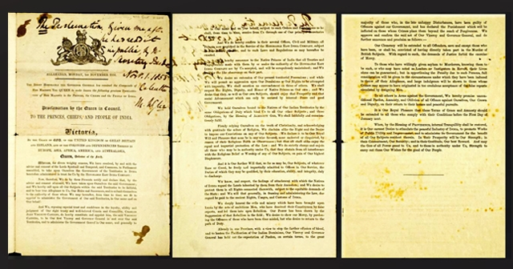

Slide 40
In the beginning the east India company was mainly concerned with trade and commerce in India but its subsequent political involvements and territorial gains created a new situations.
In that time an established principle of English constitutional law was that no subject could acquire foreign territories except for the sovereign. In 1759, Lord Clive, in his letter to the Crown, suggested that the crown should take over the territories which were in the possession of the company.

Slide 41
Main causes for taking over the company
1. Public opinion against company gathered momentum in England.
2. Corruption amongst the member of the company.
3. Complicated administrative problems of the dual government.
4. Lack of proper judicial administration.
5. Degenerated financial condition of the company and its heavy debts.

Slide 42
6. Company’s defeat in 1769 at the hands of Haider Ali of Mysore
7. Terrible famine in Bengal which took a heavy tool of its population.
8. The company applied for loan of one million pound in 1772

Slide 43
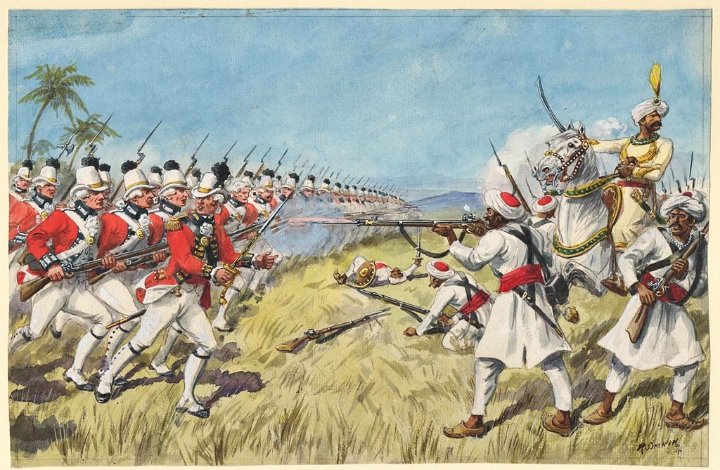

Slide 44
Appointment of Parliamentary Committees:
The House of Commons appointed two parliamentary committees, namely:
1. Select Committee, and
2. Secret Committee

Slide 45
Main purpose of the two committees were to study in detail the financial position of the company and related matters and to uproot corruption from the administrative and judicial machinery of the company.
Two acts were passed by parliament in 1773. The first act granted the company a loan of 1,400,000 at 4% interest. The company was required to submit accounts after every six months to the treasury.

Slide 46
The Regulating Act, 1773
The second and far more important was the Regulating Act, 1773 which was introduced by Lord North on may 18, 1773 in the House of the Commons. Its main three objects were to:
1. Reform the constitution of the company
2. Reform the company’s administration in India
3. Provide solution against illegalities and oppressions committed by the servant of the company in India.

Slide 47
Important features of the Regulating Act, 1773
(The Act permitted the company to retain its Indian possession, but its management was brought under the definite control of the Crown and the Parliament.)

Slide 48
(i) Election for Directors
The Directors of the company were elected for a period of 4 years, one fourth of them were to retire every year and retiring directors were not allowed to be elected again.

Slide 49
(ii) Appointment of Governor General and council
A Governor General and four councilors were appointed at Calcutta. Warren Hastings was appointed as the first Governor General of Bengal.
The majority vote of the council could defeat the decision of the Governor-General.
The Presidencies of Bombay and Madras were Placed under the control and superintendence of the Governor-General-in-Council.

Slide 50
(iii) Change in the company’s law making system
The rules, regulations and ordinances must not be inconsistent to the laws of England.
They were not valid or effective unless registered and published in the Supreme court.
The Governor-General and council were required to transmit copies of all rules, regulations and ordinances to the Secretary of State in England.

Slide 51
(iv) Prohibition against private trade:
Section 23 of the Act provided that Governor-General, the members of the council and judges of the Supreme court were prohibited from accepting present, gifts and rewards or engaging themselves in private trade.
No person holding any civil or military post under the Crown or the company could not accept any present or reward from any of the Indian princes.

Slide 52
Establishment of Supreme Court
(Section 13 of the Act made detailed provisions for the establishment of a Supreme court at Calcutta and authorized the crown to issue charter to establish a Supreme court)

Slide 53
The British Crown issued the Charter of 1774, establishing the Supreme Court of Judicature, which abolished the Mayor’s court of Calcutta.
The charter contained detailed provisions regarding the appointment and removal of the judges as well as the jurisdictions, powers and functions of the Supreme Court in accordance with the Regulating Act.

Slide 54
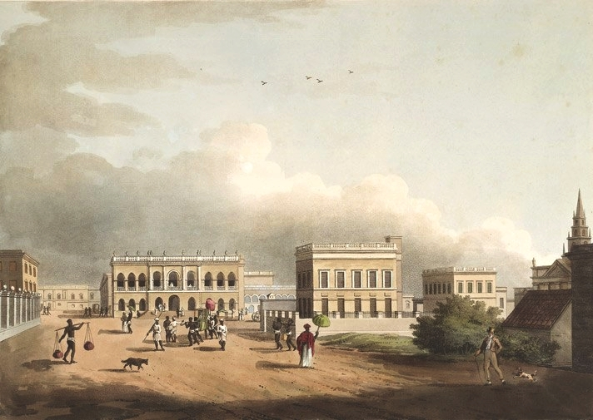

Slide 55
Constitution of the Court
A Chief Justice and three other judges to be appointed by the Crown.
Qualification of the Judges:
Barrister of not less than 5 years standing.
Tenure of the Office:
Judges were to hold office during the pleasure of the Crown.

Slide 56
Civil Jurisdiction:
Original civil jurisdiction in case of:
1. The East India Company and His Majesty’s subject residing in Bengal, Bihar and Orissha.
2. Inhabitants of Bengal, Bihar and Orissha if they consented in writing to refer their disputes to the Supreme court where the value of the subject matter of suits exceeds Rs. 500.

Slide 57
Criminal Jurisdiction:
The criminal jurisdiction of the supreme court extended to all British subjects residing in Calcutta and within the territory of Bengal, Bihar and Orissa.
Its jurisdiction extended to British people and their servants and persons employed in the service of the company.

Slide 58
Admiralty Jurisdiction:
Court of Admiralty for the territories of Bengal, Bihar and Orissa.
It was empowered to try all cases civil and maritime and all crimes committed upon vessels, ships, ferries and high seas and off-shores of Bengal, Bihar and Orissa.

Slide 59
Other Jurisdictions:
1. The court also exercised ecclesiastical jurisdiction over British subjects.
2. The court was also a court of equity and was empowered to apply principle of equity and good conscience.
3. The court could also issue writ of certiorari, mandamus or procedento to courts and officers subordinate to it.

Slide 60
Appeal Jurisdiction:
In civil cases appeal from the decision of the Supreme court could be taken to England with the leave of the Supreme court provided the subject matter in dispute exceeded 1000 pagodas.
Such an appeal could be filed within 6 months of the date of judgment.

Slide 61
Importance of the Regulation Act, 1773
1. It was an attempt to establish parliamentary control over the company.
2. The Act for the first time recognized the political status of the company.
3. The Act attempted towards the unification of the company’s territories in India.
4. It made an attempt to apply regular principles of law and justice in India.

Slide 62
5. It made first attempt by the British parliament to set up a Government in this country suitable to the changed conditions.
6. The Act declared that no person in Indian service could receive presents from the Indian Princes.
7. It secured to some extent a unity of control and a uniformity of policy.

Slide 63


