Slide 1
Reproductive System

Slide 2
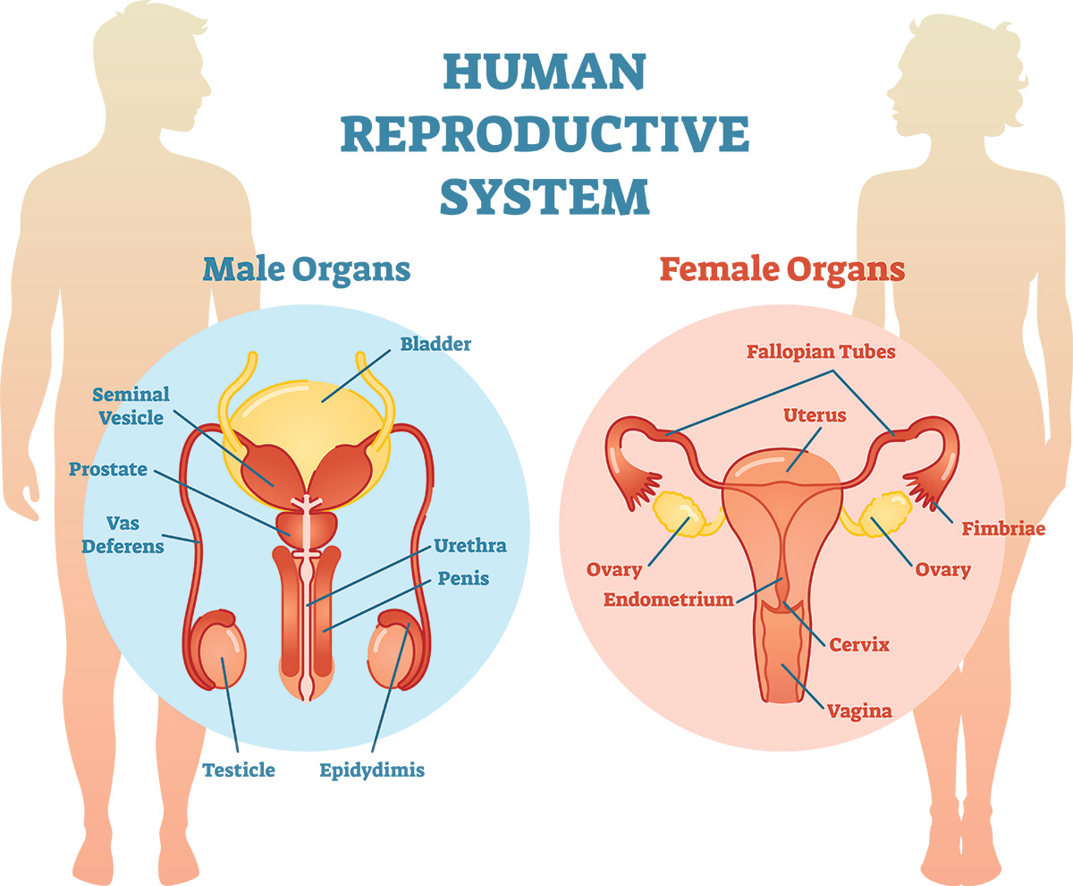

Slide 3
The reproductive system or genital system is a system of sex organs within an organism which work together for the purpose of sexual reproduction.
Reproduction: The organs and glands in the body that aid in the production of new individuals.
It is the process by which our genetic material is passed on from one generation to the next generation. This maintain the continuation of the species.
Fertilization: The process of combining the male gamete, or sperm, with the female gamete, or ovum. The product of fertilization is a cell called a zygote.

Slide 4
What is the male reproductive system?
The male reproductive system includes a group of organs that make the reproductive system and urinary system in men.
The male reproductive system contains internal and external parts.
Organs of male reproductive system:
External parts:
Penis
Scrotum
Testicles (testes)
Internal parts:
Epididymis
Vas deferens

Slide 5
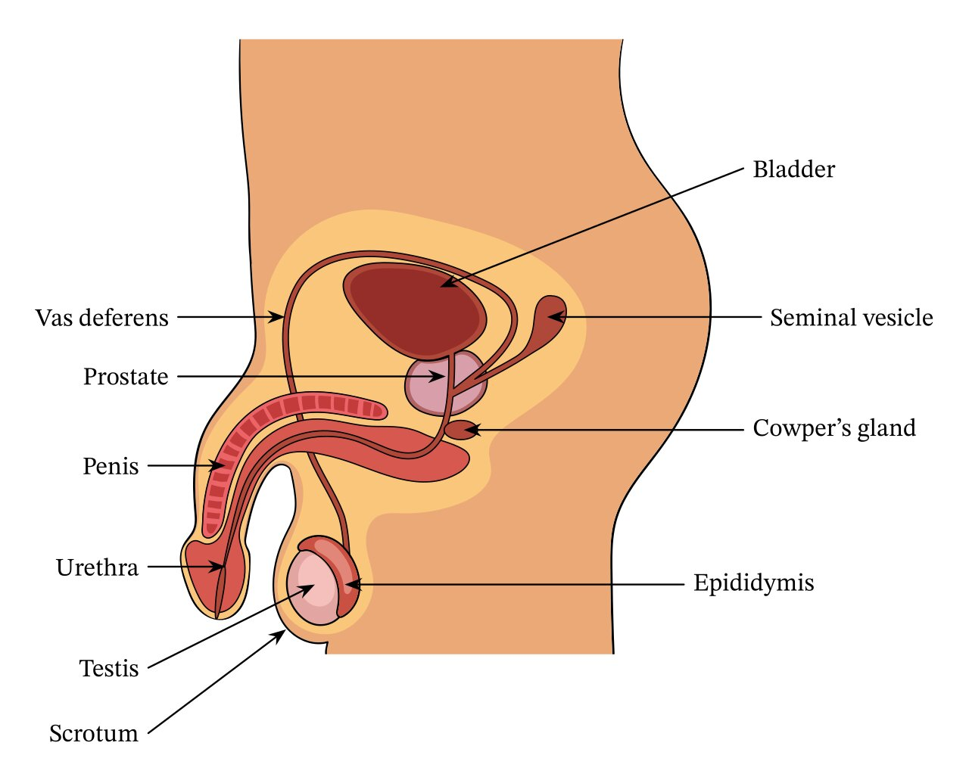
Ejaculatory ducts
Urethra
Seminal vesicles
Prostate gland
Bulbourethral glands

Slide 6
Penis:
The penis is the male organ for sexual intercourse and it is also responsible for expelling urine from the male body. It is a spongy tissue that grows in size upon sexual arousal due to an increase in blood flow. It is called erectile tissue, as it can change from flaccid to erect.
Scrotum
The scrotum is a sac of skin that hangs from the body between the legs just below the penis. The scrotum is divided into two sections, each of which usually contains one testis. It keeps the testes at a temperature 2–3∘C lower than the internal body temperature. This is beneficial, as sperm production is more efficient at lower temperatures.

Slide 7
Testes
The testes are male gonads that produce sperm and male sex hormones. The testes are responsible for producing sperm.
Epididymis
The epididymis is a long, coiled tube that stores sperm and transports them from the testes into the vas deferens.
Vas Deferens (Ductus Deferens)
The vas deferens is a duct in the male reproductive system that transports sperm cells from the epididymis to the urethra.

Slide 8
Ejaculatory ducts
Each of your two testicles has a vas deferens that joins with each of your seminal vesicle ducts to form your ejaculatory ducts.
Urethra:
The urethra is a duct for the expulsion of sperm during ejaculation and urine during urination.
Seminal Vesicles
The seminal vesicles are two glands located behind the bladder that add an alkaline fluid rich in fructose sugar to semen when it is in the prostate, making 50–80% of the total semen volume.
Prostate Gland
The prostate gland is located below the bladder in males and secretes an alkaline prostate fluid, one of the components of semen added to sperm arriving from the vas deferens.

Slide 9
Cowper’s Glands (Bulbourethral Glands)
The Cowper’s glands are two small glands located on either side of the male urethra below the prostate gland that secrete alkaline mucus into semen to neutralize the acidic urethra and vagina.
The primary hormones that help the male reproductive system function include:
FSH is necessary to produce sperm (spermatogenesis).
LH is necessary to continue the process of spermatogenesis.
Testosterone is the main sex hormone in people. It helps you develop certain characteristics, including muscle mass and strength, fat distribution, bone mass and sex drive (libido).

Slide 10
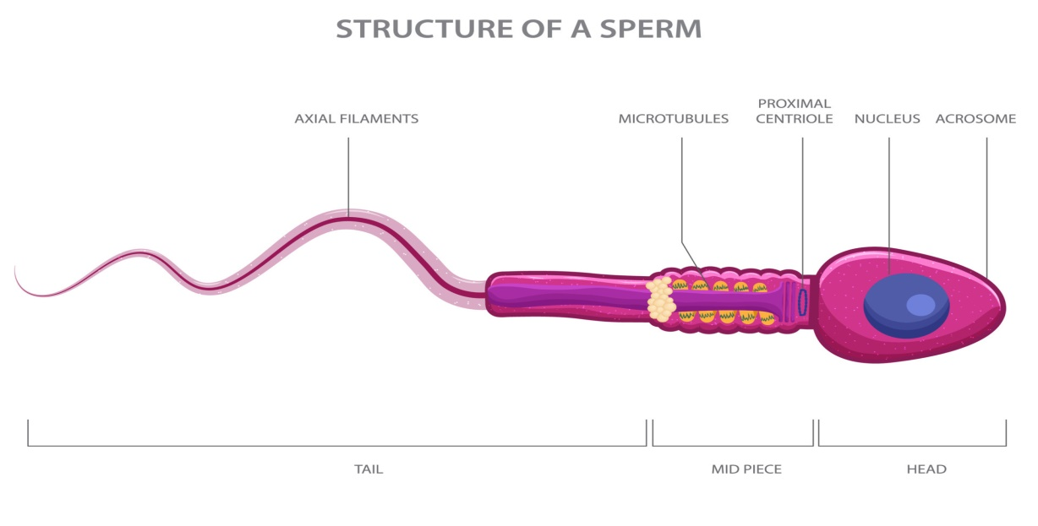
Sperm
Sperm are the male reproductive cells, or gametes. Mature sperm cells, also called spermatozoa, are haploid cells, which means they have half the number of chromosomes that a normal body cell has. Sperm cells are produced through a process called spermatogenesis. Sperm is a microscopic, single-celled structure. It consists of a head, midpiece, and tail. The head contains the nucleus with genetic material (DNA). Sperm are highly specialized for motility, using their tail to swim. This motility is crucial for reaching and fertilizing the egg in the female reproductive system.

Slide 11
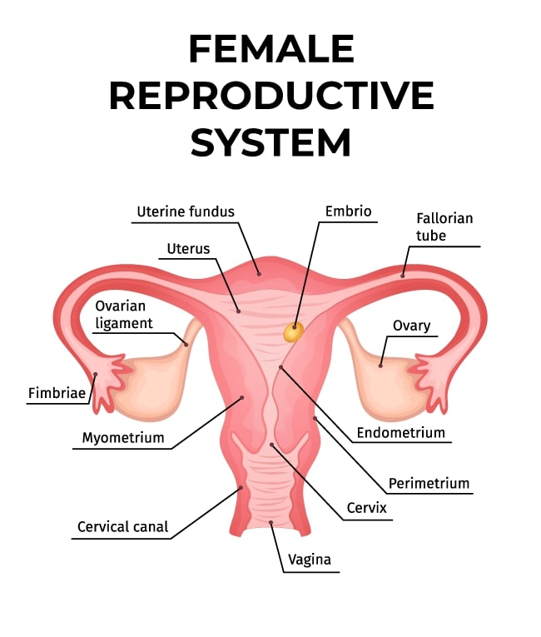

Slide 12
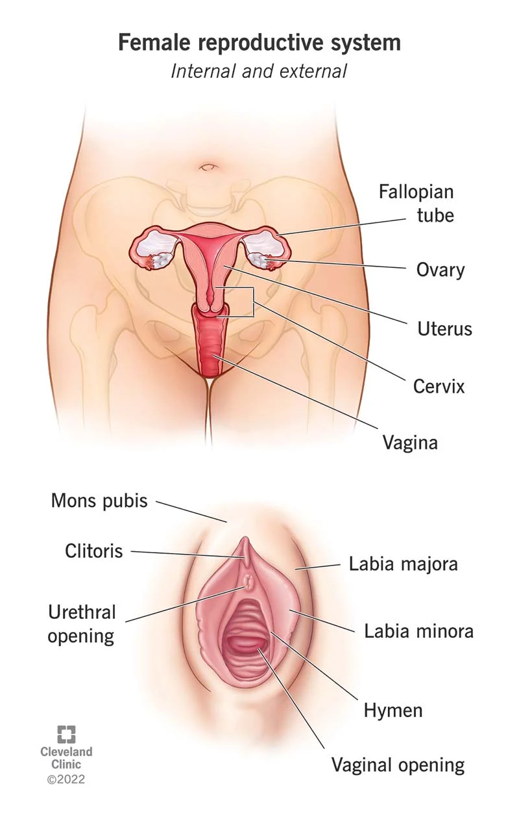
The female reproductive system is the body parts that help women have sexual intercourse, reproduce, menstruate.

Slide 13
Organs of female reproductive system:
External parts (vulva is the collective name for all your external genitals)
Labia majora: Your labia majora (“large lips”) enclose and protect the other external reproductive organs.
Labia minora: They lie just inside labia majora, and surround the opening to vagina and urethra.
Clitoris: Two labia minora meet at clitoris, a small, sensitive protrusion. Clitoris is covered by a fold of skin called the prepuce and is very sensitive to stimulation.
Hymen: Hymen is a piece of tissue covering or surrounding part of vaginal opening.
Vaginal opening
Urethral opening

Slide 14
Internal parts:
Vagina: Vagina is a muscular canal that joins the cervix (the lower part of uterus) to the outside of the body. It’s lined with mucous membranes that help keep it moist.
Cervix: Cervix is the lowest part of uterus. A hole in the middle allows sperm to enter and menstrual blood to exit.
Uterus: Uterus is a hollow, pear-shaped organ that holds a fetus during pregnancy. Uterus is divided into two parts: the cervix and the corpus. Corpus is the larger part of uterus that expands during pregnancy.
Ovaries: Ovaries are small, oval-shaped glands that are located on either side of uterus. Ovaries produce eggs and hormones.

Slide 15
Fallopian tubes: These are narrow tubes that are attached to the upper part of uterus and serve as pathways for egg (ovum) to travel from ovaries to uterus. Fertilization of an egg by sperm normally occurs in the fallopian tubes. The fertilized egg then moves to the uterus, where it implants into uterine lining.
Ovum:
An egg cell or ovum is a female reproductive cell that fuses with sperm in the process of fertilization. This ovum develops into its mature form via a process called oogenesis. A pair of ovaries produce ovum in females. The ovum is a single, large cell. It has a spherical shape. Unlike sperm, the ovum is not motile. It is moved through the female reproductive system by cilia and muscle contractions.

Slide 16
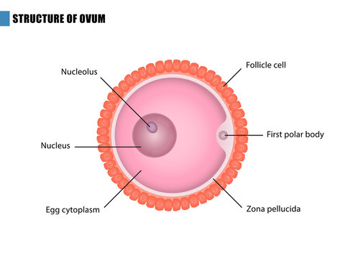

Slide 17
The fertilization process (human):
An egg (ovum) is released from an ovary into the fallopian tube during the woman's menstrual cycle. Sperm, deposited in the vagina through sexual intercourse, swim through the cervix and uterus to reach the fallopian tube. Fertilization occurs when a sperm penetrates the outer layers of the egg. The fusion of the genetic material from the sperm and egg forms a zygote, which now contains a complete set of chromosomes. The zygote undergoes rapid cell division, forming a ball of cells called a blastocyst. The blastocyst travels down the fallopian tube to the uterus and embeds itself into the uterine lining in a process called implantation. The implanted embryo continues to develop, and the cells differentiate into various tissues and organs. The placenta, an organ that provides nutrients and oxygen to the developing embryo, forms and connects to the uterine wall. The developing organism is now referred to as an embryo during the early stages and later as a fetus.

Slide 18
