Slide 1
Introduction To Economics
Chapter 01

Slide 2
Areas Covered
1. Introduction to Economics
2. Components of EE – Inflation, TVM, Depreciation, Make or Buy, Elements of Costs
3. Trade Barriers and Trade Preferences
4. Economics of Textile Materials
5. Economics of Textile Materials Processing

Slide 3
Origin of the word ‘Economics’
The word "economics" is derived from a Greek word "okionomia", which means "household management" or "management of house affairs".
The meaning of 'eco' is home and 'nomos' is accounts.
Economics means how people earn income and resources and how they spend them on their necessities, comforts and luxuries.
With the passage of time, the word "okionomia" was used for an economy of a nation.
Economics means how a nation takes steps to fulfill its desires and preferences with the help of scarce(limited) means. That's why economics was called political economy in its early ages.

Slide 4
Economics - Definition
Economics was first read in ancient Greece.
Aristotle, the Greek Philosopher termed Economics as a science of ‘household management’.
Towards the end of the eighteenth century Adam Smith, the celebrated English Economist and the father of Economics, termed Economics as the ‘Science of Wealth’.
According to him, “Economics is a science that enquires into the nature and causes of the wealth of nations”.
The subject-matter of economics are how wealth is produced and how it is used.

Slide 5
Economics - Definition
According to Alfred Marshall, Economics studies not only the wealth but also the activities centering the wealth.
In simple words, economics can be defined as: "Economics is the study of those natural laws which governs production, distribution and consumption of wealth; in economics we study individual and social behavior of man which satisfy his desires and causes overall economic development."

Slide 6
Goals of Economics
The following are the goals of Economics:
A high level of employment
Price stability
Efficiency
An equitable distribution of income
Growth
Some of the above goals are interdependent. The economic goals are not always complementary; in many cases they are in conflict. For example, any move to have a significant reduction in unemployment will lead to an increase in inflation.

Slide 7
Famous Economists and Their Contributions Adam Smith (1723 - 1790)
Nationality: Adam Smith was a Scottish philosopher and political economist who is widely considered ‘the father of modern economics’
Contribution: World's first free-market capitalist, for he explained how―in a free-market economy―rational self-interest led to economic well-being. He influenced the likes of Karl Marx, John M. Keynes, and Thomas Malthus.
Books: Smith's contribution to economics came in the form of his famous works: The Theory of Moral Sentiments (1759) and The Wealth of Nations (1776)
Education: University of Glasgow, Balloil College, Oxford, UK

Slide 8
Why read Wealth of Nations?
Adam Smith clearly explains why countries are rich and poor.
Wealth of nations explains why some people are wealthy and others are not.
It will answer your questions, why outsourcing, manufacturing coming to China/Bangladesh.
Adam Smith explain individual’s economic behavior with greater clarity than any psychologist.

Slide 9
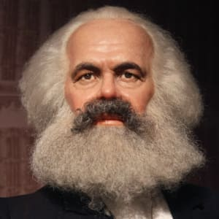
Famous Economists and Their Contributions Karl Marx (1818 - 1883)
Nationality: German philosopher, economist, journalist and revolutionary.
Contribution: one of the most influential figures in history, He was of the belief that humans were not motivated by grand ideas, but by material concerns related to survival. Marx looked at capitalism negatively and in his book ‘Das Kapital’ argued that the capitalist's profits come from exploiting labor. He predicted the end of capitalism and emergence of communism, where people would own the means of production, and thus, there would be no need to exploit labor for profit.
Books: Das Kapital (1867), Critique of Political Economy (1859)
Education: University of Bonn, University of Berlin, Germany

Slide 10
Importance of the Study of Economics
In the daily life of people: People are facing multiple wants in their daily life. But the resources to satisfy those wants are limited. By studying economics we can know to use of limited resources to satisfy alternative wants on the basis of priority.
In the proper use of resources: We can learn about the use of resources with the knowledge of economics. Study of economics helps us to understand about how to produce the maximum output by the proper use of limited resources.
In state affairs management: Politician and Government official need to have proper knowledge of the currency system, banking system, tax system, industrial and trade policy, budgeting etc. The knowledge of economics helps in managing the state affairs.

Slide 11
Importance of the Study of Economics
To social workers: To diagnose and solve the problems of poverty, unemployment, illiteracy, excessive growth of population, lack of housing and medical facilities etc.
To the labor leaders: For improving their bargaining capacity in respect of the formation of trade unions, the increase of wage and other benefits, the improvement of their working condition etc.
Achievement of knowledge of international issue: The knowledge of economics is necessary to know and understand the socio economic events of different countries, international relationship and commerce etc.

Slide 12
Economic Systems
Different type of economic system succeeds in different countries of the world. They are -
1. Market Economy
2. Command Economy
3. Mixed Economy

Slide 13
Market Economy
A market economy is one in which individuals and private firms make the major decision about production and consumption.
In this market consumer are independent.
What: Firms produce the commodity that yield the highest profit. From here you can get answer of the question What.
How: Firms use the techniques of production which are least costly. From here you can get answer of the question How.
Whom: Consumption is determined by individual decisions about how to spend the wages and property ownership. We get the answer of question for whom.
Example: - In the united states of America most economic question are solved by the market so their economic system can be treated as Market Economy.

Slide 14
Command Economy
A command economy is one in which the government makes all decisions about production and distribution.
Government also owns and directs the operations of enterprise in most industries.
Government is the employer of most workers and tells them how to do their jobs.
In a command economy, government
decides how the output of the society is to be divided among different goods and services.
answers the major economic questions through its ownership of resources and its power to enforce decisions.
Example: During the most of the 20th century Soviet Union is operated by Command Economy.

Slide 15
Mixed Economy
In modern society, the rules of market economy or command economy, both are followed and practiced simultaneously.
Like market economy, here will be private ownership of property, earning of profit and individual initiatives.
Like command economy, here government has control over the economic activities at the private level.
Large scale and basic industries and important commercial venture are run in the public sector
Example: Mixed Economy exists in Bangladesh where both market and government plays role simultaneously in production, distribution, consumption etc.

Slide 16
Economic Terms: Micro Vs Macro
Microeconomics
Microeconomics: The study of the choices that individuals and businesses make, the way these choices interact, and the influence that governments exert on these choices.
Macroeconomics
Macroeconomics: The study of the aggregate (or total) effects on the national economy and the global economy of the choices that individuals, businesses, and governments make.

Slide 17
Microeconomics vs. Macroeconomics
Economic analysis is divided into two main branches microeconomics and macroeconomics.
Microeconomic
Greek word Micro means ‘small’. Microeconomic is the study of decisions of the people and business and the interaction of those decisions in markets. The goal of microeconomics is to explain the prices and quantities of individual goods and services. Microeconomic also studies the effect of government regulation and taxes on the prices and quantities of individual; goods and services.
Example: Microeconomic studies the factors that determine the prices and quantities of a product (say cement) of cement factory.
Macroeconomics
Macro means Big. Macroeconomic is the study of national economy as well as global Economy and the way that a Economic system work. The goal of macroeconomics is to explain general price level, national income, Employment, Production. Macroeconomics also studies the effect of Government actions-taxes, spending and the defect on total incomes and price level.
Example: Macroeconomic studies the forces that the average cost of living, the total value of production in a country.

Slide 18
Goods and Services
There is a major difference between goods and services. Goods and services based on both tangible as well as intangible factors. Goods are basically objects or products which have to be manufactured, stored, transported, market and sold. Square Pharmaceutical, BMW, Adidas are some companies manufacturing goods.
Services on the other hand are output of individuals and they can be collective or individualistic action or performance by an individual. For example a barber or a chartered accountant is giving individual services. Airlines on the other hand have airplanes which are a produced but travelling by airplanes is a service (airlines are one of the most competitive service sectors today).
Thus the different between goods and services is based on tangibility. Where goods are tangible in nature, services are mostly intangible. The classic rules which defined services were intangibility, heterogeneity, perishability and variability. However, although the old rules are applicable even today, several new rules have been added to define the difference between goods and services.

Slide 19
BASIS FOR COMPARISON | GOODS | SERVICES
Meaning | Goods are the material items that can be seen, touched or felt and are ready for sale to the customers. | Services are amenities, facilities, benefits or help provided by other people.
Nature | Tangible | Intangible
Transfer of ownership | Yes | No
Evaluation | Very simple and easy | Complicated

Slide 20
Return | Goods can be returned. | Services cannot be returned back once they are provided.
Separable | Yes, goods can be separated from the seller | No, services cannot be separated from the service provider.
Variability | Identical | Diversified
Storage | Goods can be stored for use in future or multiple use. | Services cannot be stored.
Production and Consumption | There is a time lag between production and consumption of goods. | Production and Consumption of goods occurs simultaneously.

Slide 21
Goods
Normal Goods are goods for which demand goes up when income is higher and for which demand goes down when income is lower.
Inferior Goods are goods for which demand falls when income rises.
Substitutes are goods that can serve as replacements for one another; when the price of one increases, demand for the other goes up. Perfect substitutes are identical products.
Complements are goods that “go together”; a decrease in the price of one results in an increase in demand for the other, and vice versa.

Slide 22
Consumer Goods & Producer Goods
CONSUMER GOODS are tangible goods that are purchased for direct consumption to satisfy a human need or want. This is in contrast to producer goods, where are purchased as an input to produce another good.
PRODUCER GOODS/CAPITAL GOODS, also called intermediate goods, in economics, goods manufactured and used in further manufacturing processing or resale. Producer goods either become part of the final product or lose their distinct identity in the manufacturing stream
Consumer goods are those that are purchased for direct consumption. ‘Consumption’ in this context does not necessity mean consume, as in eat. There are plenty of consumer goods that no one would consider eating, such as clothes. Clothing is a good purchase to satisfy a human need – the need to be clothed.
Another way to identify a consumer good is to think of a production line. The goods used as inputs at the beginning of the production line are not consumer goods; these would be considered capital or producer goods, and might include cloth, plastic, or other materials. The good that is produced at the end of production line (the clothing line) is a consumer good. It’s a final end product made for a buyer to consume.

Slide 23
Types of Consumer Goods Consumers buy an enormous variety of products. Some are goods that will last for many years. Other items are consumed on the spot when we purchase them. To business people and economists, these are known as durable and non-durable goods. The production of durable and non – durable goods is the basis for important measures of economic trends.
Durable goods tend to have a long useful life. For statistical purposes, a durable good is expected to last three years, according to the Economics and Statistics Administration. Goods consumed in a short time or that have useful lives of less than three years are classified as non- durable. The dividing line isn’t always rigid. For example, people sometimes use a piece of clothing for more than three years. Consumer durable goods include items like furniture, jewelry and cars. Large appliance such as stoves and washing machines are durable goods. The category also includes defense and commercial procurement of heavy equipment and assets like aircrafts, trucks and ships.
Non-durable good include food, medicines and other consumable, as well as products that last a limited lifetime such as clothing, shoes and small electronic devices.

Slide 25
Need and Want
Need: Needs and wants are an important part of an economy. Needs are things that people require to survive. Food, water, clothing, and shelter are all needs. If a human body does not have those things, the body cannot function and will die.
Want: Wants are things that a person would like to have but are not needed for survival.

Slide 26
Maslow’s hierarchy of needs

Slide 27
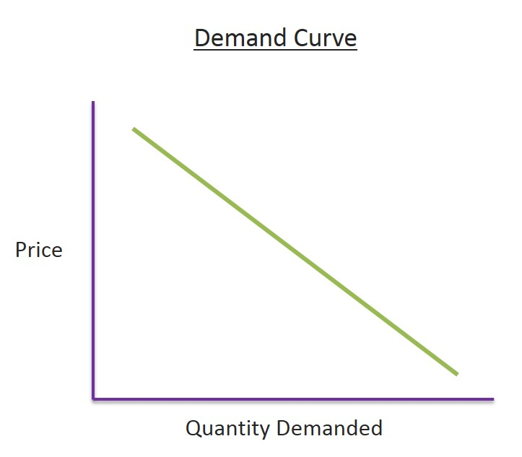
Demand and Supply
Demand: Demand in economics is the consumer's desire and ability to purchase a good or service. It's the underlying force that drives economic growth and expansion. Without demand, no business would ever bother producing anything.
Price is inversely proportionate to demand, If price increase, demand will be lower

Slide 28
Determinants of Household Demand
A household’s decision about the quantity of a particular output to demand depends on:
The price of the product.
The income available to the household.
The household’s amount of accumulated wealth.
The prices of related products available to the household.
The household’s tastes and preferences.
The household’s expectations about future income, wealth, and prices.

Slide 29
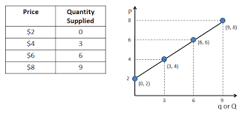
Supply
Supply: Supply means the quantities that a seller is willing and able to sell at different prices. It is obvious that if the price goes up, he will offer more for sale.
But if the price goes down, he will be reluctant to sell and will offer to sell less.

Slide 30
Demand-Supply Curve

Slide 31
The Law of Supply
The law of supply states that there is a positive relationship between price and quantity of a good supplied.
Higher price ensures greater quantity of supply.

Slide 32
Equilibrium
In economics, economic equilibrium is a state where economic forces such as supply and demand are balanced and in the absence of external influences the (equilibrium) values of economic variables will not change.
For example, in the standard textbook model of perfect competition, equilibrium occurs at the point at which quantity demanded and quantity supplied are equal.

Slide 33
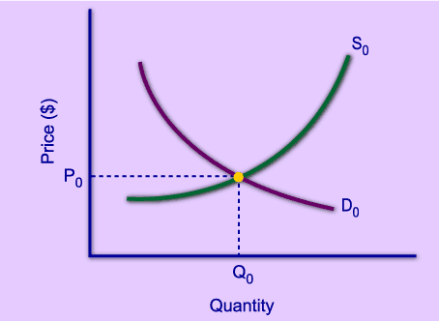
Market Equilibrium
The operation of the market depends on the interaction between buyers and sellers.
An equilibrium is the condition that exists when quantity supplied and quantity demanded are equal.
At equilibrium, there is no tendency for the market price to change.

Slide 34
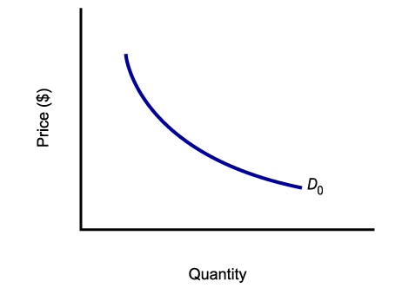
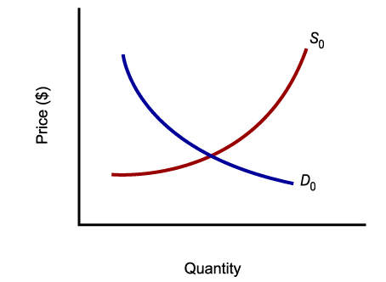
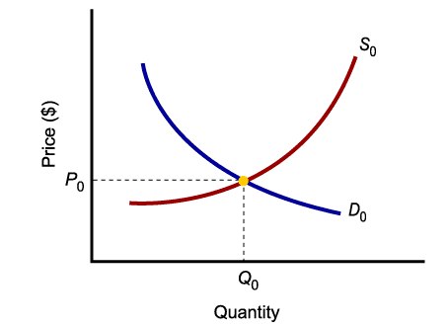
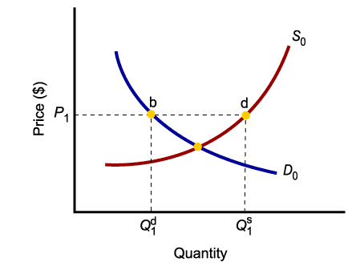
Market Equilibrium
Only in equilibrium is quantity supplied equal to quantity demanded.
At any price level other than P₀, the wishes of buyers and sellers do not coincide.

Slide 36
Gross Domestic Product (GDP)
Definition: Gross domestic product (GDP) is the monetary value of all the finished goods and services produced within a country's borders in a specific time period. Though GDP is usually calculated on an annual basis, it can be calculated on a quarterly basis as well.
GDP includes all private and public consumption, government outlays, investments, private inventories, paid-in construction costs and the foreign balance of trade ( exports are added, imports are subtracted). Put simply, GDP is a broad measurement of a nation’s overall economic activity.

Slide 37
How to Determine GDP
There are three primary methods by which GDP can be determined. All, when correctly calculated, should yield the same figure.
These three approaches are often termed
A. the expenditure approach,
B. the output (or production) approach and
C. the income approach

Slide 38
How to Determine GDP
A. the expenditure approach:
The expenditure approach or spending approach, which is the most common method, calculates the monies spent by the different groups that participate in the economy. For instance, consumers spend money to buy various goods and services and businesses spend money as they invest in their business activities (buying machinery, for instance). And governments also spend money. All these activities contribute to the GDP of a country. In addition, some of the goods and services that an economy makes are exported overseas, their net exports. And some of the products and services that are consumed within the country are imports from overseas. The GDP calculation also accounts for spending on exports and imports.

Slide 39
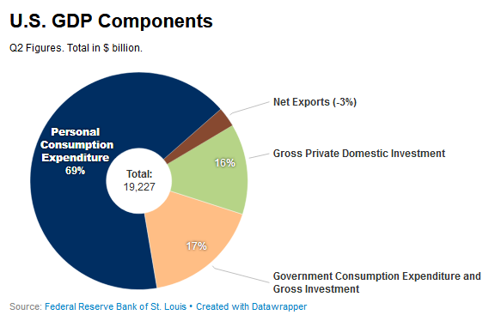
A country's gross domestic product can be calculated using the following formula: GDP = C + G + I + NX.
C is equal to all private consumption, or consumer spending, in a nation's economy,
G is the sum of government spending,
I is the sum of all the country's investment, including businesses capital expenditures and
NX is the nation's total net exports, calculated as total exports minus total imports (NX = Exports - Imports).

Slide 40
How to Determine GDP
B. the output (or production) approach:
The production approach is something like the reverse of the expenditure approach. Instead of exclusively measuring input costs that feed economic activity, the production approach estimates the total value of economic output and deducts costs of intermediate goods that are consumed in the process, like those of materials and services.

Slide 41
How to Determine GDP
C. the income approach:
Income earned by all the factors of production in an economy includes the wages paid to labor, the rent earned by land, the return on capital in the form of interest, as well as an entrepreneur’s profits. An entrepreneur’s profits could be invested in his own business or it could be an investment in any outside business. All this constitutes national income, which is used both as an indicator of implied productivity and of implied expenditure.
In addition, the income approach factors in some adjustments for some items that don’t show up in these payments made to factors of production. For one, there are some taxes – such as sales taxes and property taxes – that are classified as indirect business taxes. In addition, depreciation, which is a reserve that businesses set aside to account for the replacement of equipment that tends to wear down with use, is also added to the national income.

Slide 42
Richest Countries – GDP per Capita

Slide 43
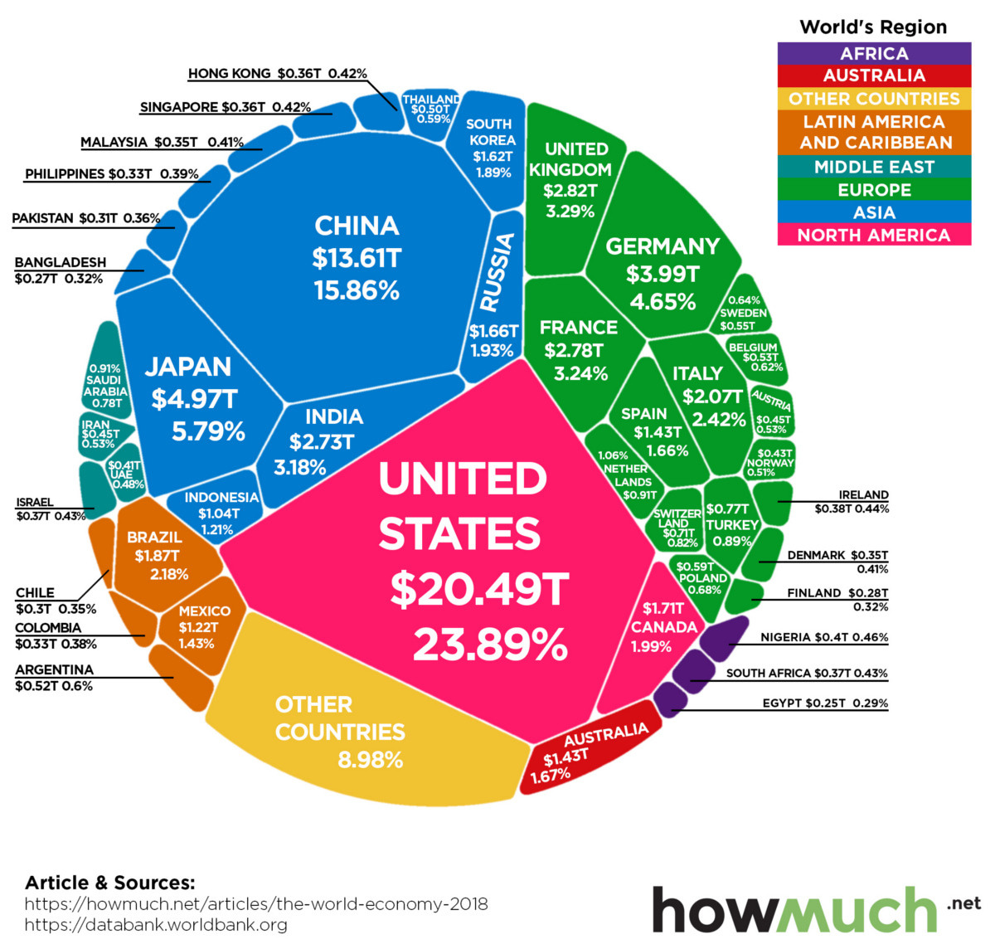
Total GDP

Slide 44
Gross National Income (GNI)
Gross national income (GNI) is the total income earned by a country's people and businesses, no matter where it was earned.
GNI is an alternative to gross domestic product (GDP) as a measure of wealth. It calculates income instead of output.
GNI can be calculated by adding income from foreign sources to the country's gross domestic product.
For many countries, there is little difference between GNI and GDP. Nations that have substantial foreign direct investment, foreign corporate presence, or foreign aid will show a significant difference between GNI and GDP.

Slide 45
Purchasing power parity (PPP)
Definition: Purchasing power parity (PPP) is an economic theory that compares different countries' currencies through a "basket of goods" approach. According to this concept, two currencies are in equilibrium or at par when a basket of goods (taking into account the exchange rate) is priced the same in both countries.
Measurement of PPP:
Law of one price
Big Mac Index
iPad Index
KFC Index

Slide 46
PPP

Slide 47
Per Capita Income
Per capita income (PCI) or average income measures the average income earned per person in a given area (city, region, country, etc.) in a specified year. It is calculated by dividing the area's total income by its total population.
Bangladesh has registered a gross national per capita income of $2,824 in 2021-22

Slide 48
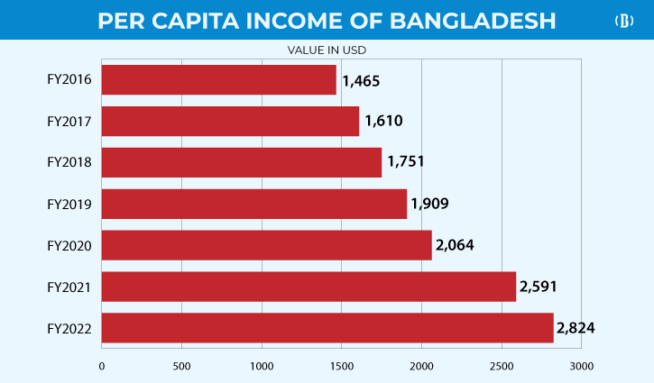
PCI of Bangladesh

