Slide 1
Engineering Economics
Definition
Engineering economics deals with the methods that enable one to take economic decisions towards minimizing costs and/or maximizing benefits to business organizations.
or
Engineering economics is a branch of economics that deals with the financial aspects of engineering decisions.

Slide 2
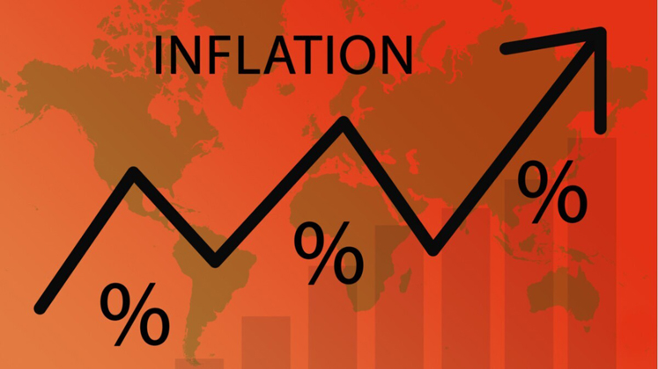
Inflation

Slide 3
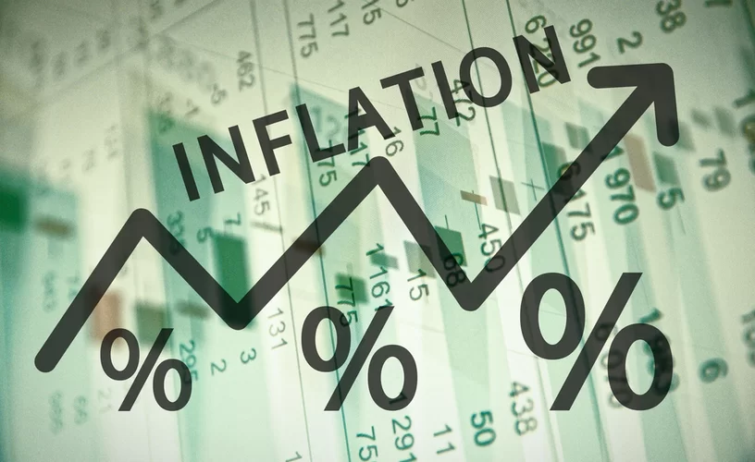
Inflation
Definition: Inflation is the rate at which the cost of goods and services rises over time.
  It could also be thought of as a reduction in the value of a currency/dollar, because consumers are now able to purchase less than they once could with the same currency/dollar bill.
  Inflation target: 2%
Types of Inflation: There are four major type of Inflation:
Creeping Inflation: 3%
  Walking inflation: above 2% but less than 10%
  Running inflation: 10% - 20%
  Hyper inflation: around 50% in a month

Slide 4
How to measure Inflation
Measures: Inflation can be measured in two ways
Consumer Price Index (CPI): A consumer price index (CPI) measures changes in the price level of market basket(approximately 80,000 specific goods and services) of consumer goods and services purchased by households. The goods and services fall into eight major categories:
  food and beverage,
  housing,
  apparel,
  transportation,
  medical care,
  recreation,
  education and communication, and
  other.

Slide 5
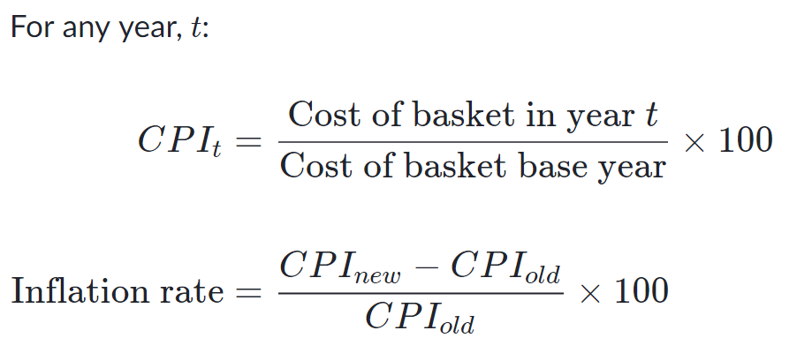
How to measure Inflation:
Consumer Price Index (CPI):

Slide 6
How to measure Inflation: Consumer Price Index (CPI)
A typical household of a nation buys 4 loaves of bread, 3 pounds of cream cheese and 8 books each week. The prices of these goods in years 2015, 2016 and 2017 are given in the table below:
Year | Price of a loaf of bread | Price of a pound of cream cheese | Price of a book
2018 | 5 | 15 | 50
2019 | 10 | 30 | 100
2020 | 15 | 30 | 125
Calculate the CPI in 2020, using 2019 as the base year.
Calculate the CPI in 2018, using 2017 as the base year
Calculate the rate of inflation between 2018 & 2019.
Calculate the rate of inflation between 2019 & 2020.

Slide 7
Problem
Find the inflation from January 2016 to January 2017, first, look up the CPI for both months.
  Jan. 2016: 236.916
  Jan. 2017: 242.839
Solution:
  Calculate the difference: 242.839 - 236.916 = 5.923
  Calculate the ratio of this difference to the former CPI = 5.923/236.916 = 2.5%
    The inflation from January 2016 to January 2017 was 2.5%. When the CPI for the former period is greater than the latter, the result is deflation rather than inflation

Slide 8
How to measure Inflation:
b. Personal Consumption Expenditures (PCE): Personal consumption expenditures is a measure of national consumer spending. It tells you how much money a nation spend on goods and services excluding food and fuel.
The goods category includes two sub-categories.
  Consumer durable goods are long-lasting items, such as cars and washing machines.
  Non-durable goods are items that households use quickly, like groceries and clothing.

Slide 9
Causes of Inflation
The inflation rate can rise in many different ways, and they can be taken under two different categories: Cost-push inflation and demand-pull inflation.
    Cost-push Inflation:
    Cost push inflation is a situation in which the overall price level go up (inflation) due to the increase in the cost of wages and raw materials.
      Prices are driven up by the rising costs to make or provide the goods and services. This can cause a supply shortage, but the demand for the goods and services has not decreased.
      Rise of wages also trigger cost-push inflation up.

Slide 10
Causes of Inflation
    Demand-pull Inflation:
    Demand-pull inflation results from strong consumer demand. Many individuals purchasing the same good will cause the price to increase, and when such an event happens to a whole economy for all types of goods, it is called demand-pull inflation.
      Demand-pull inflation can be the sort of inflation businesses dream about.
      Often demand-pull inflation can develop as a result of too much money being made, devaluing the currency and requiring an increase in price.

Slide 11
Effects of Inflation:
The impact of inflation affect many different groups when it hits. Not every group is affected the same way.
Generally in a period of mild inflation, job-seekers will get benefit.
If inflation increased, spending can cause increased demand, and companies may decide to hire new employees for better management of the new demand.
If someone has borrowed money from a lender, inflation could be convenient for him. With the currency devalued, what someone borrowed a year or two ago is now the equivalent to a lower amount of money.

Slide 12
Effects of Inflation:
In assumed manageable level of inflation, businesses that sell goods and services can benefit as well. A healthy amount of inflation is said to increase and incentivize spending more.
An unhealthy, unmanageable level, however, is disastrous for nearly everyone.
If inflation spirals out of control, people lose faith in their currency.
Financial institutions suffer as people pull their money out of them.
Businesses suffer as their goods become too expensive for most people.

Slide 13
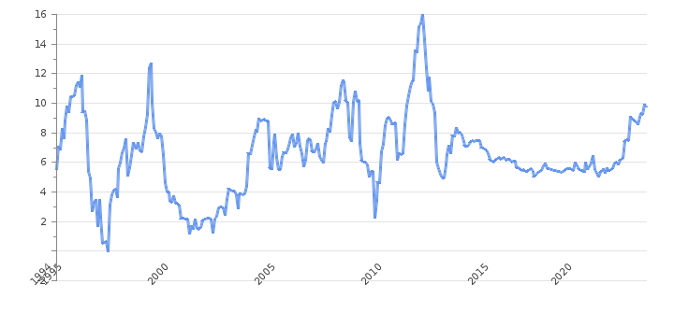
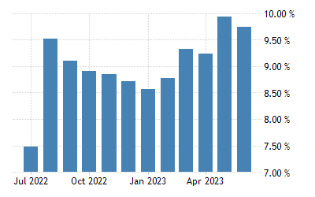
Inflation
Example: Bangladesh Inflation Rate (CPI)

Slide 14
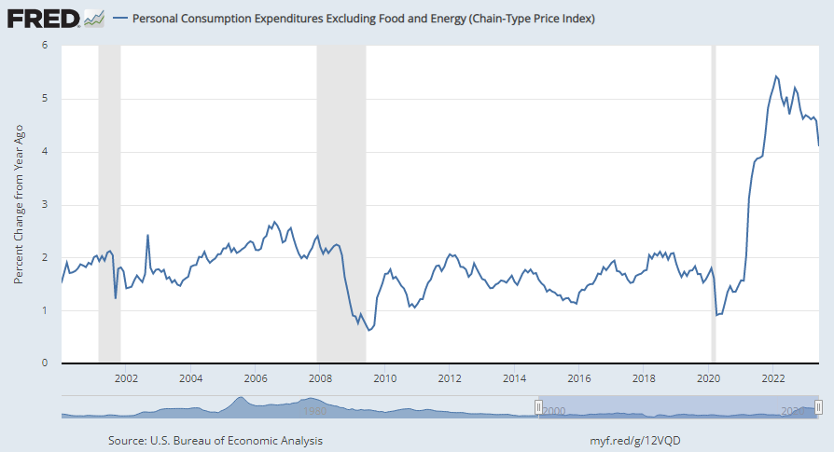
Inflation of USA

Slide 15
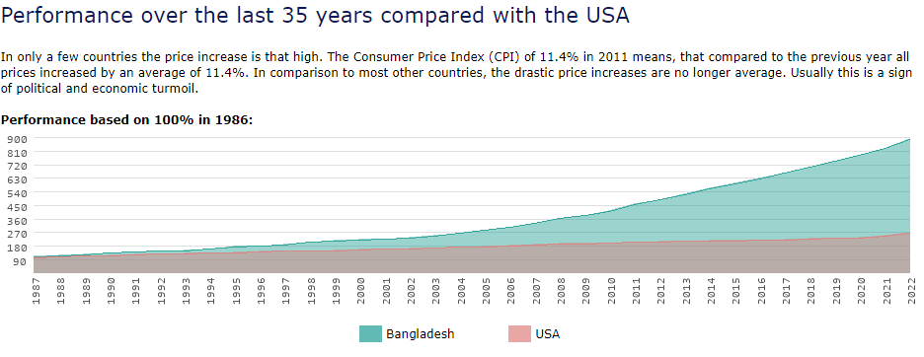
Inflation

Slide 16
Related News
News on Deflation of Chinese Economy – Impact of deflation
Link: https://www.anandabazar.com/photogallery/china-faces-economic-challenges-with-deflation-dgtl-photogallery/cid/1453466

Slide 17
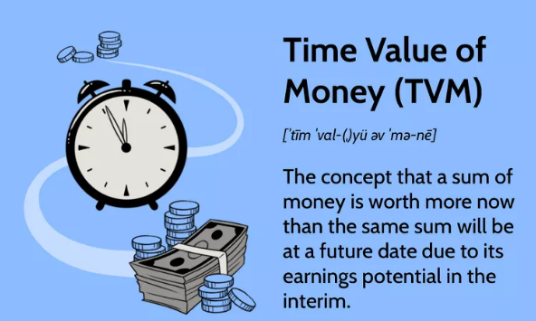
Time Value of Money
Interest rate is the rental value of money
The time value of money (TVM) is the concept that a sum of money is worth more now than the same sum will be at a future date due to its earning potential in the interim.

Slide 18
TVM Calculation
If an investor invests a sum of BDT. 100 in a fixed deposit for five years with an interest rate of 15% compounded annually, the accumulated amount at the end of every year will be as shown in below table:
Amount Deposited = BDT 100
Year End Interest (BDT) Compound Amount
0 100.00
1 15.00 115.00
2 17.25 132.25
3 19.84 152.09
4 22.81 174.90
5 26.24 201.14

Slide 19
Time Value of Money Formula
The formula to find the future worth in the third column is
F = P × (1 + i)^{n}
where
P = principal amount invested at time 0,
F = future amount,
i = interest rate compounded annually,
n = period of deposit.
The maturity value at the end of the fifth year is BDT. 201.14. This means that the amount BDT. 201.14 at the end of the fifth year is equivalent to BDT. 100.00 at time 0 (i.e. at present).

Slide 20
A person deposits a sum of BDT. 20,000 at the interest rate of 18% compounded annually for 10 years. Find the maturity value after 10 years.
Solution
P = BDT. 20,000
i = 18% compounded annually
n = 10 years
F = P(1 + i)^{n} = P(F/P, i, n)
= 20,000 (F/P, 18%, 10)
= 20,000 × 5.234 = BDT. 1,04,680
The maturity value of BDT. 20,000 invested now at 18% compounded yearly is equal to BDT. 1,04,680 after 10 years.

Slide 21
You are purchasing a $1,000 CD from a bank that pays 2% every year. Calculate the value of your money after five years.
We Know,
  F = P × (1 + i)^{n}
  F = Future Value
  P = Present Value
  i = Interest Rate Compounded annually
  n = Number of Years
  FV = $1,000 x [ 1 + 0.02 ] ^ (5) = $1,104.08

Slide 22
H.W.
A person deposits a sum of BDT. 500,000 at the interest rate of 8% compounded annually for 5 years. Find the maturity value after 5 years.

Slide 23
You think a stock will grow 10% a year for the next five years, at which time you would like to be able to sell each share for $50. If your 10%-per-year projection holds true, what is a fair price to pay for the stock today?
PV = $50 / [ 1 + 0.10 ] ^ 5 = $ 31.05 a current fair value of $31.05 per share

Slide 24
Solution
PV = $50 / [ 1 + 0.10 ] ^ 5 = $ 31.05
  a current fair value of $31.05 per share

