Slide 1
Large Scale Path Loss
Propagation model that predict the mean signal strength (not rapid change in amplitude of signal) for an arbitrary transmitter-receiver (T-R) separation distance are useful in estimating the radio coverage area of a transmitter are called large-scale propagation models. Since they characterize signal strength over large T-R separation (several hundreds or thousands of meters).
On the other hand, propagation model that characterize the rapid fluctuations of the received signal strength over very short travel distance (few wavelengths) or short time duration (on the order of seconds) are called small-scale or fading models.

Slide 2
Fig.1 Small and large scale fading
Fig.1 shows the small scale fading (signal fades rapidly) and the more gradual large scale (local average signal) variation for an indoor radio communication system.

Slide 3
The three Basic Propagation Mechanisms
Reflection, diffraction and scattering are the three basic propagation mechanisms which impact propagation in mobile communication system.
Reflection
Reflection occurs when a propagating EM wave impinges upon an object which has very large dimensions compared to wavelength of the propagating wave. Reflection occur from the surface of the earth and from buildings and walls.

Slide 4
Diffraction
Diffraction occurs when the radio path between the transmitter and receiver is obstructed by a surface that has sharp irregularities (edges). The secondary waves resulting from the obstructing surface are present throughout the space and even behind the obstacle, giving rise to a bending of waves around the obstacle, even when the LOS path does not exist between T and R. Diffraction depends on the geometry of the object as well as the amplitude, phase and polarization of the incident wave at the point of diffraction.

Slide 5
Scattering
Scattering occurs when the medium through which the wave travels consists of objects with dimension that are small compared to the wavelength and where the number of obstacles per unit volume is large. Scattered waves are produced by rough surfaces, small objects or by other irregularities in the channel.
Absorption
Attenuation by solid material (for example wall)

Slide 6
Diffraction
T
R
1st Fresnel zone
Obstruction
Diffraction occurs when waves hit the edge of an obstacle
  “Secondary” waves propagated into the shadowed region
  Excess path length results in a phase shift

Slide 7
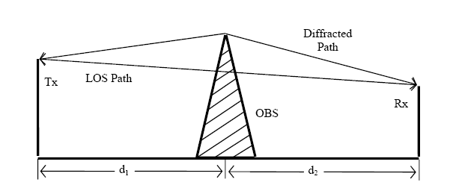
Huygen’s Principle
All points on wave front can be considered as point sources to produce secondary wavelets and these wavelets combine (vecctor sum) to form a new wave in the direction of propagation.

Slide 8
Diffraction
Phenomena: Radio signal can propagate around the curved surface of the earth, beyond the horizon and behind obstructions.
Although the received field strength decreases rapidly as a receiver moves deeper into the obstructed ( shadowed ) region, the diffraction field still exists and often has sufficient strength to produce a useful signal.
The field strength of a diffracted wave in the shadowed region is the vector sum of the electric field components of all the secondary wavelets in the space around the obstacles.

Slide 9
α
h
T
β
γ
R
d₁
d₂
Consider a transmitter and receiver separated in free space and an obstructing screen of effective height h with infinite width be placed between them at a distance d₁ from the transmitter and d₂ from the receiver. It is apparent that the wave propagating from the transmitter to receiver via top of the screen travels a longer distance than if a direct LOS.

Slide 10



α
Derive the path length difference,
h
T
β
γ
R
d₁
d₂
The corresponding phase difference,
Fresnel-Kirchoff diffraction parameter,
Therefore
Which Depends on h, position of obstacle and location transmitter and receiver

Slide 11
Knife-edge Diffraction Model
Huygen’s secondary source
α
h
R
d₁
d₂
Knife edge obstruction
When shadowing is caused by a single object such as a hill or mountain, the attenuation caused by diffraction can be estimated by treating the obstruction as a diffracting knife edge. This is the simplest of diffraction models and the diffraction loss in this case can be readily estimated using the classical Fresnel solution for the filed behind a knife edge.

Slide 12
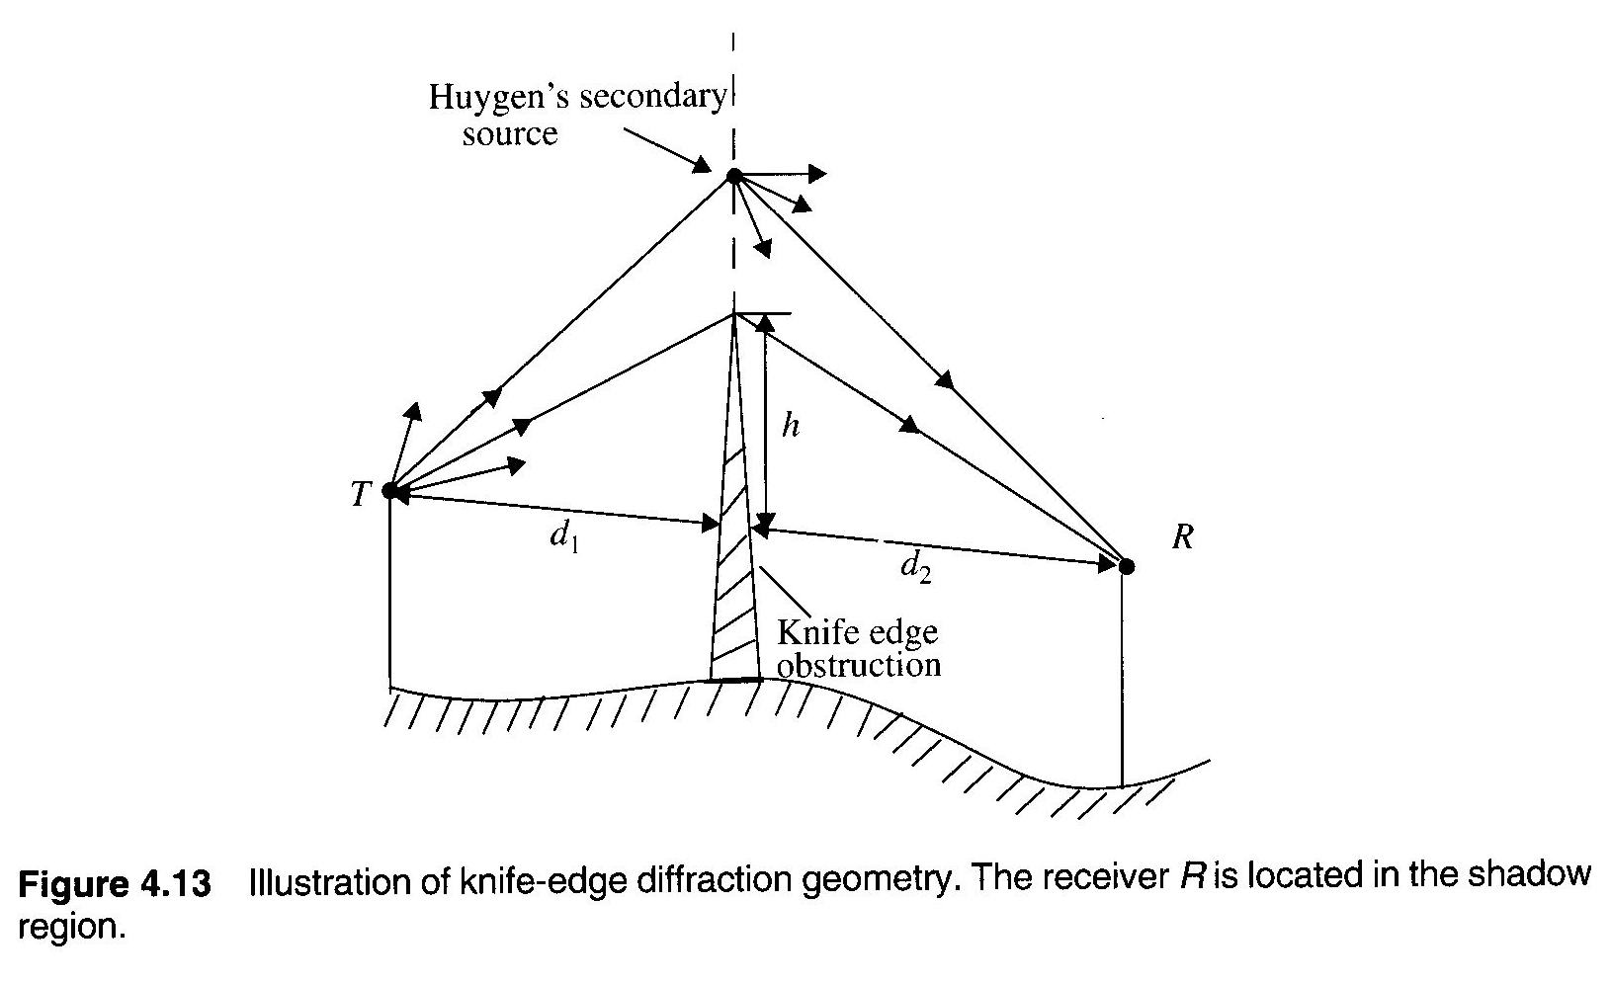
Consider a receiver at point R in the shadow region (also called the diffraction zone). The field strength a point R in above fig is a vector sum of the fields due to all of the secondary Huygen’s sources in the plane above the knife edge.

Slide 13
The electric field strength, E_{d} of a knife edge diffraction wave is,
Where E₀ is the free space field strength in the absence of both the ground and the knife edge and F(v) is the complex Fresnel integral. The Fresnel integral F(v) is a function of the Fresnel-Kirchoff diffraction parameter v.

Slide 14
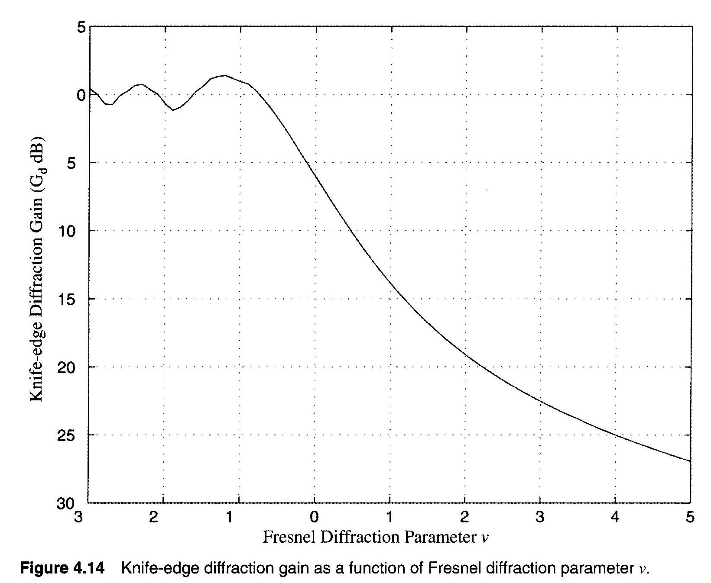
The diffraction gain due to the presence of a knife edge, as compared the free space E-field.
G_{d}(dB) = 20log|F(v)|.
An approximate solution of above equation is,

Slide 15
Fresnel zones under different knife-edge diffraction scenarios
α
h
α
d₁ d₂
h
d₁ d₂
α and v are positive since h is positive
α
α and v are 0 since h is 0
h
d₁ d₂
A family of ellipsoids can be constructed between transmitter and receiver by joining all points for which the excess path delay is an integral multiple of λ/2. The ellipsoids represent Fresnel zones.
α and v are negative since h is negative

Slide 16
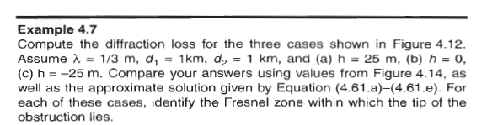
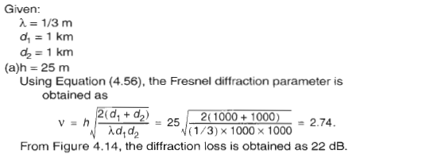

Slide 17
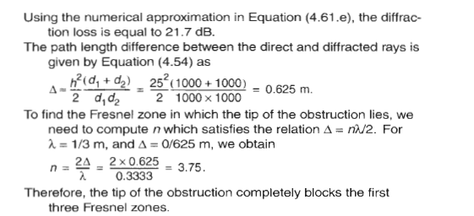

Slide 18
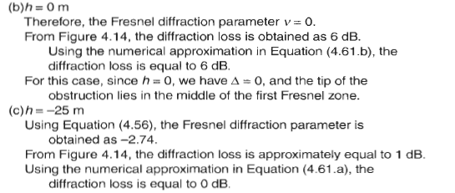

Slide 19
Example-1
For the following geometry determine (i) loss due to knife edge diffraction and (ii) height of the obstruction due to 6dB diffraction loss where f = 900MHz.
T
100m
R
50m
25m
10Km
2Km

Slide 20
α
Redrawing the geometry subtracting the height of the smallest structure
β
75m
25m
γ
10Km
2Km
The wavelength,

Slide 21
Now Fresnel-Kirchoff diffraction parameter,
The diffraction gain due to the presence of a knife edge,
ii)
For 6dB diffraction loss, v = 0,

Slide 22
Therefore the knife edge obstruction just touch the LOS. The geometry will take the form,
T
β
25m
H
γ
R
10Km
2Km

Slide 23
Scattering
Received signal strength is often stronger than that predicted by reflection/diffraction models alone
The EM wave incident upon a rough or complex surface is scattered in many directions and provides more energy at a receiver
  energy that would have been absorbed is instead reflected to the Rx.
Scattering is caused by trees, lamp posts, towers, etc.
flat surface → EM reflection (one direction)
rough surface → EM scattering (many directions)
Notes:
stronger

Slide 24
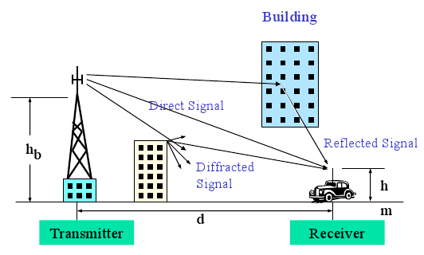

Slide 25
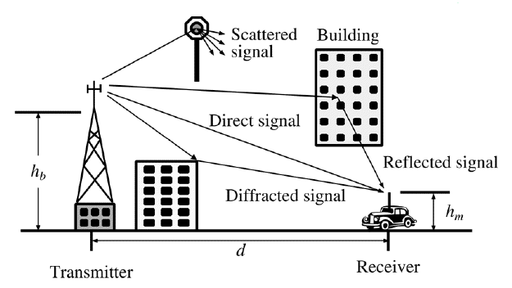

Slide 26
Scattering
When a radio wave impinges on a rough surface, the reflected energy is spread out (diffused) in all directions due to scattering. Flat surfaces that have much larger dimension than a wavelength may be modeled as reflective surfaces. However the roughness of such surfaces often induces propagation effects different from the specular reflection. Surface roughness is often tested using the Rayleigh criterion which defines a critical height (h_{c}) of surface protuberances for a given angle of incidence θi given by,
h_{c}=λ/8sin(θ_{i})
A surface is considered smooth if its minimum to maximum protuberance h is less than h_{c} and is considered rough if the protuberance is greater than h_{c}.

