Slide 1
3G Core Network

Slide 2
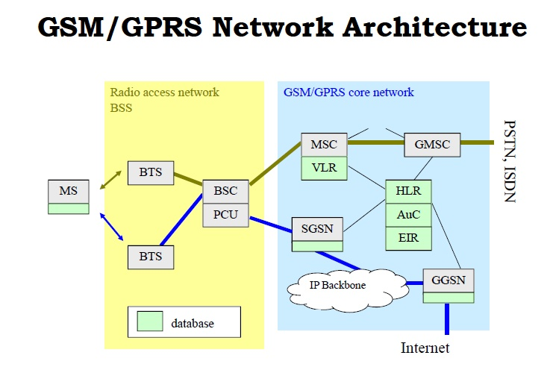

Slide 3
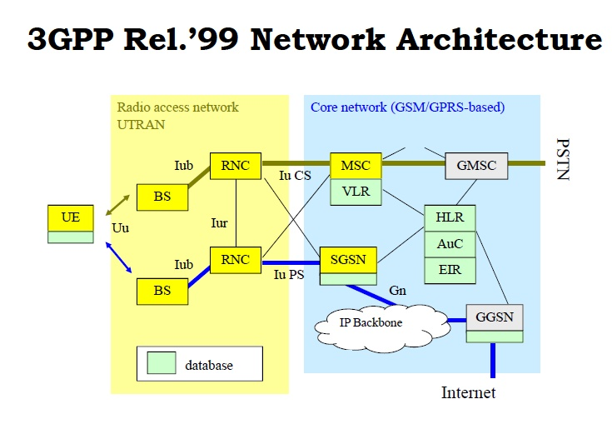

Slide 4
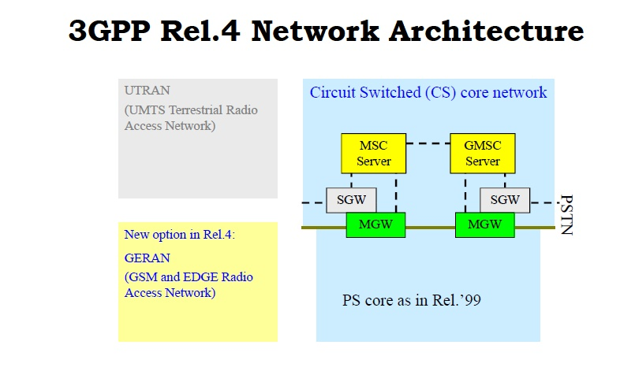

Slide 5
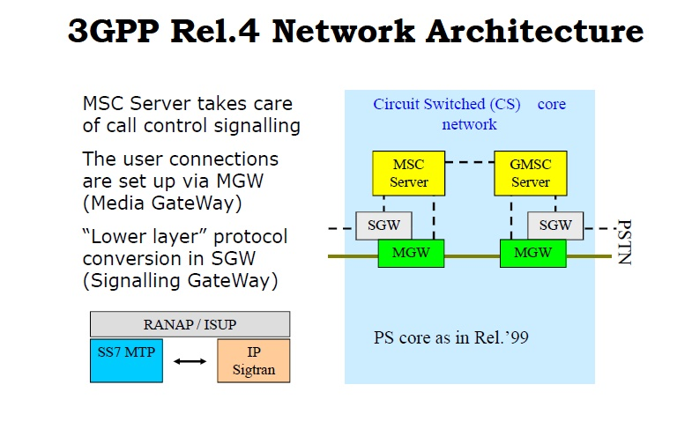

Slide 6
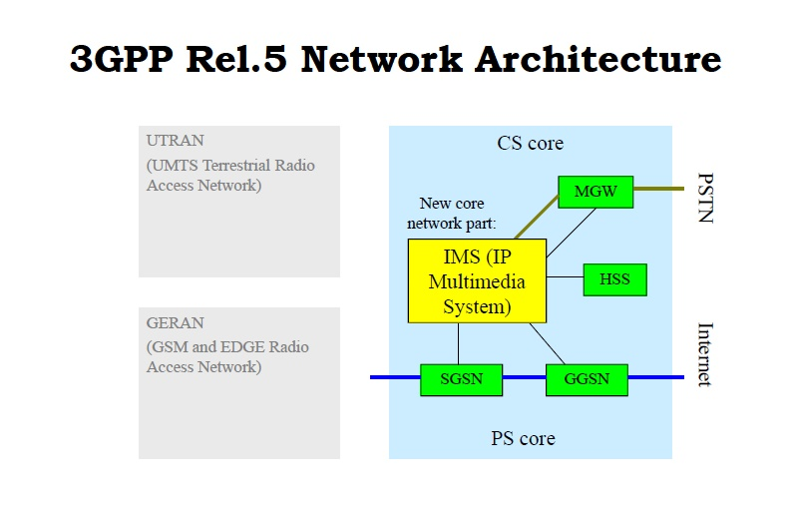

Slide 7
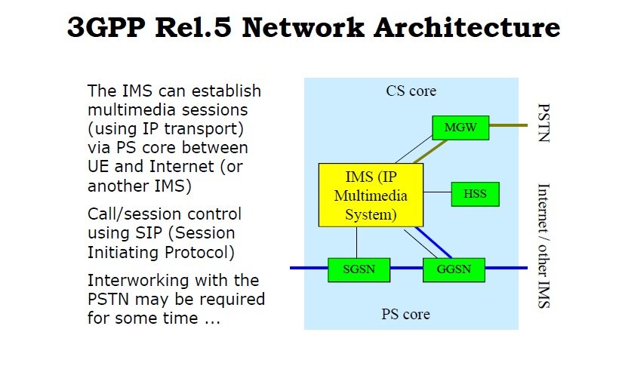

Slide 8
CAMEL (Customized Applications for Mobile network Enhanced Logic) is a set of “IN” (intelligent network) type functions and procedures that make operator-specific IN services available to subscribers who roam outside their home network.
CAMEL = IN technology + global mobility
CAMEL (2G & 3G)
CAMEL Service Environment (CSE) is a logical entity in the subscriber’s home network which processes IN related procedures
CSE » SCP in home network

Slide 9
The IMS
The IP Multimedia Subsystem
The Third generation networks aim to merge two most valuable resources in communication technology, along with local PSTN networks
Cellular Networks
The Internet
Use packet switching, IP
The IP Multimedia Subsystem or IMS is the solution to integrate all the services that the internet provides with the cellular and other networks
Triple Play: coordination of voice, video and data

Slide 10
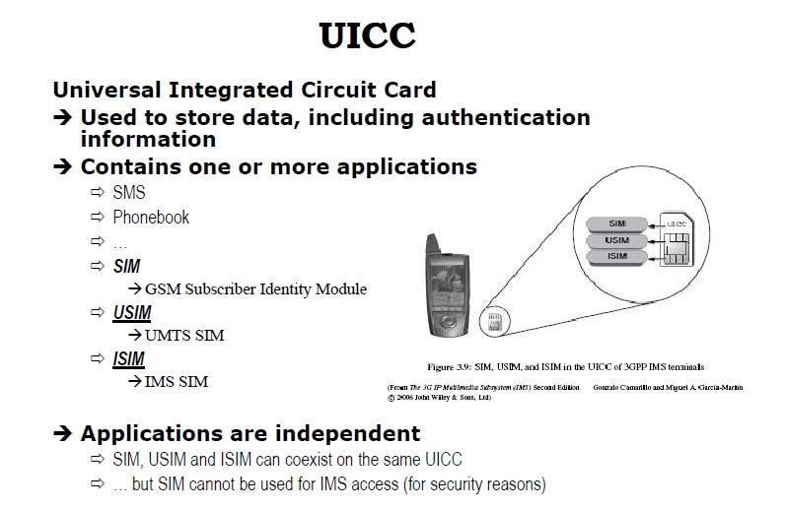

Slide 11
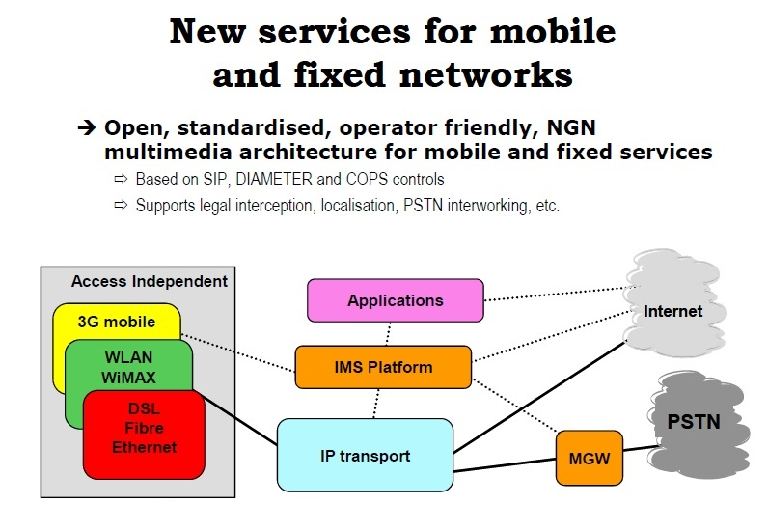
IMS Architecture

Slide 12
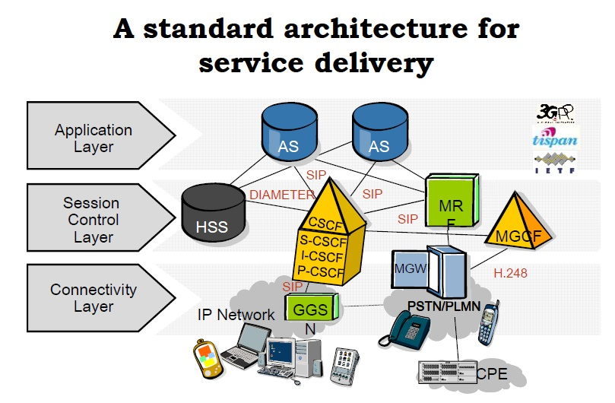

Slide 13
IMS Functional Elements
Session Management (SIP)
Routing
Databases
Network Interoperability Elements
Services and Support Components
Charging Components

Slide 14
Nodes/Functions in the IMS
User databases
HSS (Home Subscriber Server)
SLF (Subscriber Location Function)
SIP servers
CSCF (Call/Session Control Function)
AS (Application Server)
MRF (Media Resource Function)
V. Mancuso, I. Tinnirello
MRFC (MRF Controller)
MRFP (MRF Processor)
BGCF (Breakout Gateway Control Function)
PSTN/CS gateways, decomposed into:
SGW (Signaling Gateway)
MGCF (Media Gateway Controller Function)
MGW (Media Gateway)
Charging collection functions

Slide 15
Databases (HSS,SLF)
HSS is an evolution of the HLR (Home Location Register) of GSM
Contains the user-related subscription data (e.g., location, authorization and authentication information)
More than one HSS is possible
If #HSS > 1 SLF required
SLF maps users’ address to HSSs
It HSS is a master user database that supports all the IMS network functions that actually handle communications
contains the subscription-related information (user profiles)
It performs authentication and authorization of the user
It can provide information about the user's physical location
It is similar to the GSM Home Location Register (HLR) and Authentication Centre (AUC) together

Slide 16
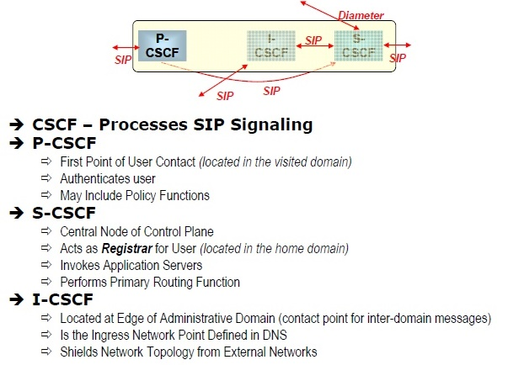
CSCF
SIP servers or proxies, collectively called Call
Session Control Function (CSCF), are used to process SIP signaling packets/messages in the IMS
P-CSCF (Proxy)
I-CSCF (Interrogating)
S-CSCF (Server)

Slide 17
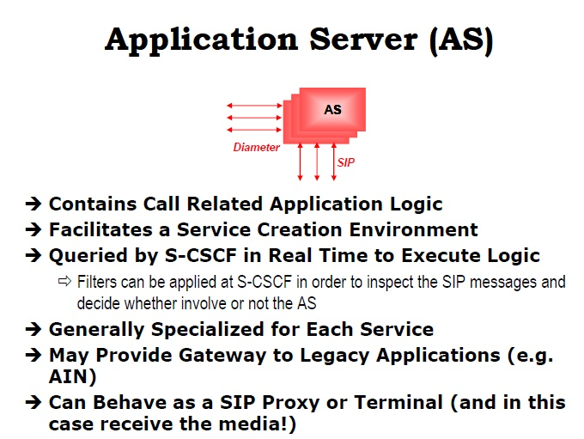

Slide 18
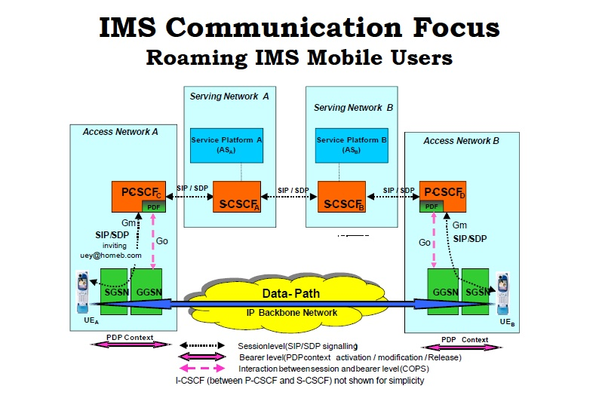

Slide 19
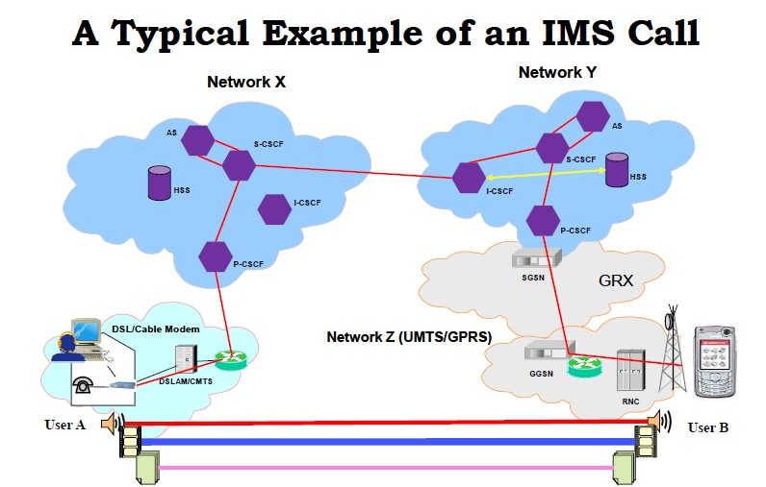

Slide 20
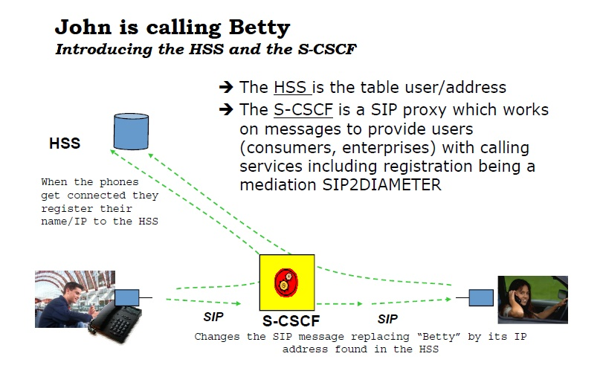
Courtesy: V. Mancuso, I. Tinnirello

Slide 21
