Slide 1
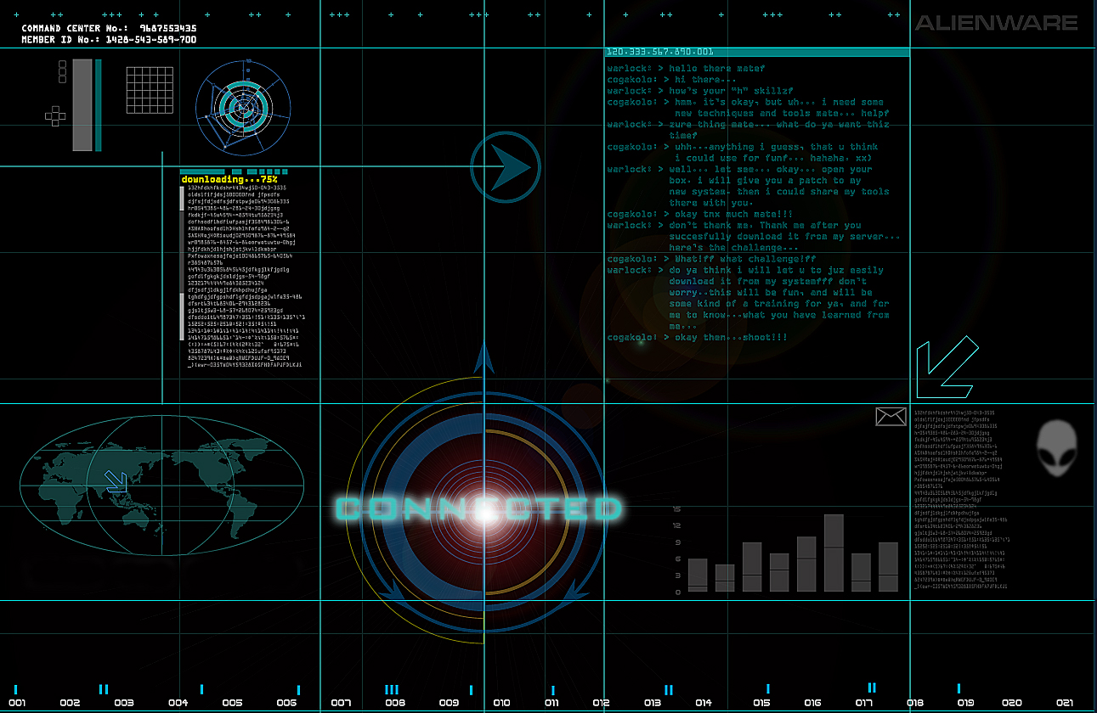
3G & Beyond

Slide 2








Mobile Network Evolution
1G
AMPS, NMT
TACS
2G
GSM/GPRS/
EDGE
cdmaOne
3G
WCDMA/HSPA+
CDMA2000/EVDO
TD-SCDMA
4G
LTE
LTE-A
1G 2G 3G 4G 5G
Mid 1980s 1990s 2000s 2010s 2020s
analog
voice
Digital voice
+ Simple data
Mobile
broadband
Mobile Internet
More & faster

Slide 3
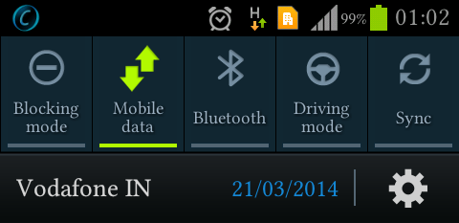
What is HSPA ?
High Speed Packet Access
A wireless access technology designed for increasing the
capacity of Internet connectivity from 3G mobile terminals
3G(3rd Generation)Mobile Telecommunication is based on
UMTS protocols

Slide 4
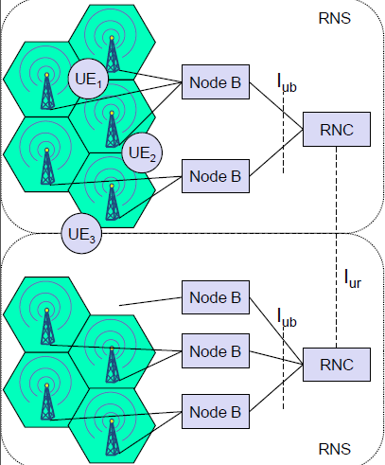
The Architecture of HSPA
The amalgamation of two mobile
telephony protocols
1.HSDPA(High Speed Downlink Packet Access)
2.HSUPA(High Speed Uplink Packet Access)
Basic Parts:
  UE(User Equipment)
  Node B
  RNC(Radio Network Controller)

Slide 5
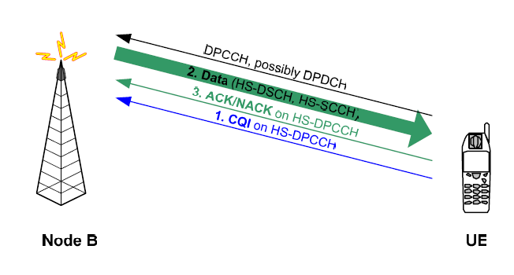
HSDPA
High Speed Downlink Shared Channel (HSDSCH)
  High Speed Signaling Control Channel (HS-SCCH)
High Speed Dedicated Physical Control Channel(HS-DPCCH)
    Channel Quality Information (CQI)
    HARQ ACK/NACK Information

Slide 6

How Dose it Work
Adaptive Modulation and Coding
Fast scheduling
Fast retransmissions

Slide 7
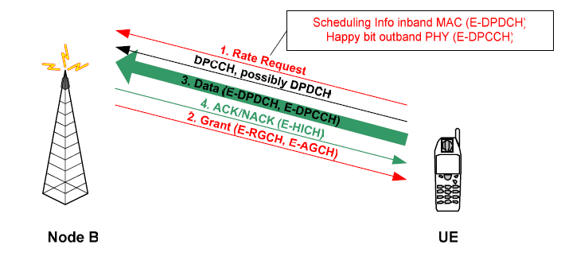
HSUPA
Enhanced Dedicated Channel (E-DCH)
Efficient uplink scheduling
Fast uplink retransmissions

Slide 8
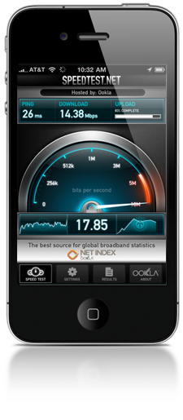
Advantages
Downloading Speed-14Mbps uploading Speed-5.8 Mbps
Smooth for Transferring Large file ,live streaming and Web Browsing
Low latency below 50 m sec
It uses Shared Channel Transmissions
Recovering Losing Data by Soft Combining Method At the time of
retransmission

Slide 9
Disadvantages
Communication range
If UE is Far away from Base Station(Node B)it cannot get the total Bandwidth
Number of users
The Quality of Service is Depends upon the Users
Cost
Expense to upgrade the whole system
Expense to Upgrade User Equipment

Slide 10
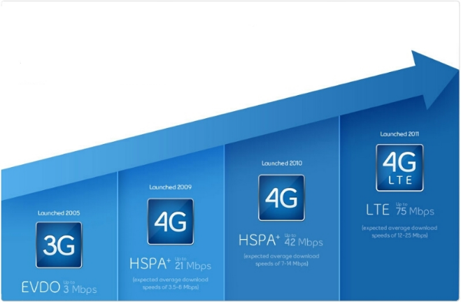
Advancement of HSPA
Evolved of HSPA (HSPA+)
Multiple Input Multiple Output Technology
Higher Order Modulations
Multi Carrier Technology

Slide 11
Development Of HSPA
2000
2001
2002
2006
2005
2003
2004
UMTS(Rel 99)
WCDMA
DL-384 kbps
UL-384 kbps
Release 5
(03/2002)
HSDPA
DL-14.4 Mbps
UL-384 kbps
Release 6
(12/2004)
HSUPA
DL-14.4 Mbps
UL-5.8 Mbps
Release 7
(12/2006)
HSPA+
DL-42Mbps
UL-11 Mbps

Slide 12
Mobile Network Evolution
1G
AMPS, NMT
TACS
2G
GSM/GPRS/
EDGE
cdmaOne
3G
WCDMA/HSPA+
CDMA2000/EVDO
TD-SCDMA
4G
LTE
LTE-A
1G 2G 3G 4G 5G
Mid 1980s 1990s 2000s 2010s 2020s
analog
voice
Digital voice
+ Simple data
Mobile
broadband
Mobile Internet
More & faster
Notes:
All these are empowered by the evoluation of mobile networks.
Today, the world is advancing to 4G LTE and even LTE advanced.
At this time point, almost everyone knows that 3G/4G mobile networks are everywhere.
This fact can be easily supported by many numbers.
For example, 3G/4G have been deployed in 203 countries; serving 6.8 billions user.
By 2014 (this year), it will go beyond our global population.
Last year, more than half a billion smartphones and tablets are shipped,
The market is $1 trillion by 2016.
And so on…
=========================================================
Mobile network is the largest scale wireless infrastructure.
It covers the whole planet and serves billions of users.
It provides mobile users with data service and carrier-grade quality voice service

Slide 13
Standards Body: 3GPP
An international standards body
Evolves and standardizes GSM, UMTS, LTE among others
  The 3rd Generation Partnership Project (3GPP) unites [Six] telecommunications standard development organizations (ARIB, ATIS, CCSA, ETSI, TTA, TTC), known as “Organizational Partners” and provides their members with a stable environment to produce the highly successful Reports and Specifications that define 3GPP technologies
We will primarily discuss 3GPP standards
Notes:
There are other standards, like 3GPP2, 5GPP

Slide 14
What is LTE?
LTE stands for “Long Term Evolution”
Fourth-generation (4G) cellular technology from 3GPP
Deployed worldwide
4G LTE: First global standard
  Increased speed
  IP-based network (All circuits are gone/fried!)
  New air interface: OFDMA (Orthogonal Frequency-Division Multiple Access), MIMO (multiple antennas)
    Also includes duplexing, timing, carrier spacing, coding...
  New service paradigm (e.g., VoLTE)
Notes:
CAT 3, CAT 4, CAT 6 (different radio technology), → different speed
All implementations must meet baseline requirements
Increased speed
IP-based network (All circuits are gone/fried!)
New air interface: OFDMA (Orthogonal Frequency-Division Multiple Access), MIMO (multiple antennas)
Also includes duplexing, timing, carrier spacing, coding...

Slide 15
What is LTE?
LTE is always evolving and 3GPP often has new “releases”
  First release: Rel-8
  Current: Rel-11, Rel-12
  Toward LTE-Advanced (4.5G)
Notes:
CAT 3, CAT 4, CAT 6 (different radio technology), → different speed
Enhancement over time (CAT3, CAT 4, CAT 6),
All implementations must meet baseline requirements
Increased speed
IP-based network (All circuits are gone/fried!)
New air interface: OFDMA (Orthogonal Frequency-Division Multiple Access), MIMO (multiple antennas)
Also includes duplexing, timing, carrier spacing, coding...

Slide 16
Evolution from 3G to 4G LTE
3G
2000s
4G
2000s
Mobile
Broadband
42+ Mbps
Faster and Better
Mobile broadband
300+ Mbps
4G LTE: First global standard
  Increased speed
  IP-based network (All circuits are gone/fried!)
  New air interface: OFDMA (Orthogonal Frequency-Division Multiple Access), MIMO (multiple antennas)
    Also includes duplexing, timing, carrier spacing, coding...
  New service paradigm (e.g., VoLTE)

Slide 17
Network Architecture Evolution
2G
3G
4G
Circuit-switching for voice
Circuit-switching for voice
Packet-switching for data
Packet-switching for everything
IP-based
Telecomm
Infrastructure
IP-based Internet

Slide 18
4G Network Architecture (LTE)
4G Packet-Switched
MME: Mobility Management Entity
BS: Base Station (4G: eNodeB)
Notes:
Let us look at the mobile network architecture to see how these services are made possible.
Here it is a 4G LTE network architecture which only supports packet-switched service.
It consists of two parts:
First, base stations to offer radio access
Second, core network which consists of MME (Mobility Management Entity) and 4G PS gateways .
The MME is used to manage user mobility, e.g., location update.
The 4G PS Gateways route packets between Internet and 4G Base stations

Slide 19
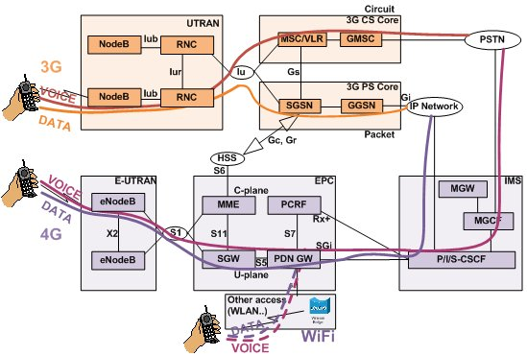

Slide 20
Packet Switching (PS)
A
C
statistical multiplexing
Sequence of A & B packets does not have fixed pattern, bandwidth shared on demand → statistical multiplexing
Store-and-forward at intermediate routers
Used by the Internet
B
queue of packets
waiting for output link
D
E

Slide 21
3G/4G Network Architecture
4G Packet-Switched
3G Packet-Switched
3G Circuit-Switched
Notes:
Now we take a look at 3G network architecture.
Similar to 4G LTE, it has Base station and core networks.
The major difference is that 3G supports both Circuit-Switched and Packet-Switched services.
3G CS Gateways are used to connect to 3G base stations and telephony networks.
3G PS Gateways plays role similar to 4G PS Gateway.
The main difference is that 3G PS Gateways are responsible for control-plane and data-plane functions at same.
In 4G LTE, the control-plane functions are moved to MME.

Slide 22
Illustration of Data and Control Planes
22
22
EPS: Evolved Packet System
PDCP: Packet Data Convergence Protocol
RLC: Radio Link Control
MAC: Medium Access Control

Slide 23
Data-Plane Protocols: IP + lower layers
@UE (IP)
@eNB (IP)
Packet Data Convergence Protocol (PDCP) – header compression, radio encryption
Radio Link Control (RLC) – Readies packets to be transferred over the air interface
Medium Access Control (MAC) – Multiplexing, QoS
PDCP
PDCP
RLC
RLC
MAC
MAC
PHY
PHY
Notes:
Wireless technology, main evolution across different generations and releases are in PHY layer

Slide 24
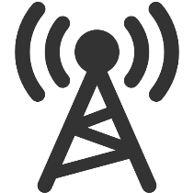


Control-Plane Protocols
Control utilities: mobile network specific
  Different from Internet counterparts
Data-plane
Control-plane
Internet
P3: Conn.
context
(QoS)
Connectivity Management
Mobility Management (MM)
P2: Location
update
Radio Resource Control (RRC)
P1: Radio conn. setup
Notes:
It means that the network side implements complex functions.
(2) To support data delivery in the data-plane, it has to support rich control-plane functions like radio resource control, mobility support, connectivity management, QoS control etc.
(3) They are much more complex than the control in the Internet.

Slide 25
Control-Plane Protocols in 4G/3G
Variants for same/similar control functions
  Hybrid 4G/3G systems
  Domains separated for voice (CS) and data (PS)
Notes:
(1 ) Layered protocol stack
(2) Variants
(3) Complicated (rich set of control protocols)

Slide 26
Distributed Operations: Device, base station, core networks
26

Slide 27
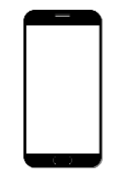

Data and Control Planes in LTE
eNodeB, S-GW and P-GW are involved in session setup, handoff, routing
Control Plane
Home Subscriber Server (HSS)
Data Plane
Mobility Management Entity (MME)
Packet Data
Base Station
Serving
Network Gateway
(P-GW)
User Equipment (UE)
\Station (eNodeB)
Gateway (S-GW)

Slide 28
Setting Up Data Service in 4G
(1) Setup radio connection
28
User
Equipment
4G BS
MME
Others
(HSS, GWs)
RRC Connection Request
4G-RRC
RRC Connection Setup
4G-RRC
RRC Connection Complete
(2) Registration (attach)
(3) Authentication
Attach Request
Authentication Request
4G-MM
Authentication Response
4G-MM
HSS
Attach Accept
Attach Complete
(4) Setup Connectivity Context
(e.g., IP, routing path, QoS)
Public Data Network Connectivity Request
4G-
CM
4G-
CM
P-Gw
Activate Bearer Context Request (192.168.0.199)
Activate Bearer Context Accept
PDN: Public Data Network
EPS: Evolved Packet System

Slide 29

Setting Up Data Service in 4G
Control-Plane Functions
29
User
Equipment
4G BS
MME
Others
(HSS, GWs)
(1) Setup radio connection
4G-RRC
4G-RRC
4G-MM
(2) Registration (attach)
(3) Authentication
4G-MM
HSS
4G-
CM
(4) Setup Connectivity Context
(e.g., IP, routing path, QoS)
4G-
CM
P-Gw
(5) data-plane delivery

Slide 30
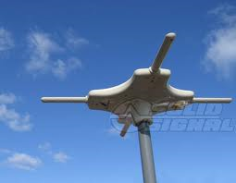
• Smart Antenna
• Beam radio signals directly at a users to follow the users as they move.
•Allow the same radio frequency to be used for other users without worry of interference.
•Seamless handoff between towers/access points.
•One transmit antenna, two receive antennas.
–Allows connection to two access points at once.

Slide 31
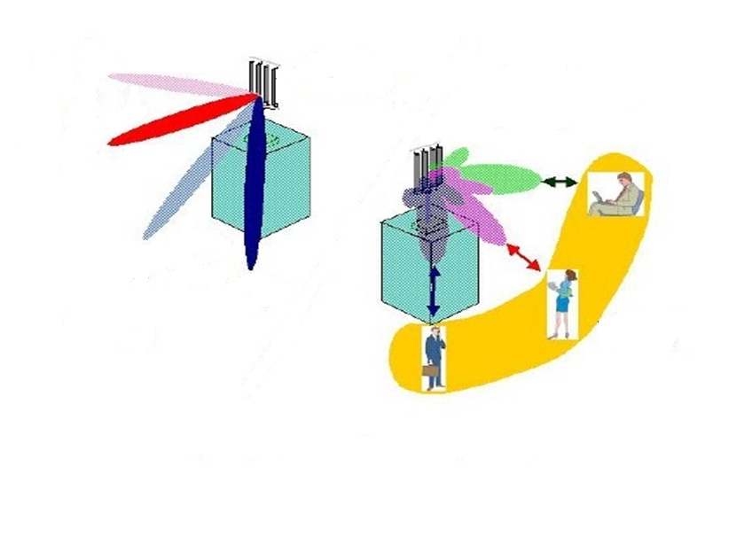


Smart Antenna
Space Division
Multiple Access
(SDMA)
Past
Now
Past
Now
Same time and frequency
Beam Tracking
Smart Antenna Technology

Slide 32
Orthogonal Frequency Division Modulation (OFDM)
Basic idea:
Using a large number of parallel narrow-band subcarriers instead of a single wide-band carrier to transport information.
Advantages:
-Very easy and efficient in dealing with multi-path.
-Robust again narrow-band interference

Slide 33


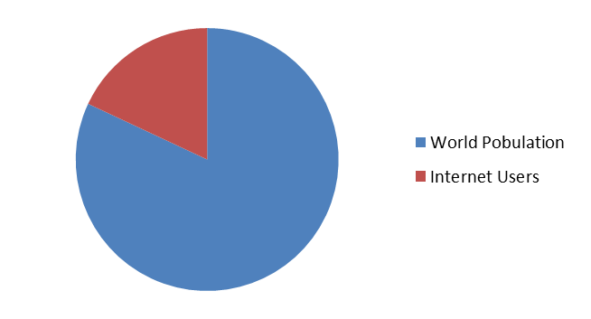
G4
Earth's population stands at around 6.6 billion.
The Internet has a population of just 1.3 billion.
IPv6 uses 128 bits for IPv6 addresses which allows for 340 billion billion billion billion (3.4x10³⁸) unique addresses.
22%

Slide 34
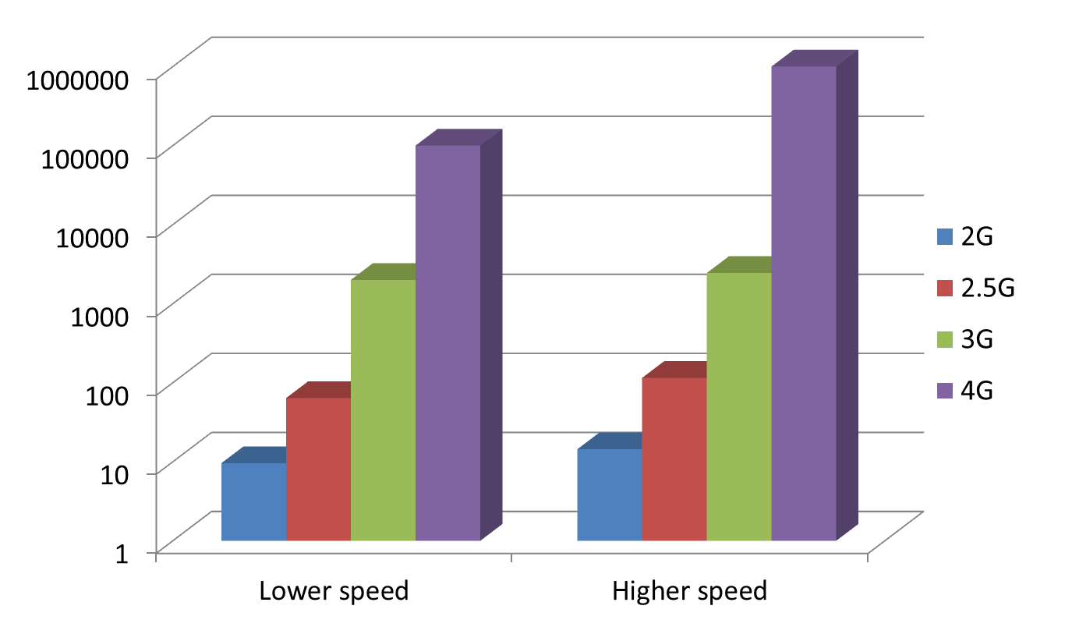
Data Rate Comparison (Kbps)

