Slide 1
Introduction of Hospital Pharmacy
BPH 315

Slide 2
OUTLINE
Definition of Hospital
Function of a modern hospital
Classification of Hospital
Organization of a hospital
Services of a hospital
Definition of Hospital pharmacy
History of Hospital pharmacy
Functions of Hospital pharmacy
Objectives of Hospital pharmacy
Location and layout of Hospital pharmacy
Personnel and floor space requirements
Requirement and Abilities required for Hospital Pharmacist

Slide 3
DEFINITION OF HOSPITAL
Hospital can be defined as an institution of community health or a specialized complex organization which makes use of physicians, surgeons, and team of technical staff and provides facilities for -
- diagnosis
- therapy
- rehabilitation
- prevention
- education and
- research

Slide 4
FUNCTIONS OF A MODERN HOSPITAL
Primary function of the hospital refers any type of care given to patient by the health team members.
To provides the means and methods by which persons can work together in groups with the objects of care of hospital department, patient and community.
It works to lowers the incidences of diseases through early detection and treatment.
To estimate the need for facilities ,supplies and equipment's and then utilize these facilities for evaluation, control and maintenance.

Slide 5
FUNCTIONS….
To provides a common link between the general public and policy makers.
To develop and to maintain an effective system of clinical and administrative record.
To raise the quality of law and general standards of medical practice.
To participate in the financial plan for the operation of hospital.
To initiate, utilize and participate in research projects designed for improvement of patients of patients care and other hospital services.

Slide 6
CLASSIFICATION OF HOSPITAL
Hospital can be classify in the following way-
ON CLINICAL BASIS
ON THE BASIS OF SIZE
ON THE BASIS OF COST
ON THE BASIS OF SYSTEM OF MEDICINE

Slide 7
On Clinical Basis - 2 types a. Clinical
MEDICINE-BASED
Pediatrics
Psychiatric and nervous diseases
T. B.
General medicine
SURGERY-BASED
Orthopedics
Gynecology & obstetrics
ENT
MATERNITY
Short-term
Long-term

Slide 8
b. Non-Clinical
GOVERNMENTAL HOSPITALS
Army hospital
City hospital
Navy hospital
Civil hospital
NON-GOVERNMENTAL HOSPITALS
Private hospitals for profit
Non-profit hospitals
Church hospital
Community hospital
Missionary hospital
Charitable hospital

Slide 9
Based on Size
LARGE HOSPITALS -- Beds : 1000 and above
MEDIUM HOSPITALS -- Beds : 500-1000
SMALL HOSPITALS -- Beds : 100-500
VERY SMALL HOSPITALS -- Beds : less than 100

Slide 10
Based on Cost
ELITE HOSPITALS
-These are symbols of high technology and advance in medical sciences, They have deluxe rooms equipped with T.V, telephones , & refrigerator etc.
Room rate/day e.g. Hong Kong Hospital US$3000, Apollo hospital BD Deluxe BDT 9000, suite BDT 20000
BUDGET HOSPITALS
These hospital are meant for moderate budget and low budget people eg. Charitable hospital& civil hospital.

Slide 11
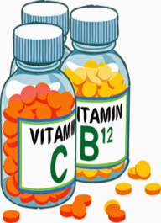
On the basis of System of Medicine
ALLOPATHIC HOSPITALS
AYURVEDIC HOSPITALS
HOMEOPATHIC HOSPITALS
UNANI HOSPITALS

Slide 12
Organization of Hospitals
An organization can be defined as “a dynamic process, in which various managerial activities bring & bind people together, for the achievement of common goals and objectives”
Most important Body of a hospital is the - Governing body/Board of Directors/Board of Trustees
Consists of various eminent personalities in the field of :
a. Medical education b. Research
c. Administration d. Politics (optional)
Function of Governing Body:
Function of Governing body is to Frame all major Policies, Plans & Programs of hospital
Governing body appoints a hospital administrator to get various functions performed like clinical services, nursing, pharmacy services, etc.

Slide 13
Governing Body or Board of Trustees
Committees
Executive
Finance
Development
Public Relation
Hospital Administration
Administrative Services
Ambulatory Services
Nursing Services
Pharmacy Services

Slide 14
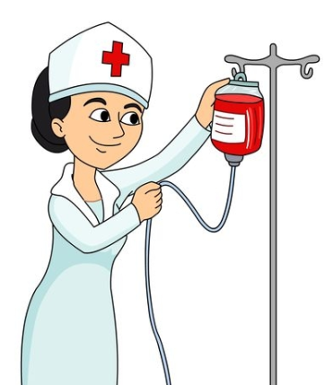
SERVICES PERFORMED BY HOSPITAL
NURSING SERVICES
Largest part of a hospital
They functions all 24 hours
Nurses are assigned specific number of beds and –they have to give personal attention to patients
Nurses are trained for PRENATAL CARE, OBSERVATION, PATIENT COMFORT etc.
NURSING DIRECTOR--- is the in-charge of NURSING SERVICES

Slide 15
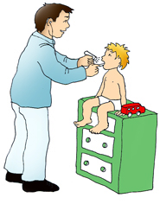
SERVICES PERFORMED….
B. OUT-PATIENT SERVICES
Focus on COMFORT for OUT-PATIENTS, as the approach for major/minor illnesses
These services make a hospital an IDEAL COMMUNITY INSTITUTION
Hospital is duty-bound to provide DIAGNOSTIC, PREVENTIVE & CURATIVE measures to the OUT-PATIENTS

Slide 16
SERVICES PERFORMED….
RADIOLOGICAL SERVICES
Performed under direction of a competent RADIOLOGIST
CHIEF RADIOLOGIST 🡪 assisted by various TECHNICIANS
Services include UTILIZATION of EQUIPMENTS like:
SONOGRAPHY
X-RAY
ECG
CT-SCAN

Slide 17
SERVICES PERFORMED….
CENTRAL SUPPLY SERVICES
- All the MEDICAL & SURGICAL SUPPLY SERVICES are
meant for diagnosis , treatment ,prevention , education & research .
Qualified and skilled staff personnel are responsible for its maintenance

Slide 18
SERVICES PERFORMED….
HOSPITAL PHARMACY SERVICES
Controls Pharmacy operation
Fills Prescription & dispense no. of requisitions from the wards.
Functions begin from Drug procurement to Distribution to I.P and O.P
Responsible for :
Proper Drug Delivery
Information system
Drug storage
Manufacture
Sterilization
Advising patient of drug use

Slide 19
SERVICES PERFORMED….
MEDICAL RECORD SERVICES
medical records are the Valuable reference materials, as they help MEDICAL & PARA-MEDICAL STAFF for EVALUATION.
Also useful for EDUCATION, RESEARCH & TRAINING
Medical Record Services Consists of -
Patient history
Lab- test reports
Physical examination details
Physician's advice etc.
- It is mandatory to store medical records properly to Facilitate easy access on requirement

Slide 20
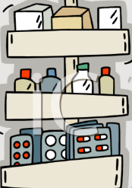
SERVICES PERFORMED….
STORE SERVICES
RECEIVE, STORE & ISSUE materials against REQUISITION FORMS of various DEPARTMENTS & WARDS
A Hospital consists of:
MEDICAL STORE
STORE FOR GENERAL ITEMS
SURGICAL STORES, etc
- Maintain a Buffer stock of certain materials, including Life-saving drugs

Slide 21
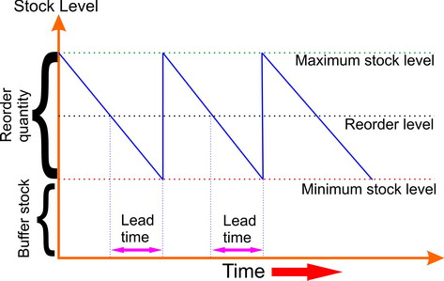
Maintaining buffer stock

Slide 22
Buffer stock refers to a reserve that is used in unforeseen emergencies.
It is also known as strategic stock or safety stock.
This mandates close monitoring of drug stocks and maintaining buffer stock at all levels, following the stocking norms, to ensure an uninterrupted supply of drugs.

Slide 23
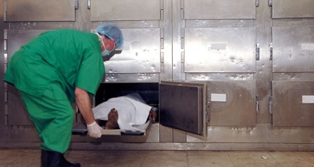
SERVICES PERFORMED….
Other services
Aimed at overall BENEFIT & PATIENT CARE
Include:
Dietary services
Ambulatory services
Laundry services
Transport services
Mortuary services
Library services

Slide 24
DEFINITION OF HOSPITAL PHARMACY
Department of hospital which deals with procurement, storage, compounding, dispensing, manufacturing, testing, packaging and distribution of drugs.
It is also concerned with education and research in pharmaceutical services.
Hospital Pharmacy is controlled by a professionally competent and a qualified pharmacist.

Slide 25
HISTORY OF HOSPITAL PHARMACY
The development of the role of the apothecary at Americas first hospital, the Pennsylvania Hospital, is presented .
The first salaried apothecary, Jonathan Roberts, was hired in 1752. Subsequent apothecaries included students of medicine and surgery, some of whom worked for the benefit of experience.
In an attempt to upgrade the position ,an apothecary from England, with training in chemistry, was hired in 1768

Slide 26
HISTORY….
During the colonial period, the hospital pharmacist, in addition to preparing drugs, sometimes acted as resident physician, steward and even as an instructor to the apprentices.
While the function of the apothecary was absorbed by the resident apprentices during the post-Revolution War period, the early 19th century brought the return of the professional apothecary whose sole function was to prepare prescriptions under the direction of the physicians.

Slide 27
FUNCTIONS OF HOSPITAL PHARMACY
Provide specifications for the purchase of drugs, chemicals, biological etc.
Manufacturing and distribution of medicaments such as transfusion fluids, parenteral products, tablets, capsules, ointments.
Dispensing and sterilizing parenteral preparations which are manufactured in hospital.
Dispensing of drugs as per the prescriptions of the medical staff of the hospital.

Slide 28
FUNCTIONS….
Filling and labelling of all drug containers from which medicines are to be administered.
Management of stores which includes purchase of drugs, proper storage conditions, and maintenance of records.
Establishment and maintenance of “Drug Information Centre”.
Providing co-operation in teaching and research programs.
Discarding the expired drugs and containers worn and missing labels.

Slide 29
OBJECTIVES OF HOSPITAL PHARMACY
To ensure the availability of right medication, at right time, in the right dose at the minimum possible cost.
To professionalize the functioning of pharmaceutical services in a hospital.
To act as a counseling department for medical staff, nurses and for patient.
To act as a data bank on drug utilization.
To participate in research projects.

Slide 30
OBJECTIVES….
To implement decisions of the pharmacy and therapeutics committee.
To co-ordinate and co-operate with other departments of a hospital.
To plan, organize and implement pharmacy policy procedures in keeping with established policies of the hospitals.

Slide 31
LOCATION OF HOSPITAL PHARMACY
Located in hospital premises so that patients and staff can easily approach it.
In multi-storeyed building of a hospital, the pharmacy should be preferably located on ground floor especially the dispensing unit.
It should be laid in such a way that there is a continuous flow of men and materials.

Slide 32
LAYOUT OF HOSPITAL PHARMACY
ASEPTIC AREA
MANUFACTURING SECTION
RAW MATERIAL
PASSAGE
STORES
FINISHED PRODUCTS
ADMINISTRATIVE SECTION
DISPENSING
OPEN SPACE

Slide 33
FLOW CHARTS FOR MATERIALS AND MEN

Slide 34
GENERAL FLOW CHART FOR OUTPATIENTS
Rx written by doctor
Rx received by pharmacist
selection
Filling of prescription
labelling
pricing
Dispensed to patient
Receipt of payment
Prescription filed
Free
Cash
Credit
Regular prescription file
Narcotic prescription
file
Statistics and reports

Slide 35
GENERAL FLOW CHART FOR IN-PATIENTS
Prescription
Copied by
nurse
Rx written
By doctor
Pharmacy
Inpatient discharge medications
Inpatient
Medication
orders
Returns to credit
Rx received by pharmacist
selection
Rx received by pharmacist
Filling of prescription
labeling
selecting
pricing
Dispensing prescription
Credit issue
labeling
Filling of order
pricing
Dispensing order
free
cash
credit
charge
Statistics and control

Slide 36
Flow charts for materials
Medical stores
receipt
issues
Inpatient department
Parenteral manufacturing
Pharmacy
receipt
Quality control
issues
Outpatient department
Manufacturing of other dosage forms

Slide 37
FACILITIES REQUIRED IN HOSPITAL PHARMACY
In smaller hospitals, with one pharmacist only, one room is required for pharmacy, having a combination of dispensing, manufacturing, administrative and all other sections of complete pharmaceutical service. For sterile products there should be a separate room or area.
Hospitals, with 200 or more beds, departmentalization of pharmacy activities is required.

Slide 38
FACILITIES REQUIRED….
A separate area is required for :-
Inpatient services and unit dose dispensing
Outpatient service
An office for the chief pharmacist
A compounding room
Prepacking and labelling room
A store room
Sterile products room
A separate area for drug information services and space assigned on various nursing units for unit dose drug administration.

Slide 39
FLOOR SPACE REQUIREMENTS
250 sq. feet is the minimum required area for any sized hospital.
10 sq. feet per bed in 100 bedded hospital.
6 sq. feet per bed in 200 bedded hospital.
Floors of pharmacy should be smooth, easily washable and acid resistant.
In manufacturing sections, drains should be provided, walls should be smooth, painted in light colour.
Wooden cabinets are laminated.
Fluorescent lamps are placed above prescription counter.

Slide 40
Requirements on The Basis of Bed Strength (Area in sq. feet)
1
2
3
4
Store room
dispensary
office
Manufacturing of
compressed tablets
And capsules
100 B – 450
300 B – 1000
700 B - 2400
100 B – 350
300 B – 500
700 B - 800
100 B – 110
300 B – 150
700 B - 200
For tablets
700 B - 900
5
6
Manufacturing under aseptic
condition for eye drops, eye lotions & other preparations for external use
Parenterals
300 B – 600
700 B - 600
For capsules
700 B - 200
300 B – 250
700 B - 250

Slide 41
EQUIPMENTS REQUIRED IN HOSPITAL PHARMACY
Prescription case
Drug stock cabinets with proper shelves and drawers.
Sectional drawer cabinets with cupboards bases.
Work tables and counters for routine dispensing.
Sink with drain board.
Cabinet to store mortar and pestles.
Cabinet for glass utensils, flasks, funnels and beakers.
Refrigerator of suitable capacity.
Narcotics safe with individually locked drawers.
Office desk with telephone connection and file cabinet.
Dispensing window for nurses and outpatients.

Slide 42
PERSONNEL REQUIREMENT IN HOSPITAL PHARMACY
No standard rules regarding the requirement of personnel for inpatient pharmacy.
Number of pharmacists required for a hospital are calculated on the basis of workload, and the number of bed available.
For a small hospital minimum 3 pharmacist are required. As the number of bed increases, the number of pharmacist also increases.
Pharmacist should possess adequate pharmacy qualification and experience.
If manufacturing drugs is involved in pharmacy, adequate number of technicians, assistants, peons etc. required.

Slide 43
Administrator
Head of pharmacy services (M.Pharm)
Dispensing
Chemist
(D.Pharm)
Clinial
Pharmacist
(B.Pharm)
Quality
Control
Pharmacist
(M.Pharm)
Medical
Stores
Pharmacist
(B.Pharm
or
D.Pharm)
Manufacturing
Chemist
(M.Pharm)
inpatient
outpateint
Other
Manufacturing
Services
(B.Pharm)
Manufacturing
of I.V. fluids
(B.Pharm/M.Pharm

Slide 44
PHARMACIST REQUIREMETS ON THE BASIS OF BED STRENGTH
Bed strength No of pharmacist required
Up to 50 beds
Up to 100 beds
Up to 200 beds
Up to 300 beds
Up to 500 beds
3
5
8
10
15

Slide 45
REQUIREMENTS AND ABILITIES REQUIRED FOR HOSPITAL PHARMACIST

Slide 46
REQUIREMENTS
Head of hospital pharmacy department should be a post graduate in pharmacy preferably in pharmaceutics, pharmacology or hospital pharmacy.
Acts as a coordinator for the pharmacy and non-pharmacy staff.
Reports to the administrator and interacts with other medical departments.

Slide 47
Flow chart for requirements of a hospital pharmacist
Director
Superintendent of Pharmaceutical services
or
Chief pharmacist (M.Pharm)
Pharmacist
(drug distribution deptt.)
B.Pharm
Pharmacist
(medical store)
Two pharmacist
B.Pharm/D.Pharm
(Dispensing)
Post graduate
Pharmacist
For
Quality control

Slide 48
ABILITIES REQUIRED
Technical ability
Ability to develop a manufacturing section
Administrative ability
Ability to control inventory
Ability to conduct and participate in research
Ability to conduct teaching programs

Slide 49
Reference-Hospital and Clinical Pharmacy by Pratibha Nand , Dr. R. K. Khar

